Slide 1
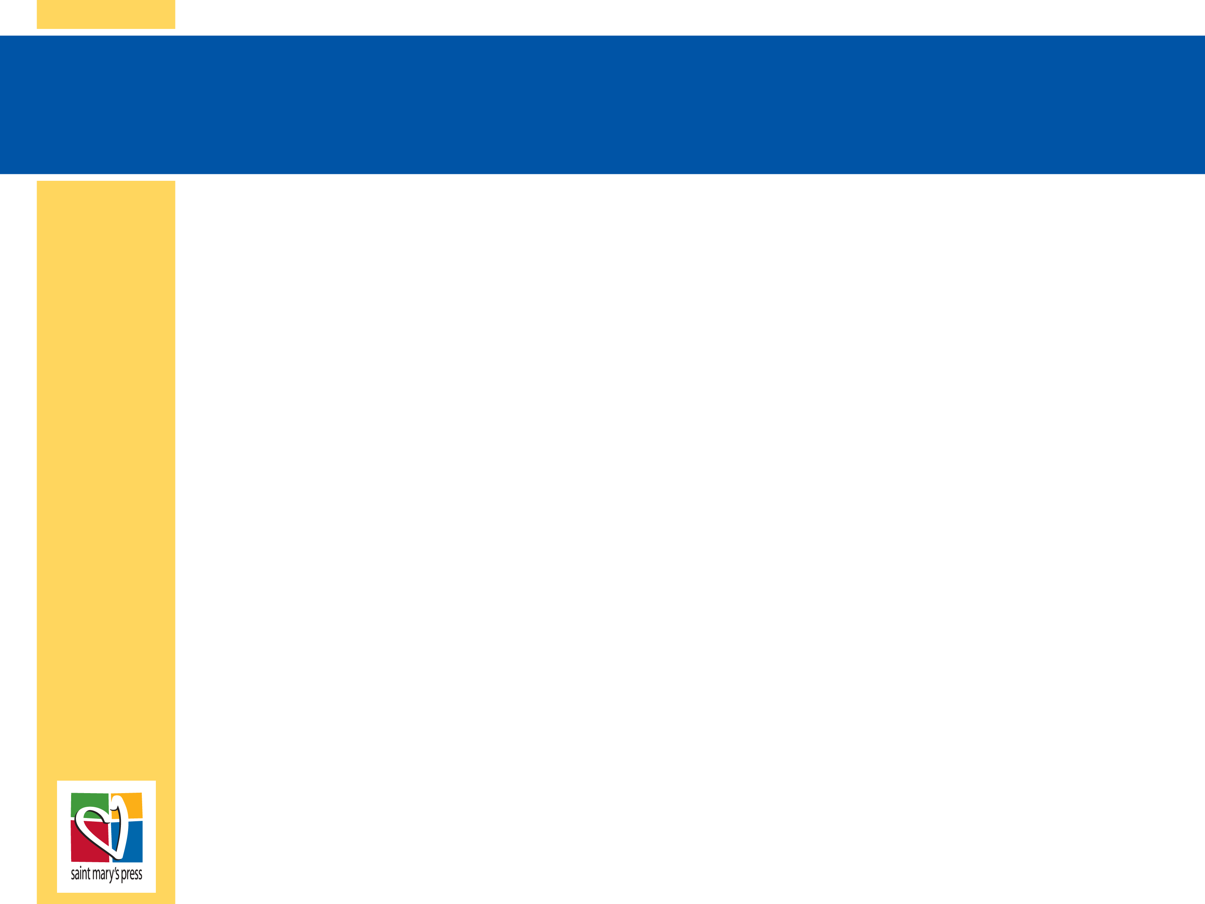
The Leadership Structure of the Church
The Church
Unit 3, Chapter 8
Document #: TX005558
© 2016 Saint Mary’s Press
Living in Christ Series

Slide 2

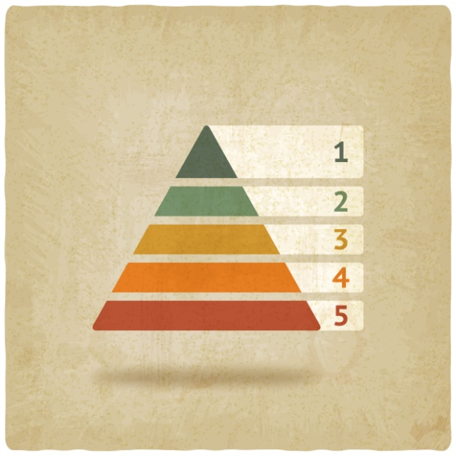
The Church and Hierarchy
The leadership of the Church is provided by the clergy.
The leadership is hierarchical, organized in a specific ascending order.
All members of the Church are equal in dignity, but are called to different roles.
© Basil / Shutterstock.com
© 2016 Saint Mary’s Press
Living in Christ Series
Notes:
Notes: Explain the last bullet point, as in article 33 of the student book.

Slide 3
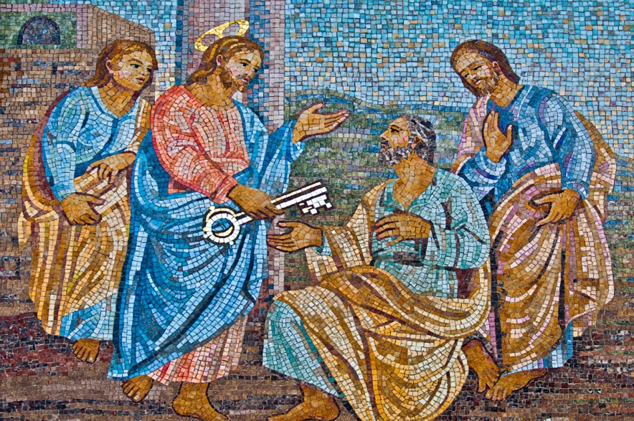
Divine Authority and Service
The hierarchy consists of the ordained ministers of the Church.
Christ established
the bishops as the
successors to the
Apostles.
He established the
Pope as the
successor to Peter,
the head of the Apostles.
© Luis Santos / Shutterstock.com
© 2016 Saint Mary’s Press
Living in Christ Series
Notes:
Notes: Explain that Christ’s own authority flows through the hierarchy, giving it the spiritual authority to govern, teach, and provide pastoral care for the Body of Christ. Read aloud Mark 10:42–44, quoted in article 33 of the student book.

Slide 4
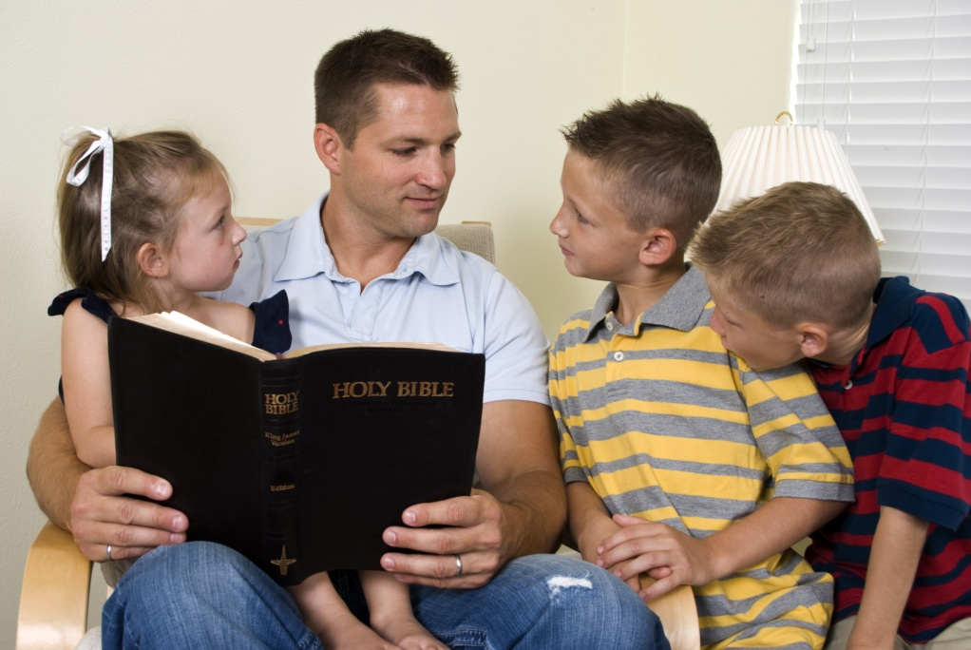
Organizational Structure
The Holy See is the
central seat of
authority.
A diocese is usually
a geographic area
led by a bishop.
A parish is a
community within
a diocese, with one or more priests.
The family is the most basic level of the Church.
© JHDT Productions / Shutterstock.com
© 2016 Saint Mary’s Press
Living in Christ Series
Notes:
Notes: Ask the students to state the mission of the Church. Ask why the family has a place on this list. Ask the question that concludes article 33 of the student book, “What are some of the different ways your family first taught you about faith?”

Slide 5
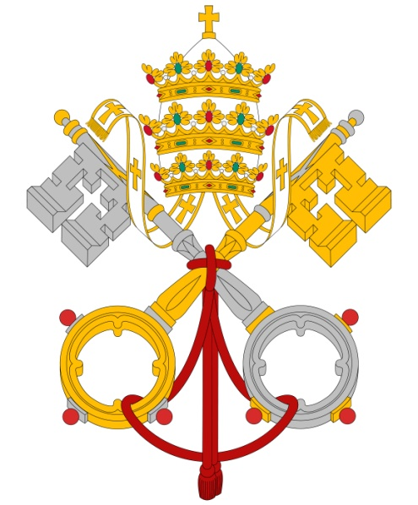
Who Is the Pope?
Successor to Peter, his authority has been passed down.
Bishop of Rome, he is the visible head of the Church.
Head of the College of Bishops,
he leads and appoints the
bishops.
© cobalt88 / iStock
© 2016 Saint Mary’s Press
Living in Christ Series
Notes:
Notes: With the students, brainstorm answers to the question that concludes article 34 of the student book, “What do you know about the current Pope?” Be prepared to supply key information they miss, such as the Pope’s previous appointment. The next slide continues the topic “Who Is the Pope?”

Slide 6
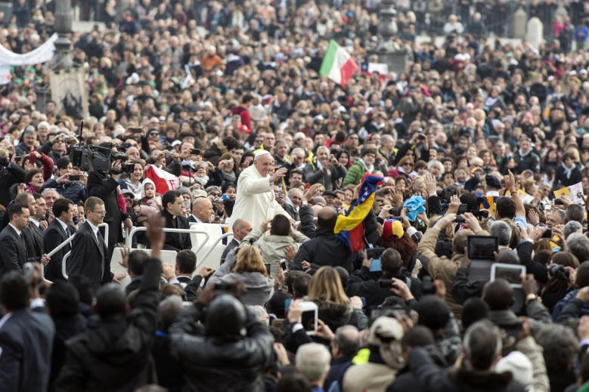
Who Is the Pope?
Vicar of Christ, he is Christ’s human representative.
Pastor of the Universal Church, he is responsible for Catholics worldwide.
© giulio napolitano / Shutterstock.com
© 2016 Saint Mary’s Press
Living in Christ Series
Notes:
Notes: Direct the students to read the sidebar in article 34 of the student book, “The Hierarchy and You.” If the students have laptops, ask them to find and identify the Holy Father’s prayer intentions for the current month. (Or you may share them.) Explain how to find the document mentioned in the last bullet point of the sidebar.

Slide 7
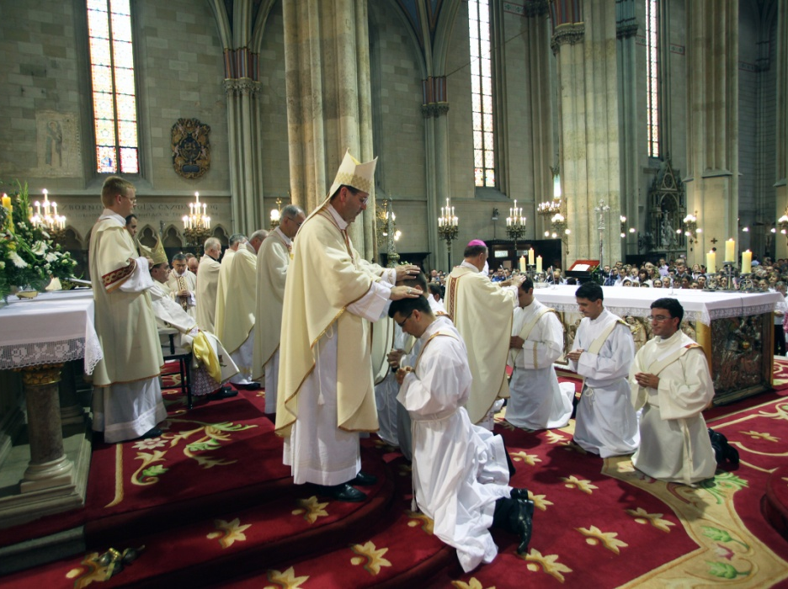
The Role of the Bishops
The bishop oversees the administration of the Sacraments in his diocese.
He celebrates Confirmation.
He is the only person who can ordain priests and deacons.
© Zvonimis Atletic / Shutterstock.com
© 2016 Saint Mary’s Press
Living in Christ Series
Notes:
Notes: Explain that all bishops are ordained as priests before they become bishops. Ask the students when they have met or seen their bishop. Ask volunteers to describe the role of archbishops and cardinals, as in article 35 of the student book. Ask if they can name any archbishops or cardinals.

Slide 8
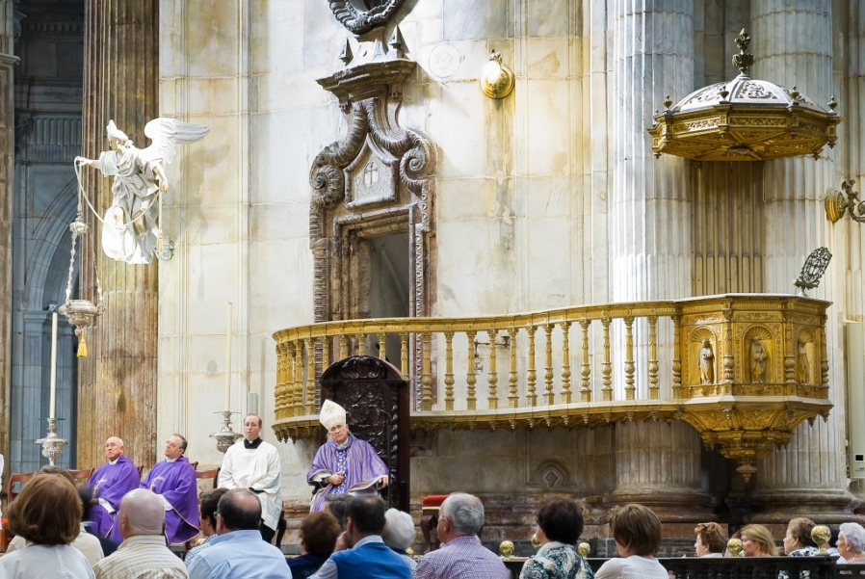
The Governing Office of the Bishops
The bishop has the authority to govern his particular church.
Priests, deacons,
and lay ecclesial
ministers help the
bishop in this work.
Bishops show a
special concern for
the poor, the
persecuted, and missionaries.
© Alvaro German Vilela / Shutterstock.com
© 2016 Saint Mary’s Press
Living in Christ Series
Notes:
Notes: Name some members of the bishop’s diocesan staff, such as the Director of Liturgy and the Director of Lay Formation, and describe their work. Or, if the students have laptops, direct them to find the members of the diocesan staff on the website of their diocese.

Slide 9
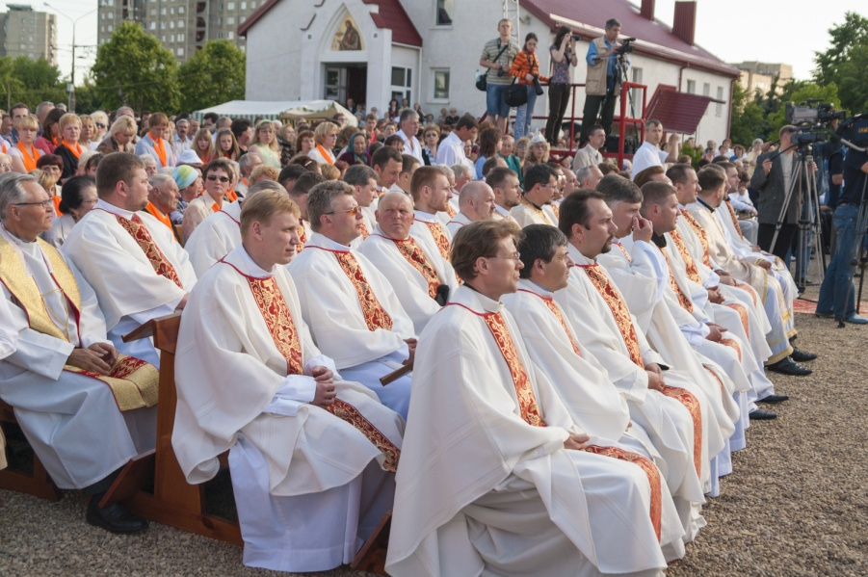
The Collegial Nature of the Bishops
A bishop is concerned for all churches throughout the world.
Bishops share equally in the authority to make decisions affecting the Church.
These decisions are always made in union with the Pope.
© Dmitry Morgan / Shutterstock.com
© 2016 Saint Mary’s Press
Living in Christ Series
Notes:
Notes: Explain that the bishop must use his authority in communion with the Church and under the guidance of the Pope.

Slide 10
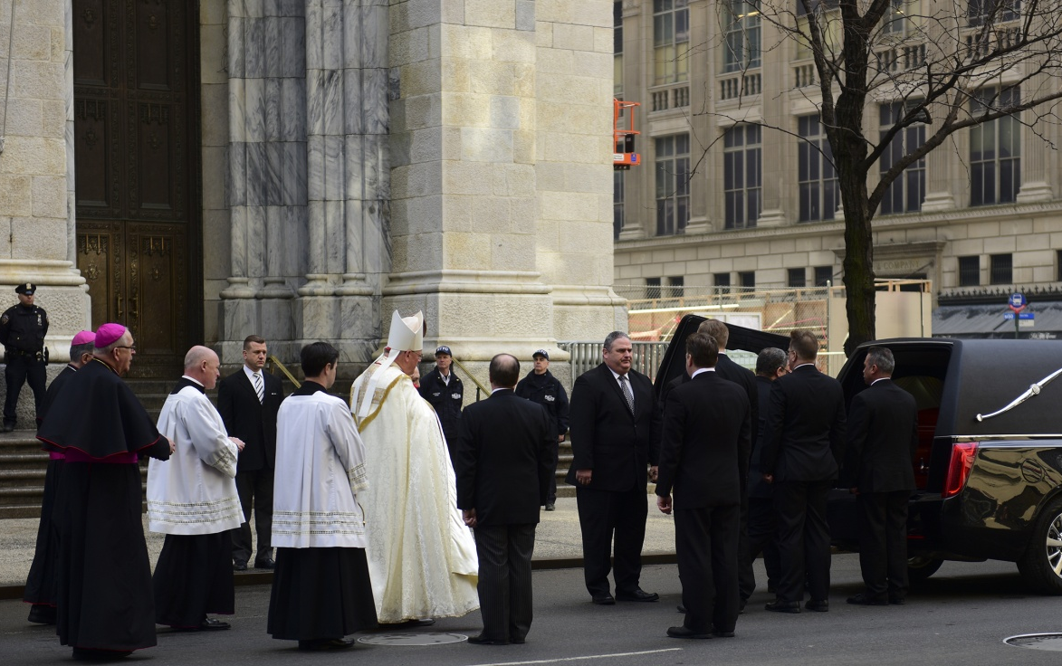
The Priest’s Responsibility
A priest’s primary role is that of sacramental minister.
He oversees the religious education in the parish.
He visits the sick and
offers spiritual care to
those who need it.
He oversees the work
of the parish staff.
© a katz / Shutterstock.com
© 2016 Saint Mary’s Press
Living in Christ Series
Notes:
Notes: Explain the distinction between the ministerial priesthood and the common priesthood of the faithful, as in article 36 of the student book.

Slide 11
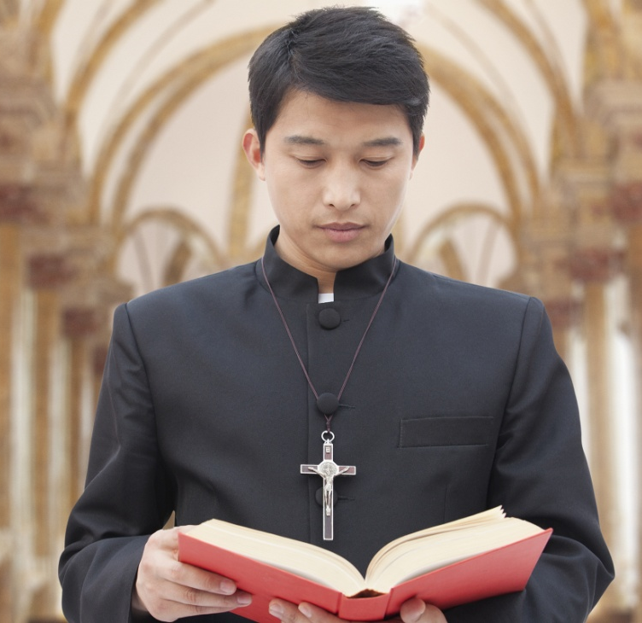
How Does a Man Become a Priest?
Candidacy is a formal period of discernment.
A candidate then enters seminary for priestly formation and theological studies.
He is then ordained to the Transitional Diaconate.
Finally, he is ordained to the priesthood by the bishop.
© XiXinXing / Shutterstock.com
© 2016 Saint Mary’s Press
Living in Christ Series
Notes:
Notes: Ask the questions that conclude article 36 of the student book, “What does your parish do to support men who are called to be priests? What can you do personally to support them?” Be prepared to explain some of the initiatives in your parish or diocese that support priests and seminarians, such as the efforts of the Vocations Office and of local Serra Clubs.

Slide 12
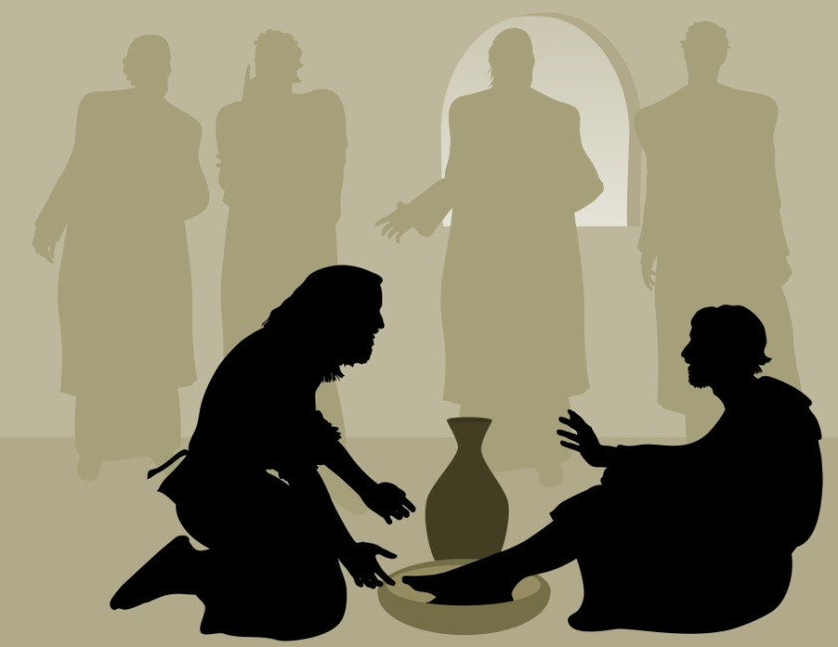
The Diaconate
Most permanent deacons earn their living by working in the world.
Permanent deacons can be married and raise families.
They are examples
of service to the
Church and the
world.
© KimsCreativeHub / Shutterstock.com
© 2016 Saint Mary’s Press
Living in Christ Series
Notes:
Notes: Explain the difference between Transitional and Permanent Diaconates. Ask if the students know of deacons serving in their parish or diocese. Ask what kinds of service they do. Ask why the image on the slide is seen as a symbol for the diaconate.

Slide 13
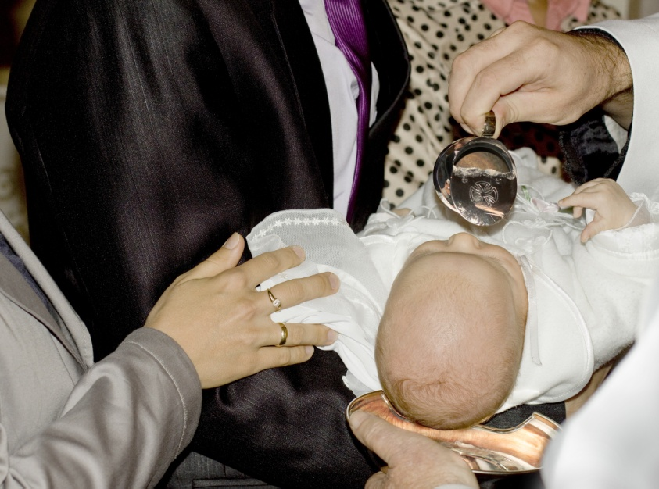
Service of the Deacons
A deacon celebrates the Sacrament
of Baptism and blesses marriages.
He gives homilies and
carries out catechesis.
A deacon also
dedicates himself to
ministries of charity.
© Hallowedland / Shutterstock.com
© 2016 Saint Mary’s Press
Living in Christ Series
Notes:
Notes: Describe some of the ministries in which local deacons serve. Point out the ancient roots of the diaconate, as in article 37 of the student book. Discuss the deacon’s call to a life of holiness, as described in the bullet points that conclude article 37. Ask how this life could contribute to their ministry.

