Slide 1
Chapter 3: Hinduism
World Religions: A Voyage of Discovery
DOC ID #: TX003940

Slide 2
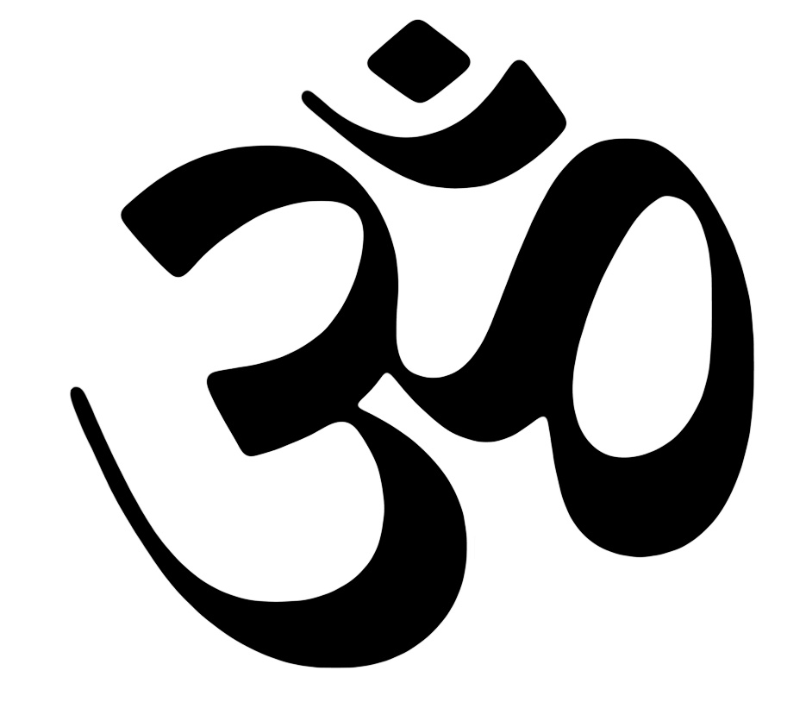
AUM
AUM (or OM) is Hinduism’s most sacred mantra.
A is the first vowel of the Sanskrit language, and M is the final consonant.
AUM thus symbolizes the totality of sound and thus all reality.
© Melanie Vollmert / www.shutterstock.com
Notes:
Notes: (AUM is commonly rendered in English as OM.) “Mantras” are explained in the student book in the Buddhism chapter, but (as noted there) they are also commonly used in Hinduism. AUM is the mystical syllable that is believed to pervade the universe. It also pervades Hindu culture, commonly appearing in religious texts and artwork. This slide provides an opportunity to discuss with the students the concept of monism, that all reality is conceived by many Hindus ultimately to be one—and this one, Brahman, is symbolized by AUM.

Slide 3
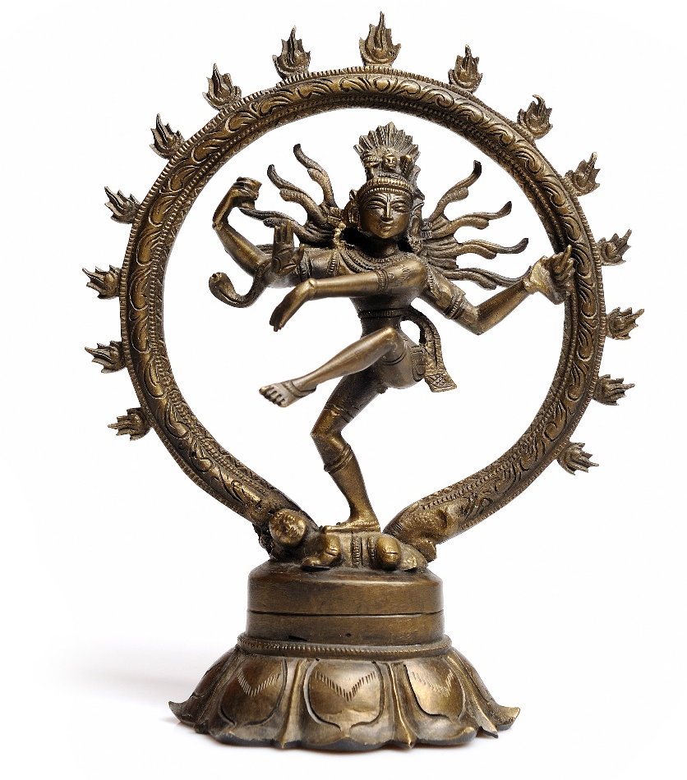
Shiva, God of Destruction
Shiva is the god of destruction.
Shiva forms a triad of important Hindu gods with Brahma, the creator, and Vishnu, the preserver.
Most Hindus believe in the existence of many deities—traditionally, 330 million.
© Smart-foto / www.shutterstock.com
Notes:
Notes: Shiva is shown, on this slide, as encircled by cosmic time, symbolized by fire. This famous image is rich in symbolic meaning, including representation of the god’s chief attributes and functions. Discuss with the students the phenomenon of a very popular god whose function involves destruction. Make connections with the Hindu cyclical concept of reality, such that the universe continuously comes to be and passes away. The following three slides provide other examples of Hindu deities.

Slide 4
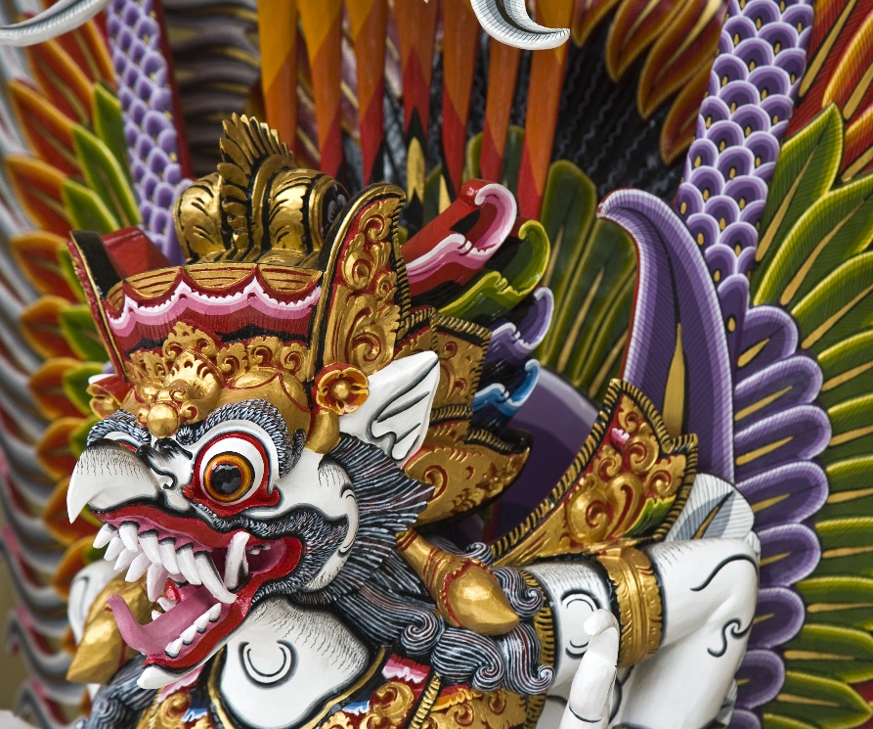
Garuda
The mythical bird Garuda is the half-vulture, half-man king of birds.
Garuda is commonly portrayed as Vishnu’s mount.
Artistic images of Hindu deities are based on mythic stories.
© Worldpics / www.shutterstock.com
Notes:
Notes: Garuda’s significance for Hinduism can be explored in more detail by delving into the mythic stories or by considering sacred places. For example, many temples devoted to Vishnu provide a pillar on which Garuda can land.

Slide 5
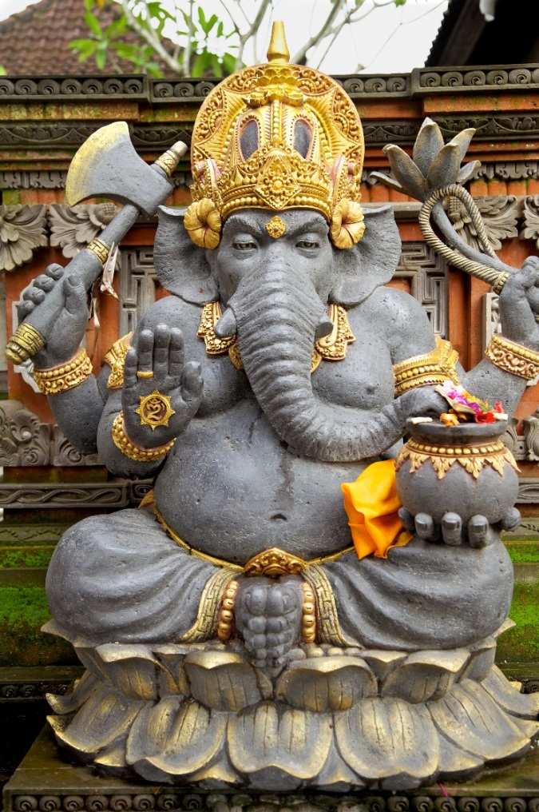
Ganesha, the Elephant God
Ganesha is the son of Shiva and his consort goddess Parvati.
Ganesha is a god of wisdom and the remover of obstacles.
Worship of Ganesha is popular among students and scholars.
© awdebenham / www.shutterstock.com
Notes:
Notes: Ganesha is also known as Ganesh. Ask the students what they observe regarding the iconography of Ganesha (e.g., his elephant’s head, his many arms). This would be a good opportunity to explain the mythic foundations of Ganesha, such as the stories about how he got his elephant’s head. Especially because of the god’s popularity among students and scholars, this also would be a good opportunity to explain that Hindus are free to choose whichever gods or goddesses they wish to worship. Why might students and scholars favor Ganesha?

Slide 6
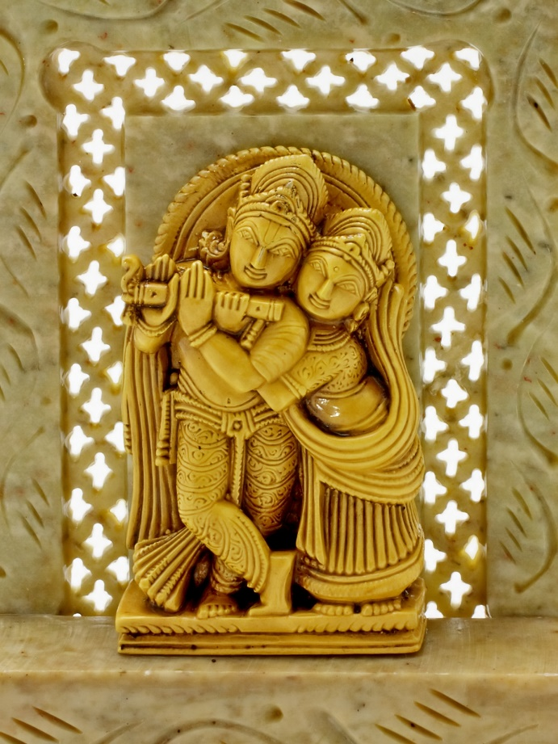
Krishna and Radha
Krishna is often pictured with his beloved gopi, or cowherd, Radha.
Radha is the human soul, perfectly loving God, symbolized by Krishna.
© devy / www.shutterstock.com
Notes:
Notes: Radha is a manifestation of the goddess Lakshmi, consort of Vishnu. The love of Radha for Krishna is celebrated in Vaishnavism, the branch of Hinduism followed by hundreds of millions that focuses on devotion to Vishnu. More elements of Vaishnavism could be explored in conjunction with this slide, as could the general issue of the relationship between romantic love and spiritual devotion.

Slide 7
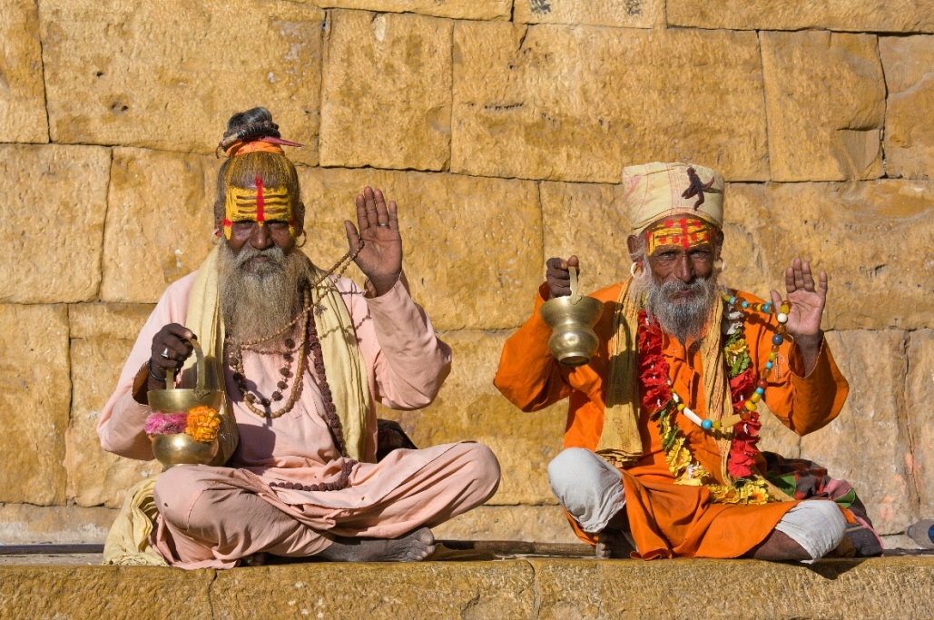
Sadhus, or Holy Men
A sadhu is an ascetic, one who is devoted to spiritual pursuits.
A sadhu is a sannyasin, the stage of life beyond the householder stage.
Sadhus renounce material attachments and depend on others for food.
© OlegD / www.shutterstock.com
Notes:
Notes: Hindu sadhus, or holy men, dedicate themselves entirely to achieving moksha, typically through yogic practices. The markings on their foreheads indicate the identity of the deities to whom they are devoted. It is very common to see sadhus at temples and pilgrimage sites in India; the students should be made aware of their prevalence. Especially given the common use of the term yoga in Western culture, it is worthwhile to review the various Hindu meanings of the term, most of them involving spiritual practices.

Slide 8
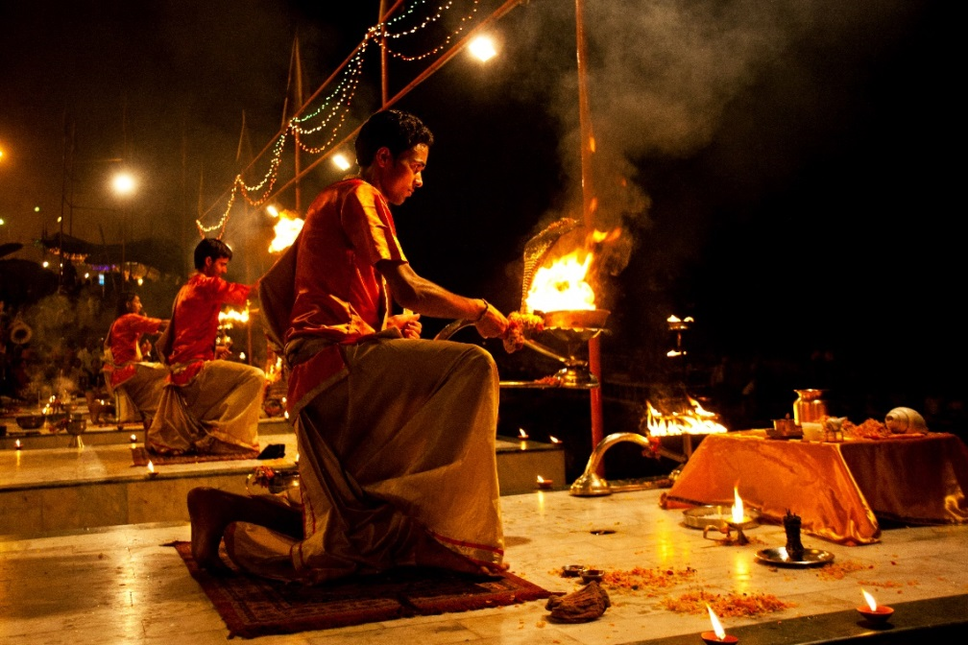
Fire Puja
Puja, a worship ritual, involves making offerings to a deity.
Fire puja is one of the most common forms of Hindu ritual.
The flames of the fire symbolize the entirety of the universe.
Copyright: Pal Teravagimov / www.shutterstock.com
Notes:
Notes: Fire puja is known by the Sanskrit term arati (also spelled aarti), meaning “worship with light.” A common form involves offerings to one or more deities of the light produced by wicks soaked in ghee or camphor. The fire puja depicted on this slide is performed on a ghat on the banks of the Ganges in Varanasi. (Slide 11 presents more information on the Ganges.)

Slide 9
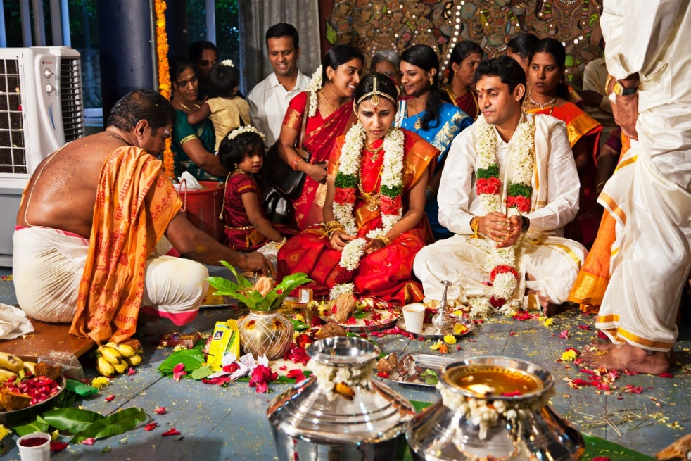
A Hindu Marriage Ceremony
Marriage in Hindu society involves religious ceremonies.
Parents traditionally choose the marriage partners.
Upon marrying, Hindus enter the householder stage of life and raise
a family.
© f9photos / www.shutterstock.com
Notes:
Notes: Discuss with the students the phenomenon of arranged marriages. What sort of cultural assumptions about love and the purpose of marriage might underlie this practice? Details regarding changes to traditional ways would help to shed light on the current status of marriage and related aspects of Hindu society, especially in urban areas and among the better educated.

Slide 10
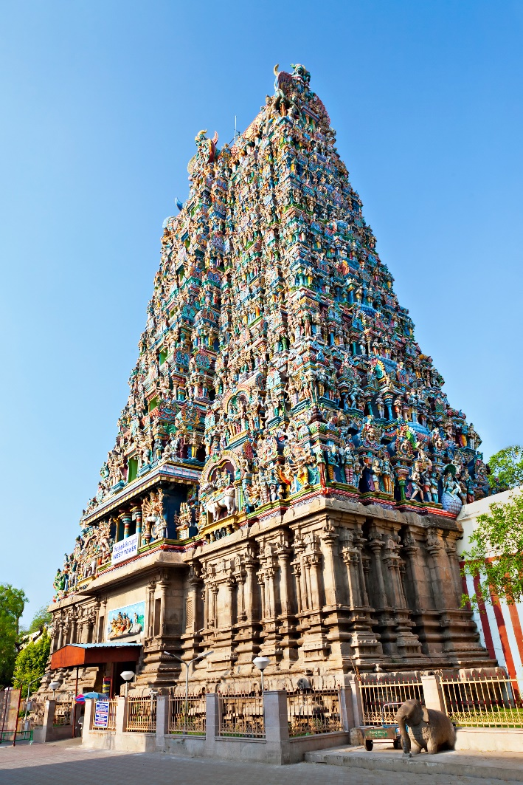
Hindu Temple
A temple is where a deity waits for its devotees.
Decorations depict religious stories and scenes of everyday life.
The inner sanctuary holds the principal image of the deity.
© saiko3p / www.shutterstock.com
Notes:
Notes: The site of Meenakshi Temple (pictured on this slide), in Madurai in southern India, has been home to a temple for some two millennia. The current temple was built in the seventeenth century. Meenakshi is the name of an avatar of Parvati, a consort of the god Shiva. Notably, this major temple is devoted to a goddess (most of India’s major temples are devoted to gods, commonly to Vishnu or Shiva). Hindu temples of various shapes and sizes are ubiquitous in India.

Slide 11
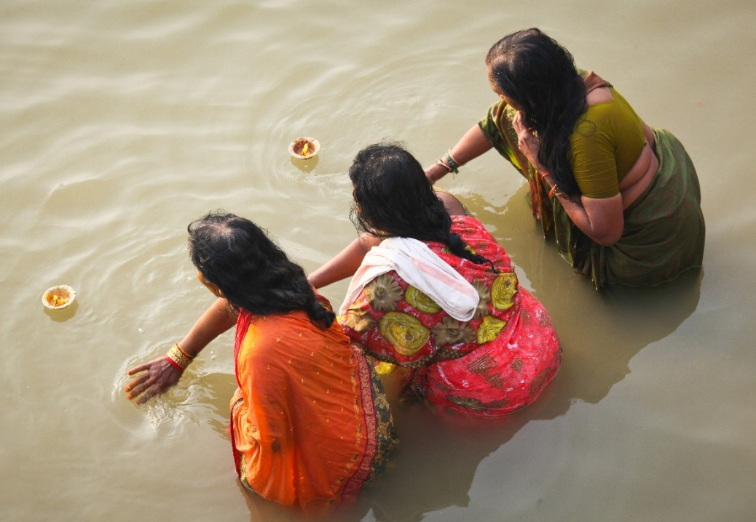
The Ganges
“Mother Ganges” is considered to be holy.
At Varanasi, India, Hindus take ritual baths in the morning.
The Ganges is India’s longest river.
© Neale Cousland / www.shutterstock.com
Notes:
Notes: An entire class session (or more) could be devoted to the role of the Ganges in Hinduism, even if focusing only on Varanasi (formerly Benares), the locale of the ghats on which the dead are cremated. The Ganges forms part of the boundary between India and Bangladesh.

Slide 12
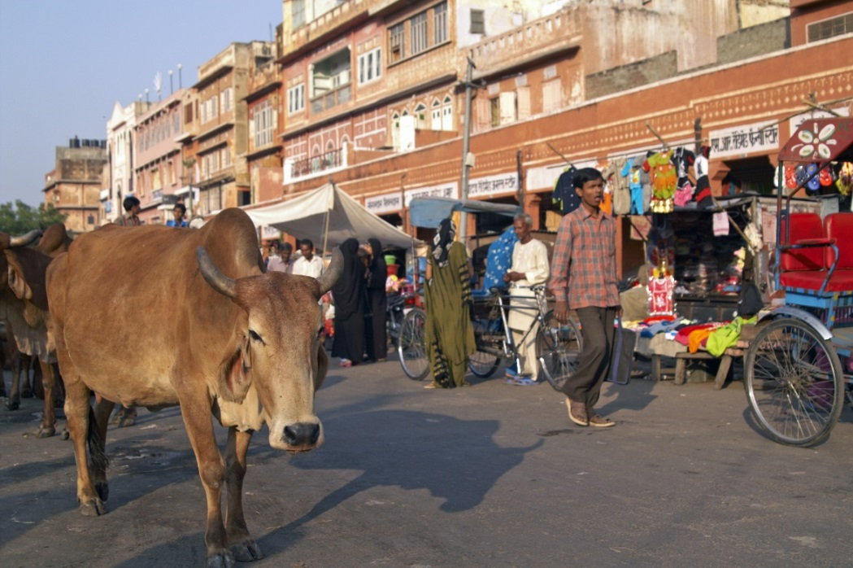
Cow Veneration
Throughout India, cows are free to wander streets, roads, and the countryside.
The cow is a symbol of motherhood, not a deity.
Veneration is a sign of respect for these creatures that benefit humankind.
© JeremyRichards / www.shutterstock.com
Notes:
Notes: See the student book’s section on cow veneration for quotations from Mahatma Gandhi and for other information regarding this important aspect of Hinduism. The spiritual significance of cows is commonly noted in Hindu culture; the cow is venerated not as a deity but as a symbol of motherhood. Krishna is popularly thought of as having been a cowherd. Sculptures of Shiva’s sacred bull, Nandi, are very often present at the god’s temples.

Slide 13
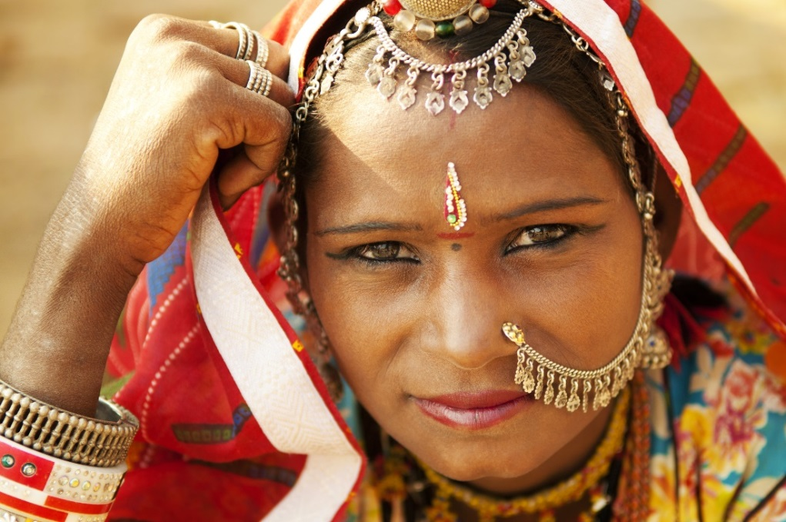
Forehead Markings
Hindus commonly mark their foreheads with meaningful symbols.
The bindi (“drop”) traditionally signified auspiciousness.
Recently the bindi has become a fashion accessory.
A red dot high on the forehead signifies that a woman is married.
© szefei / www.shutterstock.com
Notes:
Notes: Traditionally the markings were made with specific natural substances, such as saffron, but now stickers are often used. A dot situated between the eyes symbolizes the act of looking inward. Some forehead markings indicate devotion to a particular deity. The tripunda, for example, consisting of three vertical lines, indicates devotion to Shiva. Devotees of Vishnu sometimes mark their foreheads with a “V.”

