Slide 1
Sacraments of Healing
The Catholic Faith Handbook for Youth, Third Edition
Chapter 21
Document #: TX003152
Notes:
Use this presentation as an overview or review of the content in chapter 21.

Slide 2

History of Penance and Reconciliation
Scriptural references to Jesus’ forgiveness
In the early Church, serious sins were confessed to the bishop.
The development of private confession
Today, the Sacrament is practiced in three forms.
Copyright: Africa Studio / www.shutterstock.com
Notes:
Invite volunteers to recall some of the Gospel accounts of forgiveness, or have the students read the Gospel references mentioned on page 226 of the student handbook.

Slide 3
The Effects of Penance and Reconciliation
Sacrament of Conversion
Sacrament of Confession
Sacrament of Forgiveness
Sacrament of Penance
Sacrament of Reconciliation

Slide 4

Receiving Penance and Reconciliation
We should confess serious sins at least once a year.
If we are guilty of a mortal sin, we must not receive the Eucharist until we have confessed the sin.
We should be sorry for our sins, and we should have a firm conviction to sin no more.
Copyright: Andrey Shadrin / www.shutterstock.com
Notes:
Tell the students about the three necessary actions of repentance, confession of sins, and contrition and reparation, or invite them to read about these three actions on pages 229–230 of the student handbook.

Slide 5
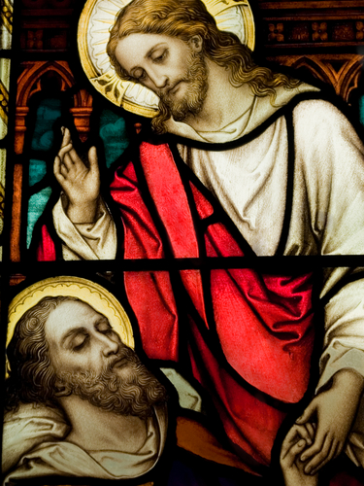
History of Anointing of the Sick
There are more than twenty accounts of healing in the
four Gospels.
Around the ninth century, the Sacrament was used to prepare people for death.
Vatican II restored the original intention of the Sacrament.
Copyright: Jurand / www.shutterstock.com
Notes:
Invite the students to recall some accounts of healing in the Gospels, or form students into groups and see how many different healing stories each group can find.

Slide 6
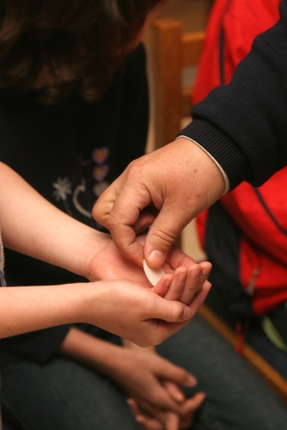
The Effects of Anointing of the Sick
Unites our suffering to the Passion of Christ
Leads to forgiveness of sins if unable to receive the Sacrament of Penance and Reconciliation
Copyright: Zvonimir Atletic / www.shutterstock.com

Slide 7

The Effects of Anointing of the Sick
Strengthens us and gives us peace and courage
Helps a person regain mental and physical health if this is God’s will
Helps a person prepare for his or her death
Copyright: Brian Dunne /www.shutterstock.com

Slide 8
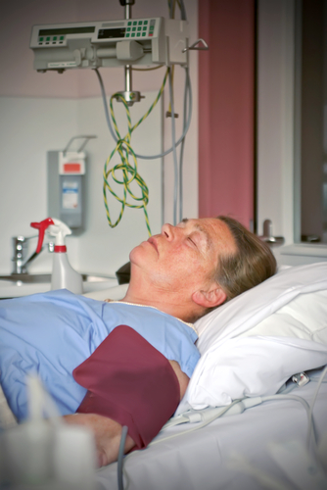
Receiving the Sacrament
Danger of death
Seriously ill or preparing for a serious medical procedure
No limit to the number of times you can receive this Sacrament
Copyright: ariadna de raadt
Notes:
Ask the students to share any stories they might have of someone receiving the Sacrament of Anointing of the Sick.

Slide 9
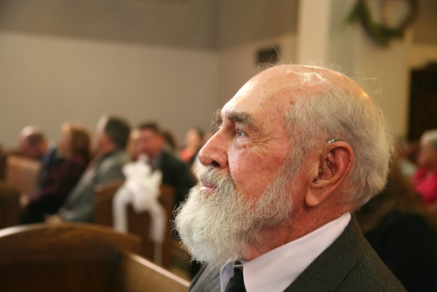
The Eucharistic Rite
Introductory Rites
Liturgy of the Word
Liturgy of the Eucharist
Concluding Rites
Copyright: Stacy Barnett / www.shutterstock.com
Notes:
Invite the students to look at the more detailed outline for the Eucharist on pages 220–221 of the student handbook. You might also consider having them take these pages to Mass at some point in order to follow the order of the liturgy.

Slide 10
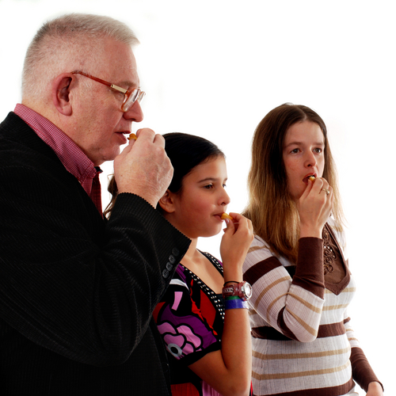
Receiving the Eucharist
Builds up our relationship with Jesus
Strengthens our relationship with the Church
Brings forgiveness for our venial sins
Strengthens us to resist serious sin
Copyright: Glenda M. Powers / www.shutterstock.com

