Slide 1
Interpreting Sacred Scripture
The Living Word: The Revelation of God’s Love, Second Edition
Unit 2, Chapter 5
Document#: TX004683

Slide 2
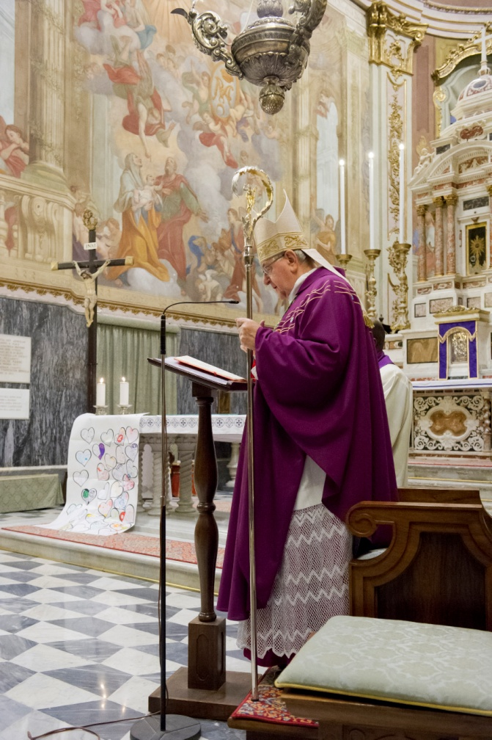
A Vocation to Interpret and Teach
The Holy Spirit guides the Magisterium as it safeguards and explains the truths in the Bible.
Scholars and priests follow the Magisterium’s principles for interpretation.
© Faabi / iStockphoto.com
Notes:
Notes: Call for a volunteer to define the term Magisterium. Ask the students this question: Why is it important for biblical scholars to follow the guidance of the Magisterium?
This slide corresponds to content in article 20, “A Vocation to Interpret and Teach,” in the student book.

Slide 3
Biblical Exegesis
Exegesis is the critical interpretation and explanation of a text.
Each biblical passage must be understood within the complete picture of the Old and New Testaments.
© Wellford Tiller / Shutterstock.com
text
Notes:
Notes: Discuss with the students the Pray It! sidebar in article 21 in the student book. Explain that the Holy Spirit guides all of the faithful as we seek to understand, with the help of scholars and of the Magisterium, what Scripture means for our lives.
This slide corresponds to content in article 21, “Biblical Exegesis,” in the student book.

Slide 4
Biblical Scholars Study Each Book
They study the language and culture of the author.
They examine the literary genres and techniques commonly used at the time.
They are mindful of the unity of all Church teachings.
© bikeriderlondon / Shutterstock.com
Notes:
Notes: Ask the students the question at the end of article 22 in the student book: What aspect of the work of biblical exegetes do you find most interesting, and why?
This slide corresponds to content in article 22, “Biblical Scholars: Bridging the Gap between Yesterday, Today, and Tomorrow,” in the student book.

Slide 5
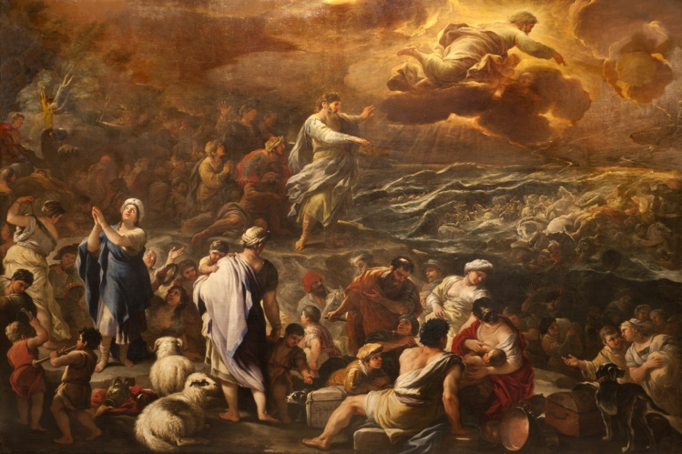
The Senses of Scripture
Saint Thomas Aquinas laid the foundation for modern biblical interpretation.
To determine the literal sense, we look at what the words of Scripture actually say—that is, the surface meaning of the text.
© Renata Sedmakova / Shutterstock.com
Notes:
Notes: Using the example of the Exodus account in article 23 in the student book, point out to the students the literal sense that God parted the sea so the Israelites could cross.
This slide corresponds to content in article 23, “The Senses of Scripture,” in the student book.

Slide 6
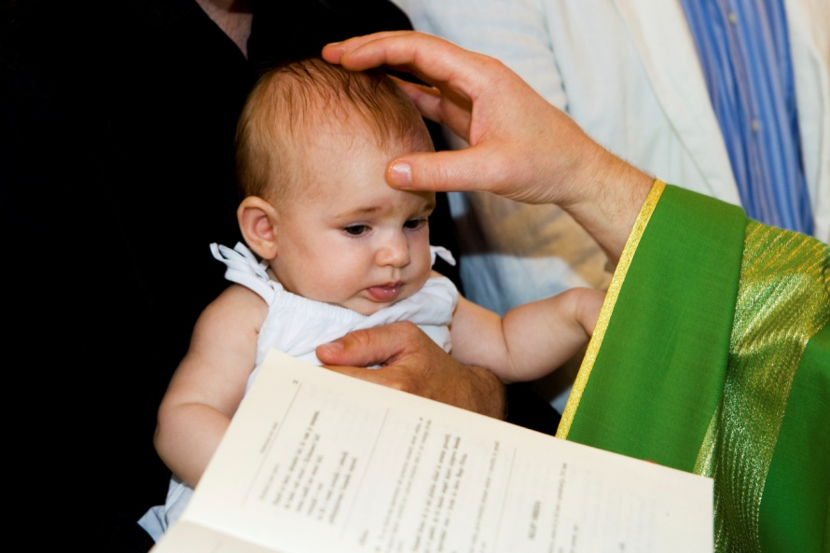
The Spiritual Sense
The allegorical sense of Scripture points to the mystery of Christ.
The moral sense instructs us how to live.
The anagogical sense leads us toward Heaven.
© choja / iStockphoto.com
Notes:
Notes: Return to the example of Exodus in article 23 in the student book, and explain to the students each of the spiritual senses of the passage.
This slide corresponds to content in article 23, “The Senses of Scripture,” in the student book.

Slide 7
Literary Analysis of Scripture
Scholars look for other written or oral sources the biblical authors knew about.
They examine how the authors redacted, or edited, existing writings.
They look for clues about the author’s purpose and main points.
They consider the literary forms.
© Vitaly Maksimchuk / Shutterstock.com
Notes:
Notes: Ask the students to name some literary forms in the Bible (prophecy, Psalms or poetry, parables, and letters), prompting them if necessary. Point out the chart in article 24 in the student book for additional examples.
This slide corresponds to content in article 24, “Literary Analysis of Scripture,” in the student book.

Slide 8
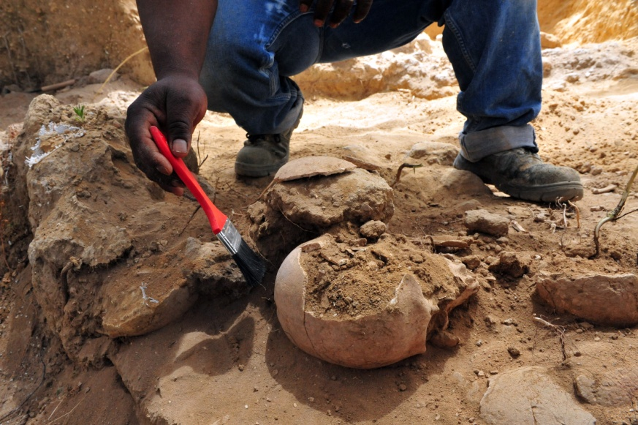
Archaeology
Archaeologists find and study the probable locations of key biblical events.
They look for the earliest copies of biblical texts.
They describe the beliefs and practices of other nations and peoples during biblical times.
© ChameleonsEye / Shutterstock.com
Notes:
Notes: Ask the students this question: For what biblical event would you be interested in seeing archaeological evidence, and why?
This slide corresponds to content in article 25, “Archaeology: Another View of Sacred Scripture,” in the student book.

Slide 9
Scripture, Science, and History
The Catholic Church teaches us how faith, science, and history can coexist and inform one another.
There is a harmony between these academic pursuits and the truths revealed throughout Sacred Scripture.
© Igor Zh. / Shutterstock.com
Notes:
Notes: Ask the students to share why some people might think that faith and science conflict.
This slide corresponds to content in article 26, “Sacred Scripture in Relation to Science and History,” in the student book.

Slide 10
The Church’s Approach
The Church supports a contextualist approach to Scripture.
In contrast, a fundamentalist approach focuses on the literal meaning only.
The Church also rejects an approach that is limited to symbolic understanding.
© Anneka / Shutterstock.com
Notes:
Notes: Make sure the students understand that the Church does not support either a fundamentalist approach or a purely symbolic approach to Scripture. Review with them the definitions of fundamentalist approach and contextualist approach in article 26 in the student book.
This slide corresponds to content in article 26, “Sacred Scripture in Relation to Science and History,” in the student book.

Slide 11
Looking from Every Angle
Guided by the Church’s Magisterium, we must continually study Scripture to reach an authentic knowledge of God’s self-Revelation.
Archaeology, history, science, and literary analysis help the Church to understand Scripture.
© Eugene Sergeev / Shutterstock.com
Notes:
Notes: Discuss with the students the last sentence in article 26 in the student book: “If science and faith conflict, it means we have an inadequate understanding of one or both of them.”
This slide corresponds to content in article 27, “Look at Sacred Scripture from Every Angle,” in the student book.

