Slide 1
Mary, Our Mother
Jesus Christ Course
Document # TX001255

Slide 2
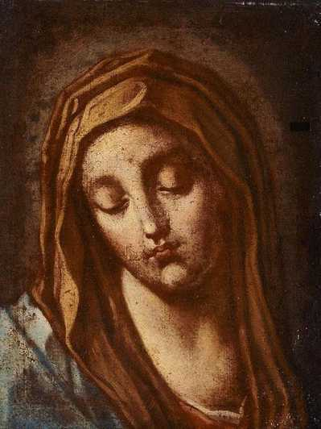
Mary, Our Mother
Think about when you first heard about Mary.
What were you told?
How has your understanding of Mary grown?
Image in public domain
Notes:
Notes: After the first bullet, allow a few quiet moments for reflection. After the second and third bullets, allow time for reflection and discussion as a class.

Slide 3
What Do We Know about Mary?
Her parents were Saints Anne and Joachim.
She was born in Jerusalem and lived in Nazareth in Galilee.
She was the cousin of Elizabeth, the mother of John the Baptist.
She was betrothed (engaged) to Joseph when the angel Gabriel came to her: “Hail, favored one! The Lord is with you” (Luke 1:28).
The Angel announced that she was to be the mother of Jesus, the Mother of God.

Slide 4
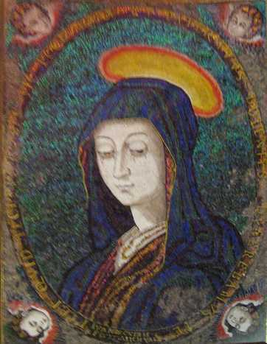
What Do We Know about Mary? (cont.)
Mary had a deep faith and trust in God.
She was young and unmarried.
She became pregnant by the Holy Spirit.
Image in public domain

Slide 5
Mary Became Pregnant by the Holy Spirit
Take a few moments to reflect on how difficult this must have been for Mary.
How would she tell Joseph?
How would he respond?
What would the neighbors say?
Remember, this was a culture that stoned unmarried pregnant women.
Mary’s “yes” would mean that she would be in danger and so would the baby she would carry: Jesus.

Slide 6
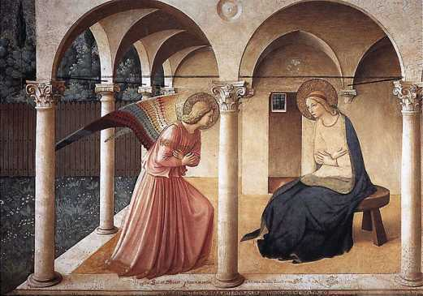
Mary Said Yes
“Behold, I am the handmaid of the Lord. May it be done to me according to your word” (Luke 1:38).
We celebrate Mary’s yes on the Solemnity of the Annunciation, March 25.
Image in public domain

Slide 7
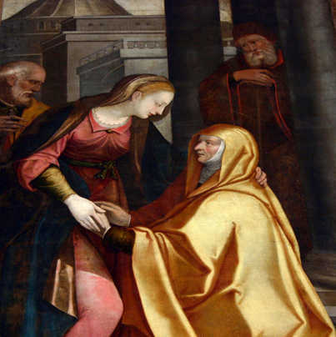
The Visitation
Mary learned that her cousin Elizabeth was also pregnant, and Mary went to visit her.
Elizabeth recognized Mary as a mother, the mother of her Lord.
Image in public domain

Slide 8
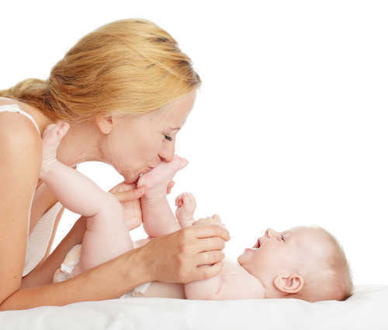
What Is a Mother?
What is a mother?
What can we learn about Mary from our response to this question?
© Shutterstock.com / Gladskikh Tatiana
Notes:
Notes: After the first bullet, allow a few moments for reflection, and then invite discussion. After the second bullet, have the class discuss.

Slide 9
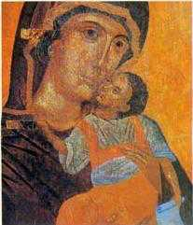
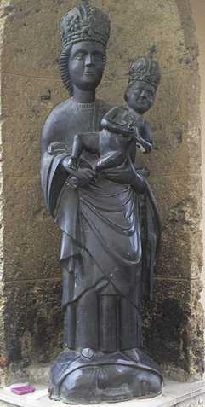
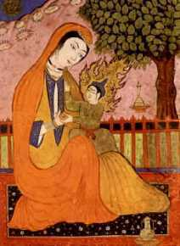
Mary, Mother of Jesus
Images in public domain

Slide 10
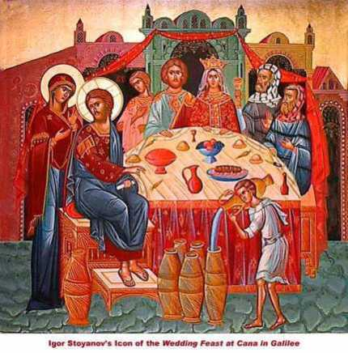
The Wedding Feast at Cana
Mary was a mother who knew her son.
She was concerned for others.
Mary saw that the couple had run out of wine at the wedding feast in Cana. She asked her son to do something.
It was his first public miracle.
He responded when she asked him to help them.
Image in public domain

Slide 11
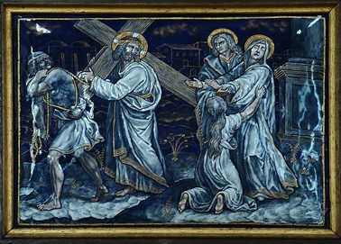
The Fourth Station of the Cross
Jesus meets his mother.
Image in public domain

Slide 12
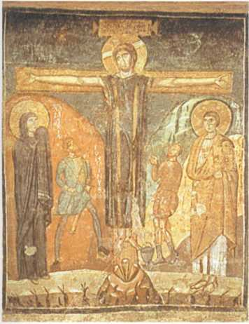
Mary at the Foot of the Cross
“Then he said to the disciple, ‘Behold, your mother’” (John 19:27).
Image in public domain

Slide 13
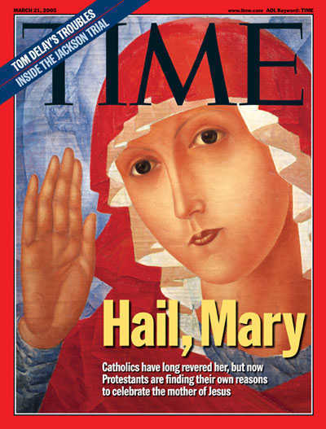
Mary, Our Mother
“Why should we not all together look to her as our common Mother who prays for the unity of God’s family and who ‘precedes’ us all at the head of the long line of witnesses of faith in the one Lord?” (John Paul II, Redemptoris Mater, 30)
© www.time.com

Slide 14
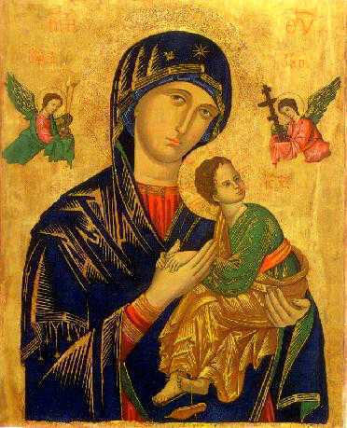
Mary, Our Mother
Image in public domain

