Slide 1
Honoring God
The Catholic Faith Handbook for Youth, Third Edition
Chapter 26
Document #: TX003157
Notes:
Use this presentation to introduce or review the key points in chapter 26 of the student handbook.

Slide 2

The First Commandment
A call to believe, to hope, and to love God above all else
We must adore, pray to, and worship God.
Copyright: wavebreakmedia / www.shutterstock.com
Notes:
Ask the students what they think might be considered false gods in the lives of teens. Then ask, “In what ways does advertising tempt people to worship today’s false gods?” Invite student responses to the question.

Slide 3

Sins against the First Commandment
Idolatry
Superstition
Copyright: Clux / www.shutterstock.com
Sacrilege
Simony
Atheism
Notes:
Invite student volunteers to find these words and their definitions in the student handbook to read aloud. Offer further explanations of these terms, and ask the students where they see these practices today.

Slide 4
The Second Commandment
God’s name should be treated with respect.
Speak God’s name in a positive way.
Copyright: lineartestpilot / www.shutterstock.com
Notes:
Ask the students, “How does using God’s name in situations other than true prayer or adoration harm our relationship with him?” Invite the students to respond.

Slide 5

Sins against the Second Commandment
Blasphemy
Perjury
Copyright: Rafa Irusta / www.shutterstock.com
Notes:
Have the students define these terms, which are found on page 292 of the student handbook. Offer further explanations, and ask the students where they see these sins today.

Slide 6
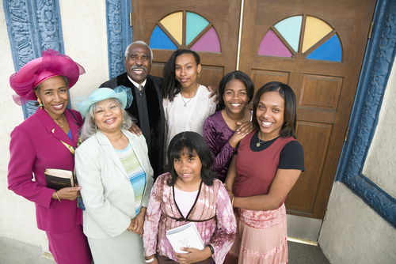
The Third Commandment
It is important that we take time for recreation.
Copyright: Blend Images / www.shutterstock.com
Time to worship our God and leisure time are fundamental human rights.
Going to Mass is an essential part of being Catholic.
We shouldn’t make demands that prevent others from observing the Lord’s Day.
Notes:
Ask the students to respond to the following question: “What would have to change to make Sundays more holy for you, your family, and your friends?”

