Slide 1
Living as a Disciple
The Paschal Mystery
Unit 4, Chapter 9
Document #: TX005440

Slide 2
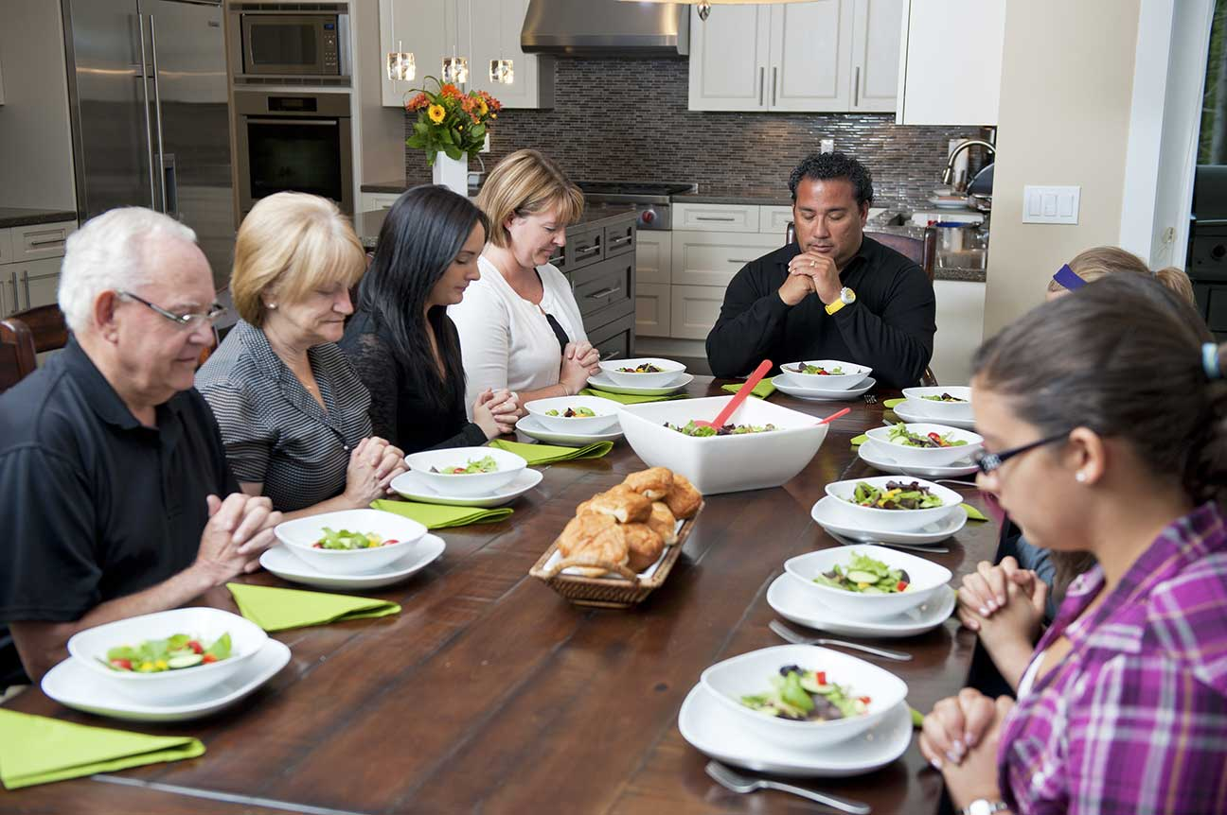
What Is Holiness?
We are called to be holy.
We are holy because we are made in the image of God.
Baptism consecrates us to God’s service.
We perfect our holiness by avoiding sin and dedicating our lives to service.
© Ron Tech3000 / Shutterstock
Notes:
Notes: Discuss the Live It! sidebar, “Daily Schedule for a Holy Teenager,” in article 33 of the student text. Ask what it means to feed your body, mind, and soul good things, and discuss challenges and benefits of doing so.
This slide corresponds to student text content in article 33.

Slide 3
Aids to Holiness
Intellect and free will help us make good choices and act on them.
Grace is God’s supernatural gift to help us live holy lives.
Self-reflection allows us to hear the voice of conscience.
The Church unites us to Christ.
© Christopher Futcher / istock
Notes:
Notes: Point out the specific help we receive from different kinds of grace and the many ways the Church helps us.
This slide corresponds to student text content in article 33.

Slide 4
How Can You Answer God’s Call?
Meet Jesus in the silence of your heart.
Let Christ’s holiness shine through you to bring God’s love to others.
© kirin_photo / istock
Notes:
Notes: Direct the students to read the paragraph under the heading “How Can You Answer God’s Call?” in article 33 of the student text. Ask volunteers to identify the hallmarks of holiness mentioned in the paragraph (prayer, forgiveness, right choices, service).
This slide corresponds to student text content in article 33.

Slide 5
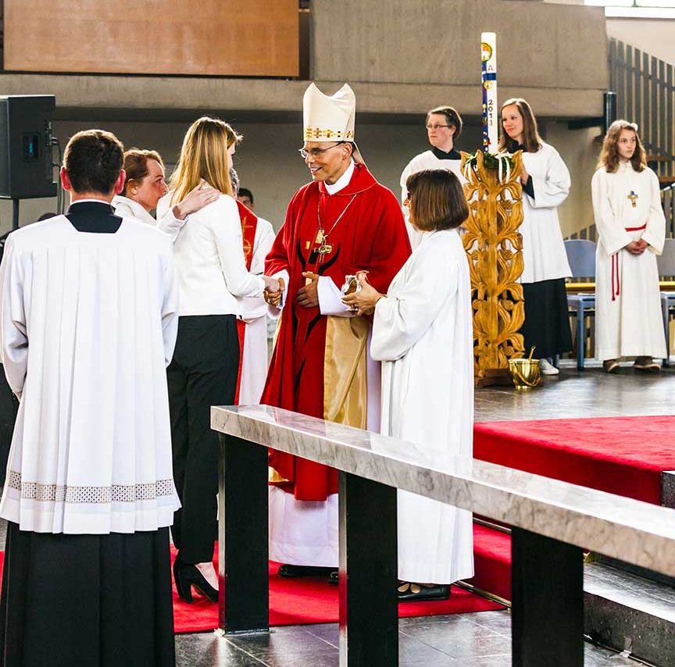
Our Call to Participate in Christ’s Ministry
We are called to participate in Christ’s ministry through our Baptism.
Jesus was anointed priest, prophet, and king.
All Christians are called to serve others in these roles.
© Jorg Hackemann / Shutterstock
Notes:
Notes: Remind the students that in the Old Testament, leaders were called forth and anointed with the Spirit to fulfill these three roles. Explain that the laity are also anointed for these roles at Baptism and Confirmation.
This slide corresponds to student text content in article 34.

Slide 6
Participating in Christ’s Priestly Ministry
Men called to the ministerial priesthood offer the sacrifice of the Mass to God.
We can offer all that we do as a spiritual sacrifice to the Father.
We can pray for others.
© digitalskillet / istock
Notes:
Notes: Explain that we are called to give up things we’d rather keep for the good of others and to grow closer to God. Ask for examples and help the students see that we may need to sacrifice time and money, but also actions and activities that are contrary to God’s will.
This slide corresponds to student text content in article 35.

Slide 7
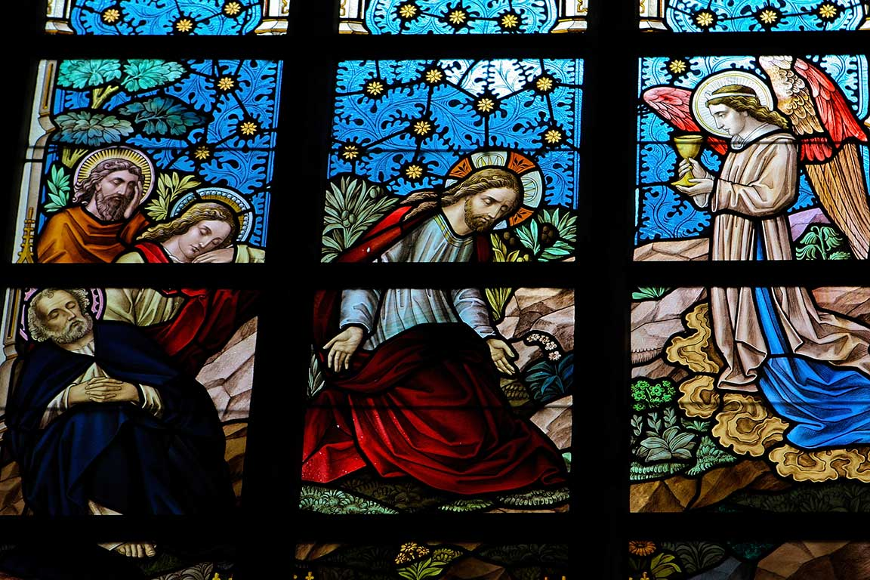
Christ’s Priestly Ministry
Jesus taught us how to pray and how to sacrifice.
He dedicated his life for the good of others . . .
. . . and called his disciples to do the same.
© Jorisvo / istock
Notes:
Notes: Call attention to the examples of Saint Benedict the Moor (section “An Example of Priestly Ministry: Saint Benedict the Moor”) and Fr. Emil Kapaun (Faith in Action sidebar) in article 35 of the student text. Ask for other examples of saints or holy people the students admire for their sacrificial service to others.
This slide corresponds to student text content in article 35.

Slide 8
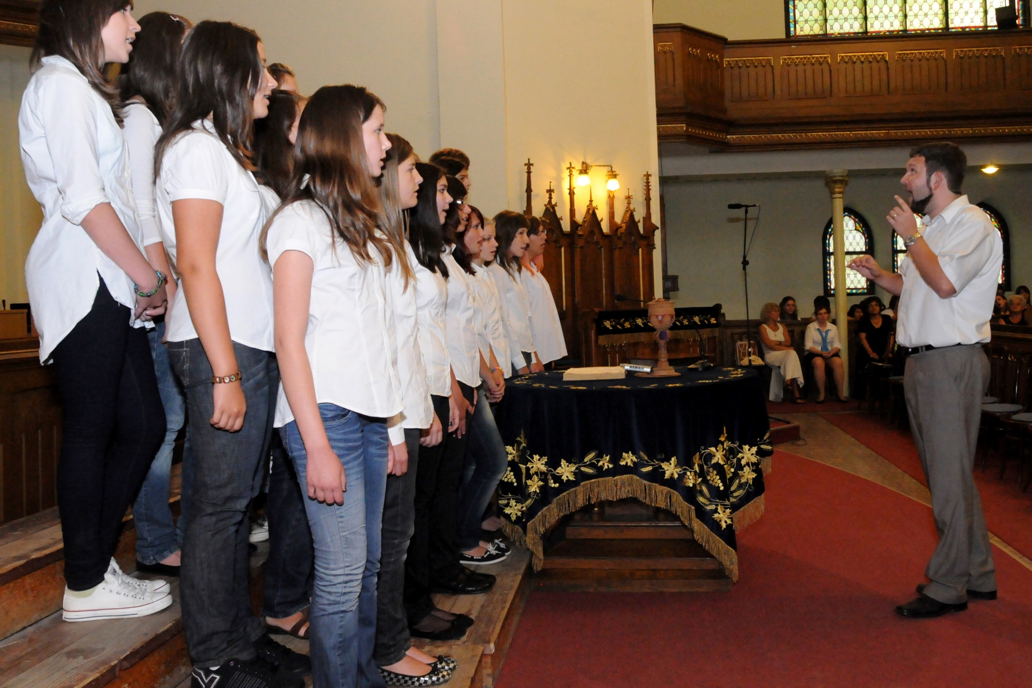
How You Can Participate
Take time to pray daily.
Attend Mass every week.
Participate regularly in the Sacrament of Penance and Reconciliation.
Sacrifice time and comfort to share God’s love with others.
© muzsy / Shutterstock
Notes:
Notes: Ask the questions that conclude article 35 in the student text: How do you already participate in Christ’s priestly ministry? What can you start doing today?
This slide corresponds to student text content in article 35.

Slide 9
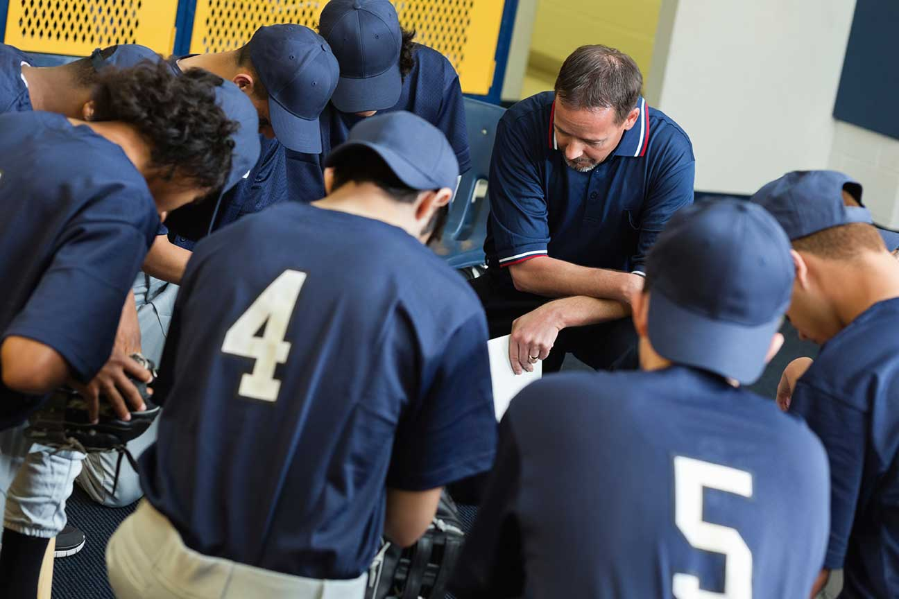
Participating in Christ’s Prophetic Ministry
We witness where clergy are often not found: work, politics, sports, and family.
We share our faith in Jesus.
We call for greater love and justice in the world.
© Steve Debenport / istock
Notes:
Notes: For the first bullet point, ask how we would appropriately share our faith in Jesus in those places. For the third bullet point, ask for examples of how people might speak out for justice or encourage others to do the right thing where justice is called for.
This slide corresponds to student text content in article 36.

Slide 10
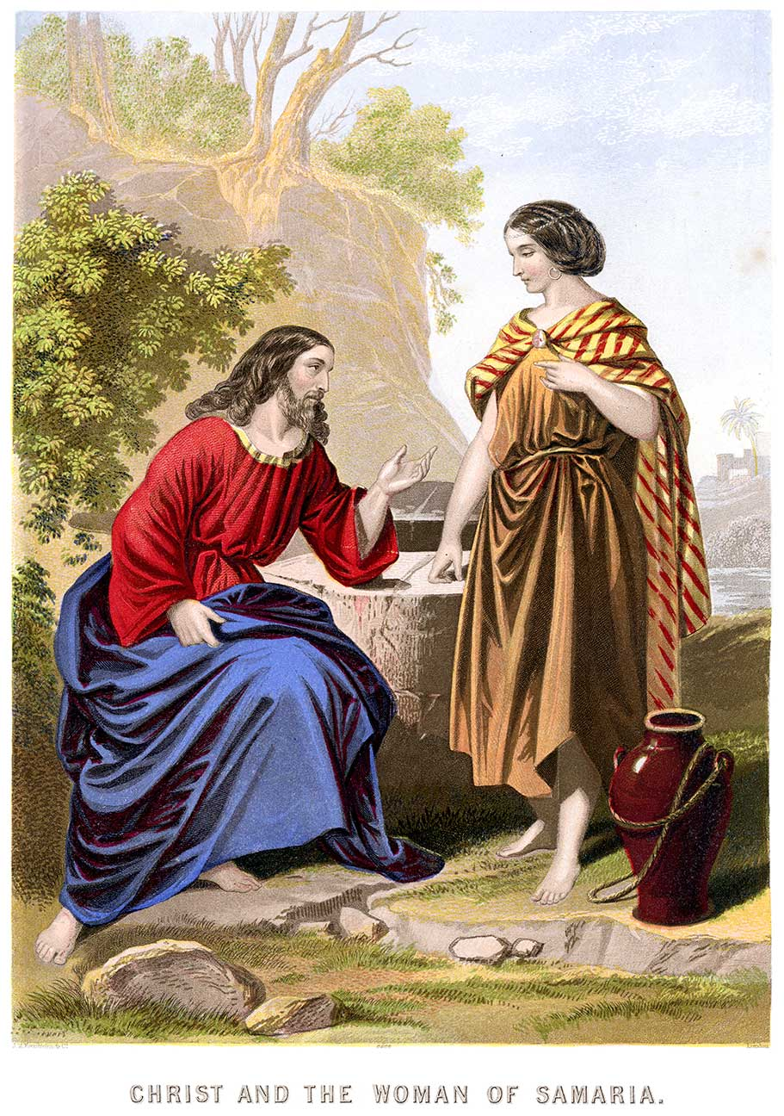
Christ’s Prophetic Ministry
A prophet speaks God’s Word, proclaiming it to those who need to hear it.
Jesus made clear that his words and actions revealed his Father.
© duncan1890 / istock
Notes:
Notes: Direct the students to look over the chart in article 36 of the student text. Ask how modern Christians can speak God’s word as the prophets did, and as Jesus did.
This slide corresponds to student text content in article 36.

Slide 11
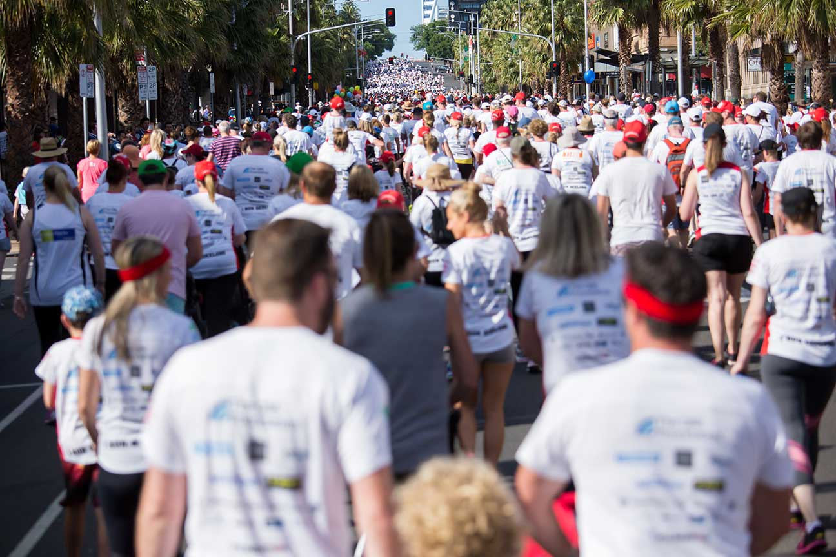
How You Can Participate
Speak out for the unborn.
Speak out against violence and prejudice in your community.
Organize to help people in need.
Share your love of God with others.
© Jarrod Boord / Shutterstock
Notes:
Notes: Ask the questions that conclude article 36 in the student text: How do you already participate in Christ’s prophetic ministry? What can you start doing today?
This slide corresponds to student text content in article 36.

Slide 12
Participating in Christ’s Kingly Ministry
Being a leader starts with the self-discipline to choose what is good and right.
It continues with our commitment to follow God’s call.
It means always serving those most in need.
© Pavliha / istock
Notes:
Notes: Ask what this kind of leadership would look like in politics, business, and student activities.
This slide corresponds to student text content in article 37.

Slide 13
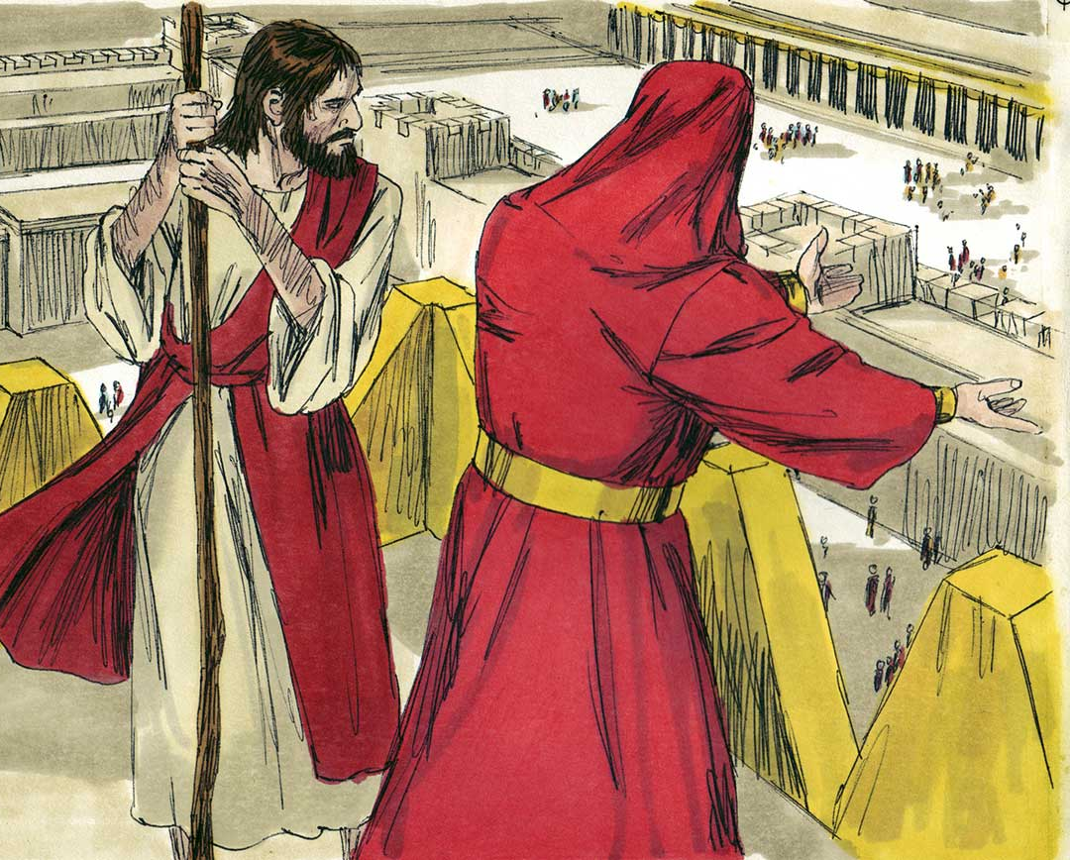
Christ’s Kingly Ministry
Jesus’ leadership was rooted in obedience to God, never using sinful means.
He taught that those who lead are the servants of others.
He reached out to all people, especially those often overlooked.
© BibleArtLibrary / istock
Notes:
Notes: Direct the students to read the paragraph that concludes the section “Christ’s Kingly Ministry” in article 37 of the student text. The paragraph begins: “These passages help us to understand . . .” Ask for examples from Jesus’ life illustrating each point.
This slide corresponds to student text content in article 37.

Slide 14
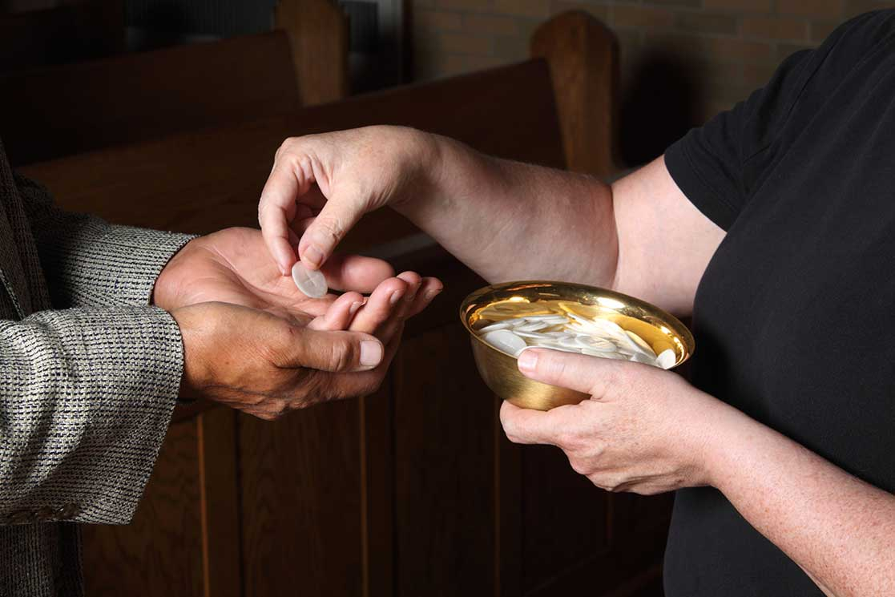
How You Can Participate
Be outstanding in your personal morality.
Find work or service that in some way helps others.
Be humble.
Have a servant attitude.
© princessdlaf / istock
Notes:
Notes: Ask the question on page 183 of the student text, “How do you already participate in Christ’s kingly ministry? What can you start doing today?”
This slide corresponds to student book content in article 37.

