Slide 1
The Sacrament of Confirmation
The Sacraments
Document #: TX002119

Slide 2
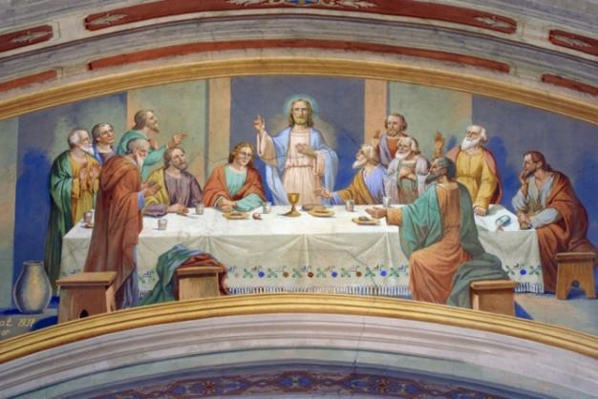
Jesus promised the coming of the Holy Spirit.
© Zvonimir Atletic/shutterstock.com
Notes:
Notes: The three Sacraments of Christian Initiation are Baptism, Confirmation, and the Eucharist.
At the Last Supper, Jesus prepared his Apostles for what was to come. He promised that he would not leave them orphans. Jesus said, “I will ask the Father, and he will give you another Advocate to be with you always, the Spirit of truth” (John 14:16). An advocate, Jesus’ word for the Holy Spirit, is someone who speaks up for you, someone who is on your side in conflict, someone who is a trusted helper and adviser.
The Church mandates that a candidate for Confirmation must have reached the age of reason (at least seven years of age). In the United States, the age of Confirmation has been set as between seven and seventeen.

Slide 3
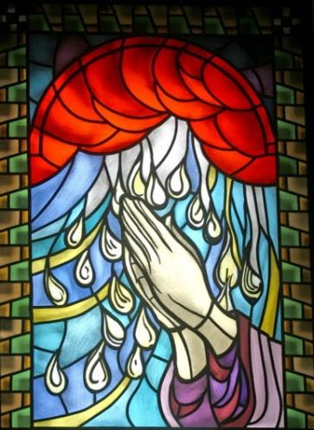
The Rite of Confirmation
The bishop is the ordinary minister of Confirmation.
When necessary, a priest may administer the Sacrament of Confirmation.
© Zvonimir Atletic/shutterstock.com
Notes:
Notes: In the Book of the Prophet Joel, we find a wonderful description of the work of the Holy Spirit:
It shall come to pass
I will pour out my spirit upon all flesh.
Your sons and daughters will prophesy,
your old men will dream dreams,
your young men will see visions.
Even upon your male and female servants,
in those days, I will pour out my spirit.
I will set signs in the heavens and on the earth.
(Joel 3:1–3)
This prophecy, fulfilled at Pentecost, is again fulfilled at every Confirmation. The effects of the Holy Spirit, which we discuss in more detail in the next article, are not always dramatic. But they are real, for, as Jesus told his disciples, the Father in Heaven will always give the Holy Spirit to those who ask (see Luke 11:13).
Alternate Image Option: Bishop, at Confirmation

Slide 4
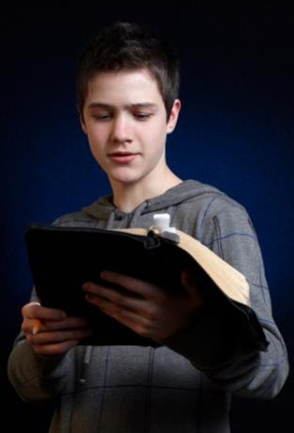
Preparing for Confirmation
Know the Holy Spirit.
Recognize the Holy Spirit’s work in his actions and gifts.
Be willing to follow the Holy Spirit’s inspirations.
Have a sponsor who supports you in your growth.
© George Muresan/shutterstock.com
Notes:
Alternate Image Option: symbol of the Holy Spirit, perhaps in stained-glass window

Slide 5
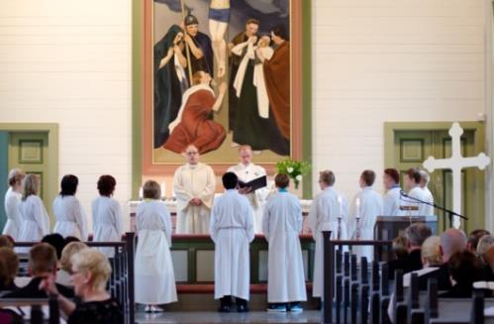
Introductory Rites
The gathering ritual
Candidates for Confirmation
Sponsors, families, members of the congregation
Bishop, parish priests, liturgical ministers
© withGod/Shutterstock.com
Notes:
Notes: As with all liturgical celebrations, the Sacrament of Confirmation begins with a gathering ritual. In this sacramental celebration, this ritual involves the candidates for Confirmation, their sponsors, families, and other members of the community. The candidates often process into the church with the bishop, parish priests, and other liturgical ministers.
Alternate Image Option: Confirmation procession entering church

Slide 6
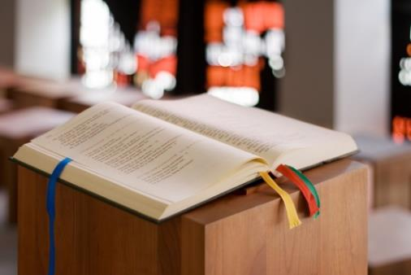
The Liturgy of the Word
Listening to God’s Word and learning his will
© Marc Dietrich/shutterstock.com
Notes:
Notes: As with preparation of catechumens for Baptism, candidates for Confirmation have prepared with a long period of evangelization. This preparation focuses on listening to God’s Word and learning his will so as to be strengthened by the Gift of the Holy Spirit to carry it out.
Alternate Image Option: teen lector reading from Scripture at Confirmation

Slide 7
The Presentation of the Candidates
The bishop reads the name of each candidate.
Notes:
Notes: The name of each candidate for Confirmation is called out to the bishop, in a similar way that the names of the elect are recorded during the Rite of Election for catechumens. Each candidate stands or comes to the sanctuary. Children are accompanied by their sponsors.
Image Option: picture of Confirmation candidates standing and being presented to assembly

Slide 8
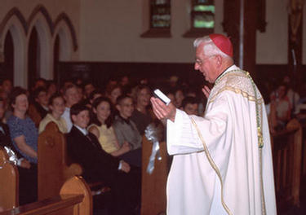
The Homily or Instruction
The bishop speaks to the candidates.
© Bill Wittman / www.wpwittman.com
Notes:
Notes: The bishop addresses the candidates to be confirmed, reminding them that the Gifts of the Holy Spirit they receive, as they are anointed with a cross on their foreheads, are given for the Church to build unity and love. (It is worthy to note that the Holy Spirit chooses who receives which Gifts of the Holy Spirit or who will be called into special service.)

Slide 9
The Renewal of Baptismal Promises
Renouncing Satan and all his works
Professing our faith in God
Notes:
Notes: Because Confirmation is usually celebrated separate from Baptism in the Latin Church, the liturgy includes the Renewal of Baptismal Promises. Candidates renounce Satan and profess their faith in God. The Renewal of Baptismal Promises concludes with these powerful words spoken by the bishop: “This is our faith. This is the faith of the Church. We are proud to profess it in Christ Jesus our Lord” (Rite of Confirmation, 23). Then, the entire assembly responds with a resounding, “Amen.”
Image Option: group of Confirmation candidates holding small lighted candles during the Renewal of Baptismal Promises

Slide 10
The Laying On of Hands
A sign of the descent of the Holy Spirit
“Give them the spirit of wisdom and understanding, the spirit of right judgment and courage, the spirit of knowledge and reverence. Fill them with the spirit of wonder and awe in your presence.”
Notes:
Notes: The bishop extends his hands over the candidates as a sign of the descent of the Holy Spirit. The bishop prays: “Give them the spirit of wisdom and understanding, the spirit of right judgment and courage, the spirit of knowledge and reverence. Fill them with the spirit of wonder and awe in your presence” (Rite of Confirmation, 25). This is not yet the conferring of Confirmation.
Image Option: a bishop extending hands over the candidates

Slide 11
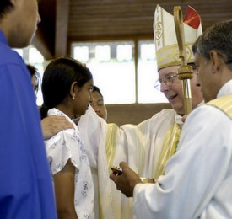
The Anointing with Sacred Chrism
Messiah means the “anointed one.”
the essential Rite of Confirmation
“Be sealed with the Gift of the Holy Spirit.”
© Bill Wittman / www.wpwittman.com
Notes:
Notes: It is important that the word messiah means “anointed one.” Anointing the candidate’s forehead with the Sign of the Cross, using the Sacred Chrism, is the essential Rite of Confirmation, along with the laying on of the minister’s hands and the words, “(Name), be sealed with the Gift of the Holy Spirit.” The newly confirmed responds, “Amen.” The bishop continues, “Peace be with you.” Then the newly confirmed responds, “And also with you” (Rite of Confirmation, 27).

Slide 12
Prayers of the Faithful
Prayers for the newly confirmed and all of the Church
Notes:
Notes: These prayers focus on the newly confirmed, their parents and godparents/sponsors, and all of the Church.
Image Option: picture of teen reading the petitions of the Prayer of the Faithful

Slide 13
The Liturgy of the Eucharist
Several special prayers for the newly confirmed
Notes:
Notes: The celebration continues with the Liturgy of the Eucharist as it would be during any Mass, except that there are several special prayers for the newly confirmed. Often some of the newly confirmed are chosen to bring the gifts of bread and wine to the altar at the Presentation and Preparation of the Gifts.
Image Option: newly confirmed presenting gifts of bread and wine at the Presentation of the Gifts

Slide 14

Question 1
What does it mean, in the Renewal of Baptismal Promises, to renounce Satan and all his works and all his empty promises?
© Santiago Cornejo/shutterstock.com
Notes:
Notes: Be sure that the students are aware that the power of the Holy Spirit enables us to overcome temptation and sin. We may fail at times, but we must take responsibility for our actions and move forward in faith.
Alternate Image Option: Jesus tempted in the desert

Slide 15

Question 2
What does it mean to be
“sealed” with the Holy Spirit?
© Ingrid Prats/shutterstock.com
Notes:
Notes: Be sure the students understand that Confirmation permanently “marks” those who receive it with the seal of the Holy Spirit, given for faith and service in the Church.
Alternate Image Option: Confirmation group visiting with bishop, family, and friends after Confirmation
(Scripture texts used in this work are taken from the New American Bible , revised edition © 2010, 1991, 1986, 1970 Confraternity of Christian Doctrine, Washington, D.C. All Rights Reserved. No part of the New American Bible may be reproduced in any form or by any means, electronic or mechanical, including photocopying, recording, or by any information storage and retrieval system, without permission in writing from the copyright owner.
The quotations labeled Rite of Confirmation are from the English translation of the Rite of Confirmation [Second Edition] © 1975, International Commission on English in the Liturgy [ICEL], in The Rites of the Catholic Church, volume one, prepared by the ICEL, a Joint Commission of Catholic Bishops’ Conferences [Collegeville, MN: Liturgical Press, 1990]. Copyright © 1990 by the Order of St. Benedict, Collegeville, MN. Used with permission of the ICEL.)

