Slide 1
We Respond to God through Prayer
Jesus Christ: God’s Love Made Visible, Second Edition Unit 5, Chapter 14
Document#: TX004820

Slide 2
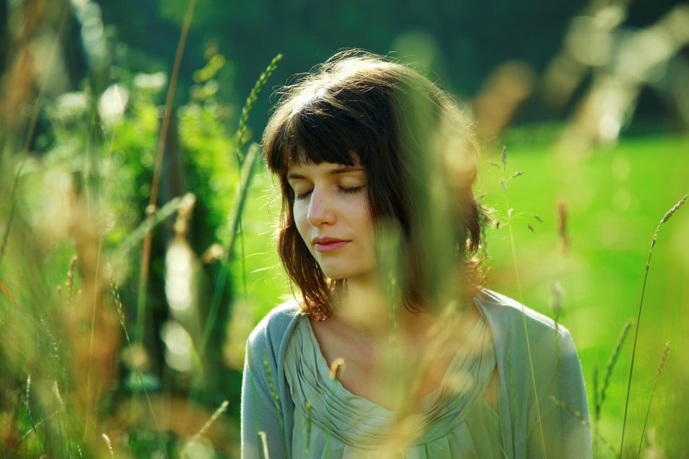
What Is Prayer?
Prayer is fundamentally a relationship.
It is a personal, vital, and intimate connection with the living God.
© ximehS / iStockphoto.com
Notes:
Explain that prayer is an ever-deepening back-and-forth dialogue between God and people, as shown in article 63 in the student book. Ask volunteers to describe times when they experienced prayer as a relationship, or share your own experience.
This slide corresponds to content in article 63, “What Is Prayer?” in the student book.

Slide 3
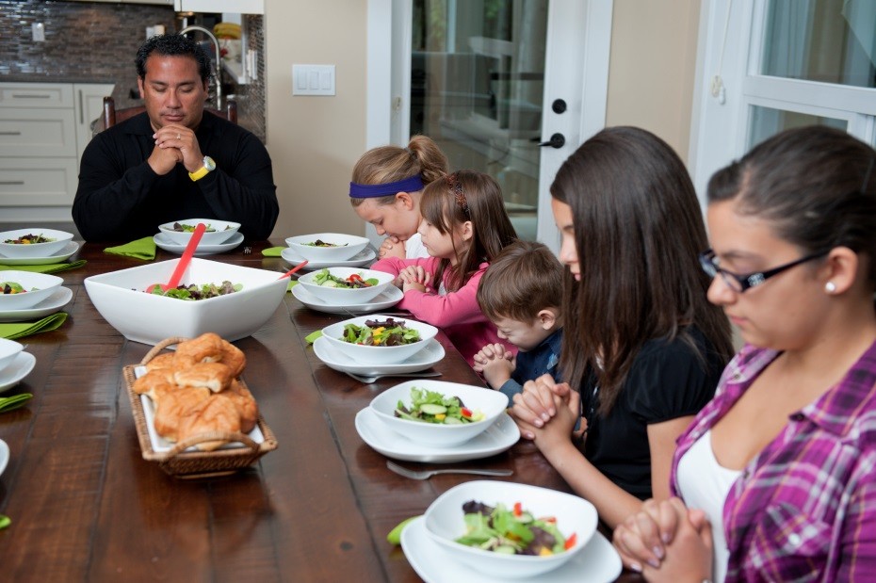
Raising the Mind and Heart to God
In prayer we are conscious of God’s presence within us.
We recall that we are wholly and completely dependent on him.
© RonTech2000 / iStockphoto.com
Notes:
Ask for a definition of the prayer known as an aspiration, defined in article 63 in the student book. Brainstorm suggestions of aspirations from Scripture passages or liturgical music.
This slide corresponds to content in article 63, “What Is Prayer?” in the student book.

Slide 4
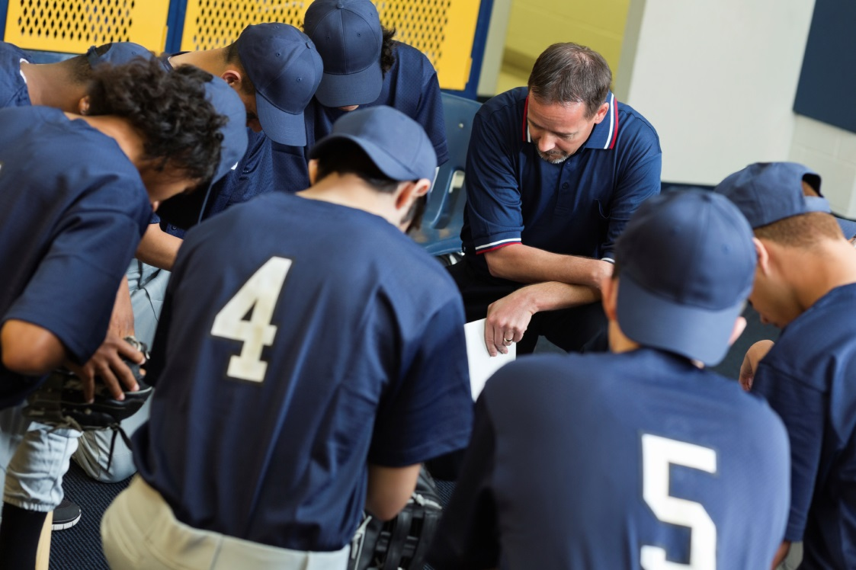
Requesting Good Things from God
Many of our prayers are prayers of petition in which we ask God for something.
In intercessory prayer we ask God for good things on behalf of other people.
© Steve Debenport / iStockphoto.com
Notes:
Discuss how prayers of petition and intercessory prayers may change as we mature spiritually. Ask the students if they can trace a change in their prayers over time.
This slide corresponds to content in article 63, “What Is Prayer?” in the student book.

Slide 5
The Practice of Prayer
In order to be consciously and continually aware of God’s presence . . .
we must commit ourselves to the practice of frequent prayer.
When we engage regularly in daily prayer, we will grow spiritually.
© AlterYourReality / iStockphoto.com
Notes:
Point out some of the ways that we grow spiritually when we pray regularly, as shown in article 63 in the student book. Ask volunteers to read aloud “Tips for Prayer” in article 63, discussing each tip.
This slide corresponds to content in article 63, “What Is Prayer?” in the student book.

Slide 6
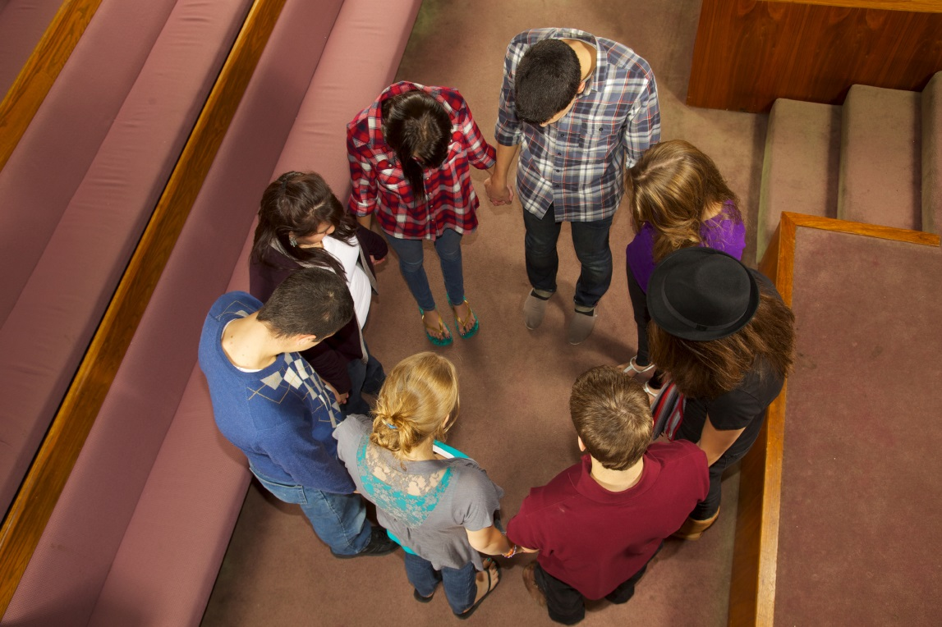
The Lord’s Prayer
In this prayer, Jesus neatly summarizes the key elements of the Gospel message.
It includes praise of God the Father’s holy name,
desire for the Kingdom,
prayer that our needs will be met,
and a plea for forgiveness.
© pastorscott / iStockphoto.com
Notes:
Point out that Jesus gave his disciples the words of this prayer, which also provides a model for all prayer. Explore why some of the bulleted elements are commonly seen in our daily prayer, while others may be missing.
This slide corresponds to content in article 64, “The Lord’s Prayer,” in the student book.

Slide 7
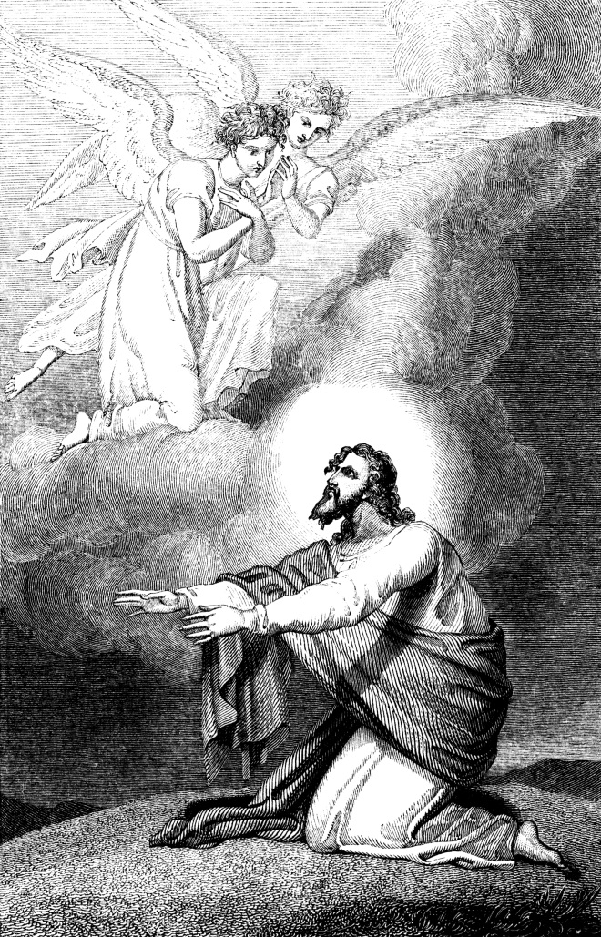
Learning from Jesus’ Example
During his earthly life, Jesus often took time alone to pray.
Jesus consciously made time for prayer.
He often got up very early and found a place where he could be alone.
© TonyBaggett / iStockphoto.com
Notes:
Jesus needed prayer to sustain him in his ministry. Ask the students whether they know anyone with a regular prayer life, and how it seems to sustain the person’s ministry, work, or faith.
This slide corresponds to content in article 65, “Jesus Teaches Us about Prayer,” in the student book.

Slide 8
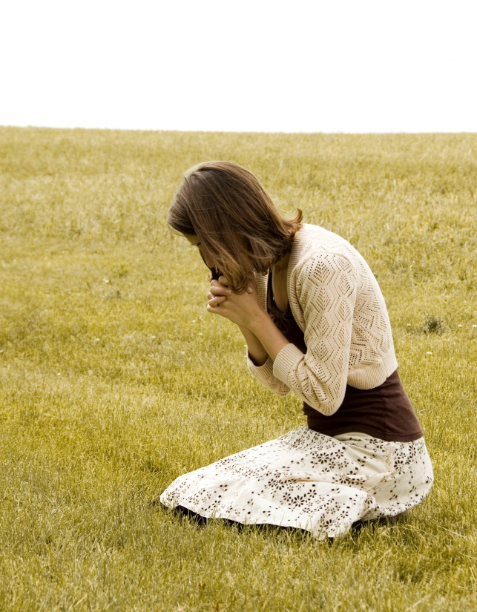
A Parable about Prayer
The parable of the Pharisee and the Tax Collector teaches us how to approach God in prayer.
Jesus addressed this parable to the self-righteous.
We all need the infinite mercy of God to flood our hearts and heal our souls.
© PeteWill / iStockphoto.com
Notes:
Read aloud Luke 18:9–14. Discuss how the Pharisee saw himself and how he saw others. Ask how authentic prayer can help us see ourselves and others more realistically.
This slide corresponds to content in article 65, “Jesus Teaches Us about Prayer,” in the student book.

Slide 9
Scripture on the Need for Prayer
Luke 11:5–8 (The Friend at Midnight) teaches us that our prayers should be persistent and courageous.
Matthew 7:7–11 (Ask, Seek, Knock) assures us that God will respond with love.
Luke 18:1–8 (The Persistent Widow) teaches us that we must not give up.
© PeskyMonkey / iStockphoto.com
Notes:
Read one or more of these passages aloud. Discuss the points in the section “When Prayers Seem to Go Unanswered” in article 66 in the student book.
This slide corresponds to content in article 66, “Sacred Scripture on the Need for Prayer,” in the student book.

Slide 10
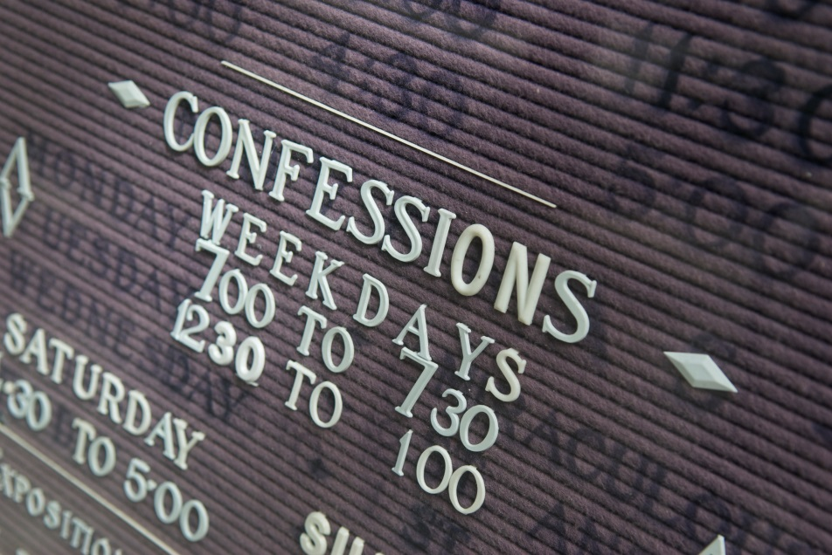
The Sacraments: Cornerstones of Prayer
Participation in the sacramental life of the Church is an essential aspect of the prayer life of a Catholic.
Eucharist and Reconciliation can be continual sources of grace for us.
© PeskyMonkey / iStockphoto.com
Notes:
Emphasize that we can approach the Sacraments as much more than “obligations”; we can see them as occasions for prayer and opportunities to receive God’s grace.
This slide corresponds to content in article 67, “The Sacraments: Cornerstones of Prayer,” in the student book.

Slide 11
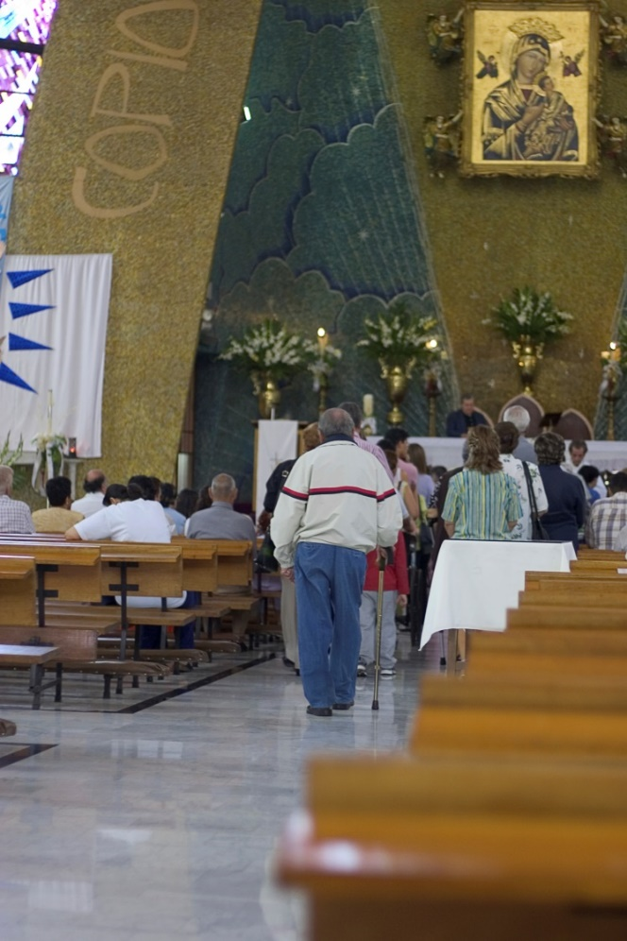
The Eucharist
The Eucharist unites us more fully with Christ.
It unites us with our fellow Christians.
It commits us to those who are poor.
© abalcazar / iStockphoto.com
Notes:
Ask volunteers to explain each point based on their own experience. The students may need help with the last point (see article 67 in the student book).
This slide corresponds to content in article 67, “The Sacraments: Cornerstones of Prayer,” in the student book.

Slide 12
Penance and Reconciliation
We admit that we have harmed others and damaged our bond with the Church.
We are forgiven, healed, and welcomed back into a loving relationship with God.
© IS_ImageSource / iStockphoto.com
Notes:
Review the Did You Know? sidebar in article 67 in the student book.
This slide corresponds to content in article 67, “The Sacraments: Cornerstones of Prayer,” in the student book.

Slide 13
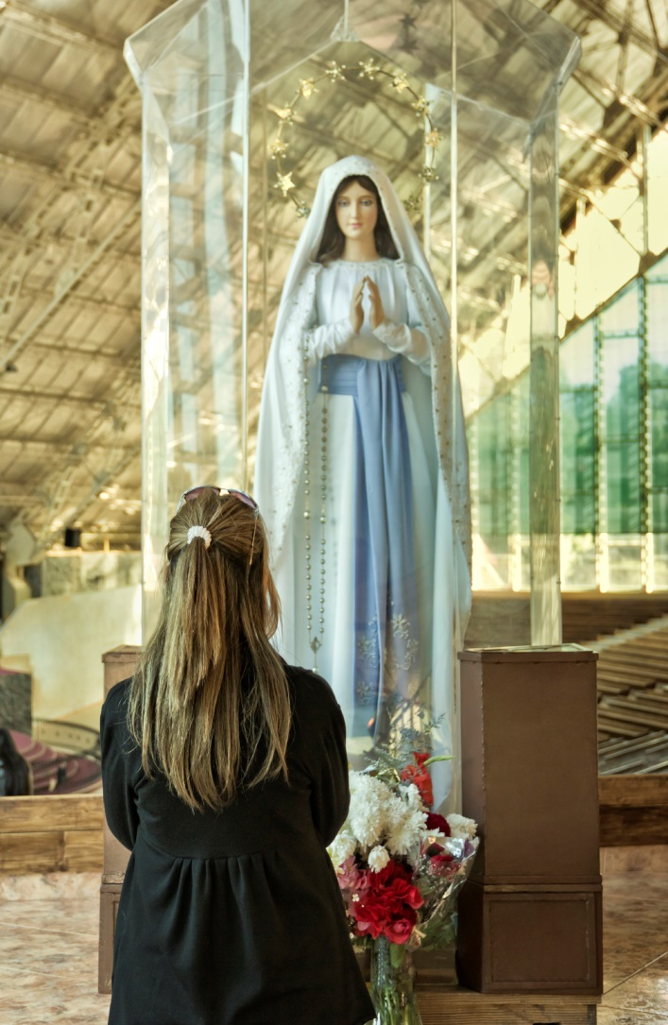
Mary, Our Intercessor
When Catholics offer prayers directed to Mary, we are asking her to intercede for us.
A prayer to Mary is a prayer asking that she offer that same prayer to God on our behalf.
© Edsel Querini / iStockphoto.com
Notes:
Ask the question at the conclusion of article 68 in the student book, “What about the Virgin Mary makes her the ideal model of discipleship and faith?”
This slide corresponds to content in article 68, “Mary: Our Model of Discipleship and Faith,” in the student book.

Slide 14
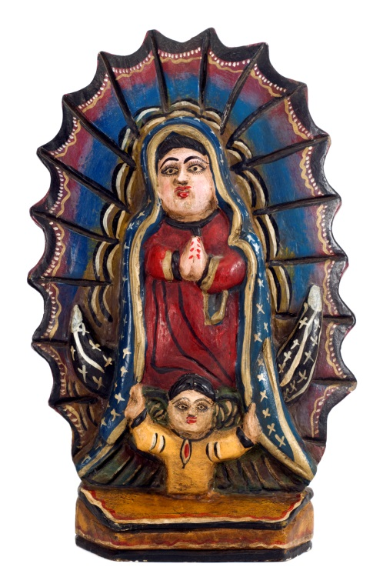
Honoring Mary
Although Catholics worship God alone, we venerate the saints, including Mary.
We celebrate various feasts and solemnities in her honor.
Many traditions of prayer and devotion are associated with Mary.
© stockcam / iStockphoto.com
Notes:
Invite students to name Marian celebrations and devotions with which they are familiar. Ask how they learned about these traditions. Consider sharing a Marian celebration or devotion that you find meaningful.
This slide corresponds to content in article 68, “Mary: Our Model of Discipleship and Faith,” in the student book.

Slide 15
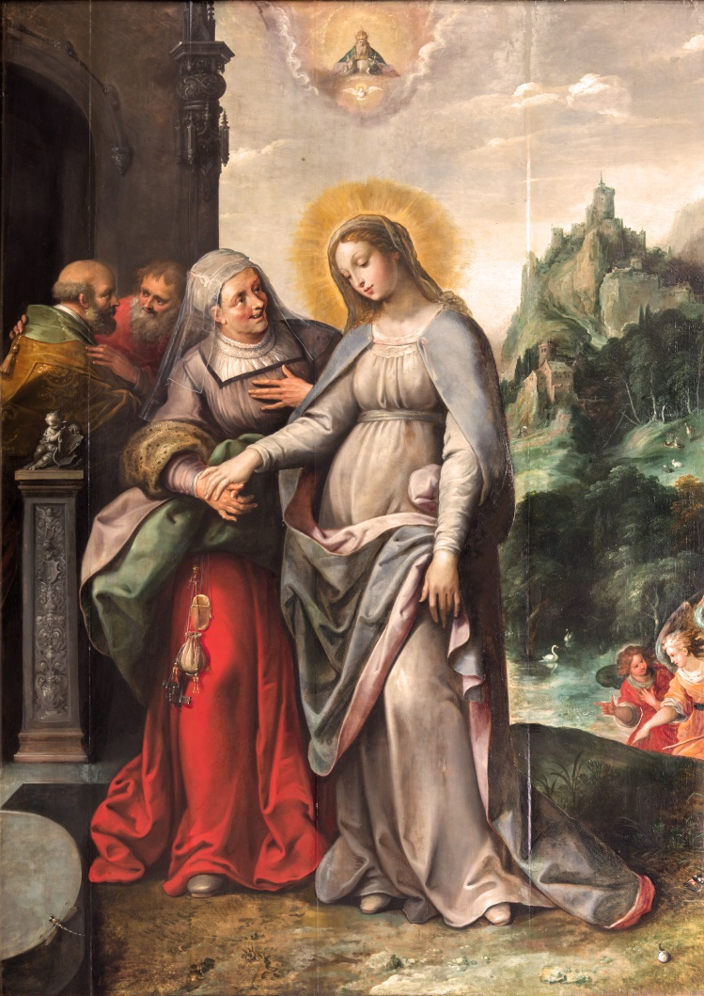
The Magnificat
One way we can truly pray with Mary is to pray in her own words.
The Gospel of Luke gives us Mary’s prayer, the Magnificat.
© Renata Sedmakova / Shutterstock.com
Notes:
Read aloud Luke 1:46–55. Remind students that Luke tells us Mary prayed these words when she was pregnant with Jesus. Ask what this prayer tells us about Jesus’ mission as Messiah and Savior.
This slide corresponds to content in article 68, “Mary: Our Model of Discipleship and Faith,” in the student book.

