Slide 1
Marriage Preparation
Vocations, Unit 4

Slide 2
What images come to mind when you hear the phrase “wedding planning”?
Notes:
Teacher Notes: Invite the students to respond to the question.

Slide 3
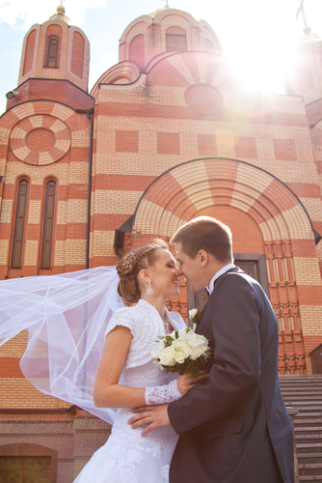
© Shutterstock/ Nata Sdobnikova
Notes:
Teacher Notes: We often focus on the wedding ceremony as a “storybook” event. We tend to forget about the important process of preparation that those who are engaged must go through to arrive at their wedding day.

Slide 4
What is the ordinary ritual for celebrating a Catholic Marriage?
Notes:
Teacher Notes: Invite the students to respond to the question. Then reveal the answer. Use the following information, as needed, in the discussion:
Catholics celebrate the Rite of Marriage, which takes place in a church and ordinarily as a part of a Nuptial Mass. Not all Catholic wedding ceremonies take place during Mass. The reasons for this will be discussed later.

Slide 5
After a couple is engaged, what is usually the next step?
attending classes at their parish
meeting several times with the priest or deacon who will officiate
taking part in a retreat with other engaged couples
meeting with a married couple who will mentor them
Notes:
Teacher Notes: Allow the students to respond to the question.

Slide 6
© Shutterstock/FuzzBones
Notes:
Teacher Notes: Because Catholics marry in a public ceremony in a church, they normally set up a meeting with a priest or deacon to begin the process of preparation for Marriage. At this initial meeting, the couple may set a date for the wedding (at least six months from the time of the initial meeting). They may also choose from a variety of options for Marriage preparation (or pre-Cana). Also, important documents must be completed during this time.

Slide 7
Besides a marriage license, what documents are required for a Catholic Marriage?
Notes:
Teacher Notes: Invite the students to respond to the question. Then reveal the answer. Use the following information, as needed, in the discussion:
There are several legal documents required. These can vary according to the situation. The most basic requirement for two Catholics or a Catholic and a baptized non-Catholic is a copy of their baptismal certificates. If both future spouses are baptized, the marriage will be a sacramental Marriage. The deacon or priest who will witness the Marriage is a legal witness in the United States and is therefore able to sign the marriage license for the state.

Slide 8
Are there other requirements for Catholics?
Notes:
Teacher Notes: Invite the students to respond to the question. Then reveal the answer. Use the following information, as needed, in the discussion:
Yes, if a Marriage takes place between a Catholic and a non-Catholic, the Catholic is required to receive a dispensation from the bishop of his or her diocese.

Slide 9
Dispensations
Mixed Marriage Dispensation
Notes:
Teacher Notes: When a Catholic marries a baptized non-Catholic, it is defined as a mixed marriage and a dispensation is required. The Catholic promises to continue practicing the faith and to make sure that any children resulting from this marriage will be brought up in the Catholic faith. This marriage is a sacramental Marriage.

Slide 10
Dispensations
Mixed Marriage Dispensation
Disparity of Cult Dispensation
Notes:
Teacher Notes: When a Catholic marries a non-baptized person, a disparity of cult dispensation is required. Again the Catholic promises to practice his or her faith and to raise children in the Catholic faith. This marriage is a nonsacramental marriage.

Slide 11
What exactly happens during the pre-Cana process?
attending classes at their parish
OR taking part in a retreat with other engaged couples
meeting with a married couple who will mentor them
Notes:
Teacher Notes: Invite the students to respond to the question. Then reveal the answer. Use the following information, as needed, in the discussion:
The term pre-Cana refers to the site of Jesus’ miracle at the wedding feast in Cana. Requirements may vary somewhat from diocese to diocese.

Slide 12
On which topics does Marriage preparation focus?
developing communication skills
acquiring basic information on natural family planning (discussed later)
learning the Church’s teaching about Marriage and its responsibilities
reflecting on what it means to be a spouse and also possibly a parent
growing in awareness of the importance of participating in the prayer and sacramental life of the Church
living as witnesses to the love of Jesus Christ for the Church
witnessing to the equality and complementarity of men and women
Notes:
Teacher Notes: Invite the students to respond to the question. Then reveal the answer. Use the following information, as needed, in the discussion:
The pre-Cana process includes psychological and spiritual preparation for Marriage in an honest dialogue between the engaged persons themselves. Often the couples discover new things about themselves and each other that will help them to deal with the challenges of Marriage. It sometimes happens that a couple will find that they are not truly compatible on key issues. This may be difficult but it may be the best thing to happen. Most often, of course, this is a beautiful time of strengthening the bonds of love and communication that will be expressed in Marriage.

Slide 13
What is the engaged couple’s role in planning the wedding ceremony?
Notes:
Teacher Notes: Invite the students to respond to the question. Then reveal the answer. Use the following information, as needed, in the discussion:
Marriage is a public act of the Church, not a private ceremony; therefore, the Church’s liturgy is celebrated. A Nuptial Mass is celebrated for two Catholics, and a Liturgy of the Word is celebrated for a Catholic and a non-Catholic. A Marriage is a Sacrament of unity; therefore a Nuptial Mass is only appropriate when two Catholics marry. For one spouse to be unable to receive Communion would show a sign of disunity that is not desirable during a wedding ceremony.

Slide 14
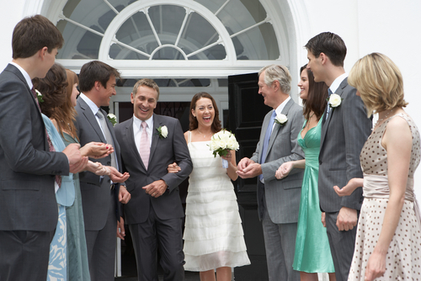
Can the couple “personalize” the Marriage liturgy?
© Shutterstock/AISPIX by Image Source
Notes:
Teacher Notes: Invite the students to respond to the question. Then reveal the answer. Use the following information, as needed, in the discussion:
Yes, to some extent. The Rite of Marriage and the couple’s essential role in this Rite will be discussed in the next class session.
Conclude the PowerPoint by asking students to ask questions or make comments.

