Slide 1
Guided Prayer
Christian Morality
Document #: TX001821

Slide 2
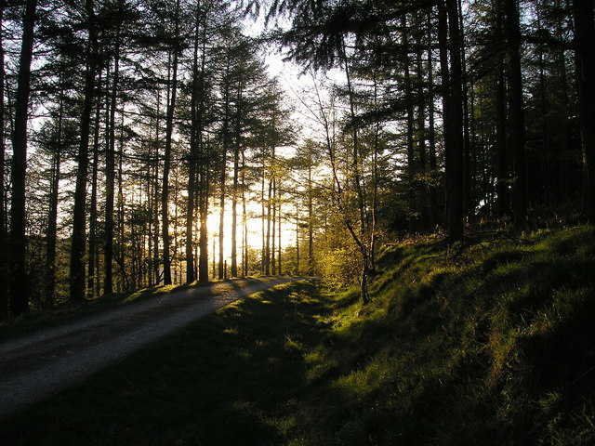
God’s Love, Mercy, and Forgiveness
Image in public domain

Slide 3
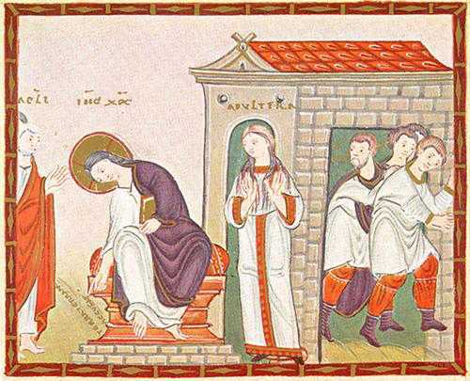
“Let the one among you who is without sin be the first to throw a stone at her” (John 8:7).
Image in public domain
Notes:
Note: Read this reflection while the slide is being projected:
Recall the times you have heard the account of the woman caught in adultery. The scribes and Pharisees confront Jesus with the woman, citing the Law of Moses that such a woman was to be stoned. After his reply Jesus began writing in the sand. Have you ever imagined what the crowd saw written in the sand? Jesus’ words and actions were an invitation to others to reflect on personal sin and to reconsider the Law of Love written in their hearts.
Recall a situation when you have seen someone judge another person without considering his or her own faults. How does acknowledgment of your own failures enable you to see others in a new light? Record your response.

Slide 4

How does acknowledgment of your own failures enable you to see others in a new light?
Record your response.
Notes:
Note: Allow the students 5 minutes to complete their journal response.

Slide 5
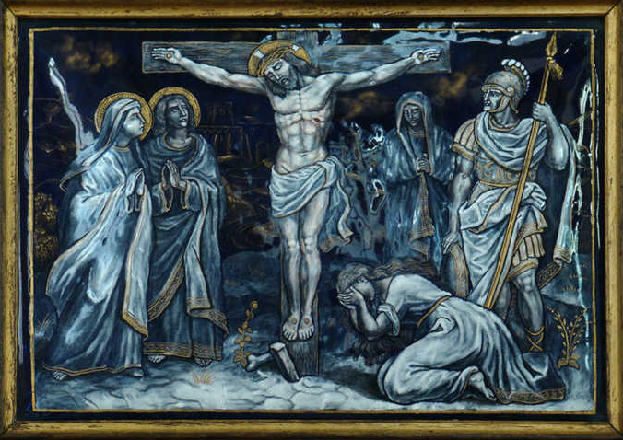
“Father, forgive them, they know not what they do” (Luke 23:34).
Image in public domain
Notes:
Notes: Read this reflection while the slide is being projected:
Recall what you have been taught about the Crucifixion as a sign of God’s great act of love. Jesus’ last words, “Father, forgive them,” show us that the power of love overcomes the power of evil. The Crucifixion is the ultimate sacrifice that puts an end to sin and opens the door to eternal life for each of us. Those who have experienced pain and loss from other people’s sinful acts may see in the Crucifixion a sign of consolation and strength, for the Son of God took on the sufferings of humankind—betrayal, unfaithfulness, distrust, pride, anger, violence, abandonment, or senseless injustice.
Where in society do you see the sins of anger, violence, betrayal, or senseless injustice, and what feelings do these acts evoke in you? Record your response in your journal.

Slide 6
Where in society do you see the sins of anger, violence, betrayal, or senseless injustice, and what feelings do these acts evoke in you?
Record your response.
Notes:
Notes: Allow the students 5 minutes to complete their journal response.

Slide 7
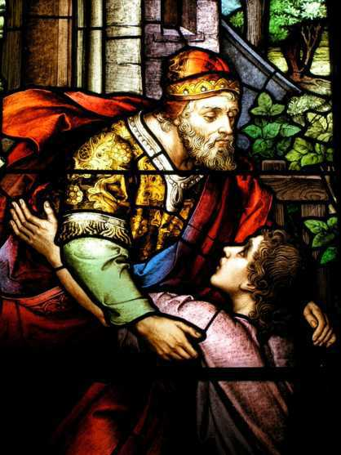
“Father, I have sinned against heaven and against you” (Luke 15:21).
Image in public domain
Notes:
Note: Read this reflection while the slide is being projected:
The account of the prodigal son represents the universal theme of sin and forgiveness. The son places his own pleasure at the center of his heart’s desire, missing the mark, rebelling against his father’s desire for his greater good, and living a life of sin. When he realizes the wrong he has done, he acknowledges he has broken a relationship with both his earthly and his heavenly fathers. With this awareness his heart is turned and he seeks forgiveness.
Consider a time when you have found yourself suddenly aware of turning away from God’s love. How does a refusal to respond to God’s love influence your moral choices? What motivates you to return to God? Record your response in your journal.

Slide 8
How does a refusal to respond to God’s love influence your moral choices?
What motivates you to return to God?
Record your response.
Notes:
Notes: Allow the students 5 minutes to complete their journal response.

Slide 9
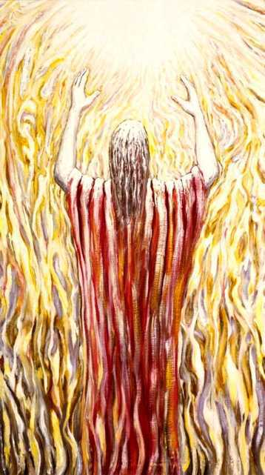
“And forgive us our debts, / as we forgive our debtors” (Matthew 6:12).
Image in public domain
Notes:
Notes: Read this reflection while the slide is being projected:
The Lord’s Prayer has been passed from parent to child from the time of Christ. We want to pray like Christ and in communion with Christ. This plea for forgiveness in the Lord’s Prayer is based on the recognition that we have done wrong and seek forgiveness; the recognition that sin damages our relationship with God, with others, and with ourselves; the recognition that we need God’s help to repair the harm; and finally, the recognition that we are in solidarity with all who sin and seek the grace of reconciliation.
Consider a time when two people have hurt each other through words or actions. The relationship between the two people is damaged, as well as each person’s relationship with God. How do you seek to reconcile a broken relationship in such a situation? How do you seek to reconcile a broken relationship with God? Record your response in your journal.

Slide 10
How do you seek to reconcile a broken relationship with another person?
How do you seek to reconcile a broken relationship with God?
Record your response.
Notes:
Notes: Allow the students 5 minutes to complete their journal response. Invite the students to pray together the Lord ’s Prayer as a conclusion to the reflection.
(The scriptural quotations on this handout are from the New American Bible with Revised New Testament and Revised Psalms. Copyright © 1991, 1986, and 1970 by the Confraternity of Christian Doctrine, Washington, D.C. Used by the permission of the copyright owner. All Rights Reserved. No part of the New American Bible may be reproduced in any form without permission in writing from the copyright owner.)

