Slide 1
The Acts of the Apostles and Saint Paul
Document # TX004713

Slide 2
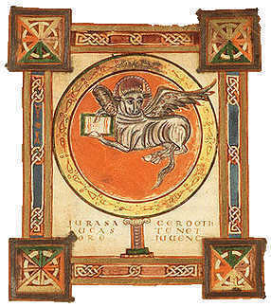
Basic Facts
Written by the same evangelist who wrote the Gospel of Luke.
Written in approximately AD 80.
The Acts of the Apostles picks up where the Gospel of Luke ends.
It recounts how the early Church grew under the guidance of the Holy Spirit.
Public domain
Notes:
Notes: The first slide introduces the Book of Acts. If time permits you may want to have students open their Bibles to the end of the Gospel of Luke and read its ending and then read the beginning of the Book of Acts to see the connection. You might also want to point out how both books are written to Theophilus.

Slide 3
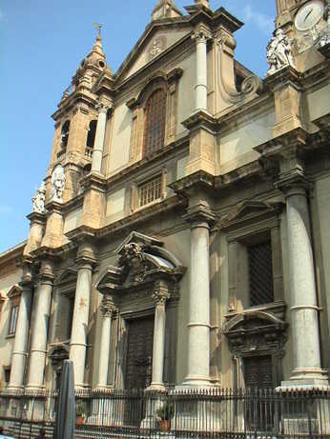
Content in the Acts of the Apostles
Chapters 1–12 focus on Saint Peter’s leadership in Jerusalem and nearby communities.
Chapters 13–28 focus on the missionary work of Saint Paul and his companions.
Public domain
Notes:
Notes: Explain to the students that, in Acts, we see the Church grow under the guidance of the Holy Spirit. What begins with a group of frightened disciples in an upper room ends with a Church spanning the Roman Empire.

Slide 4
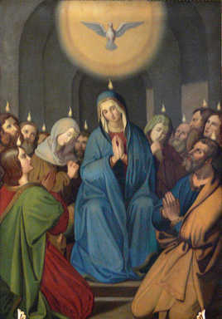
The Pentecost Event
The Feast of Pentecost celebrates the fulfillment of Jesus’ promise to send the Holy Spirit to guide the disciples and their followers.
We celebrate Pentecost fifty days after Easter.
Some people call it the birthday of the Church, because the disciples went in confidence to form the first Christian community in Jerusalem.
Public domain
Notes:
Notes: Prior to this slide, you can write the word Pentecost on the board and have the students volunteer information as to what they think Pentecost is and what it celebrates.

Slide 5
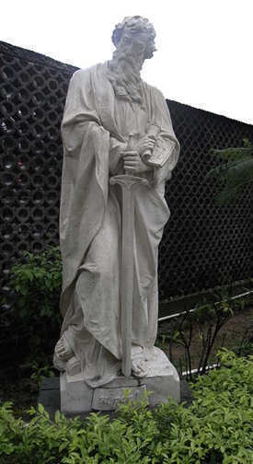
Saint Paul
Saint Paul lived during the early to middle first century AD.
He was born into a Jewish community.
He was a Roman citizen.
He became a Pharisee.
He spent the first part of his life persecuting Christians, and he witnessed the martyrdom of Saint Stephen.
Public domain
Notes:
Notes: This slide gives basic information about Saint Paul. To begin presenting the material on this slide, you might consider asking the students what they know about Saint Paul. A good way to do this is to have the students do a KWL [Know\Want to Know\Learned] chart in their notebooks about Saint Paul.

Slide 6
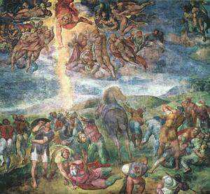
The Conversion of Saint Paul
Saint Paul encountered the risen Christ on the road to Damascus, in Syria.
He established many Christian communities in major Roman cities.
To remain in contact with these communities, he wrote letters offering advice, encouragement, and teaching.
Public domain
Notes:
Notes: Depending on time and on your knowledge of the class, it may benefit the students to ask them what they understand about someone undergoing a conversion. Tell them that the story of Saint Paul’s conversion is found in Acts, chapter 9.

Slide 7
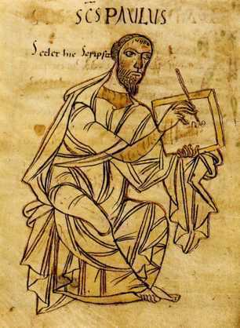
Pauline Letters
They are written to individuals and Christian communities in the Apostolic Church.
Over half of the letters are attributed to Paul or to disciples who wrote in his name.
Paul’s letters follow a specific pattern.
Public domain
Notes:
Notes: Other information to be mentioned with the information on this slide is that the letters are the oldest Christian documents we have and that they are older than the Gospels. Also, to provide the students with fuller information, tell them that the captivity letters are Ephesians, Philippians, Colossians, and Philemon. It is believed that these were written while Saint Paul was in jail. The pastoral letters are First Timothy, Second Timothy, and Titus, and are believed to have been written by him and his companions while on mission.

Slide 8
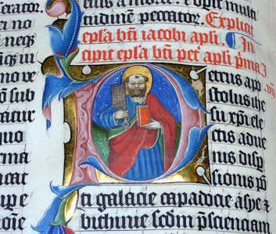
The Catholic Letters
The catholic letters are intended for a general audience or an unnamed individual.
Seven non-Pauline letters are considered part of the catholic letters.
Like Paul’s letters the non-Pauline letters offer advice, encouragement, and teaching about community life and faith in Jesus Christ.
Public domain
Notes:
Notes: Remind the students that catholic means “universal.” The seven non-Pauline letters considered part of the catholic letters are attributed to the Apostles James, Peter, Jude, and John.

Slide 9
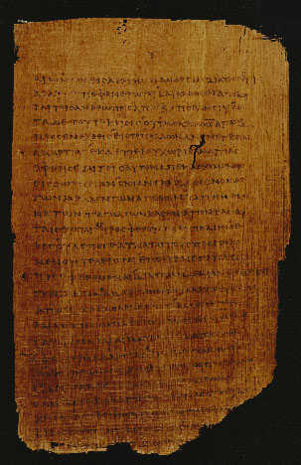
The Letter to the Hebrews
Another non-Pauline letter found in the New Testament is the Letter to the Hebrews.
The author of Hebrews supports and enlivens faith in Jesus Christ.
The Letter to the Hebrews emphasizes the divinity of Christ.
It also emphasizes the redeeming power of Christ’s Death on the cross.
http://www.cbl.ie/getfile/11fc493d-bdbb-4ee7-8a5f-80f8bc105b60/paul6.aspx
Notes:
Notes: Another thing to discuss when talking about the Letter to the Hebrews is how it speaks about the priesthood of Jesus Christ.

