Slide 1
Mystery of the Trinity:
God Is Three-in-One
Document #: TX004826

Slide 2
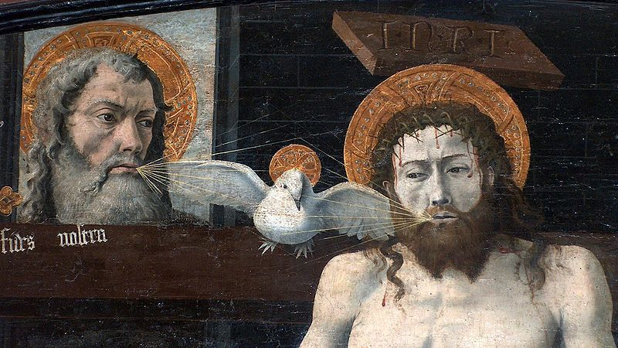
Public domain
Notes:
Ask the students to reflect on this image of the Trinity. Encourage discussion by asking some or all of the following questions:
• What do you see?
• What is going on in this picture?
• What is the symbolism in this picture?

Slide 3
Mystery of the Trinity: God Is Three-in-One
There are three Divine Persons in one God:
  God the Father
  God the Son
  God the Holy Spirit
Public domain
Notes:
The three persons of the Trinity:
share the same substance or essence
are united as one divine unity
are inseparable
share the same attributes
are distinct from one another

Slide 4
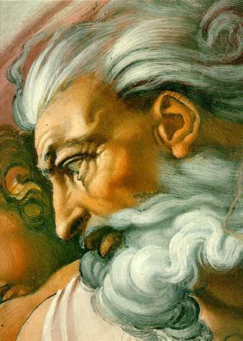
God the Father, First Person of the Trinity
Public domain
Notes:
Ask the students to reflect on the image. What does Michelangelo want the audience to know about God through this depiction? What does this image show?

Slide 5
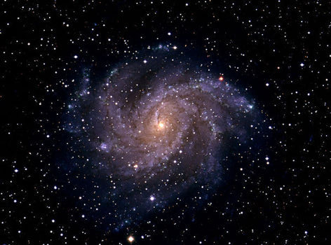
God the Father, First Person of the Trinity (cont’d.)
The Creator
“In the beginning, when God created the heavens and the earth . . . ” (Genesis 1:1).
Public domain

Slide 6
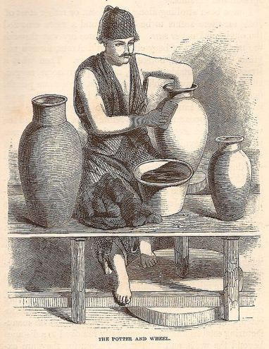
God the Father, First Person of the Trinity (cont’d.)
The Potter
Yet, Lord, you are our father;
we are the clay and you our potter:
we are all the work of your hand.
  (Isaiah 64:7)
Public domain

Slide 7
God the Father, First Person of the Trinity (cont’d.)
  [Jesus] said, “Abba, Father, all things are possible to you”
  (Mark 14:36).
Abba
This word for father comes from Aramaic.
It is a term used by children to address their fathers.
Jesus used this term to express his relationship with God.
Jesus used this term so that his followers could understand God in a new way.

Slide 8
God the Father, First Person of the Trinity (cont’d.)
God transcends gender:
Can a mother forget her infant,
be without tenderness for the child of her womb?
Even should she forget,
I will never forget you.
See, upon the palms of my hands I have engraved you;
your walls are ever before me.
(Isaiah 49:15–16)
Notes:
“God’s parental tenderness can also be expressed by the image of motherhood,¹ which emphasizes God’s immanence, the intimacy between Creator and creature. The language of faith thus draws on the human experience of parents” (Catechism of the Catholic Church, no. 239).

Slide 9
God the Father, First Person of the Trinity (cont’d.)
As an eagle incites its nestlings,
hovering over its young,
So he spread his wings, took them,
bore them upon his pinions.
(Deuteronomy 32:11)
You spread out the heavens like a tent;
setting the beams of your chambers upon the waters.
You make the clouds your chariot;
traveling on the wings of the wind.
You make the winds your messengers;
flaming fire, your ministers.
(Psalm 104:2–4)
Notes:
Read these passages aloud, and ask the students this question after each: What is God like from the perspective of this passage?

Slide 10
God the Father, First Person of the Trinity (cont’d.)
You set a table before me
in front of my enemies;
You anoint my head with oil;
my cup overflows.
(Psalm 23:5)
He said:
I love you, Lord, my strength,
Lord, my rock, my fortress, my deliverer,
My God, my rock of refuge,
my shield, my saving horn, my stronghold!
(Psalm 18:2-3)
Notes:
Read each passage aloud, and ask the students this question after each: What is God like from the perspective of this passage?

Slide 11
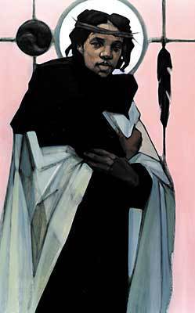
Jesus: God the Son, the
Second Person of the Trinity
Jesus was eternally begotten, incarnate.
The word consubstantial comes from the Latin words cum (“with”) and substantia (“substance”). The word describes the relationship of the Son as “one in being with” the Father.
“The Father and I are one” (John 10:30).
Jesus was born to a woman and died a human death.
http://www.bridgebuilding.com
© www.bridgebuilding.com

Slide 12
Jesus: God the Son, the
Second Person of the Trinity (cont’d.)
“I am the bread of life” (John 6:35).
“I am the light of the world” (8:12).
“I am the gate for the sheep” (10:7).
“I am the good shepherd” (10:11).
“I am the resurrection and the life” (11:25).
“I am the way and the truth and the life” (14:6).
“I am the vine, you are the branches” (15:5).
http://www.bridgebuilding.com
© www.bridgebuilding.com

Slide 13
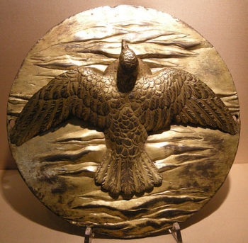
God the Holy Spirit, the Third Person of the Trinity
The Holy Spirit proceeds from the Father and the Son.
The Hebrew word ruah, meaning “wind,” may also be translated as “Spirit of God.”
In the Old Testament, the Spirit was
the creative aspect of God.
The Holy Spirit is the source of
inspiration and power.
Public domain

Slide 14
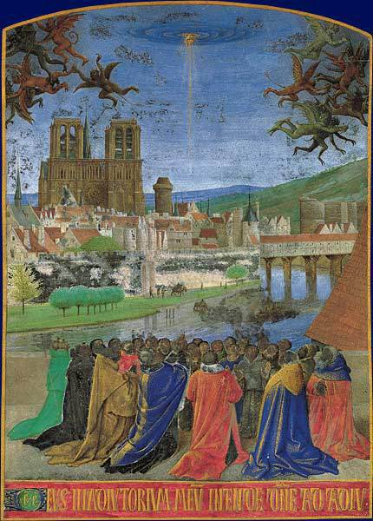
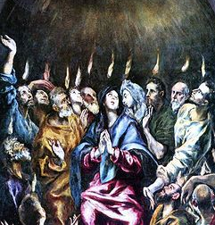
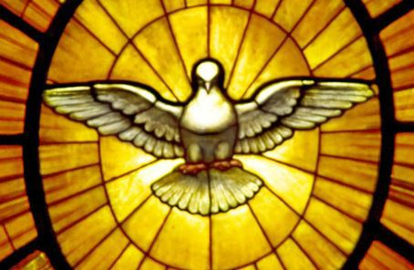
God the Holy Spirit, the Third Person of the Trinity (cont’d.)
Wind
Common images of the Holy Spirit:
Fire
Dove
Images in public domain
Notes:
Ask the students to recall Scripture passages that depict each of these images. Consider Moses and the burning bush, Pentecost, Jesus’ breathing on the Apostles as a blessing, Jesus’ Baptism, and Noah and the Flood.

Slide 15
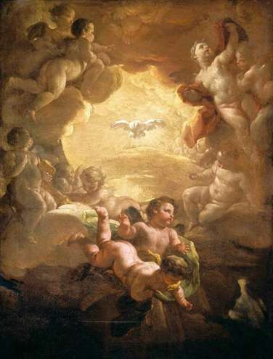
God the Holy Spirit, the Third Person of the Trinity (cont’d.)
Manifestation of the Holy Spirit can be seen through:
  the Gifts of the Holy Spirit
  the fruits of the Holy Spirit
Public domain

Slide 16
Acknowledgments
The Scripture quotations in this PowerPoint are taken from the New American Bible, revised edition © 2010, 1991, 1986, 1970 Confraternity of Christian Doctrine, Inc., Washington, DC. All Rights Reserved. No part of this work may be reproduced or transmitted in any form or by any means, electronic or mechanical, including photocopying, recording, or by any information storage and retrieval system, without permission in writing from the copyright owner.
The first excerpt on slide 8 is from the English translation of the Catechism of the Catholic Church for use in the United States of America, second edition (CCC), number 239. Copyright © 1994 by the United States Catholic Conference, Inc.—Libreria Editrice Vaticana (LEV). English translation of the Catechism of the Catholic Church: Modifications from the Editio Typica copyright © 1997 by the United States Catholic Conference, Inc.—LEV.
Endnote Cited in Quotation from the Catechism of the Catholic Church, Second Edition
1. Cf. Isaiah 66:13; Psalm 131:2.

