Slide 1
Models of Church
The Church Course
Document # TX001504

Slide 2
Five Models of the Church
What are the five models of the Church:
Institution
Mystical Body / Communion
Herald
Servant
Sacrament
Notes:
(Notes: Before you begin, you might explain that Cardinal Avery Dulles wrote about the Church and developed five (later six) models to explain the role of the Church in the world today.)

Slide 3
The Church: A Great Mystery and a Divine Gift
We can only begin to understand the Church as mystery through analogy—through models.
No matter what model—or combination of models—we choose, our models will fall short.
©Shutterstock/Rafa Irusta

Slide 4
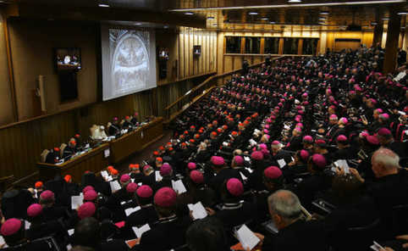
Institution
The Church is defined primarily in terms of its visible structures, especially the rights and powers of its hierarchy.
Church government is not democratic or representative, but hierarchical.
© MAX ROSSI/Reuters/Corbis
Notes:
(Notes: Emphasize that this hierarchy is based on Christ’s commissioning of the Apostles.)

Slide 5
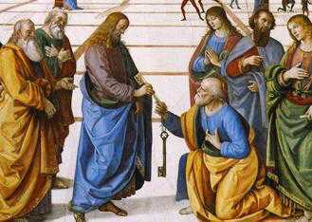
Leadership Is Hierarchical
This model maintains that the Church’s leadership structure is part of the original Deposit of Faith handed down by Christ’s disciples.
Therefore, the authority of the Church leadership is understood as God-given, and should be accepted by the faithful wholeheartedly.
Image in public domain

Slide 6
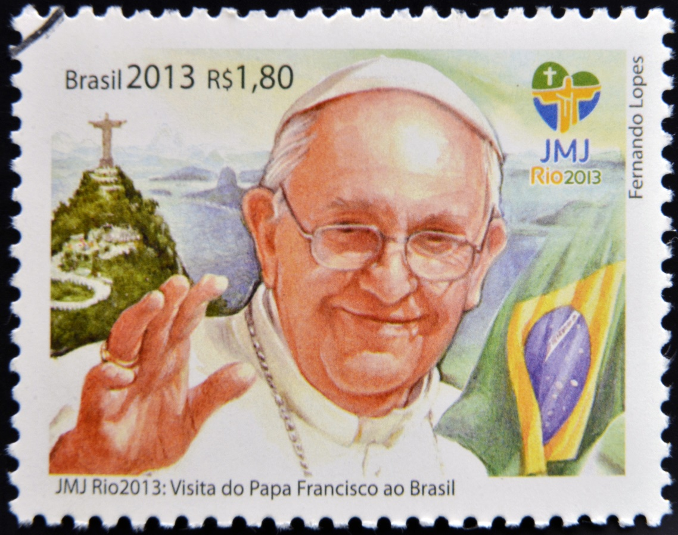
Need for Order
This model reflects a need for order, unity, and consistency of teaching.
© Neftali / Shutterstock.com

Slide 7
Institution
Members: All those who formally recognize themselves in relationship to an official Church community and Church teachings.
Signs and functions:
Popes, bishops, priests
Catechism of the Catholic Church
Canon Law
Magisterium
Diocesan directories

Slide 8
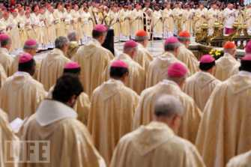
Strength in Unity
The strength of this model lies in its visible manifestation of unity.
Unlike any of the following models, all tests of membership are clearly visible.
This is the only model that must not be paramount. The institution must serve other ends besides its own preservation.
©life.com

Slide 9
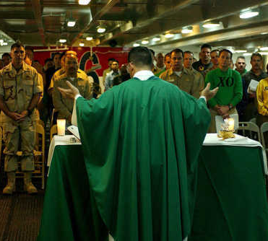
Mystical Body / Communion
The Church consists of people of faith who are united by their common participation in God’s Spirit through Christ.
It is a communion of people, expressed by external bonds of creed, worship, and ecclesiastical fellowship.
Image in public domain
Notes:
(Notes: Explain that we, as the People of God, are the Mystical Body of Christ, in communion with Christ and one another.)

Slide 10
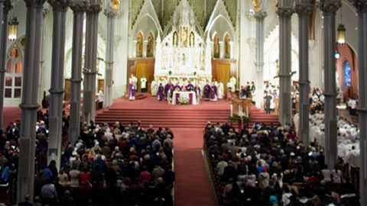
Strength through Sharing
The strength of this model lies in its emphasis on the shared life of mutual fellowship in loving community.
This model emphasizes sharing.
Bostoncatholic.org
Notes:
(Notes: Community life is vital for growth in the faith.)

Slide 11
Mystical Body / Communion
Members: All who share in the body of Christ through the grace of the Holy Spirit.
Signs and functions:
Prayer groups
Parishes
Relationships

Slide 12
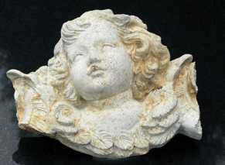
Herald
The herald model emphasizes faith and proclamation over interpersonal relations and mystical communion.
The Church is a herald—one who receives an official message with the commission to pass it on.
It is the task of the Church to proclaim.
Image in public domain

Slide 13
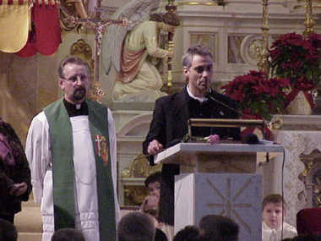
The Gospel Message
The strength of this model lies in its emphasis on the message of the Gospel.
Sometimes the spoken word eclipses the true Word of God, the Word Made Flesh.
We must not only proclaim and witness but also act.
Image in public domain

Slide 14
Witness
Members: All those who give witness to their life in Christ and see the Word of God as key.
Signs and functions:
Bible studies
Evangelization
Missions
Media

Slide 15
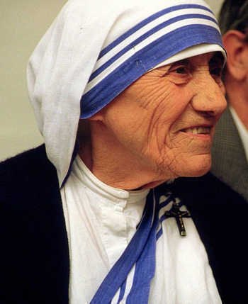
Servant
The servant model shows that the Church is part of the total human family, sharing the same concerns as the rest of mankind.
Image in public domain

Slide 16
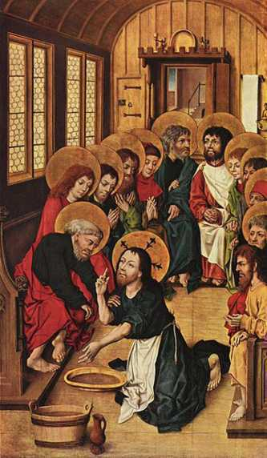
Ministry of Jesus
This model is based on the ministry of Jesus, the Suffering Servant of God, who was a man who served others.
Just as Christ came into the world not to be served but to serve, so the Church, carrying on the mission of Christ, seeks to serve the world.
Image in public domain
Notes:
(Notes: Emphasize that we can serve on an individual basis, in our families and at school, or as part of the larger service of the Church.)

Slide 17
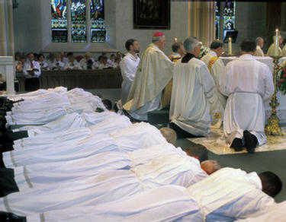
Serving Others
The strength of this model lies in its emphasis on serving others, and not simply serving the Church’s self-interests.
Authentic service includes the ministry of the Word and Sacrament.
The concept of service must keep alive the distinctive mission and identity of the Church.
© wpwittman.com
Notes:
(Notes: Interpreted in the light of the Gospel, the Kingdom of God cannot be properly identified with abstract values such as peace, justice, reconciliation, and affluence. The New Testament personalizes the Kingdom. It identifies the Kingdom of God with the Gospel, and both of them with Jesus.)

Slide 18
Serving as Christ Did
Members: All those who serve the needs of others as Christ did. “Whatever you did for one of these least brothers of mine, you did for me” (Matthew 25:40).
Signs and functions:
Hospitals
Charities
Service organizations
Religious education classes
Notes:
(Notes: Matthew, chapter 25)

Slide 19
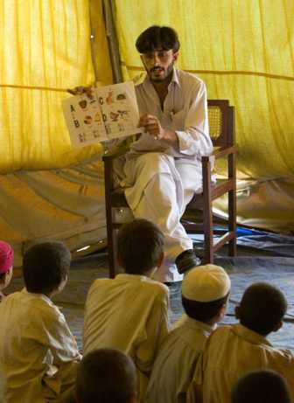
Servant
Name some of the servant groups of the Church:
Deacons and priests
Women religious
Saint Vincent de Paul Society
Campaign for Human Development
Catholic Relief Services
©crs.org
Notes:
(Notes: Have the students name some groups before you click for the bullet list.)

Slide 20
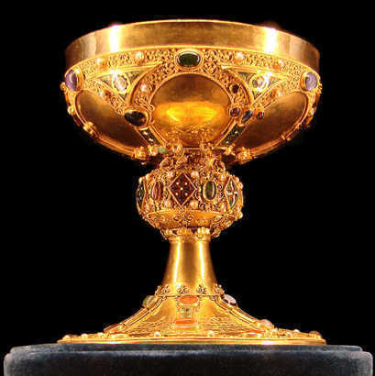
Sacrament
In this model the Church is a sacrament, a sign and transmitter of God’s grace in the world.
Image in public domain

Slide 21
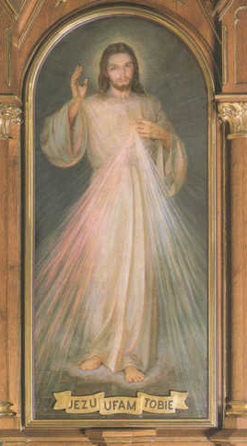
Visible Sign
A sacrament is a “visible sign of an invisible grace.”
The Church truly transmits grace—the favorable presence of God.
Image in public domain
Notes:
(Notes: Ask the students to discuss the first bullet before you click for the second bullet.)

Slide 22
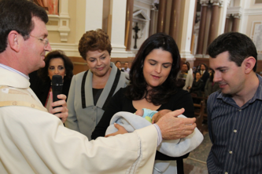
Community
Sacraments are never merely individual transactions. Nobody baptizes, absolves, or anoints themselves, and the Eucharist is not to be celebrated in solitude.
Here, the order of grace corresponds to the order of nature. Man comes into the world as a member of a family, a race, a people.
Image in public domain

Slide 23
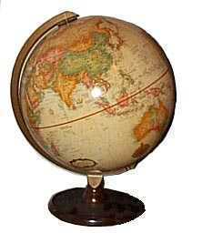
Church Is Sign and Instrument
The strength of this model is that the Church is truly a sign and an instrument of grace to its members and to the world.
Image in public domain

Slide 24
Grace
Members: All who share in the liturgical life of the Church, to be transformed by grace to be a sign of Christ in the world.
Signs and functions:
Liturgy
Light and salt for the world
Communal prayer
Source of grace

Slide 25
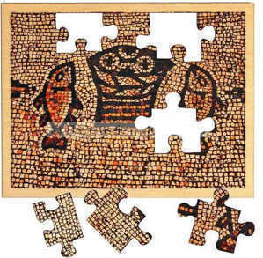
Integrating the Models
Each model of Church offers helpful insights and positive contributions to understanding the role of the Church in the world.
If the best insights are preserved from each model and integrated into one, a stronger vision of the Church is achieved.
© jerusalemgiftshop.com

Slide 26
No Model Is Complete
In the end, none of the models is sufficient to address the fullness of God’s call to the Church.
Each model truly highlights and underscores a vital aspect of the Church.
Institution
Mystical Body / Communion
Herald
Servant
Sacrament

