Slide 1
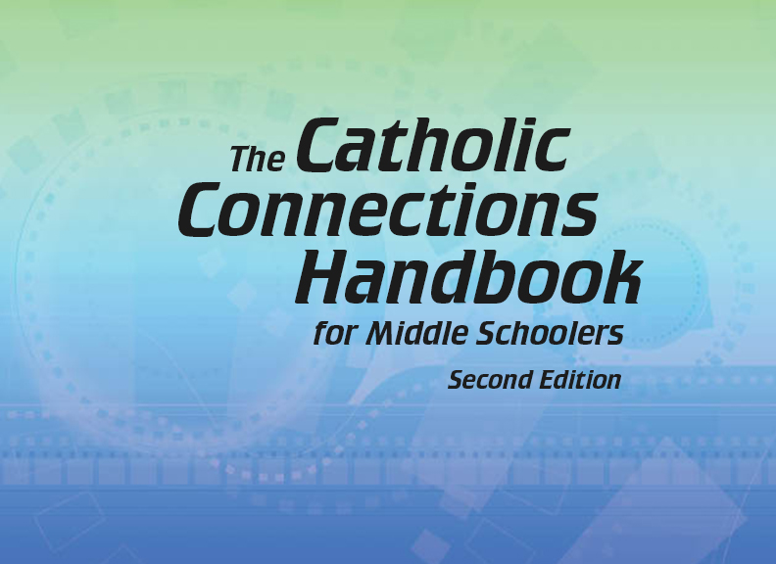


Slide 2
Christian Morality
and Social Justice
Chapter 39
Moral Decision Making

Slide 3

Chapter Summary
Moral Decision Making
In this chapter, you will consider the process of decision making. You will learn the three elements of a moral action (the object, the intention, and the circumstances) through clear examples. You will explore the relationship between free will and conscience, and you will review venial and mortal sins in the context of God’s love and forgiveness. Finally, you will see the solid ways the Church, in the teaching of the Magisterium, guides us through life.
© Sadeugra/www.istockphoto.com

Slide 4
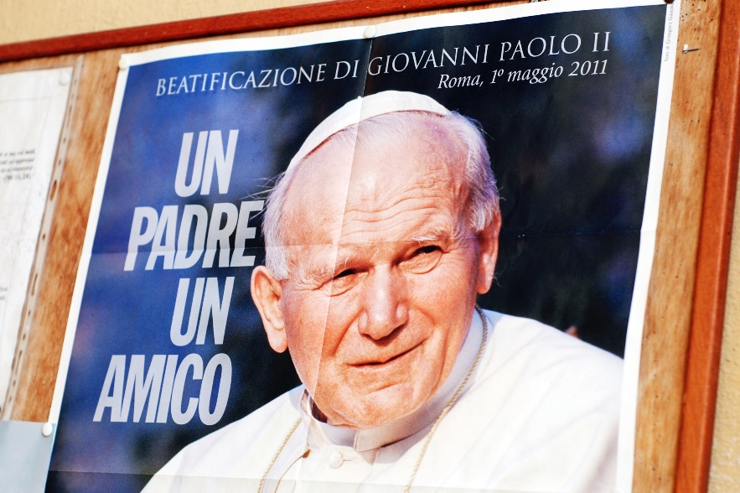
Key Points of Reference
Pope Saint John Paul II’s definition of freedom:
“Freedom consists not in doing what we like, but in having the right to do what we ought.”
“When freedom does not have a purpose, when it does not wish to know anything about the rule of law engraved in the hearts of men and women, when it does not listen to the voice of conscience, it turns against humanity and society.”
(Homily of Pope Saint John Paul II,
Saint John’s Cathedral, Hertogenbosch,
The Netherlands, May 11, 1985)
“The peace that Christ gives is to guide you in the decisions you make.” (Colossians 3:15; Handbook, page 427)
© ilbusca/www.istockphoto.com

Slide 5

Introduction and
“The Sources of Moral Actions”
(Handbook, pages 426–429)
When judging the morality of an action, we must consider the object, intention, and circumstances.
© rsiel/www.istockphoto.com

Slide 6
Introduction and
“The Sources of Moral Actions”
(Handbook, pages 426–429)
Our conscience—the God-given voice inside us—tells us what is right or wrong.
We judge a moral act in three ways:
  the object (what is actually done)
  the intention (what the person intended by doing this particular thing)
  the circumstances (whether the person was doing the action freely or was in a threatening or coercive situation)
The degree of right or wrong depends on these three sources of moral action.

Slide 7
Introduction and
“The Sources of Moral Actions”
(Handbook, pages 426–429)
Activity
Write “Moral Actions” at the top of a sheet of paper.
Write “Object,” “Intention,” and Circumstances” down the left side.
Pair up and define these terms in your own words.
Share with the class!
© CSA-Archive/www.istockphoto.com

Slide 8

“Freedom of Conscience” and “Sins Both Great and Small”
(Handbook, pages 429–431)
Freedom is the ability
to make good and right choices based on a
well-formed conscience. Sins are offenses against God.
© aydinmutlu/www.istockphoto.com

Slide 9
“Freedom of Conscience” and “Sins Both Great and Small”
(Handbook, pages 429–431)
Mortal and venial sins are offenses against God and hurt our relationship with God.
Sin is anything we say or do that goes against God’s Law.
God wants to bring us back to him through justification.
Through God’s love we are freed from sin.

Slide 10

“Freedom of Conscience” and“Sins Both Great and Small”
(Handbook, pages 429–431)
Activity: “Holy Choices”
Your teacher may select a portion of the video “Holy Choices: Good Decision Making” for you to view.
Think about these questions quietly for a few moments (or while watching the video):
  How does free will affect decision making?
  What is a holy choice?
  How can opening ourselves to God and holy choices impact our lives?
3. Discuss your responses !
© ra2studio/www.shutterstock.com

Slide 11

“Aiming for God”
(Handbook, pages 431–434)
Our relationship with God and our neighbor should be the focus of our lives.
© STILLFX/www.shutterstock.com

Slide 12
“Aiming for God”
(Handbook, pages 431–434)
God is our target, and sin is a sign that we have gone astray.
Sin is anything we say or do that goes against God’s Law. It is a failure to love.
Sin can start in small ways and become bigger.
Justification is from God. God forgives us, makes us holy, and renews our lives.
God’s love will support us throughout our lives.

Slide 13
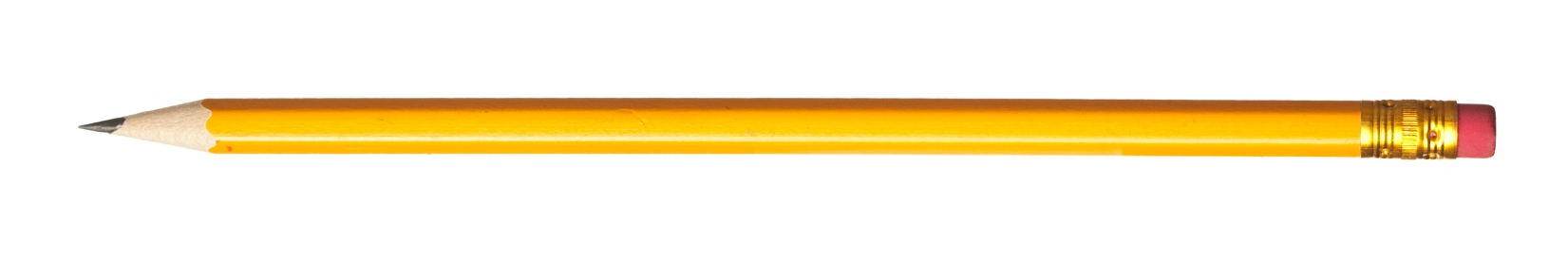
“Aiming for God”
(Handbook, pages 431–434)
Your teacher may show the video for the song “Forgiven,” by Sanctus Real.
Journal It!
© RusianDashinsky/www.istockphoto.com
Write two or more paragraphs answering the following questions:
What does forgiveness mean?
In what ways are we forgiven for our sins?
How can you work to forgive those around you?

Slide 14

“Rock-Solid Guidance”
(Handbook, pages 435–436)
The Church offers us guidelines that help us grow in our love of God and neighbor.
© Kudryashka/www.shutterstock.com

Slide 15
“Rock-Solid Guidance”
(Handbook, pages 435–436)
Making good decisions is not always easy, but God and the Church offer us support. This support comes in the form of the Ten Commandments, God’s grace, and guidelines for Church life called the “Precepts of the Church.” When we participate in the life of the Church, it is easier for us to make good decisions.

Slide 16
“Rock-Solid Guidance”
(Handbook, pages 435–436)
The teachings of Jesus continue today in the teachings of the Pope and the bishops. This is called the Magisterium of the Church. The Pope and the bishops are the official teachers of the Church. (Note that the Latin word magis means “teacher.”)

Slide 17
“Rock-Solid Guidance”
(Handbook, pages 435–436)
The official teachings of the Church, or doctrine, are based on the teachings of Jesus. The Magisterium’s explanation of doctrine is infallible; in other words, it is without error in regard to faith and morals. (The Pope can make mistakes when doing arithmetic but not when he, in union with the bishops, officially explains faith or morals.)

Slide 18
“Rock-Solid Guidance”
(Handbook, pages 435–436)
In your group . . .
Use the Bible to search for the answers to these questions:
  How did Jesus teach?
  What did he teach?
  Can you recall a favorite teaching of Jesus that helps you in your life?
2. Share with the class!
© dendiz/www.shutterstock.com

Slide 19
Acknowledgments
The scriptural references and quotations in this presentation are from the Good News Translation® (Today’s English Version, Second Edition). Copyright © 1992 by the American Bible Society. All rights reserved. Bible text from the Good News Translation (GNT) is not to be reproduced in copies or otherwise by any means except as permitted in writing by the American Bible Society, 1865 Broadway, New York, NY 10023 (www.americanbible.org).
The excerpt from Pope Saint John Paul II about freedom on slide 4 was quoted in the New York Times, May 12, 1985. It originally appeared on the Vatican website in Italian from a homily at Saint John’s Cathedral, Hertogenbosch, May 11, 1985, http://w2.vatican.va/content/francesco /it/homilies/2014/documents/papa-francesco_20141129_omelia-turchia.html. Copyright © 1985 Libreria Editrice Vaticana.
To view copyright terms and conditions for Internet materials cited here, log on to the home pages for the referenced websites.
During this presentation’s preparation, all citations, facts, figures, names, addresses, telephone numbers, Internet URLs, and other pieces of information cited within were verified for accuracy. The authors and Saint Mary’s Press staff have made every attempt to reference current and valid sources, but we cannot guarantee the content of any source, and we are not responsible for any changes that may have occurred since our verification. If you find an error in, or have a question or concern about, any of the information or sources listed within, please contact Saint Mary’s Press.

