Slide 1



Slide 2
Christian Morality
and Social Justice
Chapter 37
The Bible: Old Law and the New Law

Slide 3
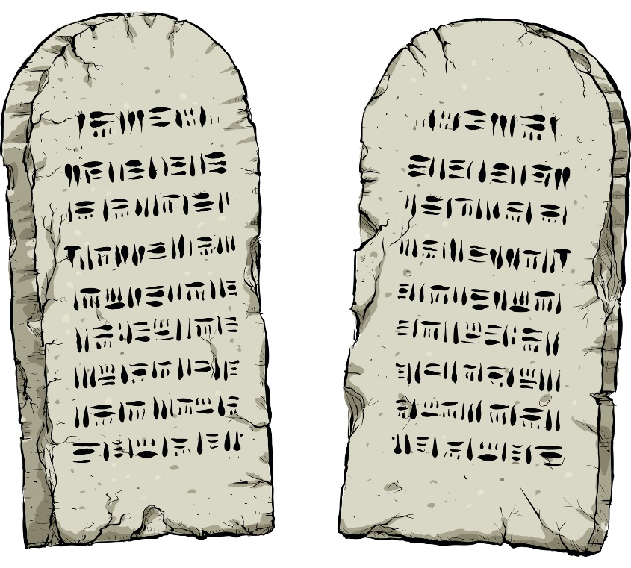
Chapter Summary
The Bible: The Old Law and the New Law
In this chapter, you will consider what the Old Law and the New Law mean to you. The Ten Commandments are the Old or Original Law. The New Law, the Law of Love, was added to increase our understanding of how to live our lives based on love of God and neighbor. This chapter provides a better understanding of how the Old and the New Law, both given by God, form the moral compass for Christian life.
© blamb/www.istockphoto.com

Slide 4

Introduction and “The Old Law”
(Handbook, pages 406–409)
God revealed the Old Law, the Ten Commandments, to give the Chosen People guidelines on how to live in right relationship with God and one another.
© dryp/www.istockphoto.com

Slide 5
Introduction and “The Old Law”
(Handbook, pages 406–409)
The Ten Commandments summarize the Old Law.
God gave us the Ten Commandments to teach us how to life in right relationship with him and with one another.
The Ten Commandments teach us important moral principles and values to guide our life.

Slide 6

Introduction and “The Old Law”
(Handbook, pages 406–409)
Activity: “Create a Moral Compass”
The Ten Commandments are like a moral compass that will always lead us in the spiritual direction we want to go: to be in a good and loving relationship with God and others.
What are the top four “moral compass” points for your life? Write and illustrate them on your compass.
© RapidEye/www.istockphoto.com

Slide 7

“The New Law”
(Handbook, pages 409–412)
Jesus revealed the New Law, the Law of Love, with the help of the Holy Spirit, as a completion and fulfillment of the Old Law.
© TangYanSong/www.shutterstock.com

Slide 8

“The New Law”
(Handbook, pages 409–412)
The New Law, the Law of Love, fulfills and completes the Old Law.
Jesus gives us the Beatitudes to teach compassion and love.
Jesus’ New Law teaches
us that we must love all people, even those who mistreat us.
© Travellinglight/www.istockphoto.com

Slide 9

“The New Law”
(Handbook, pages 409–412)
Activity: “Beatitudes Attitudes”
In groups of two or three . . .
Write capital letters spelling BEATITUDES down the left side of a sheet of paper.
Come up with two- to three-word phrases summarizing “Beatitudes attitudes,” each phrase beginning with a letter on the left side of the page.
© KreativKolors/www.shutterstock.com

Slide 10
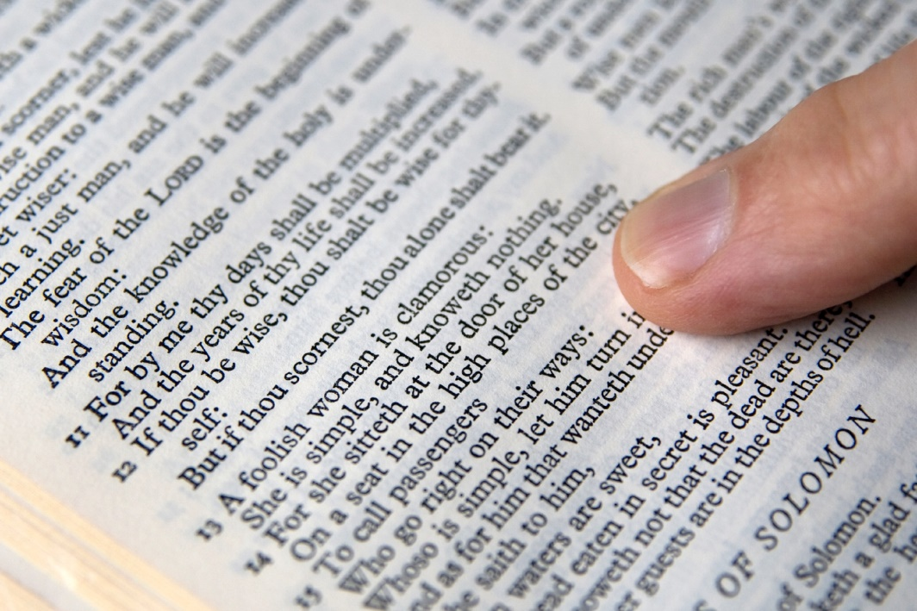
“Practical Moral Advice”
(Handbook, pages 412–414)
The Bible offers advice and guidelines for making good moral choices.
© whitemay/www.istockphoto.com

Slide 11
“Practical Moral Advice”
(Handbook, pages 412–414)
The Bible gives us guidelines for making good moral choices.
The Book of Proverbs offers practical examples for us to follow.
Many letters in the New Testament—for example, Saint Paul’s Letter to the Ephesians—help us understand the New Law of Love and find ways to live it out.

Slide 12

“Practical Moral Advice”
(Handbook, pages 412–414)
Journal It!
© RuslanDashinsky/www.istockphoto.com
Write one paragraph that answers this question:
How can you let God’s Word in Scripture be the compass guiding you to a happy and holy life?

Slide 13

“The Bible:
The Old Law and the New Law”
(Handbook, pages 406–415)
Review what you have learned in chapter 37.
(See next slide.)
© petekarici/www.istockphoto.com

