Slide 1
Jesus’ Death
The Catholic Faith Handbook for Youth, Third Edition
Chapter 10
Document #: TX003141
Notes:
Use this presentation to introduce or review the key points in chapter 10 of the student handbook.

Slide 2
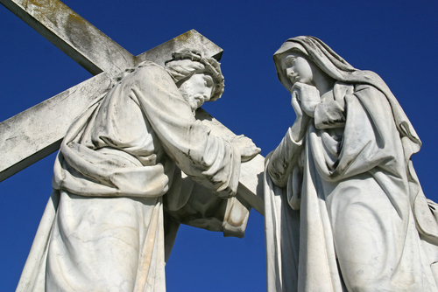
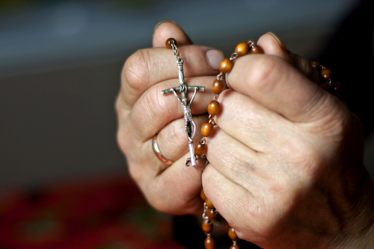
Jesus’ Death and Catholic Life
Crucifixes
© clearimages / www.shutterstock.com
Stations of the Cross
Rosary
© Zvonimir Atletic / www.shutterstock.com
© udra / www.shutterstock.com
Notes:
Ask the students about their experience of these items and practices, making sure that everyone knows what they are. Invite them to share how each recalls the Passion and death of Jesus. Ask students if the experiences they’ve mentioned have contributed to their understanding or to their faith life.

Slide 3
© Stephen Mcsweeny / www.shutterstock.com
Notes:
Ask the students what Catholics do on Good Friday. Remind them that we venerate the cross on Good Friday. You may wish to share your own experience of this practice and the place it has in your faith life.

Slide 4
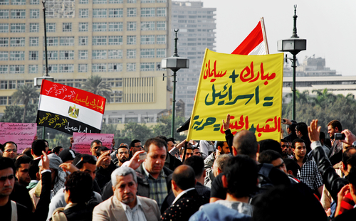
The Death of Jesus
The religious and political authorities of his day saw Jesus as a threat.
© Mohamed Elsayyed / www.shutterstock.com
He challenged Jewish leaders’ authority, teachings, beliefs, and practices.
He was likely seen as a potential leader of a rebellion against the Romans.
Notes:
Explain that throughout history people have resented oppressive regimes and have wanted to rise up against them. Use a current world situation to illustrate how oppressive governments, which may be related to religious powers, may come down hard on threats. You may wish to include more detail in your presentation about the reasons for Jesus’ death. If so, review with the students the material on pages 105–107 in the student handbook.

Slide 5
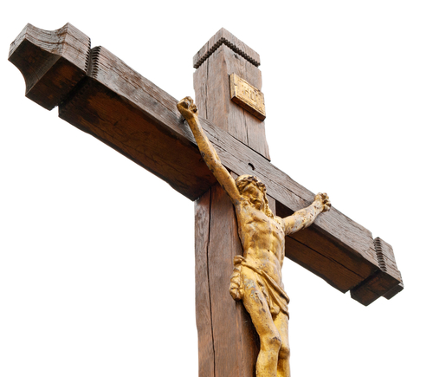
Jesus’ Death Is the Real Thing
Jesus experienced doubt, pain, and fear.
Jesus was fully human and not spared from human feelings because of his divine nature.
His execution was especially brutal:
scourged
carried the cross
stripped his clothes
crucified
© Galushko Sergey / www.shutterstock.com
Notes:
Explain that Jesus knew he would face death when he entered Jerusalem because he understood he would be seen as a threat. Ask the students what personal qualities Jesus must have had. (Courage, commitment, and obedience to God’s will)

Slide 6
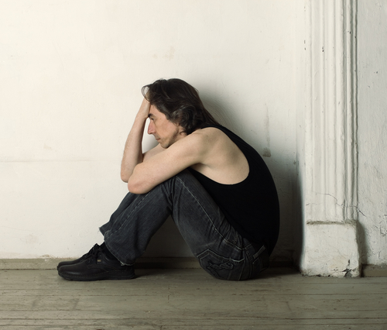
Jesus Challenged Some Beliefs
Jesus taught that God does not reject sinners, if they repent.
He taught that God calls everyone, not only Jews, to his Kingdom.
He taught that the Messiah will rule a Kingdom, but not an earthly one.
© Refat / www.shutterstock.com
Notes:
Explain that Jesus built on Scripture and religious laws, but makes their true meaning clear to his followers.

Slide 7
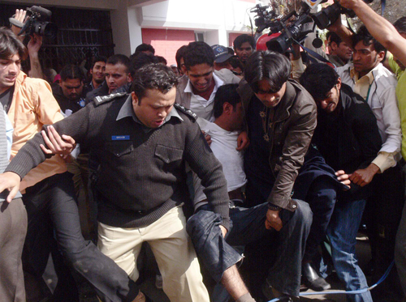
Jesus, the Suffering Servant
“Suffering Servant” passages in Isaiah
Figure who suffers to save others
Jesus: the innocent who suffers on our behalf
© Asianet-Pakistan / www.shutterstock.com
Notes:
Ask the students to give examples of people who make sacrifices, or risk suffering, on behalf of others. Ask them what these people have in common with Jesus, and ask them how Jesus’ sacrifice was unique.

Slide 8
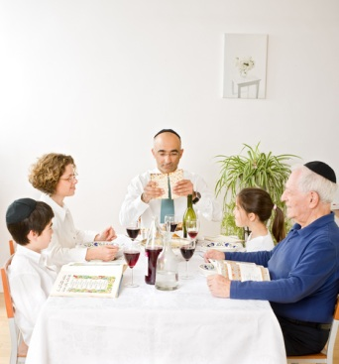
Jesus, the Paschal Lamb
Exodus: The Passover Story
Blood of a lamb on the doorposts
Jesus: the sacrifice, the Lamb of God, that saves us from death
© Noam Armonn / www.shutterstock.com
Notes:
Review the Passover story, if necessary. The student handbook provides a brief summary on page 110.

Slide 9
Jesus, the Ransom for Many
Ransom was the price paid for freeing slaves
Indicated that the slave could no longer be owned by another person
Jesus: the one who freed us from our slavery so we are no longer “owned” by sin and death
© rook76 / www.shutterstock.com
Notes:
Ask the students to picture themselves behind bars. Direct them to imagine a loved one, perhaps a parent or sibling, bringing bond money so the student can be released. Tell them to picture themselves walking away arm in arm with the person who paid the bail. Ask the students to analyze this metaphor. Which points correspond with Christ’s saving action, and which points don’t correlate?

Slide 10
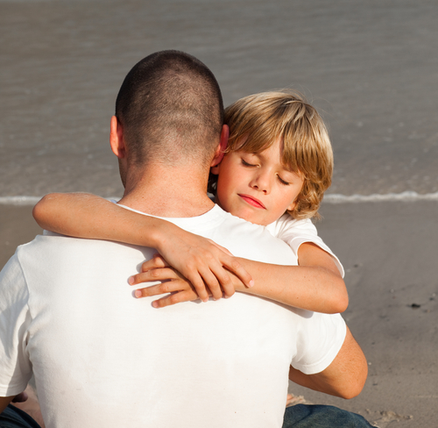
Jesus Died for Us
This is the ultimate sign of God’s love for us.
Through his sacrificial death, Christ saves us and gives us the grace to be reconciled with God.
The cross has been transformed into the symbol of freedom and life.
© wavebreakmedia / www.shutterstock.com
Notes:
Remind the students that it was God himself who took on flesh so that he could die for us.

Slide 11
“For while we were still weak, at the right time Christ died for the ungodly. Indeed, rarely will anyone die for a righteous person—though perhaps for a good person someone might actually dare to die. But God proves his love for us in that while we were still sinners Christ died for us” (Romans 5:6–8).
© Stephen Mcsweeny / www.shutterstock.com
Notes:
Read the quotation on the slide aloud. Ask the students to reflect quietly on whether they could ever picture themselves risking their life for a loved one—or for a stranger. Direct the students’ attention to the last line, and remind them that this means Christ died for each of us. Ask them to picture a criminal who has committed the worst kind of crime they can imagine. Assure the students that Jesus died for that person too. Lead a discussion about how the criminal they pictured should respond to Jesus’ sacrificial death. Ask, “How should we respond?”

