Slide 1
The Early Leaders of Israel
Document #: TX004705

Slide 2
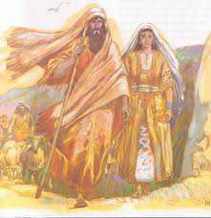
Abraham
Despite humanity’s sin, God chose to stay in relationship with humanity and chose a group of people to call his own, namely the Hebrew people. They would later be called the Israelites.
God called Abram (later renamed Abraham). Abram and his wife, Sarai, were Semitic nomads wandering the highlands of the Near East.
© houseandhome.org
Notes:
Notes: Ask a student to read aloud Genesis 12:1–8. Next, have students respond to the question, “What exactly does God promise to Abram?”

Slide 3
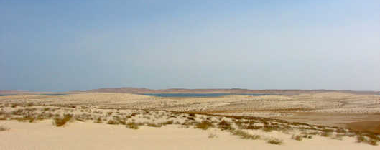
Abraham
Abram takes Sarai, his nephew Lot, and all of their possessions and leaves for Canaan, not knowing where God is leading them.
How would you describe this decision?
Public Domain

Slide 4
Abraham
Sarai and Abram find their faith tested and strengthened.
How does the pregnancy of Hagar and the birth of Ishmael show that Sarai and Abram’s faith had been tested?
Public Domain

Slide 5
Abraham
When Abram is ninety-nine years old, God again speaks with him and establishes his Covenant with Abram and his descendants.
Sarai becomes known as Sarah, and Abram becomes known as Abraham. Sarah bears Abraham a son, named Isaac.
Through Abraham God chooses to make his Covenant, through which he forms his people. Through this Covenant God later reveals his Law to his people through Moses.
Notes:
Notes: Ask a student to read aloud Genesis 17:3–8. You may wish to review the definition of covenant as a solemn agreement between human beings or between God and a human being in which mutual commitments are recognized.

Slide 6
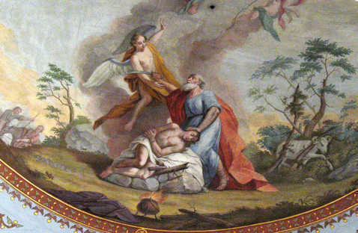
Abraham
God’s command that Abraham sacrifice his only son, Isaac, tests Abraham’s faith.
Because of his faithfulness and complete trust in God, Abraham and Sarah are blessed with countless descendants.
Public Domain
Notes:
Notes: Have a student read aloud Genesis 22:1–19.

Slide 7
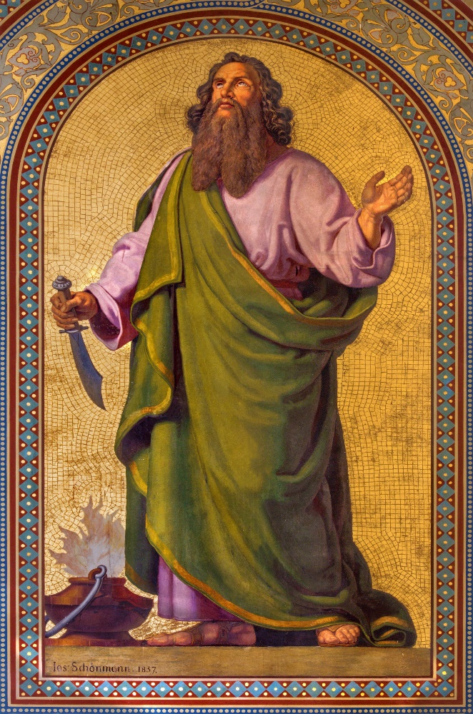
Patriarchs and Holy Women
A patriarch is the father and spiritual leader of a tribe, clan, or tradition. Abraham, Isaac, and Jacob were the patriarchs of the Israelite people.
Matriarchs are sometimes called holy women. A matriarch is the original mother of a group, who would form a “house.” The term often refers to the wives of the patriarchs because they, as well as their spouses, contributed to the building of the nation of Israel.
© Renata Sedmakova / Shutterstock.com

Slide 8
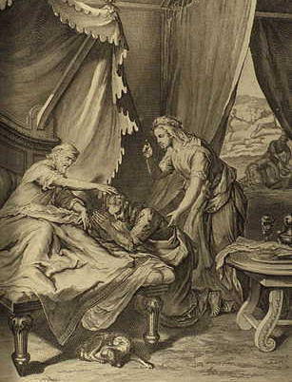
Isaac and Jacob
Isaac was the son of Abraham and Sarah.
Abraham’s servants found Isaac a wife, Rebekah, from among Abraham’s people.
Isaac and Rebekah had twin sons, Jacob and Esau. Esau was born first, but Jacob ended up getting his brother’s birthright and their father’s blessing.
Through a dream, God renewed his Covenant with Jacob.
Public Domain
Notes:
Notes: Have students read aloud Genesis 25:19–34, Genesis 27:1–45, and Genesis 28:10–22.

Slide 9
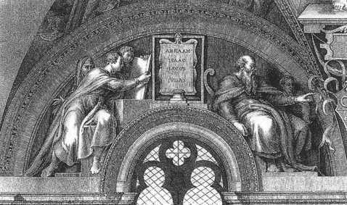
Qualities of the Patriarchs
They obeyed God.
They knew God wanted his people to treat all people with justice.
They lived good, moral lives.
They understood that God wanted his people to come back to him with their whole selves.
Public Domain
Notes:
Notes:
They obeyed God: In the Old Testament, the Hebrew word for obedience meant primarily “listening” or “hearing.” An obedient person heard God’s Word and followed it (see Exodus 15:26). To be obedient was simply to align oneself with God’s will.
They knew God wanted his people to treat all people with justice: They understood the need for and purpose of divine justice. The Hebrew and Greek words translated as “justice” are also translated as “righteousness” and “judgment.” Divine justice calls for the fair and equitable distribution of life’s necessities. The scriptural idea of justice is based on the truth that all humans have dignity and worth and are children of God. God’s love for all creation is shown in his emphasis on justice, which is love in action.
They lived good, moral lives: They committed themselves to ethical responsibility. The commandments of God are the fundamental rules of conduct for the Chosen People. The Ten Commandments are about love of God and love of neighbor.
They understood that God wanted his people to come back to him with their whole selves: The patriarchs needed to be able to ask the Jews and Israelites to return to the Covenant in body, mind, and spirit. At this time the Abrahamic and Mosaic Covenants had been entered into, and long adhered to, by the people. Therefore God no longer looked only for sacrifice to appease him. He sought more. Specifically, God was interested in a full return to the Covenant by his people in body, mind, and spirit. Yet the Israelites were unsure of how to accomplish this goal. The leaders God chose were men and women who committed themselves to a relationship with God and to being his voice. They spoke on God’s behalf to the people.

