Slide 1


Document #: TX005819

Slide 2
Liturgy
and Sacraments
Chapter 32
The Eucharist: Communion and Sending Forth

Slide 3

Chapter Summary
We will look at the Eucharist with a consideration of the Communion Rite and the Sending Forth. Special emphasis is given to the Eucharistic call to be the Body of Christ in and for the world.
© Angela Waye / Shutterstock.com

Slide 4
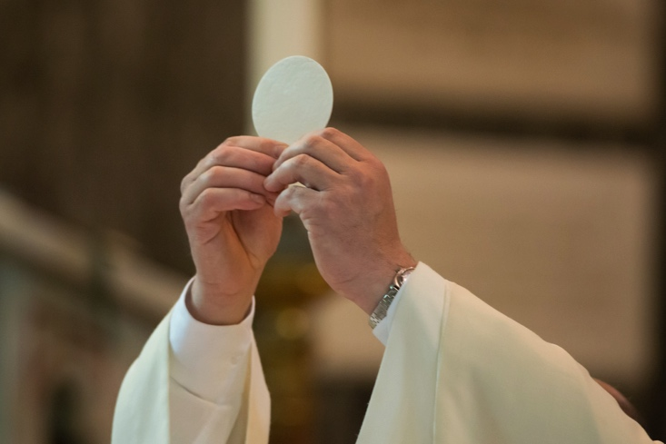
Introduction and “Our Family Prayer” (Handbook, pages 340–343)
The Communion Rite is the culmination of the Sacrament of the Eucharist, when we are united with and as the Body of Christ.
© FabioLotti/Shutterstock.com

Slide 5
“A Sign of Peace” and “Jesus, the Paschal Lamb”
(Handbook, pages 343–345)
The Sign of Peace and Lamb of God litany are moments of unity and peace as we come together for the breaking of the bread.
© Johavel/Shutterstock.com

Slide 6
Search It!
Look up the word litany in a dictionary or online. Write down the definition in your notebook. Then write your own litany of things for which you are grateful.
© iDesign/Shutterstock.com

Slide 7
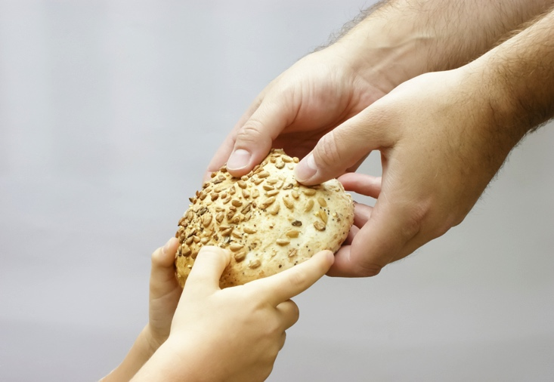
“Communion: Becoming One Body”
(Handbook, pages 345–347)
As we receive the Body of Christ during Communion, we become the Body of Christ. We become one with Christ, his people, and his mission.
© EwaPix/Shutterstock.com

Slide 8

Journal It!
What is meant when people talk about diversity? Why is diversity important?
© Andrey Popov / Shutterstock.com

Slide 9
“Sent to Announce the Gospel”
(Handbook, pages 348–350)
Communion is followed by a sending forth, in which we are called to continue the work of Christ in the world.
© AnnaYefimenko/Shutterstock.com

Slide 10

Share It!
Share your answer to the following questions, with the person sitting next to you:
If you were giving away money, how do you think people would react?
How would people react if you were giving away compassion, forgiveness, hope, joy, or love?
© Imagentle/Shutterstock.com

