Slide 1
Chapter 5: Jainism
World Religions: A Voyage of Discovery
DOC ID #: TX003942

Slide 2
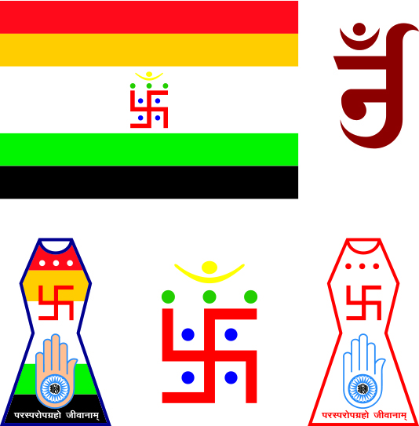
Jain Symbols
Each of the five colors of the flag signifies a specific category of spiritual status.
The swastika signifies the four realms:
hells
animal realm
human realm
heavens
The hand represents ahimsa.
© Ajay Shrivastava / www.shutterstock.com
Notes:
Notes: The Jain flag and so-called Jain emblem are ancient features of the tradition. They are so symbolically rich and variegated in significance that an entire class session or more could be devoted to delving into the details. The swastika, of course, has a very complex history; it is worth pointing out that for millennia before it was appropriated by the Nazis, it was revered by various traditions in India. The outline of the Jain emblem represents the loka, or universe. The loka, as explained in the student book’s chapter on Jainism, is itself symbolic of the realms of rebirth and of the ultimate goal of kevala, the state of enlightenment in which the soul, liberated from karma, bubbles up to the loka’s umbrella-shaped top.

Slide 3
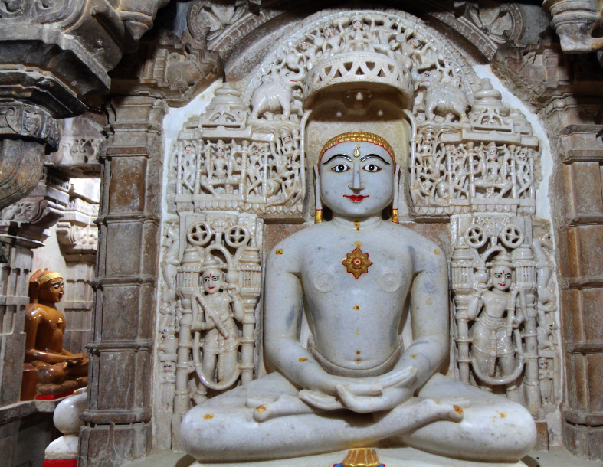
Rishabha
Rishabha is also known as Adinath, which means “First Lord.”
Rishabha is revered as the first of the twenty-four tirthankaras.
Some temples contain images of all twenty-four tirthankaras.
© TerryJLawrence / www.istockphoto.com
Notes:
Notes: The marble statue shown on this slide is located in a temple dedicated to Sambhavnath, the third tirthankara of the current world cycle. Veneration of more than one tirthankara at any given Jain temple is common. The temple is one of several located in the fort complex of Jaisalmer, the “Golden City” located in western Rajasthan. Two other significant temples are dedicated to Shantinath and to Parshva (featured in the next slide), the sixteenth and twenty-third tirthankaras, respectively.

Slide 4
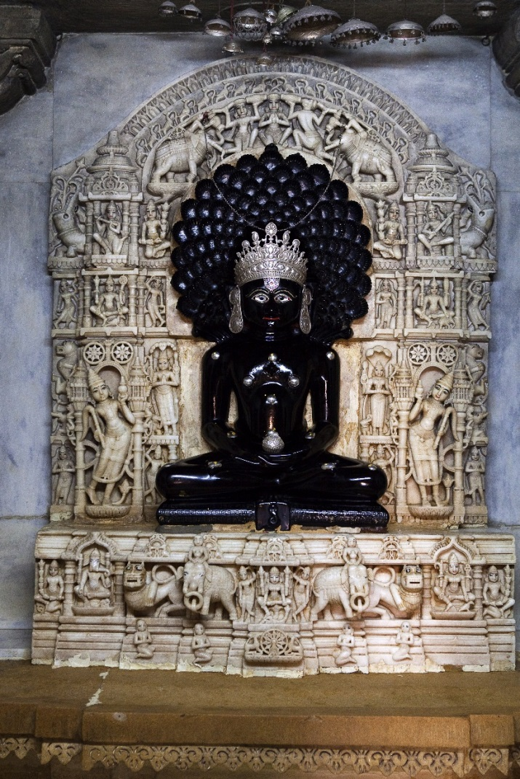
Parshva
Parshva is the twenty-third tirthankara.
Parshva attained kevala 250 years before Mahavira did.
Parshva probably established some aspects of Jainism as we know it today.
© ostill / www.shutterstock.com
Notes:
Notes: Although the dating of Parshva’s enlightenment at 250 years prior to that of Mahavira is traditional and not verifiable, most scholars agree that Parshva was a historical figure and that Mahavira himself was not responsible for founding the religion. The sculpture shown on this slide is located in the Temple of Lodhruva (also spelled Lodawra, Lodurva, or Lodarva), some nine miles outside of Jaisalmer.

Slide 5
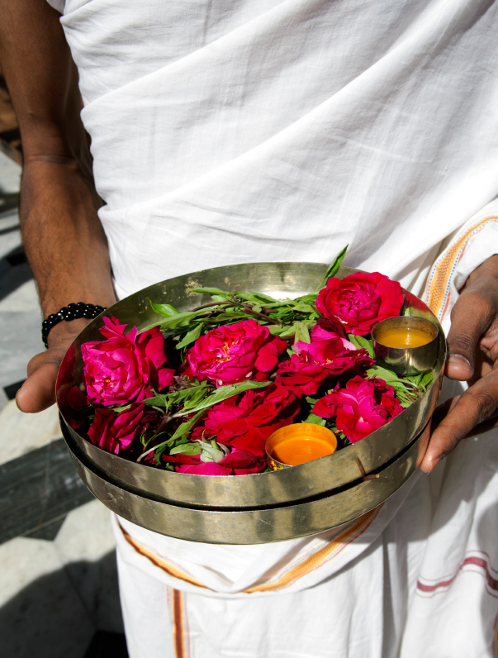
A Jain Pilgrim
The temple complex of Shatrunjaya is a sacred site.
Jains place flowers on the sculptures of those they revere.
© eranyardeni / www.istockphoto.com
Notes:
Notes: Shatrunjaya is depicted on slide 8; slide 11 depicts Jains placing flowers on Bahubali. The white garment is typical dress for pilgrims, as for monks and nuns.

Slide 6
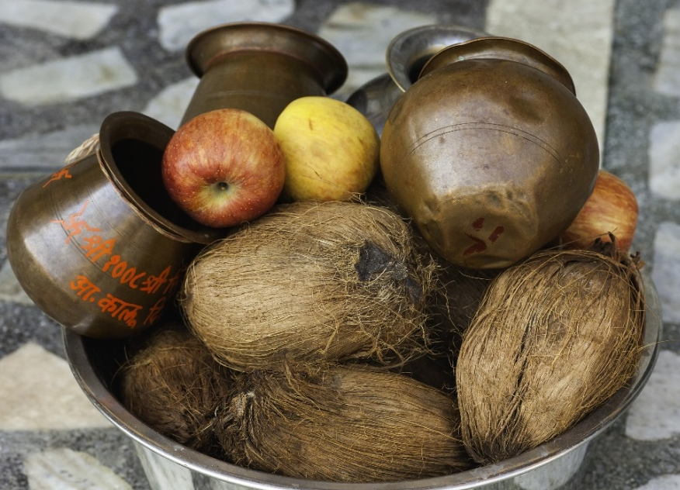
Offering of Fruit and Coconuts
Jains are strictly vegetarian.
Jainism prohibits eating fruits with a large number of seeds.
Vegetarianism is a pronounced signifier of Jain identity.
© Daniel J. Rao / www.shutterstock.com
Notes:
Notes: The offering shown on this slide is being made during the Chaturmas festival, at the Ajmer Jain Temple, Ajmer, Rajasthan; the temple is especially important for Digambara Jains. Given that Jains are strictly vegetarian, it is natural that food offerings would consist of such items as these. The student book section “Vegetarianism: A Jain Ideal” offers an example of the type of perspective readily accessible at websites of student organizations.

Slide 7
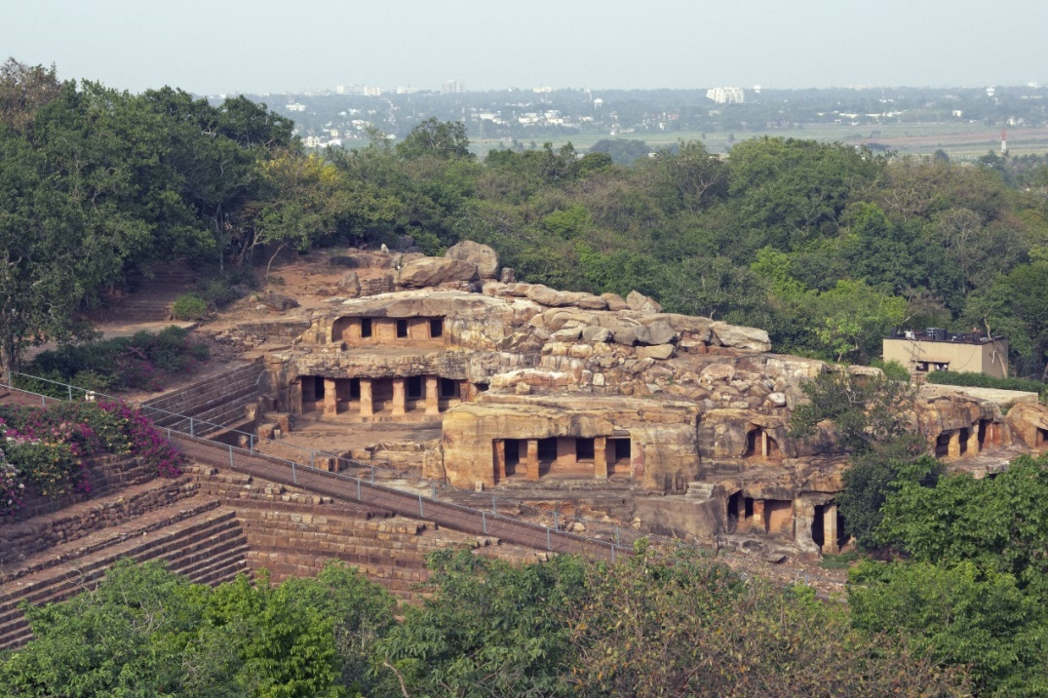
Ancient Cave Temples
There are eighteen caves on the hill of Udayagiri in eastern India.
The temples likely were created partly from natural caves.
The caves provided living accommodations for Jain ascetics.
© JeremyRichards / www.shutterstock.com
Notes:
Notes: The cave temples are located outside of Bhubaneswar, in the state of Odisha. Another nearby hill, Khandagiri, also has caves. They are believed to have been created during the reign of Kharavela in the second century BC. Some of the caves are especially renowned for their ornate carvings, the presence of Jain sculptures, and historically important inscriptions.

Slide 8
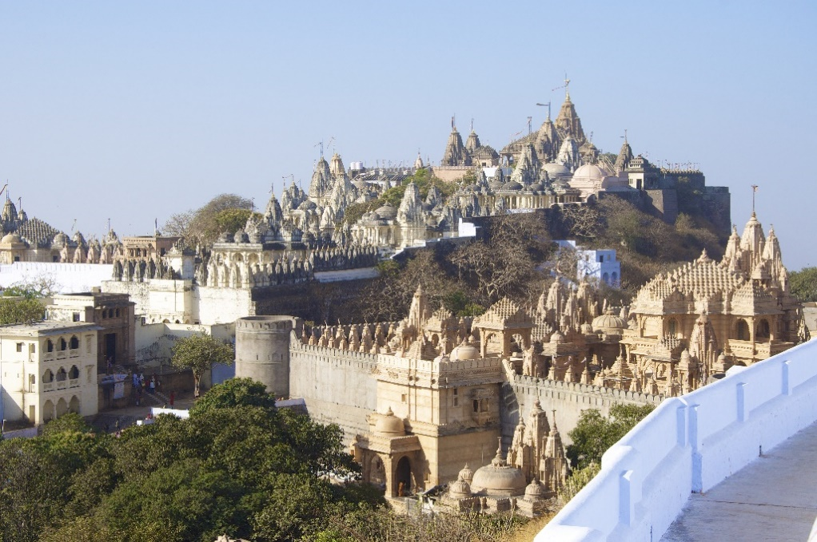
Mount Shatrunjaya
Mount Shatrunjaya is located in the state of Gujarat, India.
The site features 863 temples, some large and some small.
Shatrunjaya means “which conquers enemies.”
© Malcolm Chapman / www.shutterstock.com
Notes:
Notes: Located near the town of Palitana, Mount Shatrunjaya has for centuries been a popular destination for pilgrims, including monks and nuns. The literal meaning of the name naturally befits a Jain sacred site, dedicated to the veneration of the jinas (“conquerors”). The climb up a 2.2-mile series of stairways is fairly rigorous. Some pilgrims with sufficient means hire the use of a doli, a palanquin or litter carried by several men.

Slide 9
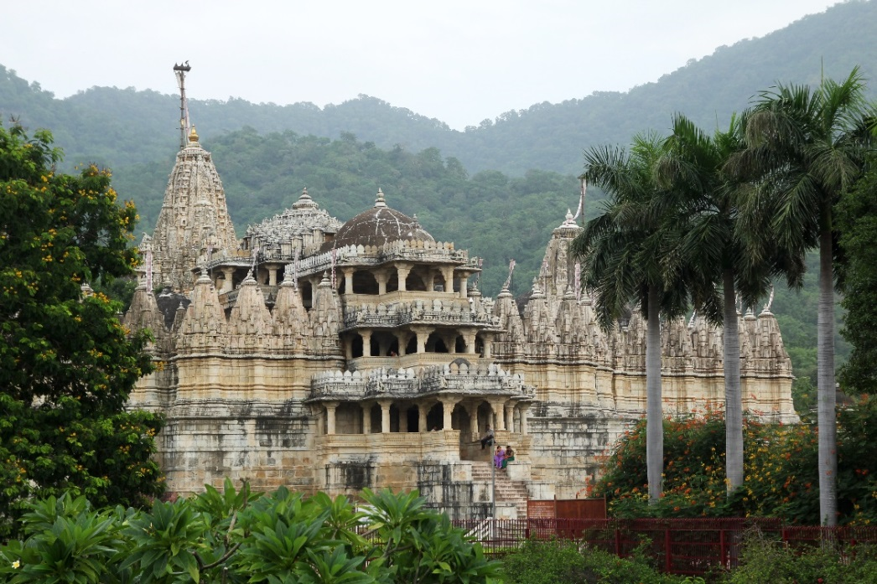
Adinatha Temple (exterior)
The Adinatha Temple was constructed in 1441.
It is one of the most beautiful and architecturally complex of Jain temples.
The temple has four entrances, one for each of the cardinal directions.
© Pinkcandy / www.shutterstock.com
Notes:
Notes: The Adinatha Temple is located in Ranakpur, in the western state of Rajasthan. (The following slide features interior marble carvings in this temple.) It is also known as the Dharna Vihar and as Chaumukha Mandir (“Four-Faced Temple”). The design symbolizes the cosmos. The four entrances each lead to the central chamber, which contains a four-faced image.

Slide 10
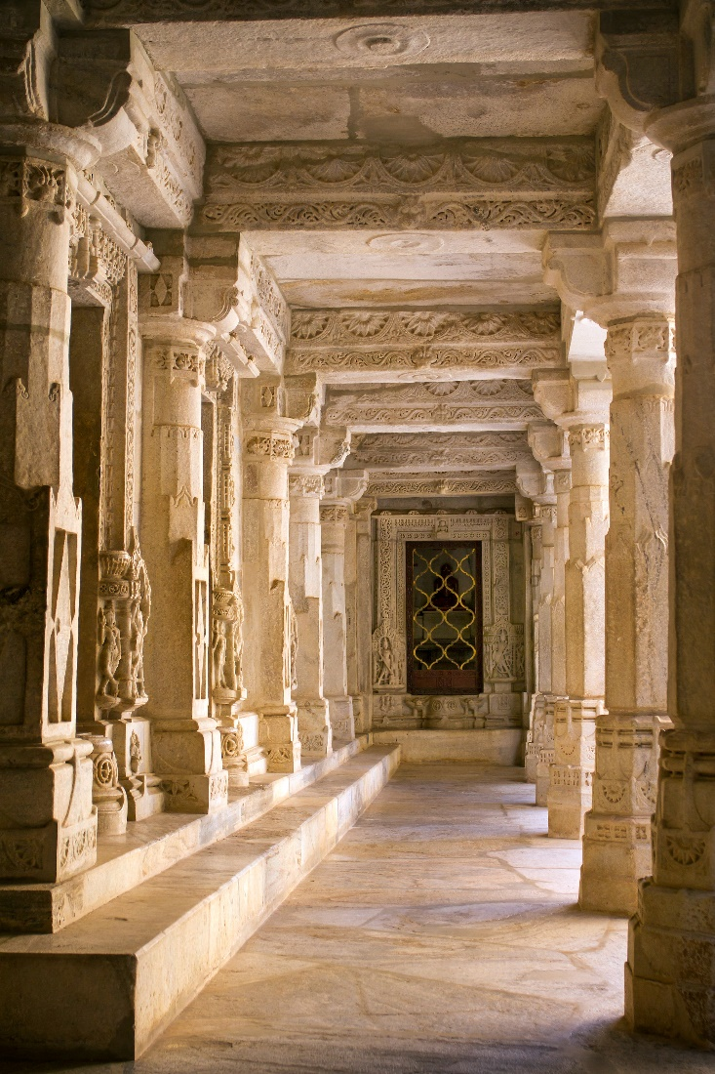
Adinatha Temple (interior)
The Adinatha Temple has more than fourteen hundred columns.
Jain temples are among India’s most impressive works of architecture and art.
© Mazzzur / www.shutterstock.com
Notes:
Notes: Ranakpur is located in southern Rajasthan. The Adinatha Temple is its greatest attraction. The special relevance of Rajasthan for Jain history is evident in the number of references to the city in these slides. Mount Abu, also located in Rajasthan, is home to the extraordinary Dilwara temples, one of which also is dedicated to Adinatha (Rishabha).

Slide 11
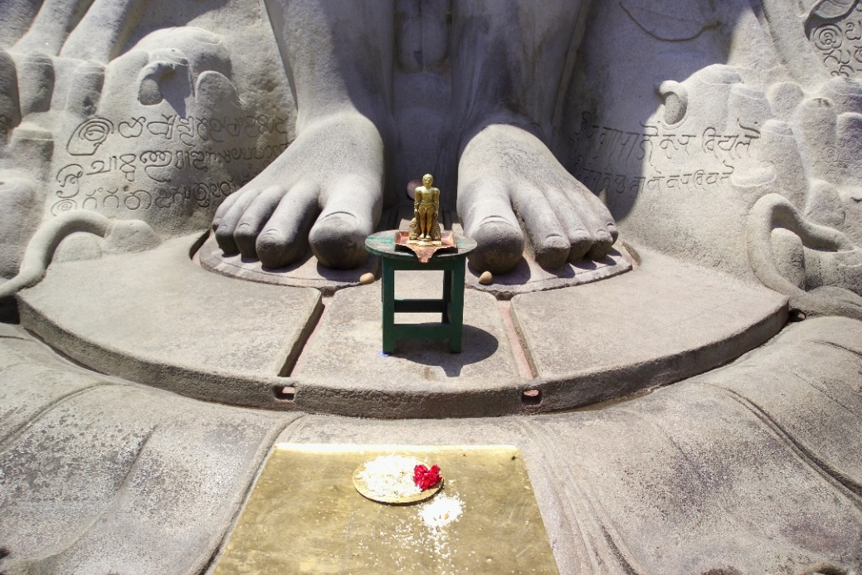
Feet of Bahubali
Bahubali was a son of Rishabha, the first of the twenty-four tirthankaras.
Bahubali’s half-brother Bharata became a great king.
Bahubali chose the spiritual path and attained kevala.
This statue stands about 60 feet high.
© SnowWhiteimages / www.shutterstock.com
Notes:
Notes: The statue shown on this slide is located at Shravanabelagona, in the southwestern state of Karnakata. It was dedicated by a victorious general in AD 981. Listed among the Seven Wonders of India, the statue has been a popular destination of Jain pilgrims through the centuries. Bahubali, also known as Gomateshvara, is believed to have been the second of one hundred sons of Rishabha, or Adinatha (Rishabha is featured on slide 3). Bahubali’s brother Bharata is the Mahabharata (“great Bharata”) who gave his name to the Indian epic poem.

