Slide 1
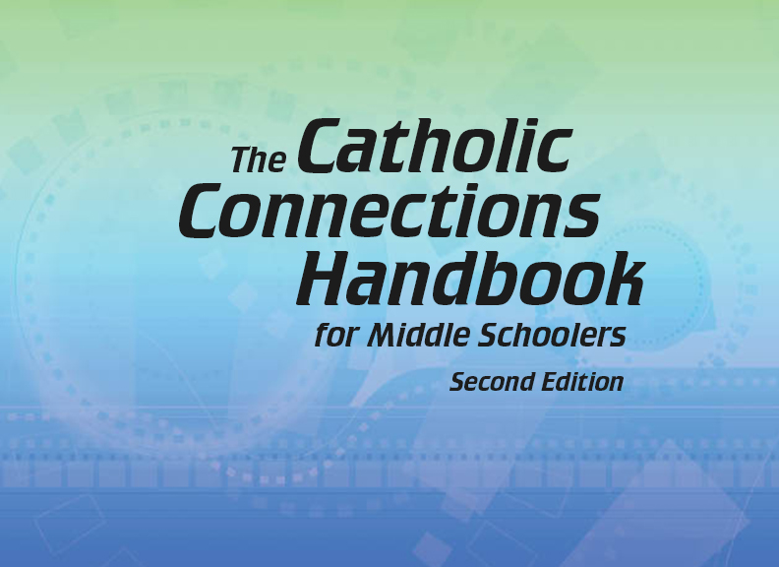

Document #: TX005854

Slide 2
The Prophets,
Jesus Christ, and the Holy Spirit
Chapter 16
The Resurrection of Jesus

Slide 3
Chapter Summary
The Resurrection of Jesus is real and confirms that everything he taught is true.
The Ascension is the event at which Jesus returned to his Father in Heaven.
Jesus will return at the end of time to judge the living and dead.

Slide 4

Introduction
(Handbook, Pages 172–173)
Discussion Questions:
If I were to tell you about
someone you know and love rising from the dead, what would your reaction be? Would you believe me?
Would you listen to me but want to confirm for yourself?
Or would you simply think I was crazy and not believe me at all?
© Z. Ayse Kiyas Asianturk / Shutterstock.com

Slide 5
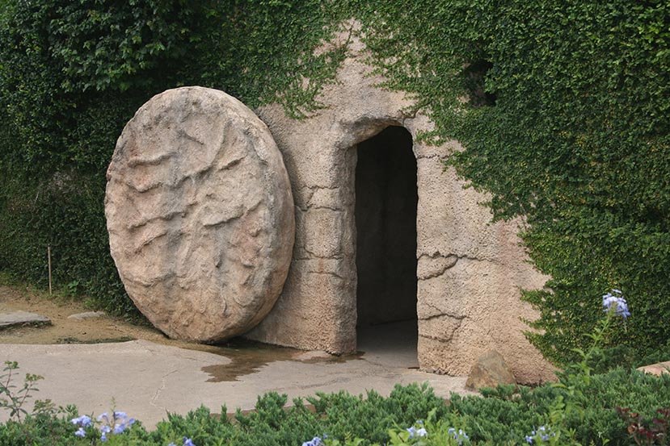
The Importance of the Resurrection
Jesus’ Resurrection is a key
fact of our faith that enables us
to understand and live our faith.
The Resurrection is God’s
greatest miracle and proves the
truth of Jesus’ claims,
teachings, and mission.
The Resurrection of Jesus
completes our reunion with
God and promises that we, too,
will be resurrected to eternal life with God.
© Tiffany Chan / Shutterstock.com

Slide 6
Share It!
Think-Pair-Share
Think: How might a person think and act differently if he or she did not believe in life after death?
Pair: Find a partner.
Share: Discuss your answers to the question with each other. Why is the belief in life-after-death so important for Christians?

Slide 7
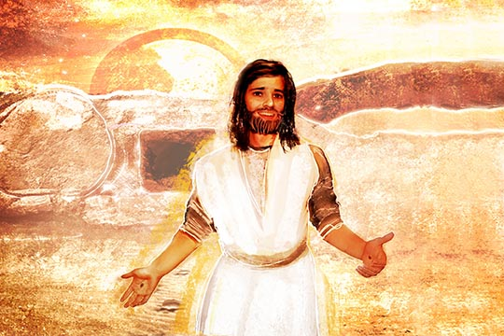
“The Risen Christ”
(Handbook, Pages 173–176)
Most of Jesus’ disciples were
not expecting him to die. And they
didn’t believe the women, who
reported that the tomb that
once held Jesus was empty.
Jesus’ body and soul were
reunited through God’s power,
and although his body is still
human, it is now a glorified human body.
In and through Jesus we, too, will be resurrected. Our eternal soul and glorified body will be reunited, and we will be raised to new life.
© Odessa Sawyer / Saint Mary's Press

Slide 8
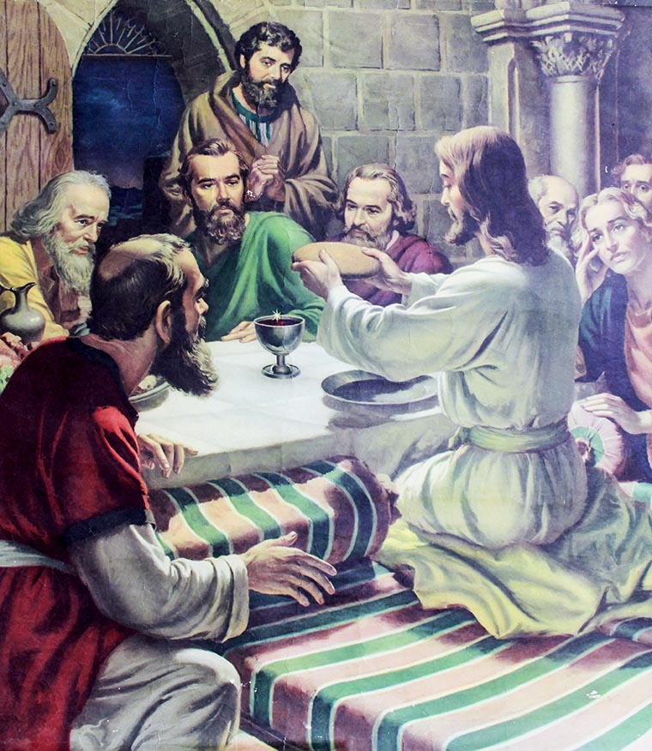
Think About It!
Discussion Questions:
If your parents knew they
were going to be gone for
the weekend and had some-
one staying with you, what kind
of instructions would they give
to the person left in charge?
When Jesus left earth two
thousand years ago, what
sort of instructions did Jesus
leave his disciples?
© Freedom Studio / Shutterstock.com

Slide 9
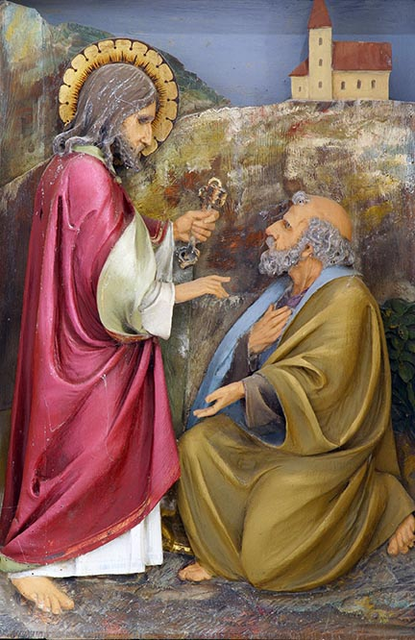
“The Ascension”
(Handbook, Pages 176–177)
The Acts of the Apostles teaches that for forty days Jesus appeared to his disciples and talked with
them about the Kingdom of God.
Jesus tells Peter to follow him, to be the chief shepherd of the Church.
© Zvonimir Atletic / Shutterstock.com

Slide 10

The Mission
Jesus gives all the Apostles
the mission to teach and
baptize in his name through-
out the entire world.
Jesus ascends into God’s
heavenly realm so that the
Holy Spirit might come to
the Apostles.
© Solomnikov/Shutterstock.com

Slide 11

Think About It!
Discussion Questions:
When teachers put a grade on your report card, what factors do you think go into that grade?
Do you think the teacher is giving you a random letter or assigning a letter that reflects the work you’ve done in the class?
© Pixsooz/Shutterstock.com

Slide 12
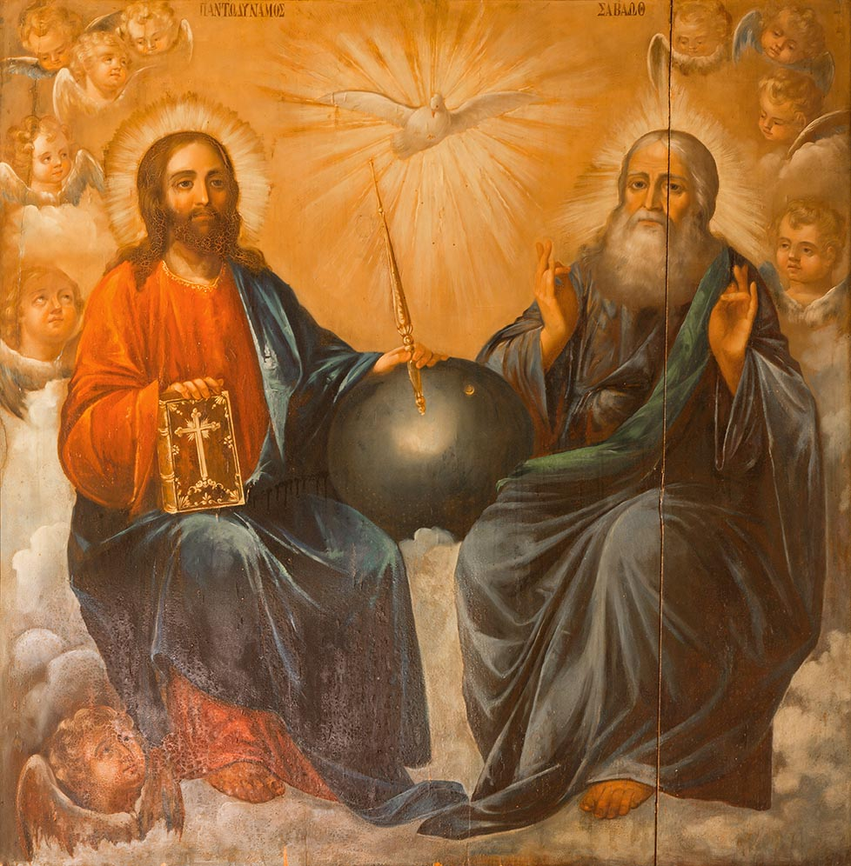
The Last Judgment
(Handbook, Pages 178–180)
To say that Jesus “is seated
at the right hand of the Father”
acknowledges the honor Jesus
now has because of obedience
to his Father.
Jesus’ followers continue
Jesus’ mission of announcing
the Kingdom of love.
Enemies, or the antichrist,
attack the Kingdom and put them-
selves in the place of God.
At the Last Judgment, Jesus will
return to judge the living and the dead.
© Renata Sedmakova / Shutterstock.com

