Slide 1
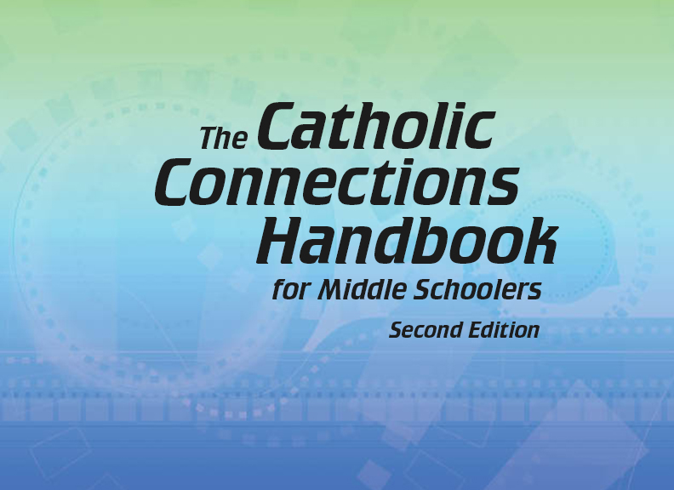

Document #: TX005846

Slide 2
The Prophets,
Jesus Christ, and the Holy Spirit
Chapter 10
The Bible: The Prophets

Slide 3
Chapter Summary
This chapter will identify the role of the prophets in
salvation history.
The prophets can be grouped into two categories:
the writing prophets and the non-writing prophets.
The prophetic mission is to speak for God, calling God’s people to be faithful to their covenant with him.
The prophets reminded God’s people that faithfulness
brings restoration, redemption, and salvation—a promise
that was ultimately fulfilled through Jesus Christ.

Slide 4
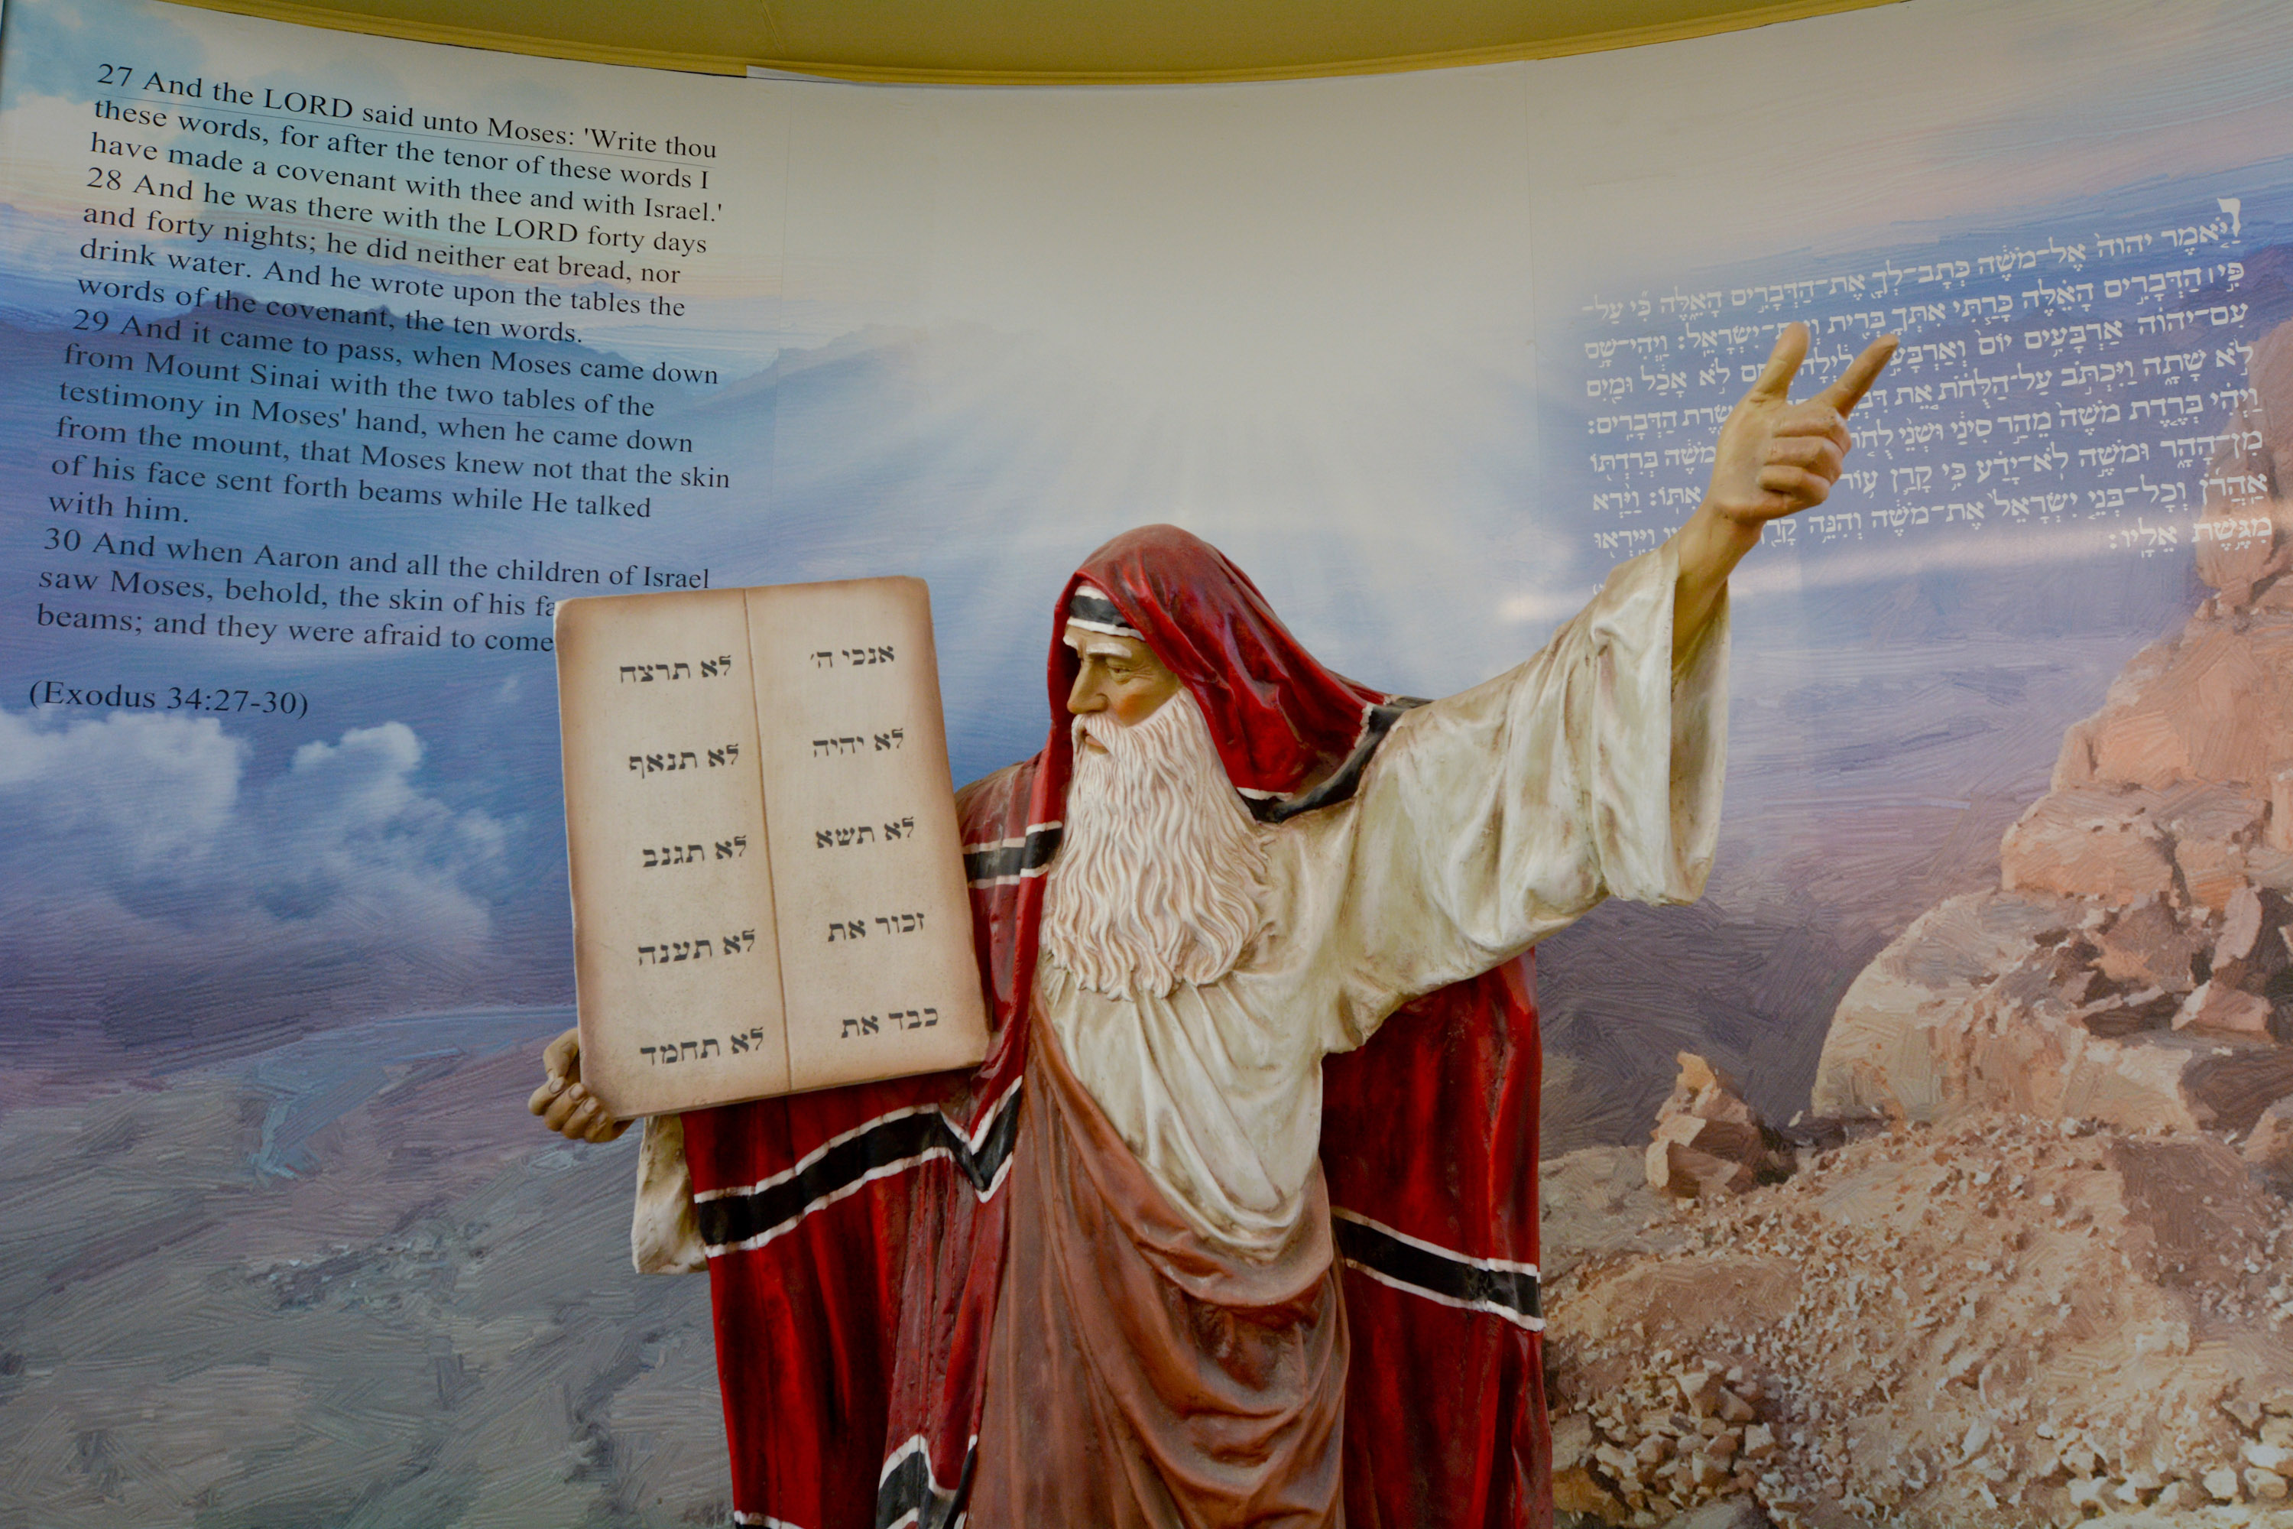
Introduction and
“The Non-Writing Prophets”
(Handbook, Pages 108–112)
Without looking in your Bible,
list as many prophets from the
Old Testament as you can recall. Remember, not every prophet
had a book named after him.
Now check your answers in your Bible.
How many of your prophets had books named after them? How many “non-writing” prophets did you remember?
© ChameleonsEye/Shutterstock.com

Slide 5
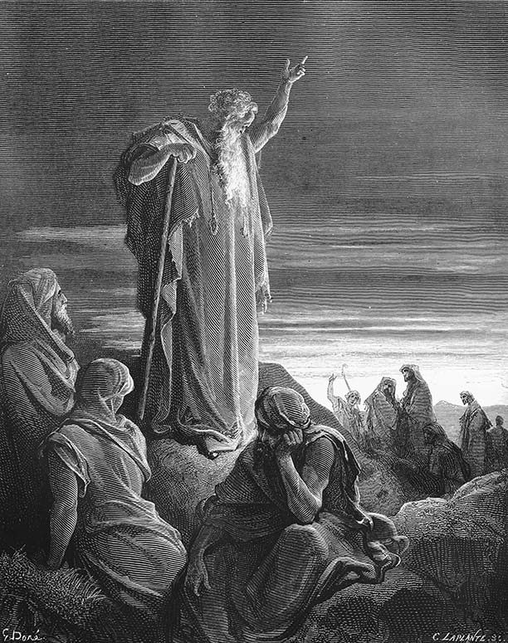
The Prophets’ Mission
A prophet is someone
who speaks for God.
When God called the prophets to carry his message to the Israelites, they bravely responded and spoke the truth even when it was not popular.
© Nicku/Shutterstock.com

Slide 6
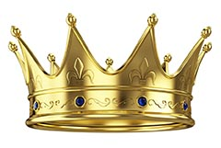
The Prophets’ Mission
God spoke directly to special
individuals, the prophets,
who then carried his message
to his people.
God sent prophets to remind
the kings of Israel to keep their
covenant with him.
Moses, Joshua, the judges, and Elijah and Elisha were all prophets of Israel. Their work is described in the Old Testament, but they do not have books named after them.
© Sashkin/Shutterstock.com

Slide 7
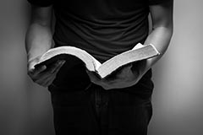
“The Classical Prophets”
(Handbook, Pages 113–116)
In the Old Testament, the words and actions of sixteen prophets are recorded in sixteen books named after them.
These prophets are sometimes called the classical or the writing prophets.
© GongTo/Shutterstock.com

Slide 8
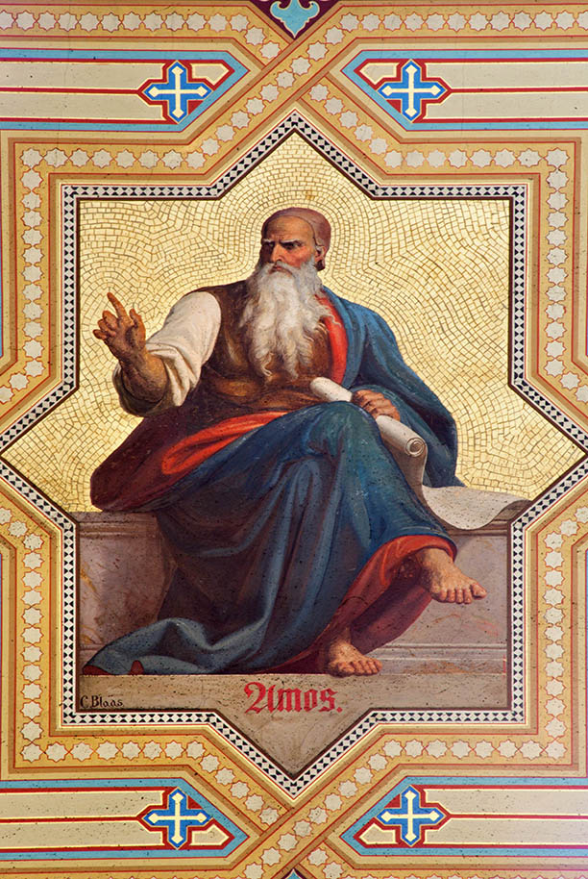
Amos
Amos was the first of the
classical prophets and
prophesied almost eight hundred years
before Jesus’ birth.
Amos is one of the minor
prophets, because his book is short.
Amos’s words are mostly condemnation
and doom, but his book concludes with
hope-filled words, saying that God would
rebuild the nation after its destruction.
© Renata Sedmakova / Shutterstock.com

Slide 9

Journal It!
Open your Handbook to page 115 and look at the picture found there. Write five words that come to mind when you
observe this image of bones in the desert.
© Andrej Sevkovskij / Shutterstock.com

Slide 10
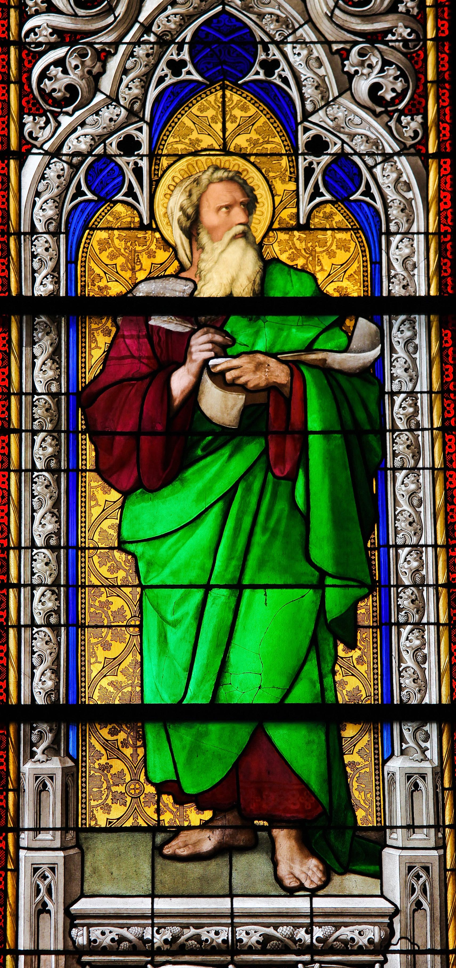
Ezekiel
Ezekiel lived about two
hundred years after Amos.
He is a major prophet,
because his book has many
chapters.
Ezekiel was a priest who was
deported to a foreign land
from which he did all his prophesying.
Ezekiel used symbolic actions to
get across his warnings that the
kingdom of Judah was coming to an end.
© jorisvo/Shutterstock.com

Slide 11
Preach It!
Think: What is one thing happening in the world that you know God is against?
Plan: What words and actions would you use to call people’s attention to this issue?
Preach: When it is your turn, use your words and actions to call the group’s attention to this issue.

Slide 12

“The Hope for a Messiah”
(Handbook, pp. 116–118)
                The most important way the
                prophets prepared people for
                the coming of Christ was by telling them that God would
                send a Savior, who would also be called the Messiah.
The Book of Isaiah contains not only the words of the original Isaiah, but also the words of some of his later followers.
The Book of Isaiah has many prophecies that were fulfilled in the life, Death, and Resurrection of Jesus Christ.
© iurii/Shutterstock.com

Slide 13
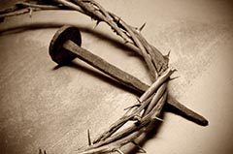
Think About It!
Think-Pair-Share
Think: Look up and read
Isaiah 50:4–6. What do these
words have to do with the life
of Jesus?
Pair: Pair up with a classmate.
Share: Discuss how this
passage from Isaiah would
prepare people for the coming
of Jesus Christ.
© nito/Shutterstock.com

Slide 14
Think About It!
Think-Pair-Share
Think: Look up and read Isaiah
52:13–53:12. What do these
words have to do with the life
of Jesus?
Pair: Pair up with a different
classmate.
Share: Discuss how this passage
from Isaiah would prepare people
for the coming of Jesus Christ.
© nito/Shutterstock.com

Slide 15
Think About It!
Think-Pair-Share
Think: Look up and read
Isaiah 61:1–2. What do these
words have to do with the life
of Jesus?
Pair: Pair up with a different
classmate.
Share: Discuss how this passage
from Isaiah would prepare people
for the coming of Jesus Christ.
© nito/Shutterstock.com

