Slide 1
Four Marks of the Church
The Church
Unit 2
Document #: TX005568

Slide 2
Four Marks
What Are the Four Marks of the Church?
ONE
APOSTOLIC
HOLY
CATHOLIC
Notes:
Notes: You might ask for input from the students about the four marks before you click for each bullet.

Slide 3
Nicene Creed
ONE
HOLY
CATHOLIC
APOSTOLIC
In the Nicene Creed, we profess, “I believe in one, holy, catholic, and apostolic Church.” These are the four marks of the Church.
They are inseparable and intrinsically linked to one another.

Slide 4
One
1
How is the Church One?
united in charity
one in the profession of faith
one in the common celebration of worship and Sacraments
one in the Apostolic Succession

Slide 5
One
1
The Church is One because of . . .
its source, the Holy Trinity, a perfect unity of three Divine Persons
its founder, Jesus Christ, who came to reconcile all humanity
its “soul,” the Holy Spirit, who dwells in the souls of the faithful, unites all the faithful into one communion of believers, and guides the Church
Notes:
Notes: See Catechism of the Catholic Church, 813.

Slide 6
One
1
The “oneness” of the Church is also visible. As Catholics we are united . . .
in our Creed and our other teachings
in the celebration of the Sacraments
in the hierarchical structure based on the Apostolic Succession preserved and handed on through the Sacrament of Holy Orders.
Notes:
Notes: You may want to note, or ask volunteers to read aloud, three quotes from Scripture that emphasize the oneness of the Church: John 10:16, 1 Corinthians 10:17, and Ephesians 4:4–6.

Slide 7
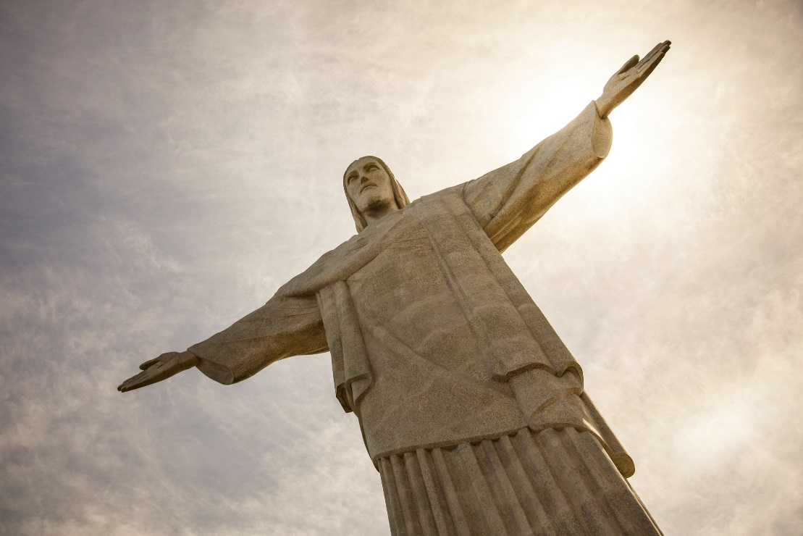
Holy
The Church is Holy because, although Church members sin, the Church as the Body of Christ is sinless.
©ndphoto / Shutterstock.com
Notes:
Notes: Emphasize this point to the students: We are sinners, but the Church itself remains sinless because it was founded by Christ and, therefore, can never be tarnished or less than perfect. You may want to ask a volunteer to read Ephesians 5:25–27.)

Slide 8
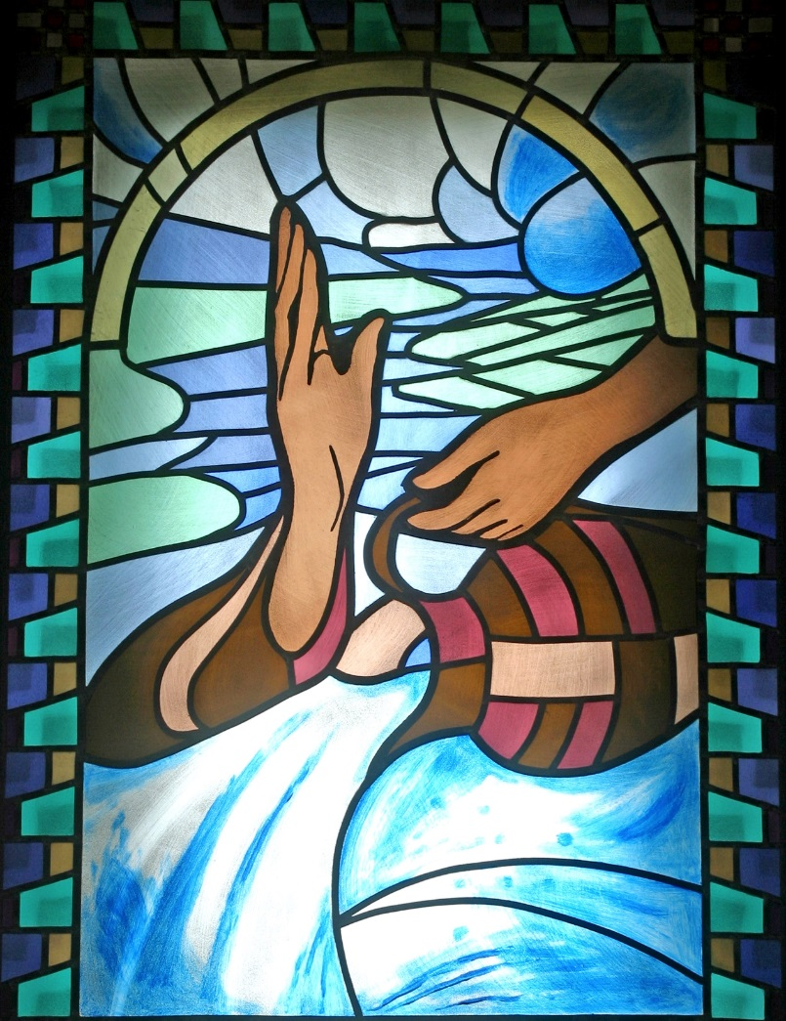
Holy
From the beginning, the Church has been endowed with the sacramental means to help make holy the sinners who are found in the Church.
The Church has been given the Sacraments along with the Word precisely in order to be able to make sinners holy.
©Zvonimir Atletic / Shutterstock.com
Notes:
Notes: The water is a symbol of the Sacrament of Baptism.

Slide 9
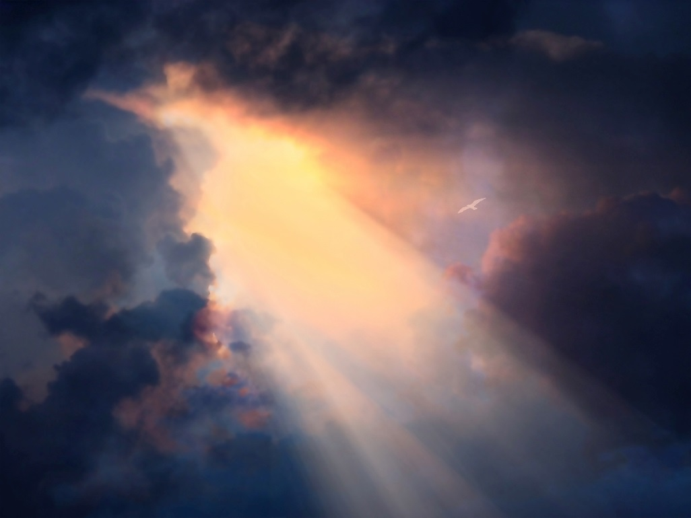
Holy
Each of us as a member of the Church has been called to holiness.
By God’s grace we strive for holiness, through the power of the Holy Spirit.
©Bruce Rolff / Shutterstock.com
Notes:
Notes: Through Baptism we have been freed from Original Sin; filled with sanctifying grace; plunged into the mystery of our Lord's Passion, death, and Resurrection; and incorporated into the Church, the holy people of God. Mention also that the saints are examples of holiness for us, and prove that holiness is possible for each individual member of the Church. No matter how dark the times, great saints have been the light radiating Christ to the world.

Slide 10
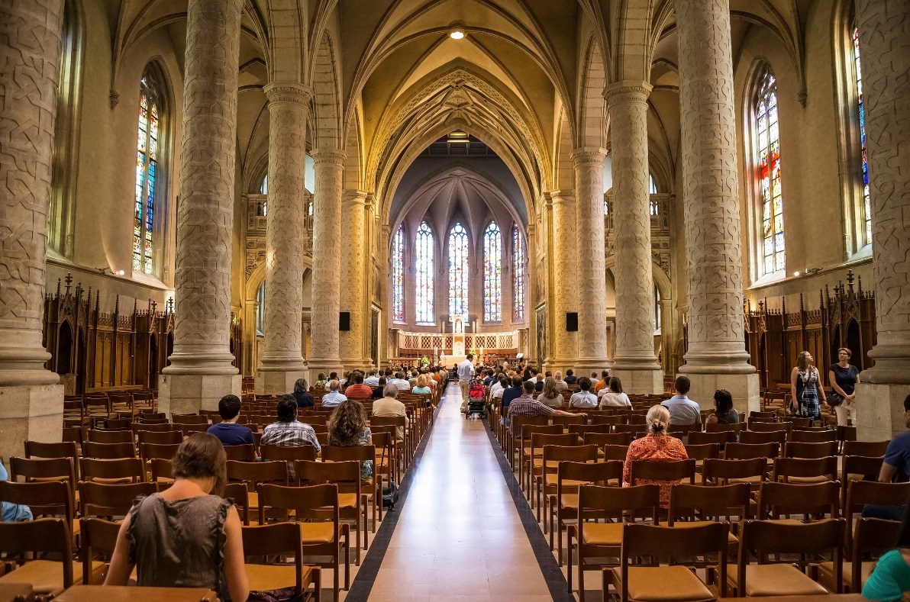
Holy
Even though members of the Church fail and sin, the Church continues to be the sign and instrument of holiness.
© NaughtyNut / Shutterstock.com

Slide 11
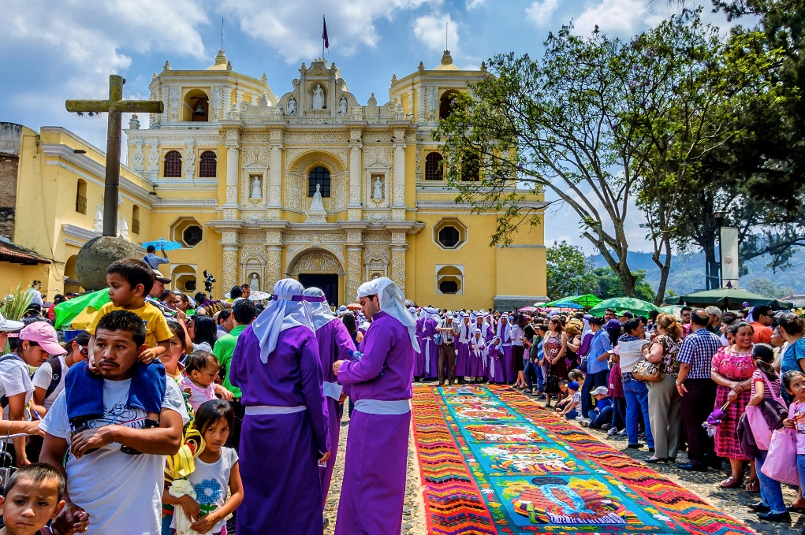
Catholic
When we say the Church is Catholic, we are saying two things:
The Church possesses the fullness of Christ and has received from him the fullness of the means of salvation.
The Church has been sent on a mission by Christ to all people in the world to gather all into the People of God.
© loca4motion / Shutterstock.com
Notes:
Notes: A Palm Sunday procession in Guatemala.

Slide 12

Catholic
The word catholic means “universal.”
At the very beginning, it was difficult to see how the “little flock” (Luke 12:32) in the land of Israel could, by any stretch of the imagination, qualify as universal.
But, through the power of the Holy Spirit, it spread to the ends of the earth.
©sdecoret / Shutterstock.com

Slide 13
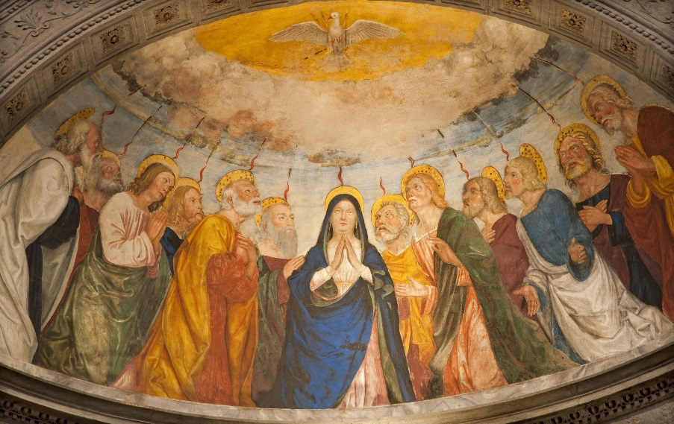
Catholic
The Holy Spirit came down upon the Church at Pentecost at a time when “there were devout Jews from every nation under heaven staying in Jerusalem” (Acts of the Apostles 2:5).
It was to them that the Holy Spirit temporarily enabled the Apostles to speak in the languages of all these various nations—a powerful sign that the Church was destined for all people everywhere.
© Renata Sedmakova / Shutterstock.com

Slide 14
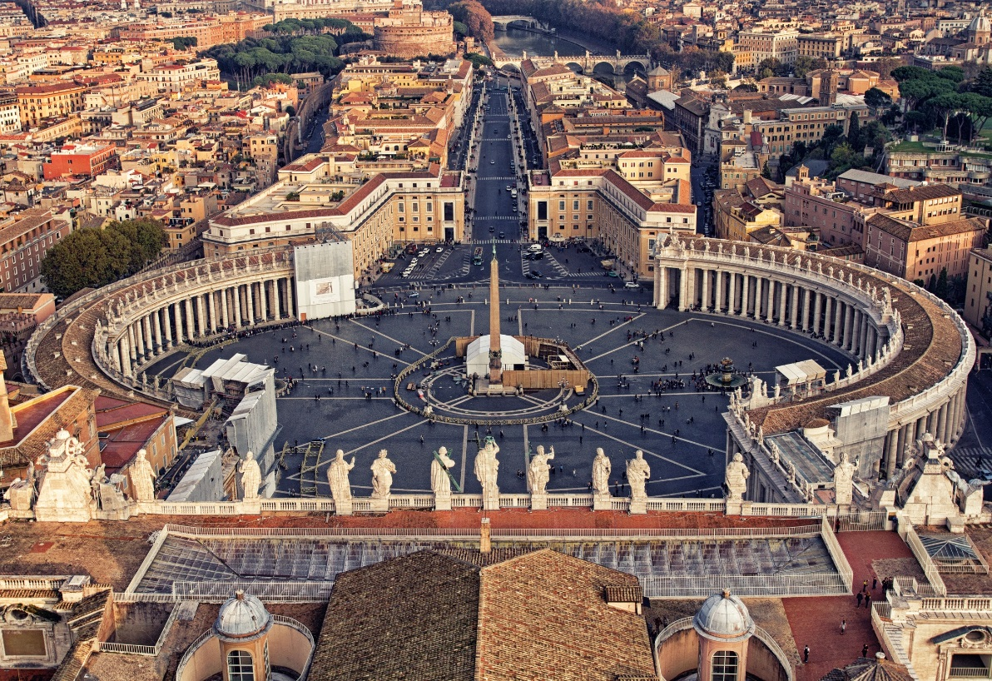
Catholic
The Church is Catholic because it exists for all people and is the means of salvation for all people.
© Banauke / Shutterstock.com

Slide 15

Apostolic
The Church is Apostolic because she is founded on the Apostles.
“Jesus answered them, ‘Did I not choose you twelve?’” (John 6:70).
Jesus sent his Apostles to continue his Father’s mission, and he gave them authority and power.
©Bernardo Ramonfour / Shutterstock.com

Slide 16
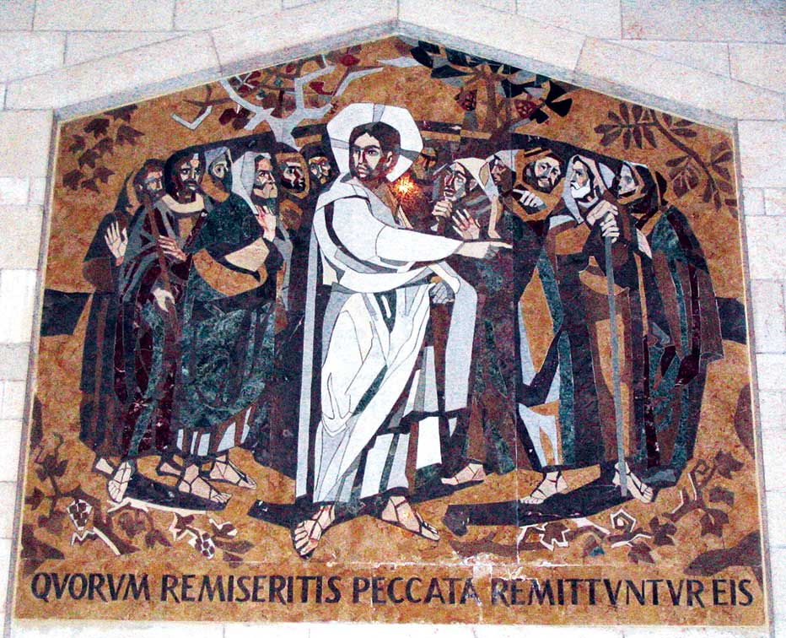
Apostolic
How do we know that the Apostles have the power and authority to pass on to others what they had received from Christ?
“Whoever listens to you listens to me” (Luke 10:16).
© Brian Singer-Towns/Saint Mary's Press
Notes:
Notes: The Apostles very definitely did have this power and authority; the New Testament evidence is clear about that. With these words, Jesus declared that the Apostles and their successors would speak for him in the serious business of gathering in and sanctifying his people and leading them toward the salvation he offers. Both Sacred Scripture and Sacred Tradition have been handed down through the Church from the Apostles.

Slide 17
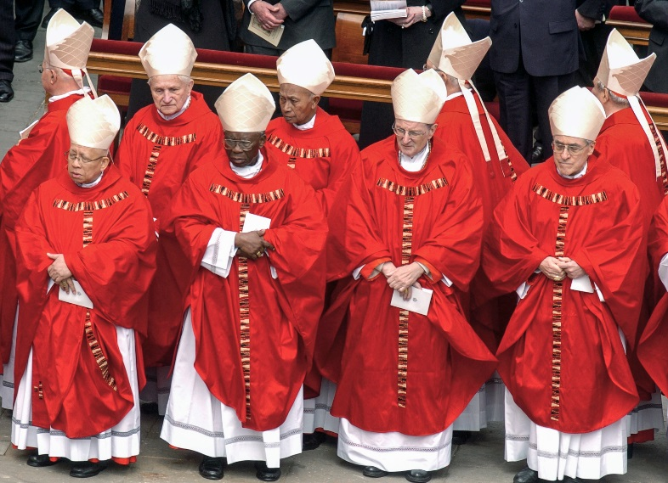
Apostolic
Under the guidance of the Holy Spirit, the Spirit of truth, the Magisterium (the teaching authority entrusted to the Apostles and their successors) has the duty to preserve, teach, defend, and hand on this Deposit of Faith.
The Pope and bishops in union with him form the Magisterium, the living, teaching office of the Church.
© Paolo Bona / Shutterstock.com

Slide 18
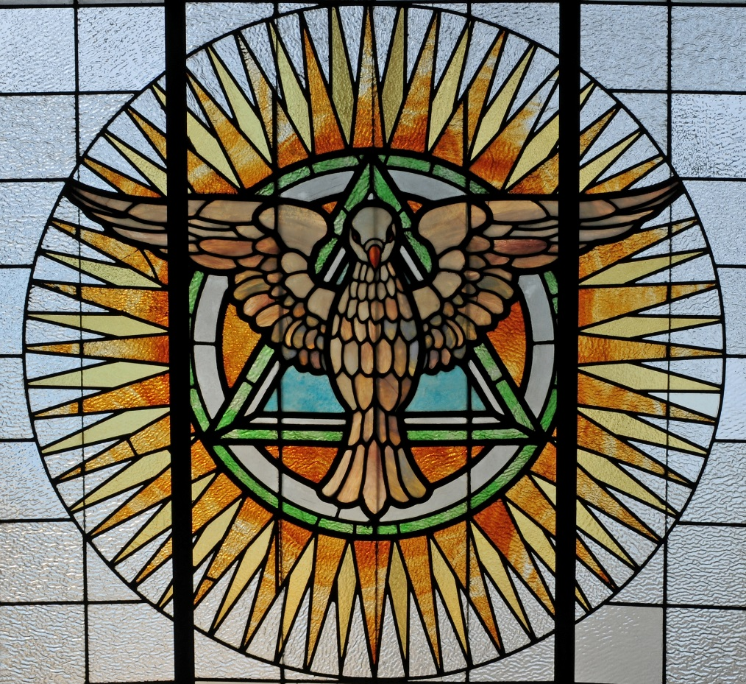
Apostolic
The Holy Spirit protects the Church from error in its teaching authority, the Magisterium.
© Nancy Bauer / Shutterstock.com
Notes:
Notes: This is an important point: the Holy Spirit protects and defends the faith, despite what humanity might try to do to it.

Slide 19
Marks of Mission
Our Lord himself founded the Church and marked it with these characteristics, which reflect its essential features and mission.
Through the guidance of the Holy Spirit, the Church fulfills these marks.
©america365 / Shutterstock.com

Slide 20
Our duty, then, as baptized Catholics, is to make these four Marks of the Church visible in our daily lives.

Slide 21
Acknowledgment
The Scripture quotation on slide 17 is from the New American Bible, revised edition © 2010, 1991, 1986, 1970 Confraternity of Christian Doctrine, Inc., Washington, D.C. All Rights Reserved. No part of this work may be reproduced or transmitted in any form or by any means, electronic or mechanical, including photocopying, recording, or by any information storage and retrieval system, without permission in writing from the copyright owners.

