Slide 1
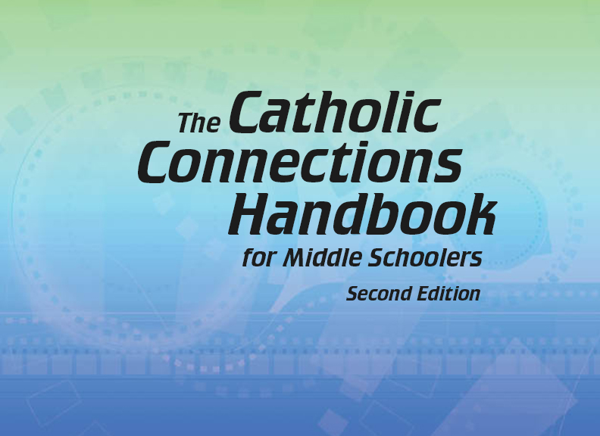
Document #: TX005835

Slide 2
Prayer and Church History
Chapter 48
Tuning In to God

Slide 3
Chapter Summary
God invites us into a relationship with him.
God is available to us all day, every day, through prayer.
We can pray in five ways: petition, blessing, intercession, praise, and thanksgiving.

Slide 4
Introduction and “Forms of Prayer” (Handbook, pages 524–526)
Prayer is our response to God’s invitation to be in relationship with him.
In this lesson we focus on petition and blessing.
© KieferPix/Shutterstock.com

Slide 5
“Prayers of Petition”
How many times a day do you ask God for “little things” you want? What are some of these things?
What deeper requests might you ask of God? What are some of these requests?
© chainarong06/Shutterstock.com

Slide 6
“Prayers of Blessing”
“God bless you!” is a real prayer—a prayer for God’s loving care for a particular person, place, or activity.
© Gustavo Frazao / Shutterstock.com

Slide 7
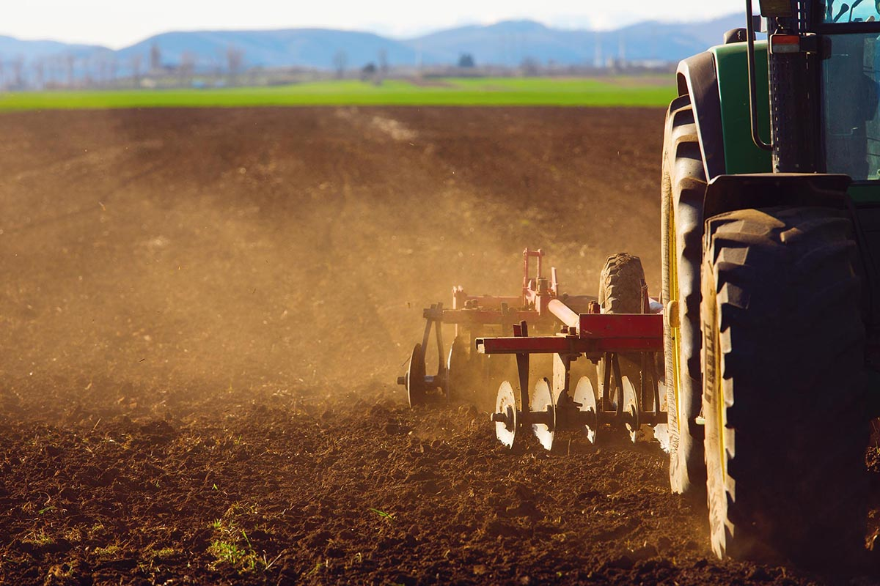
We Ask God to Bless . . .
Gather in threes. Make a list of all the things we can ask God to bless (people, places, and things). Share your list with your group.
All of these blessings remind us of God’s goodness and love.
© danm12/Shutterstock.com

Slide 8
“Prayers of Intercession, Praise, and Thanksgiving” (Handbook, pages 526–528)
Intercessions, praise, and
thanksgiving help us express
our dependence on God.
© forestpath/Shutterstock.com

Slide 9
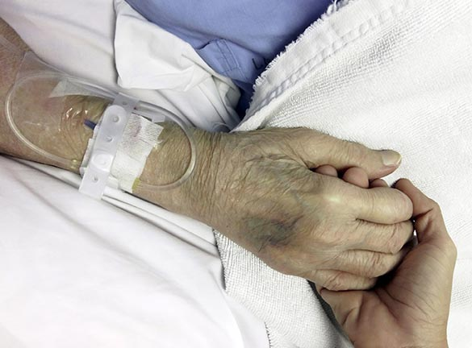
Prayers of Intercession
Any time you pray on behalf of someone else, it is a prayer of intercession.
Do you know someone who needs prayer? Stop and pray for that person now.
© studio2013/Shutterstock.com

Slide 10
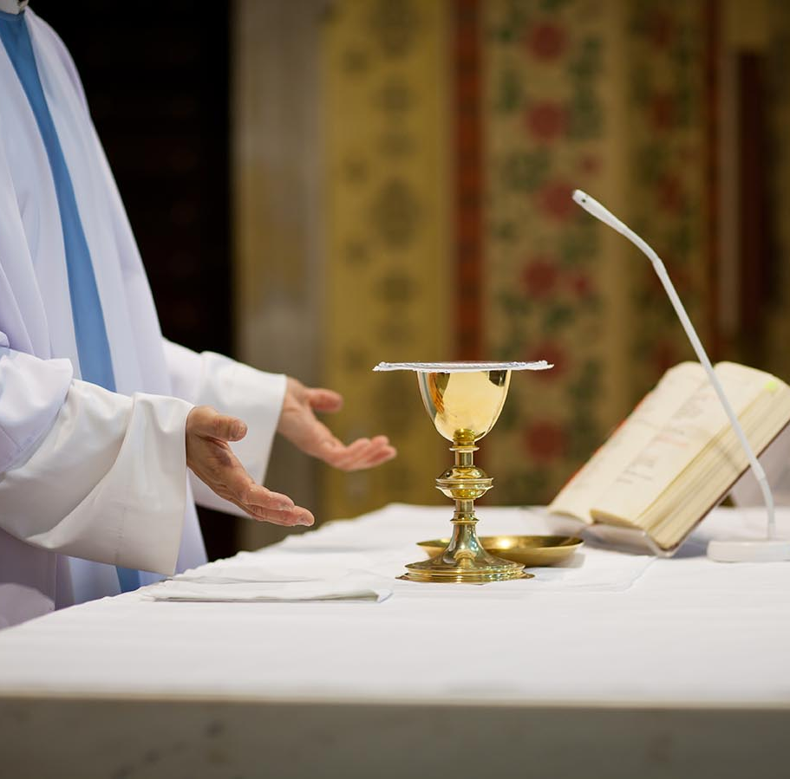
Prayers of Praise and Thanksgiving
A prayer of praise or thanksgiving is when we tell God how much we appreciate who he is, what he does for us, and how thankful we are.
At Mass, we praise God together as one community of faith. The word Eucharist means “thanksgiving.”
© l i g h t p o e t / Shutterstock.com

Slide 11
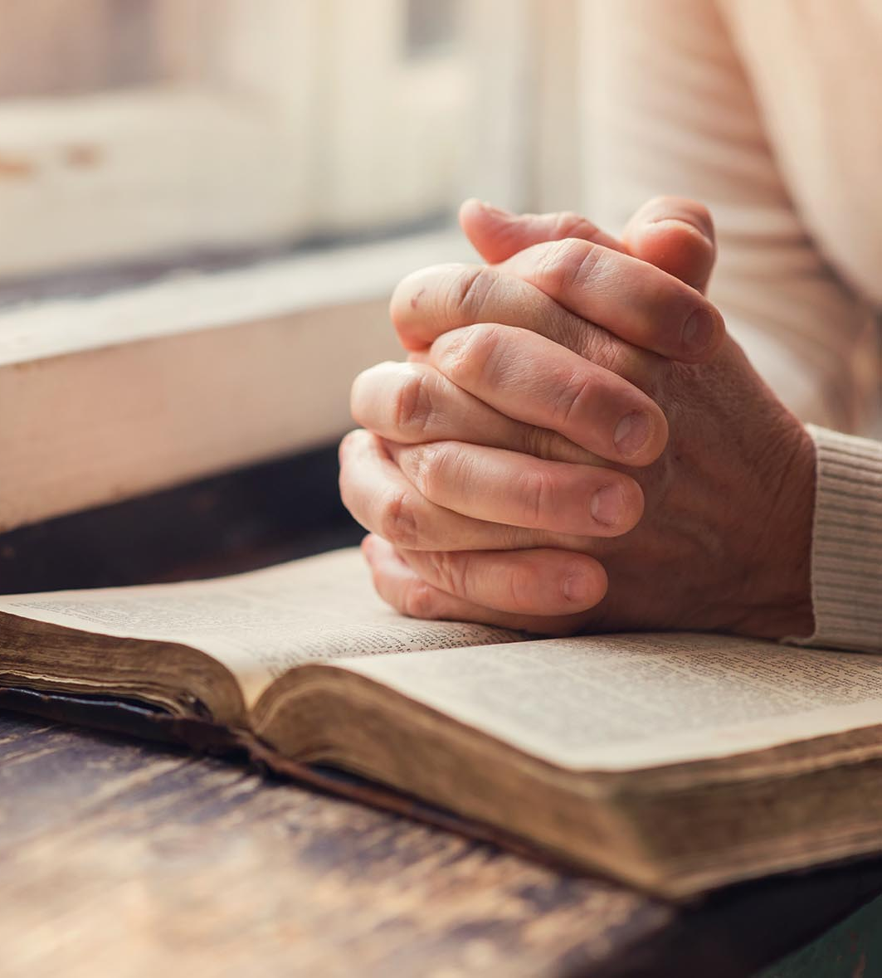
“Learning to Pray” (Handbook, pages 529–531)
We learn to pray through daily prayer, the liturgy, reading and hearing the Word of God, and the virtues of faith, hope, and love.
© Halfpoint/Shutterstock.com

Slide 12
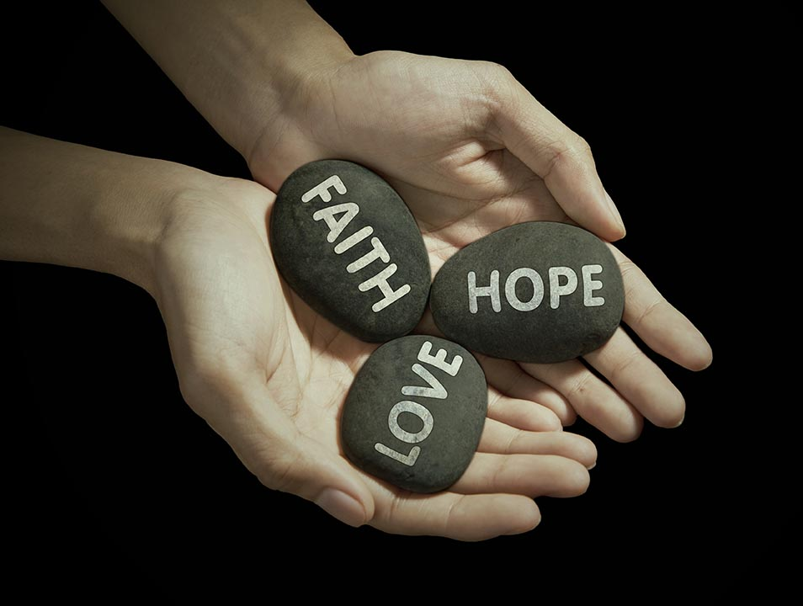
Faith, Hope, and Love
The virtues of faith, hope, and love help us to pray.
Faith is not just belief in God. It is the belief that God loves and cares for me personally.
Hope is trust that God wants my best good, no matter what my situation is.
Love is the greatest of all, God’s gift to share with others.
© Creativa Images / Shutterstock.com

Slide 13
“Personal Prayer” (Handbook, pages 531–532)
Christians throughout history have practiced three major expressions of prayer: vocal prayer, meditation, and contemplation.
© Pagina/Shutterstock.com

Slide 14
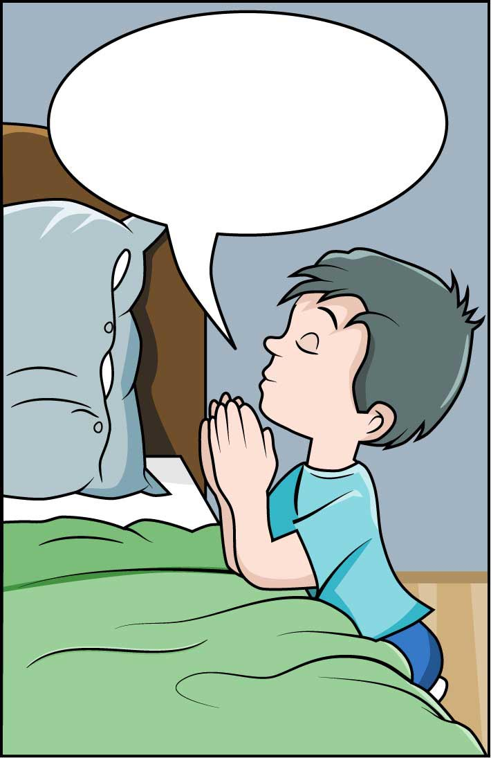
Vocal Prayer
Vocal prayer uses words to speak to God.
Vocal prayers can be memorized prayers. What vocal prayers do you know by heart?
Vocal prayers can also be spontaneous prayers. When do you pray using your own words? What is on your mind and heart now? Talk to God about it.
© Paul974/Shutterstock.com

Slide 15
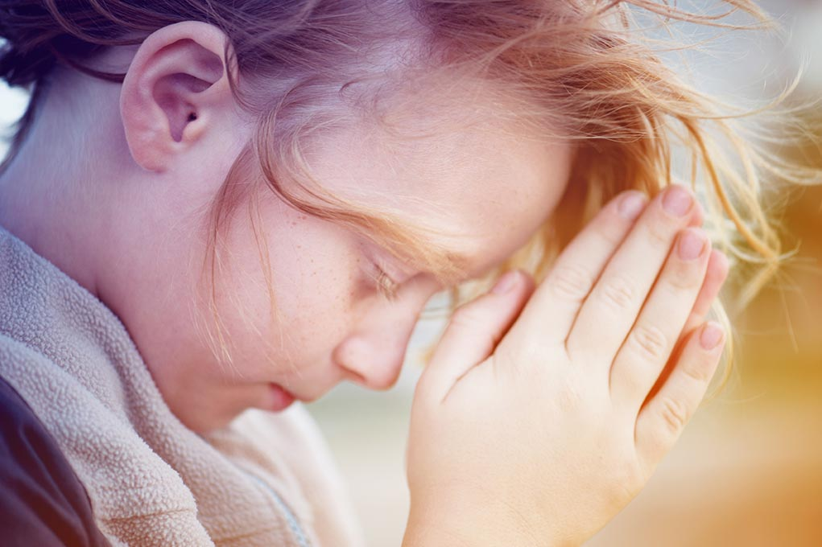
Meditation
Meditation uses thoughts, imagination, and emotions to get in touch with God.
We can meditate on a Scripture verse, a picture, or the Rosary.
In meditation, we focus our mind and heart on God.
© Vinogradov Illya / Shutterstock.com

Slide 16
Meditation on Scripture
Simple Meditation
One way to meditate is by simply repeating a word or Scripture verse slowly and silently to yourself. Try it.
Choose a word or verse (for example, the name of Jesus, “peace,” or a special verse, such as “I am the light of the world”).
Be still. Close your eyes. Slowly breathe in and out.
Repeat your word in your mind for one or two minutes. Go to next slide.

Slide 17
Simple Meditation, continued
If other thoughts come to mind, gently notice them, let them go, and go back to your word. Don’t fight or struggle. Stay peaceful.
After two to three minutes, open your eyes.
For the rest of the day, when you have a free moment, return to your special word. Let it remind you that God is with you!

Slide 18
Contemplation
Contemplation is wordless prayer, listening to God in stillness, “resting in God,” experiencing oneness with him, and just being with God.
Be still now. Take time to find peace in God.
© oriontrail/Shutterstock.com

