Slide 1
What Is Faith?
Jesus Christ: God’s Love Made Visible, Second Edition Unit 5, Chapter 13
Document#: TX004819

Slide 2
Faith
Faith is the theological virtue that enables us to accept God’s revealed truth.
It allows us to be in union with him in our mind and heart.
Faith is the surrendering of our whole selves—mind, heart, and spirit—to God’s saving love.
© BBG019 / iStockphoto.com
Notes:
Explain that the term faith comes from the Latin word fides, meaning “trust” or “belief.” Ask for examples of people the students have faith in, and emphasize that faith involves belief and trust.
This slide corresponds to content in article 58, “Faith and Religion,” in the student book.

Slide 3
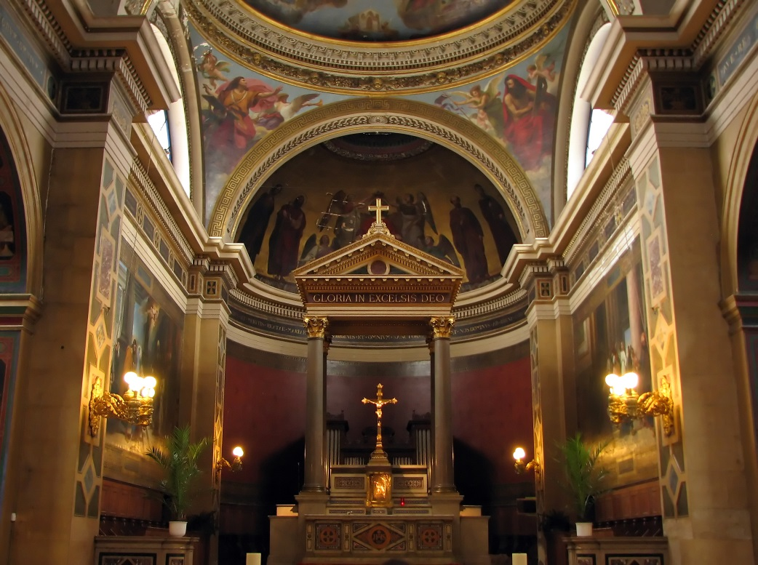
Faith and Religion Are Inseparable
Religion is the practice of prayer, worship, service, and shared beliefs.
Religion results from surrendering ourselves to God’s love.
Faith and religion: we cannot truly have one without the other.
© Francesco Dazzi / Shutterstock.com
Notes:
Ask the question that concludes article 58 in the student book, “In your words, why is faith inseparable from religion?” (Faith without religion will fade away; religion without faith is empty ritual.)
This slide corresponds to content in article 58, “Faith and Religion,” in the student book.

Slide 4
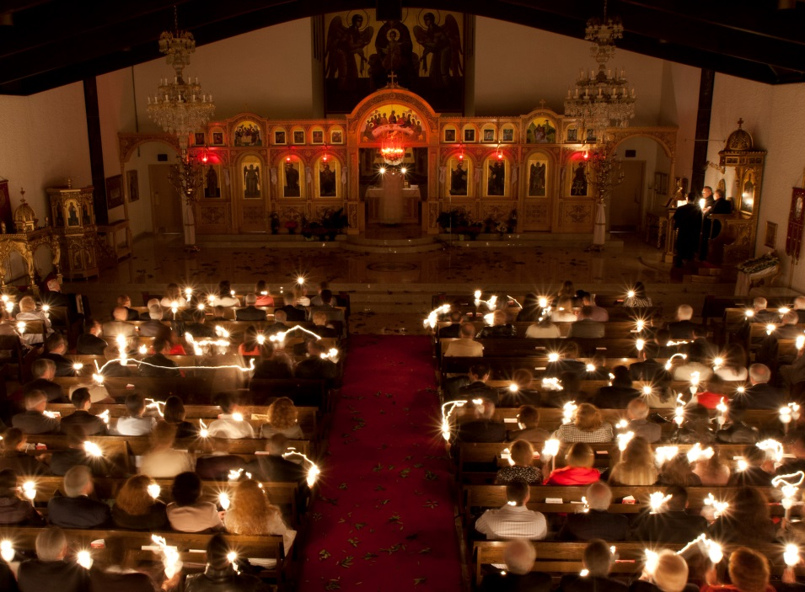
Religion: Worship and Adoration
Worship of God is a key component of religion.
When we truly adore God, we acknowledge him as Savior and Creator.
We recall that every blessing we enjoy is a gracious gift from God.
© Vasileios Economou / iStockphoto.com
Notes:
Discuss the Did You Know? sidebar near the close of article 58 in the student book, “The Book of Psalms: Prayers of Praise.” Share some examples of liturgical music the students know and appreciate, with lyrics based on the Psalms.
This slide corresponds to content in article 58, “Faith and Religion,” in the student book.

Slide 5
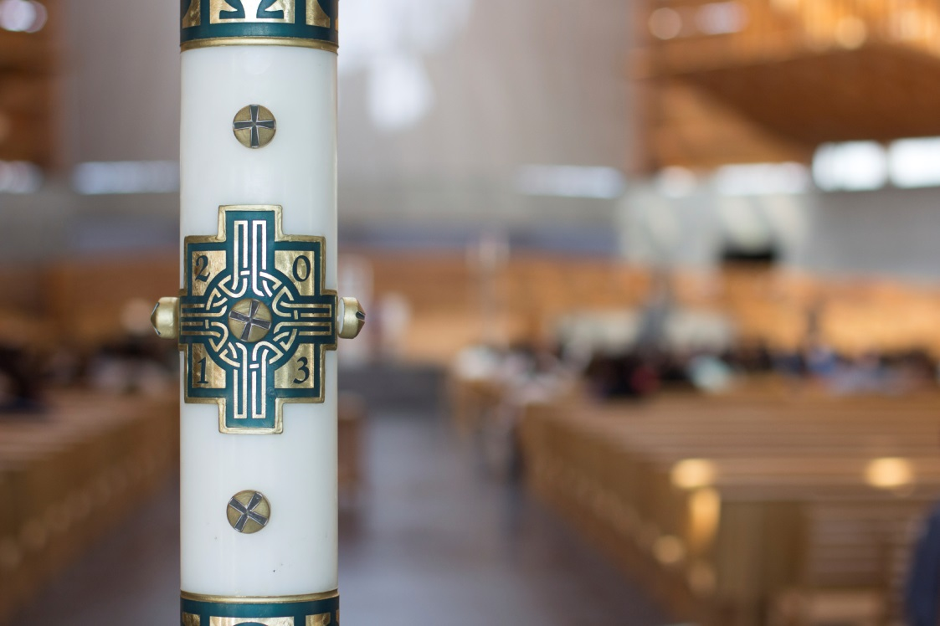
Religion: Service and Sacrifice
Religious practices include service offered on behalf of our neighbor.
We sacrifice our time, money, or other resources for the good of others.
© liquidmachine / iStockphoto.com
Notes:
Explain that when we make sacrifices to serve others, we can make our lives a sacrifice to God, as Jesus did. Ask what small sacrifice the students made for someone in the past twenty-four hours; challenge them to consciously offer a similar sacrifice to God by this time tomorrow.
This slide corresponds to content in article 58, “Faith and Religion,” in the student book.

Slide 6
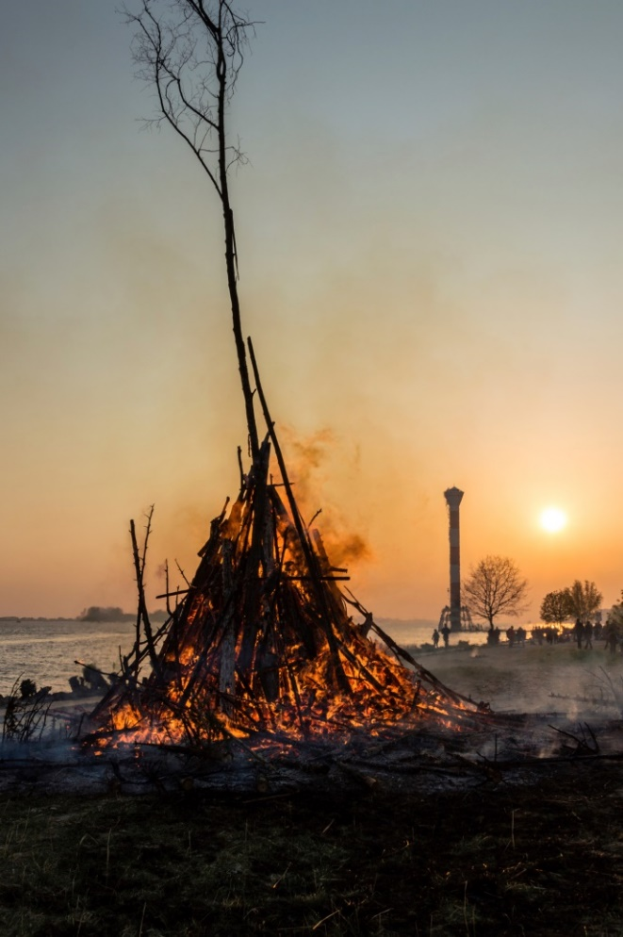
Faith: A Gift from God
Faith is a supernatural gift that God freely offers to us.
None of us can maintain faith on our own.
Divine grace and the help of the Holy Spirit make our faith possible.
© Symbiont / iStockphoto.com
Notes:
Point out that because faith is a gift from God, we can pray for an increase in our faith. Consider sharing an example from your own or another person’s life where persistent prayer was an effective response to doubt or half-heartedness.
This slide corresponds to content in article 59, “Faith: A Gift from God,” in the student book.

Slide 7
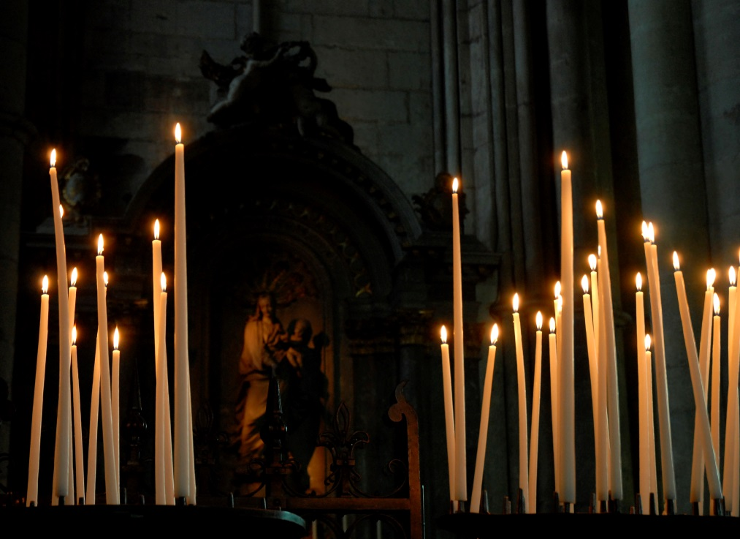
Belief and Faith
God invites us to believe in Revelation.
Belief is only possible with the Holy Spirit’s help, but …
we freely choose to accept or reject God’s invitation to believe.
© david franklin / iStockphoto.com
Notes:
Discuss things that can stand in the way of accepting Jesus’ invitation to believe in Divine Revelation. Identify ways of responding to those barriers.
This slide corresponds to content in article 59, “Faith: A Gift from God,” in the student book.

Slide 8
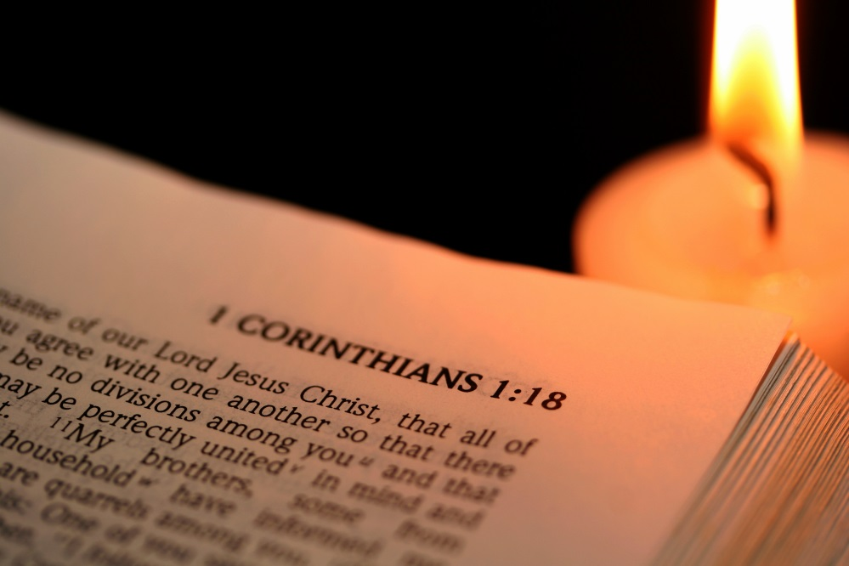
The Obedience of Faith
Through our faith we pay attention to Revelation . . .
and humbly seek God’s will for our lives.
© seechung / iStockphoto.com
Notes:
Ask how the support of other faithful Christians can help us trust in God’s Revelation.
This slide corresponds to content in article 59, “Faith: A Gift from God,” in the student book.

Slide 9
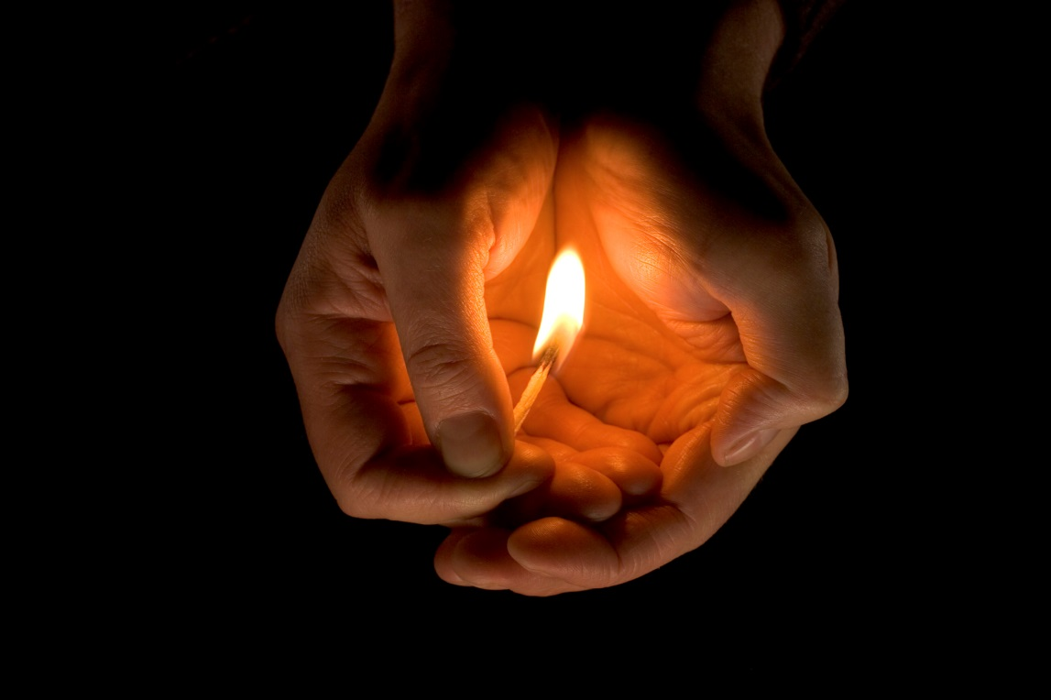
Faith Needs Nourishment
It is possible to lose the gift of faith if we do not nourish it and help it to grow.
© stockcam / iStockphoto.com
Notes:
Lead a discussion about ways we can consciously nourish our faith. (See article 59 in chapter 13 of the student book.)
This slide corresponds to content in article 59, “Faith: A Gift from God,” in the student book.

Slide 10
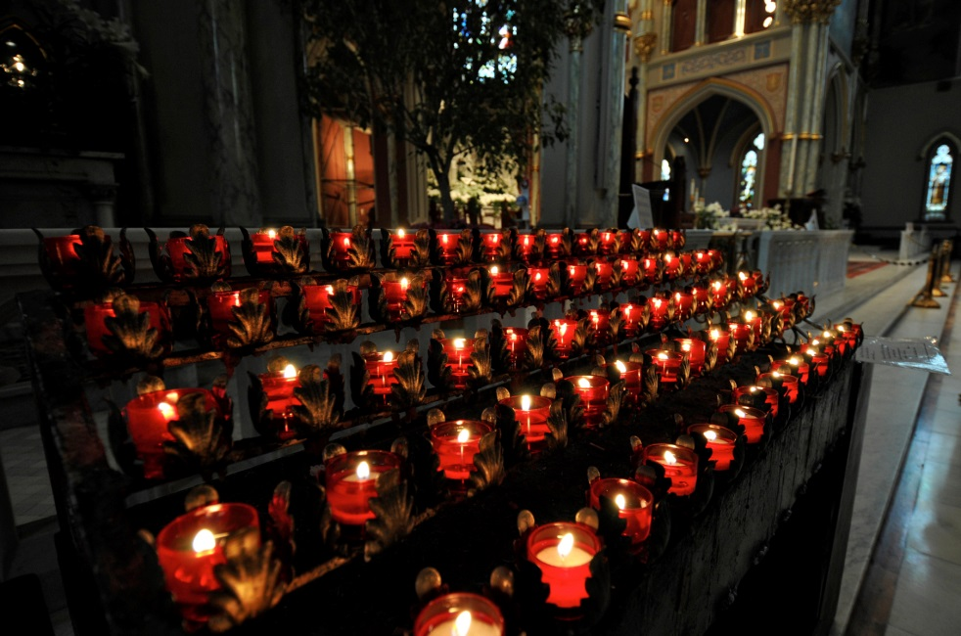
Biblical Figures
The Scriptures are filled with examples of people whose response to God’s Revelation inspires faith.
Some responded with faith in difficult circumstances.
Others made great sacrifices to surrender to God.
© dlewis33 / iStockphoto.com
Notes:
Review examples from article 60 in chapter 13 of the student book. Ask the question at the end of article 60 in the student book, “Whom do you look to when you feel discouraged in faith?”
This slide corresponds to content in article 60, “Biblical Figures, Saints, and Martyrs: Examples of Faith,” in the student book.

Slide 11
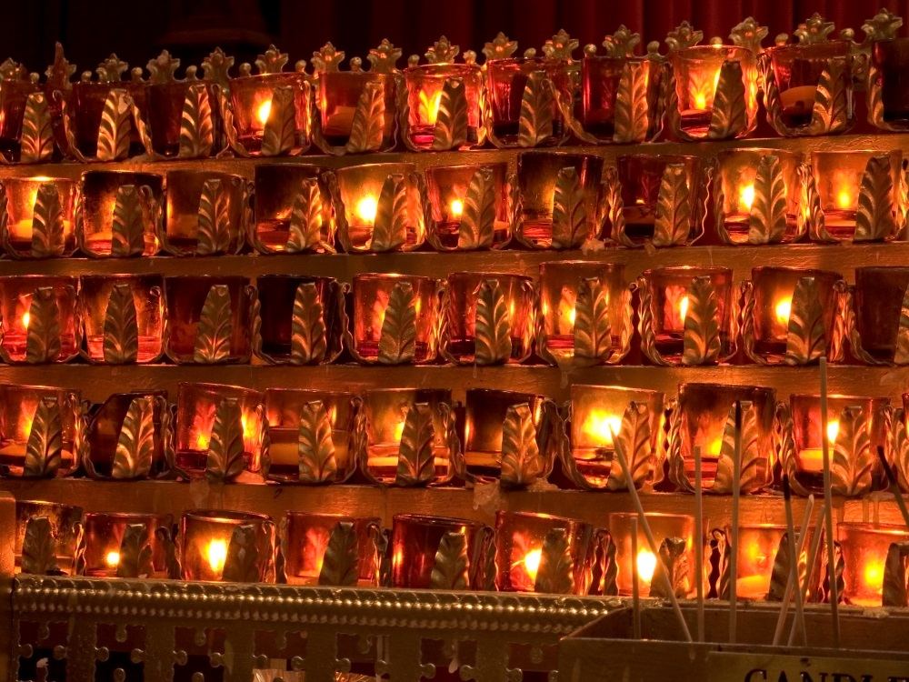
Saints and Martyrs
The lives of the saints, some of whom were also martyrs, are a source of inspiration.
They show us how to maintain and grow our faith.
They teach us how to surrender our whole selves to the truth God has revealed.
© andykazie / iStockphoto.com
Notes:
Ask students for examples of saints who have inspired them.
This slide corresponds to content in article 60, “Biblical Figures, Saints, and Martyrs: Examples of Faith,” in the student book.

Slide 12
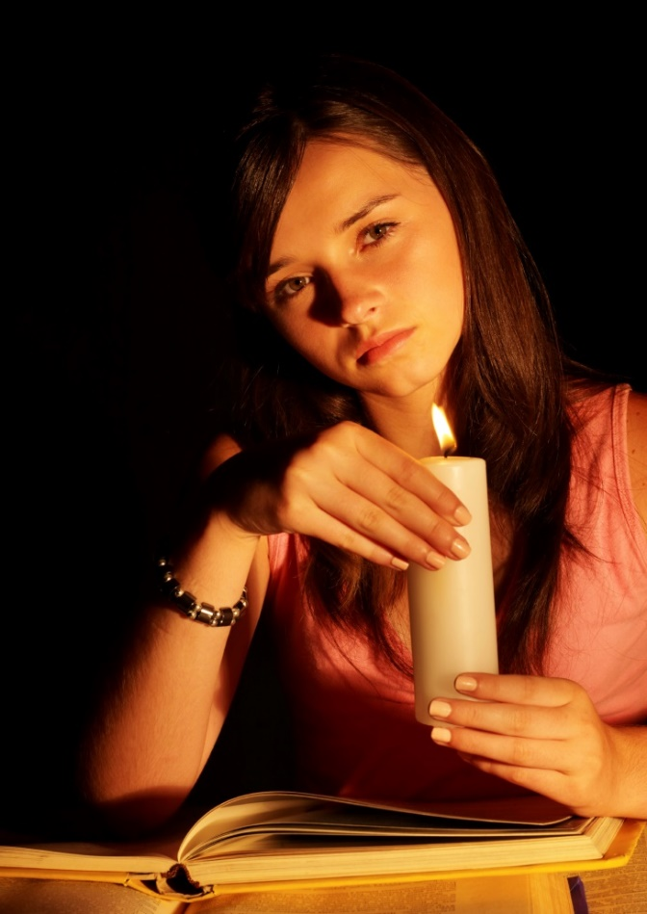
We Respond through Discipleship
God initiates a relationship with us through Revelation; we respond to God through faith.
When we have faith in Jesus Christ, we become his disciples.
© targovcom / iStockphoto.com
Notes:
Ask students to imagine what the original disciples of Jesus were like. Brainstorm how we would expect them to act, what attitudes and beliefs we might see. (See article 61 in the student book.) Ask for examples of belief and behavior we might see in Jesus’ disciples today.
This slide corresponds to content in article 61, “Faith: Our Response to Revelation,” in the student book.

Slide 13
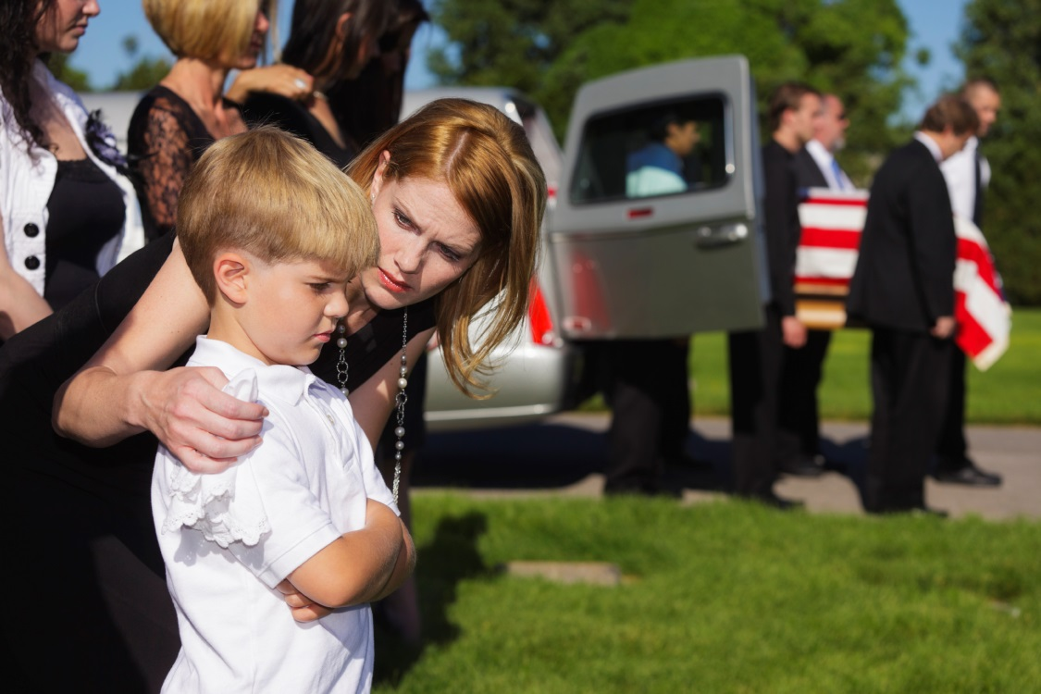
We Respond through Evangelization
All disciples of Jesus have a common vocation.
We are to be holy and to proclaim our faith in Jesus and the Gospel.
We can witness to our faith through our words and deeds.
© Tony Campbell / Shutterstock.com
Notes:
Direct the students to think of someone they believe is living out their vocation as a Christian. Ask how that person witnesses to their faith.
This slide corresponds to content in article 61, “Faith: Our Response to Revelation,” in the student book.

Slide 14
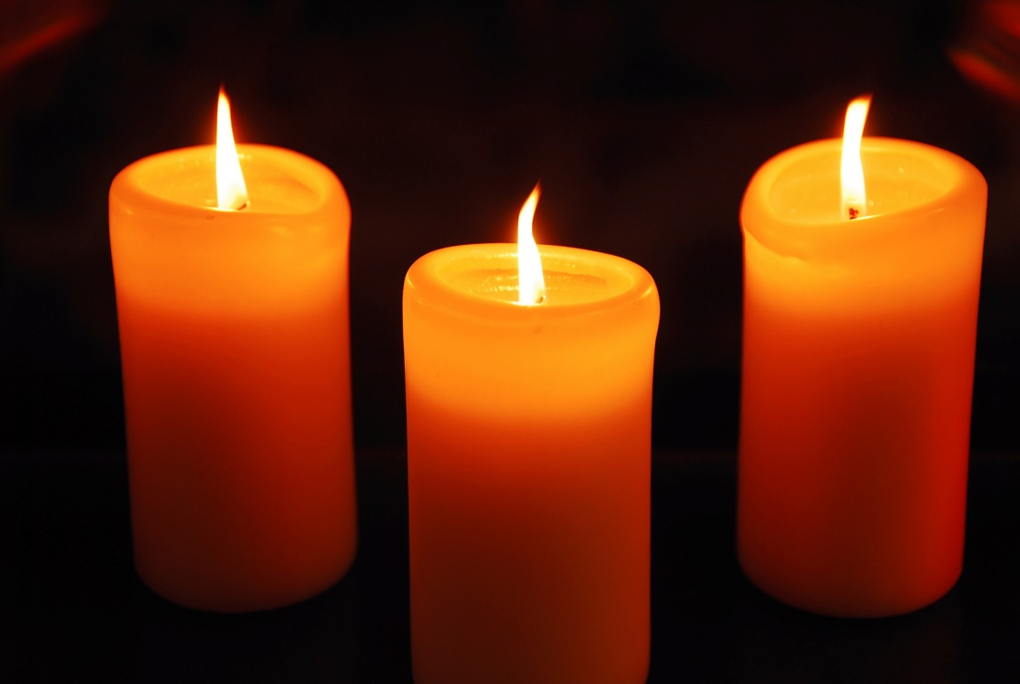
The Theological Virtues
A virtue is a good habit, a continual disposition to do good.
The three theological virtues are faith, hope, and charity or love.
These virtues enable us to live in relationship with the Blessed Trinity.
© sivarock / iStockphoto.com
Notes:
Direct students to read the descriptions of each virtue in article 62 of the student book. Discuss how each virtue helps guide us to God, as Pope Saint John Paul II asserted.
This slide corresponds to content in article 62, “The Theological Virtues: Faith, Hope, and Love,” in the student book.

