Slide 1
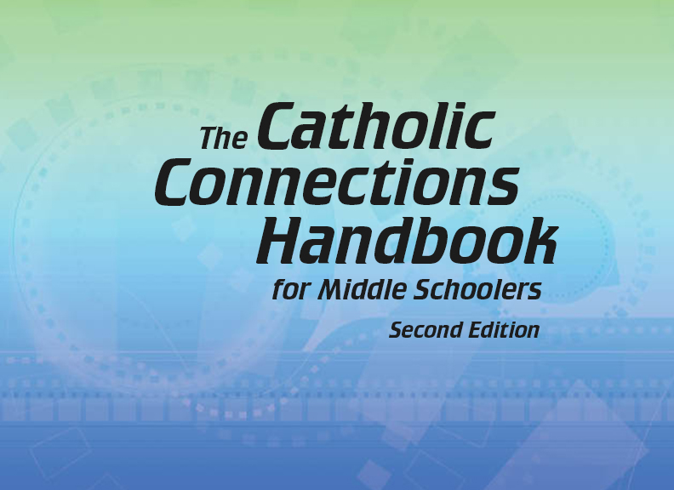


Slide 2
The New Testament
and the Church
Chapter 20
The Bible: The Acts of the Apostles

Slide 3
Chapter Summary The Bible: The Acts of the Apostles
This chapter will explore the story of the young Church found in the Acts of the Apostles.
It will also discuss the power of the Holy Spirit to transform the Apostles and all who encountered them on Pentecost.
We will talk about Peter as he courageously reaches out to all people, and we will journey with Paul, from conversion to martyrdom, as he spreads the Good News.

Slide 4
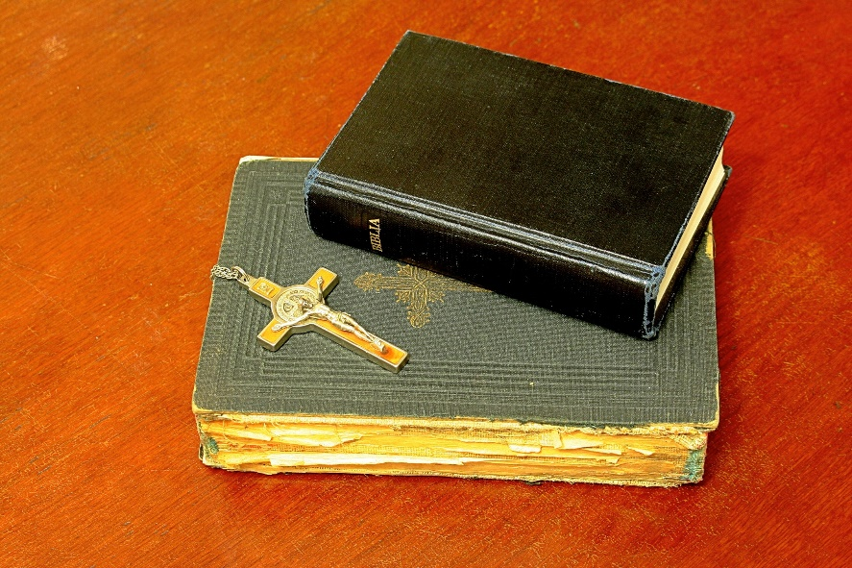
Introduction (Handbook, pages 212–213)
The Acts of the Apostles is a story of transformation for early Christians and can serve as an inspiration for the Church today.
Neither the Bible nor
the Catechism existed in
the early Church.
© ioannicolae/www.istockphoto.com

Slide 5

Introduction (Handbook, pages 212–213)
Faith spread through the spoken word and by the lived witness of believers.
The Holy Spirit guided the Apostles and can guide us to share our faith.
Discussion Question
How can you respond to the calling of the Holy Spirit and share your faith with someone in your life?
© Nelosa/www.istockphoto.com

Slide 6
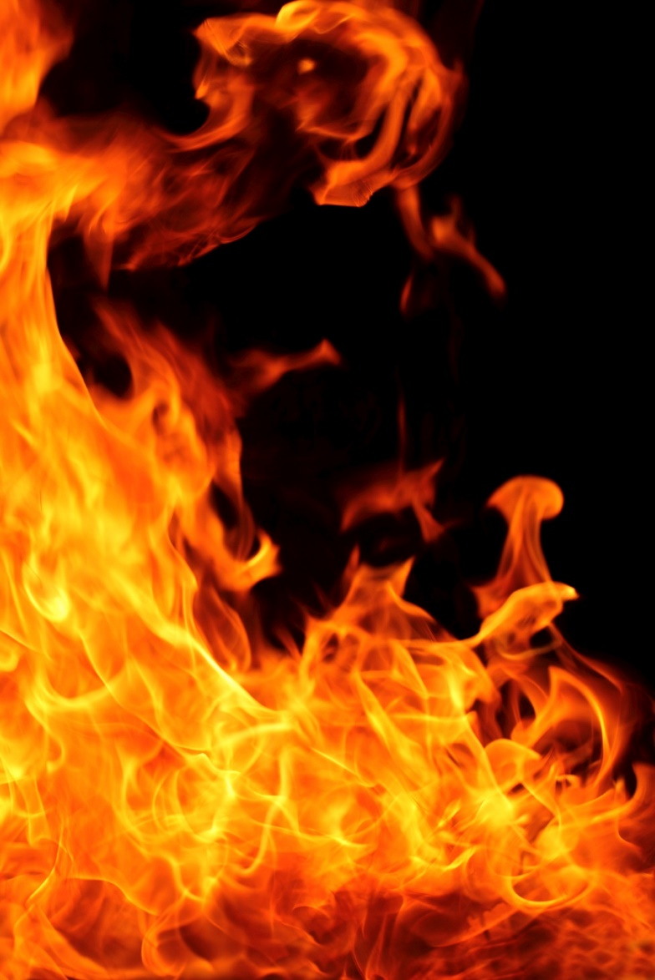
“Pentecost” (Handbook, pages 213–215)
The Holy Spirit empowered the growth of the early Church, especially at Pentecost.
As told in Acts, the Holy Spirit
guided the Apostles to evangelize
so the Word of God could spread.
© FuatKose/www.istockphoto.com

Slide 7

“Pentecost” (Handbook, pages 213–215)
The Holy Spirit came upon the disciples at Pentecost, empowering them to evangelize people throughout the earth with the Good News.
The Holy Spirit gave Peter the wisdom and courage he needed to evangelize, speaking words that would transform the lives of many at Pentecost, and beyond.
© Molodec/www.shutterstock.com

Slide 8
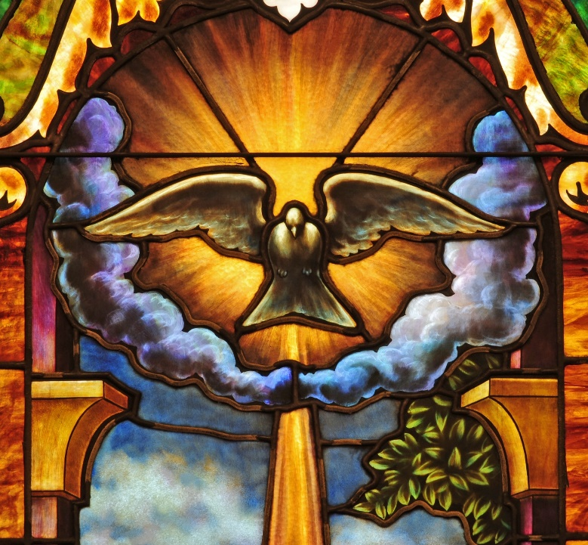
“Pentecost” (Handbook, pages 213–215)
Activity
Silently read Acts 2:38–42.
Which image from the Pentecost story is most inspiring to you?
Strong, driving wind
Tongues as of flame
Apostles speaking so everyone understands
Peter’s powerful speech
3,000 becoming Christian that day
© Nancy Bauer/www.shutterstock.com

Slide 9
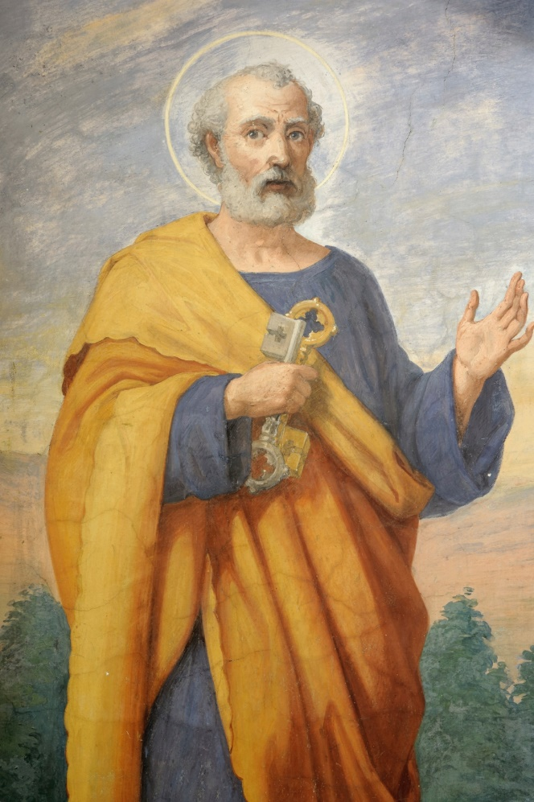
“The Work of Saint Peter” (Handbook, pages 216–217)
Peter was a disciple of courage and persistence who guided the Church’s early growth.
Peter, commissioned by Jesus,
led the early Church with his
courageous words and actions.
© PaoloGaetano/www.istockphoto.com

Slide 10
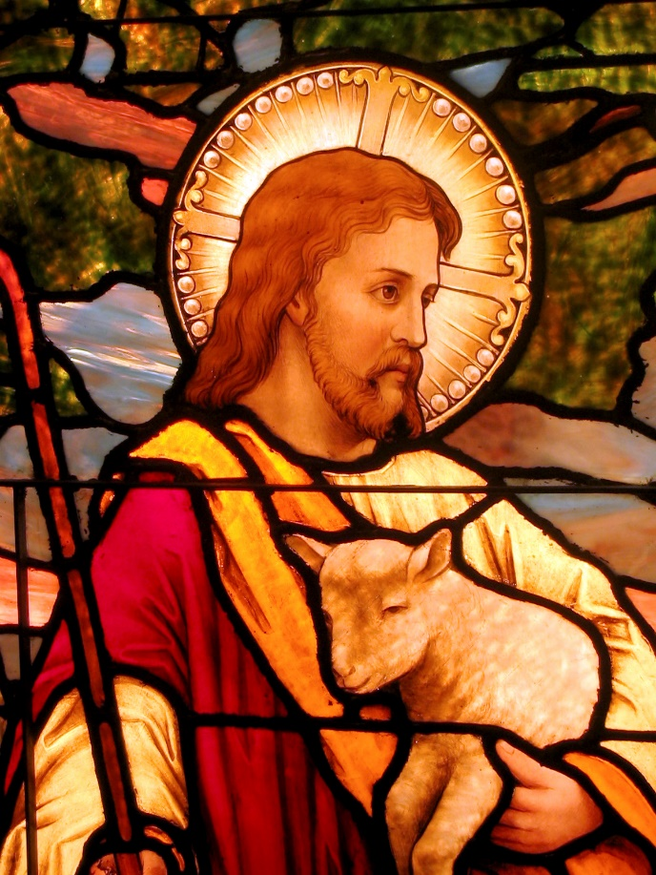
“The Work of Saint Peter” (Handbook, pages 216–217)
Peter boldly spread the Good News despite imprisonment and persecution.
Peter and the Apostles heeded Jesus’ challenge to spread the Gospel to all nations and to baptize people.
Discussion Question
Jesus asked Peter, “Who do you say I am?” (Matthew 16:15). How would you describe Jesus to a friend?
© JustinMcD/www.istockphoto.com

Slide 11
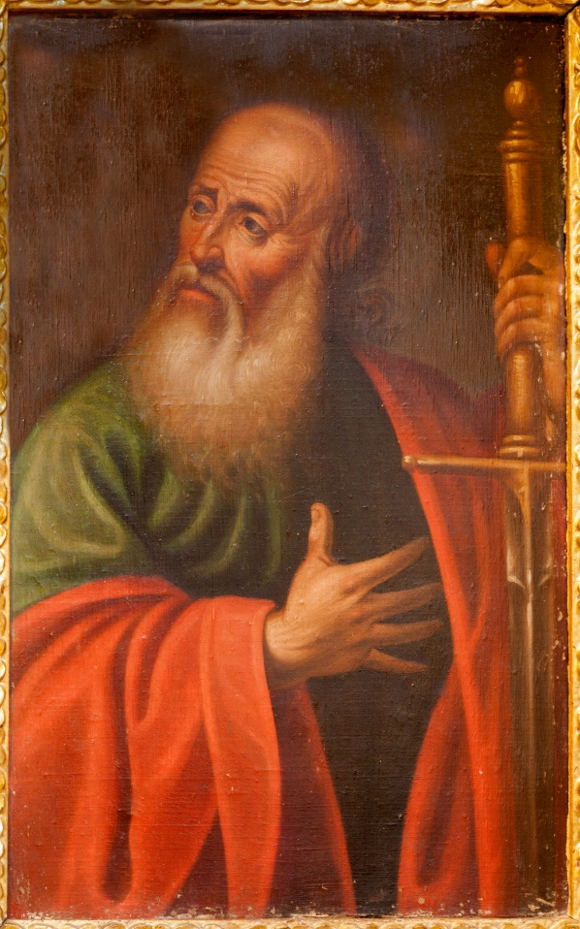
“The Travels of Saint Paul” (Handbook, pages 218–221)
Paul’s transformation led to his essential missionary journeys and the growth of the Church.
Saint Paul was a devout Jew who persecuted Christians before his dramatic conversion.
© RenatSedmakova/www.shutterstock.com

Slide 12

“The Travels of Saint Paul” (Handbook, pages 218–221)
Paul traveled tirelessly to bring the Good News to cities throughout the Roman Empire.
Paul endured hardships and persecutions in his journeys, eventually dying for his faith.
Discussion Question
Saints Peter and Paul both followed in Jesus’ mission of making disciples of all nations. How can you and other young people contribute to this mission?
© Pamela Moore/www.istockphoto.com

Slide 13
Acknowledgments
The scriptural references and quotations in this presentation are from the Good News Translation® (Today’s English Version, Second Edition). Copyright © 1992 by the American Bible Society. All rights reserved. Bible text from the Good News Translation (GNT) is not to be reproduced in copies or otherwise by any means except as permitted in writing by the American Bible Society, 1865 Broadway, New York, NY 10023 (www.americanbible.org).
During this presentation’s preparation, all citations, facts, figures, names, addresses, telephone numbers, Internet URLs, and other pieces of information cited within were verified for accuracy. The authors and Saint Mary’s Press staff have made every attempt to reference current and valid sources, but we cannot guarantee the content of any source, and we are not responsible for any changes that may have occurred since our verification. If you find an error in, or have a question or concern about, any of the information or sources listed within, please contact Saint Mary’s Press.

