Slide 1
Document #: TX005844

Slide 2
Prayer and Church History
Chapter K
The Church Today

Slide 3
Chapter Summary
The changing world affects the Catholic Church.
The Church’s mission is to transmit the truth the Apostles received from Jesus to the people of our times.
The popes have influenced world events, and Catholics have been involved in these events.
Today’s Catholics, including middle schoolers, are encouraged to take their place in Church history!

Slide 4
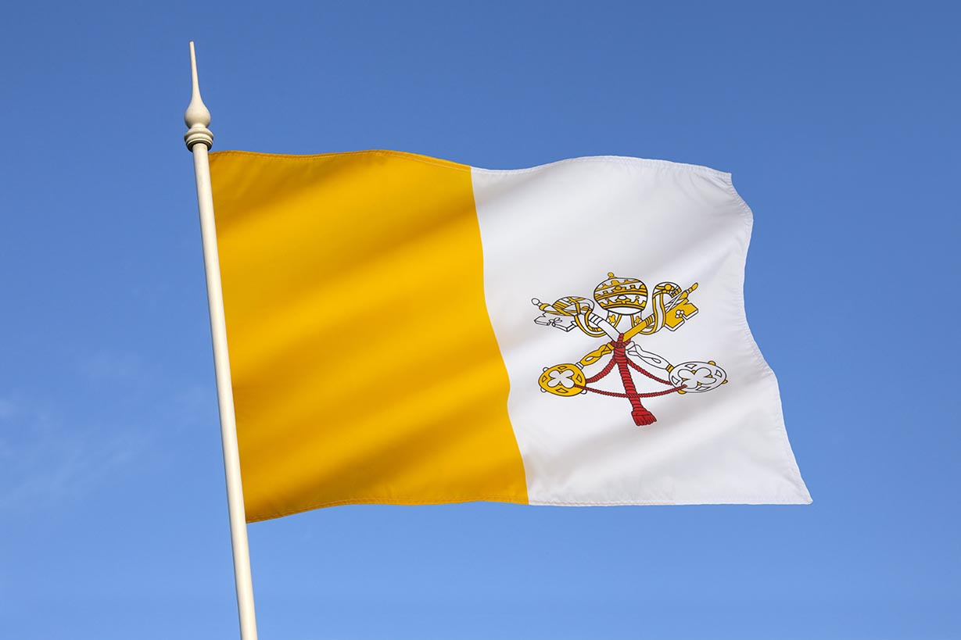
Introduction and “Popes for a New Era” (Church History, pages 124–130)
In an ever-changing world, the Church looked to Popes Paul VI, John Paul I, and John Paul II for guidance.
© Steve Allen / Shutterstock.com
(This is a photo of the Vatican flag.)

Slide 5
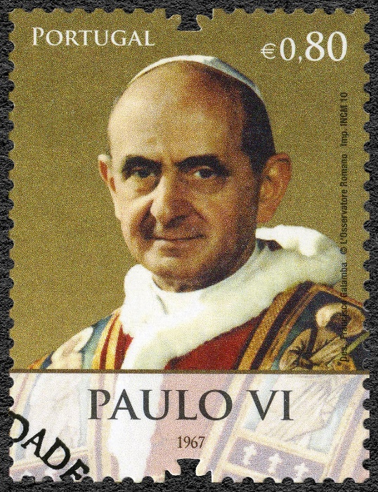
Pope Paul VI
Pope Paul VI led the last three sessions of Vatican Council II.
He addressed the United Nations in 1965 and spoke against the war in Vietnam. He also wrote addresses and encyclicals on marriage, abortion, and the world-wide gap between rich and poor.
He asked the bishops of the world to meet in local synods to discuss Church issues.
© Olga Popova / Shutterstock.com

Slide 6
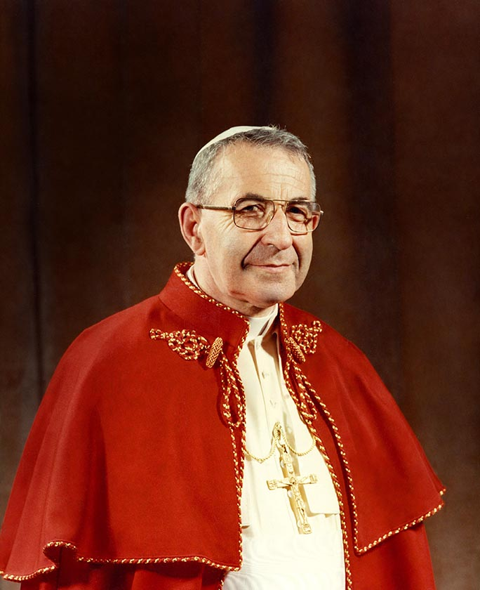
Pope John Paul I
As a bishop, Albino Luciani had participated in Vatican Council II.
He was elected pope in 1978 and was the first to choose a double name: John Paul.
He died in his sleep from a heart attack only 33 days after his election.
©www.bridgemanimages.com

Slide 7
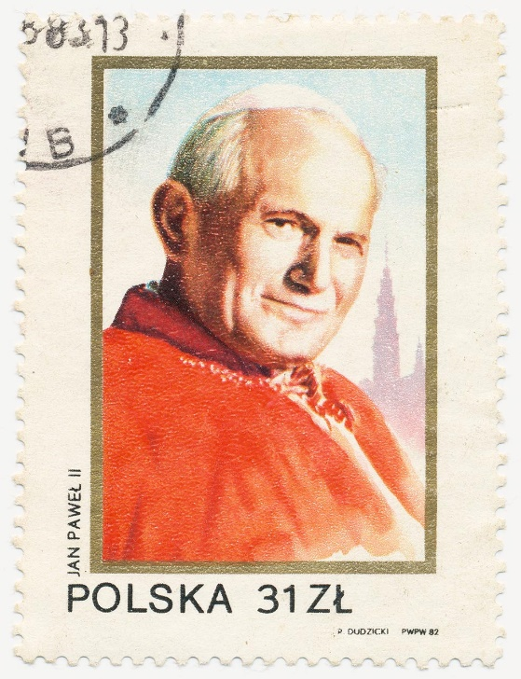
Pope Saint John Paul II
Pope Saint John Paul II also attended the Council. He was chosen as pope in 1978.
His term of 27 years was among the longest in history.
He inaugurated World Youth Day.
He died April 2, 2005.
© Solodov Alexey / Shutterstock.com

Slide 8
Journal It!
If you were the Pope, what would your name be? What would you do for the Church? for the world? for young people?
As Pope _______, write a letter of encouragement to people of good will around the world. Write something special to young people your age. Explain how we can all follow Jesus more sincerely and more closely.

Slide 9
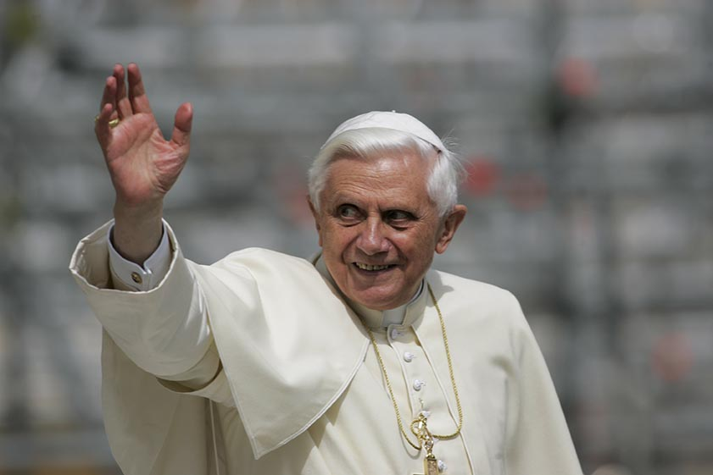
“Historic Times” (Church History, pages 130–136)
The popes of the 21st century, Pope Benedict XVI (shown here) and Pope Francis, dedicated their papacies to the Church as proclaimer of the Gospel and helper of the poor.
© Gasper Furman / Shutterstock.com

Slide 10
Pope Benedict XVI
Pope Benedict was born in Germany in April 1927.
He was well-known as a theologian and writer.
As Pope, he wrote a famous encyclical called “God Is Love.” He also emphasized that faith should influence modern culture.
Due to his failing health, Pope Benedict resigned in February of 2013. He spends his days in a small monastery near Saint Peter’s Basilica, in prayer and study. His title is now “Pope Emeritus Benedict XVI.”

Slide 11
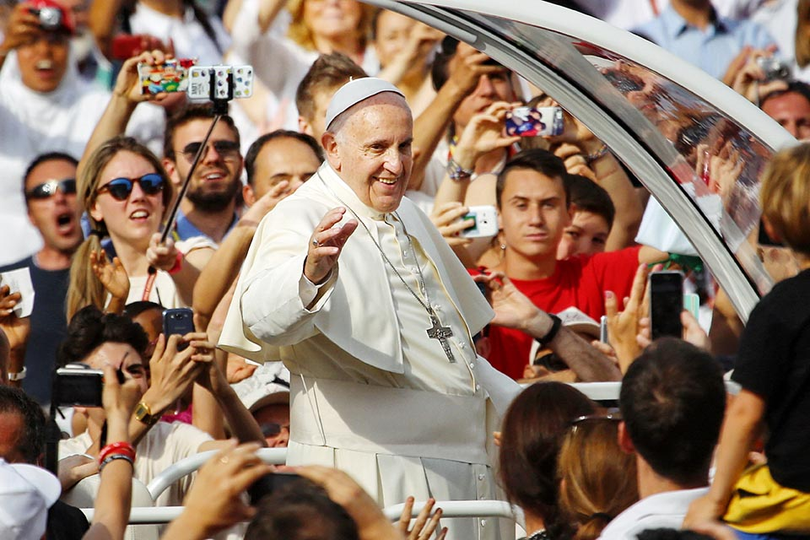
Pope Francis
Pope Francis was born in Buenos Aires, Argentina, in 1936. He is the first pope to have been elected from the Americas.
He belongs to the Society of Jesus (Jesuits), an order of priests and brothers devoted to education and to social justice.
He chose the name Francis to signal his concern for the poor, in imitation of Saint Francis of Assisi.
His first encyclical was called, “The Joy of the Gospel.” Following Christ and serving others is a joyful way of life!
© MikeDotta/Shutterstock.com

Slide 12
Think About It!
Gather in groups of two or three.
Imagine that you have been chosen as youth advisors to Pope Francis. He has asked you to list your problems and concerns as well as what solutions you propose.
Share your list of problems and solutions with your group.

Slide 13
“Reasons for Hope” (Church History, pages 136–138)
There are many problems
in the world but, because
Jesus is with us, there are
also many reasons
for hope.
© 2jenn/Shutterstock.com

Slide 14
Some Good Reasons for Hope
Pope John Paul II was hopeful and enthusiastic about the Church in the United States because:
Young people respond to God’s call to serve.
Lay leadership flourishes.
Young people express their faith in unique ways.
Immigrants re-vitalize parishes.

Slide 15
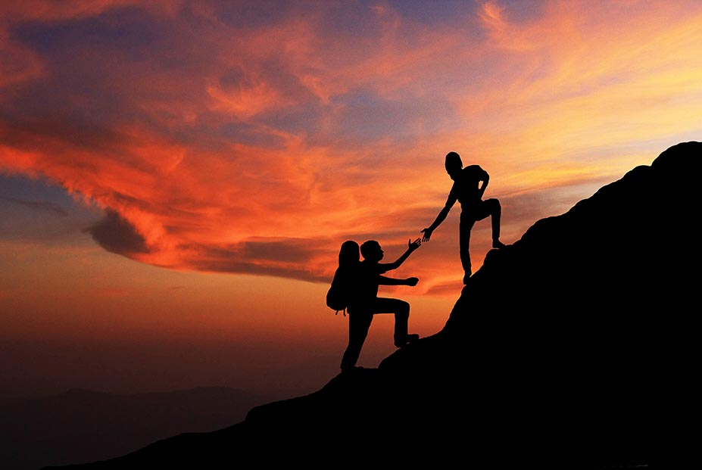
“You Are the Future” (Church History, pages 138–142)
Modern Catholics face many challenges, but history teaches us that challenges are to be expected for the followers of Christ.
© wanphen chawarung / Shutterstock.com

Slide 16
Proclaim It!
Pope Francis has focused the world’s attention on three important issues:
Reducing the gap between the rich and the poor
Taking care of the earth
Welcoming and supporting immigrants
In groups of two or three, sketch out a Facebook page focused on promoting one of these issues. Choose an image, make a slogan, and make a list of action steps someone might take.

Slide 17
A Last Word from Pope Francis
No other generation has had the opportunity to communicate so quickly with so many people. As Pope Francis has reminded us, media is a great gift and a great responsibility!
How can you use social media wisely, with respect and love?
Think, pair, and share on this question!
© squarelogo/Shutterstock.com

