Slide 1
Images of Church
The Church
Unit 4
Document #: TX005571

Slide 2

Body of Christ
Together, we form the Body of Christ.
This is the most prominent image in Paul’s letters and the only one with no Old Testament equivalent.
Christ the Head rules and nourishes the Body.
© Vibrant Image Studio/Shutterstock.com
Notes:
Notes: 1 Corinthians 10:16–17, 12:12–13,20

Slide 3

Salt of the Earth
Jesus said to his disciples, “You are the salt of the earth” (Matthew 5:13).
Of all the spices, salt may be the most necessary (every body must have salt) and the tastiest.
Jesus calls us to bring out the true flavor and goodness of the world, not only in ourselves but also in others.
© skhoward/iStock.com

Slide 4
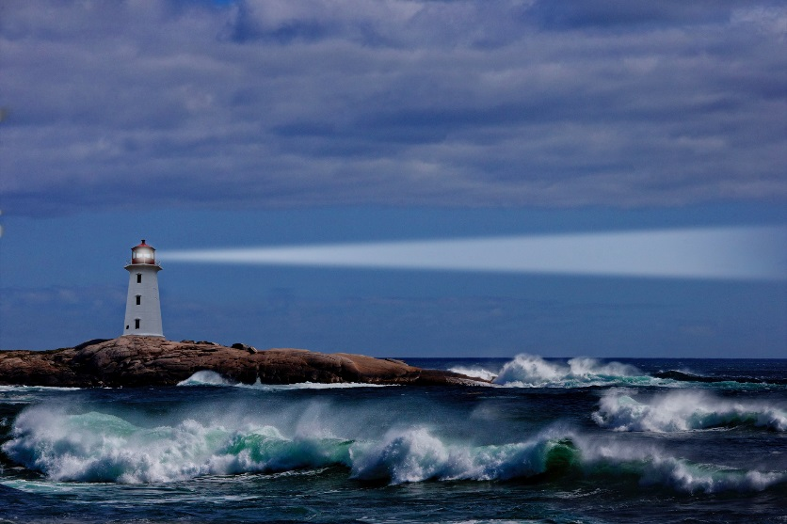
Light
Jesus tell his disciples, “You are the light of the world” (Matthew 5:14).
Jesus encourages us to put a light on a lampstand, “where it gives light to all in the house” (Matthew 5:15).
“Just so, your light must shine before others, that they may see your good deeds and glorify your heavenly Father” (Matthew 5:16).
© stevecoleimages/iStock.com

Slide 5

Bride of Christ
The Church is the Bride and, therefore, Christ is the Groom, to whom the Church is promised and given.
This metaphor speaks of Christ’s great love for the Church.
©Sven Bannuscher / Shutterstock.com

Slide 6
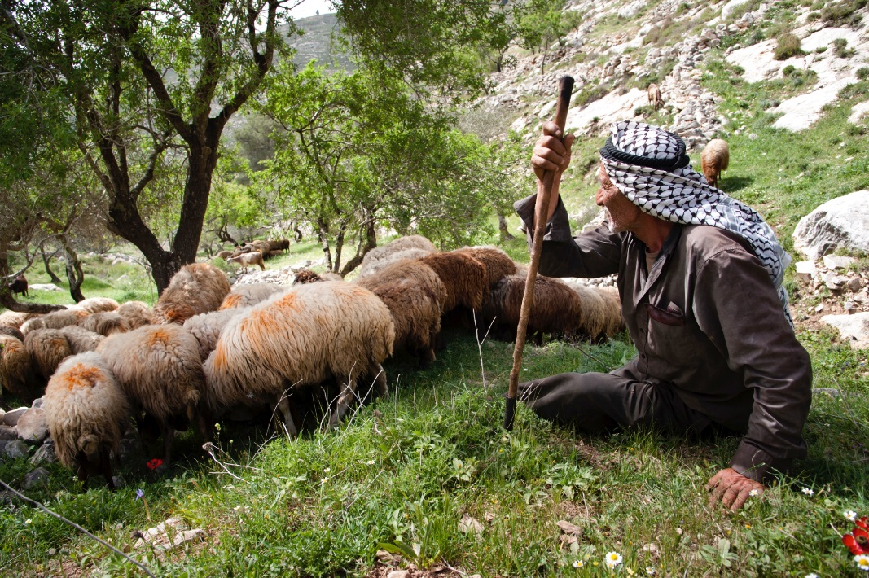
Christ’s Flock
Jesus is the Good Shepherd, the Great Shepherd, and the Chief Shepherd, who knows and watches over his sheep and gives his life for them.
They know his voice and follow him.
© rrodrickbeiler/iStock.com
Notes:
Notes: John 10:11, Hebrews 13:20, 1 Peter 5:4, Luke 12:32

Slide 7
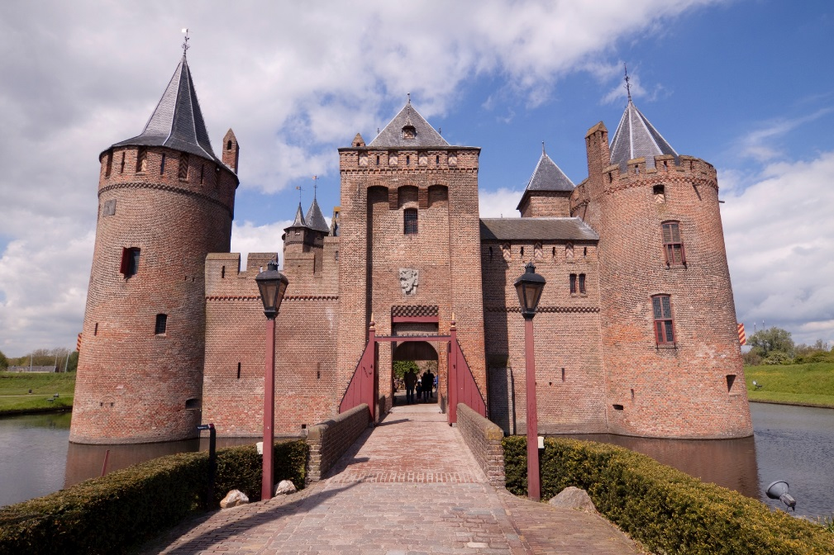
Kingdom
It is the Kingdom of God’s beloved Son, a Kingdom of “righteousness, peace, and joy in the holy Spirit” (Romans 14:17), in which he exercises his rule in his People through the Spirit.
© Lingbeek/iStock.com
Notes:
Notes: Colossians 1:13

Slide 8
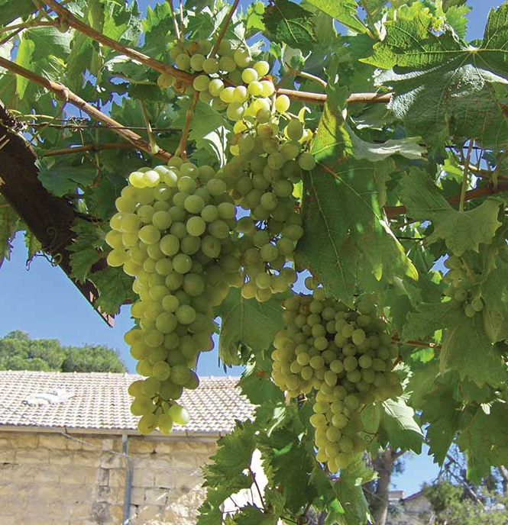
Vine and Vineyard
Jesus uses the metaphor of the vine and the branches to describe the intimate relationship he has with his disciples.
He is the true vine, his Father the vine grower, and his disciples the branches.
Only if they abide in him, and he abides in them, will they bear fruit.
© Brian Singer-Towns/Saint Mary's Press

Slide 9
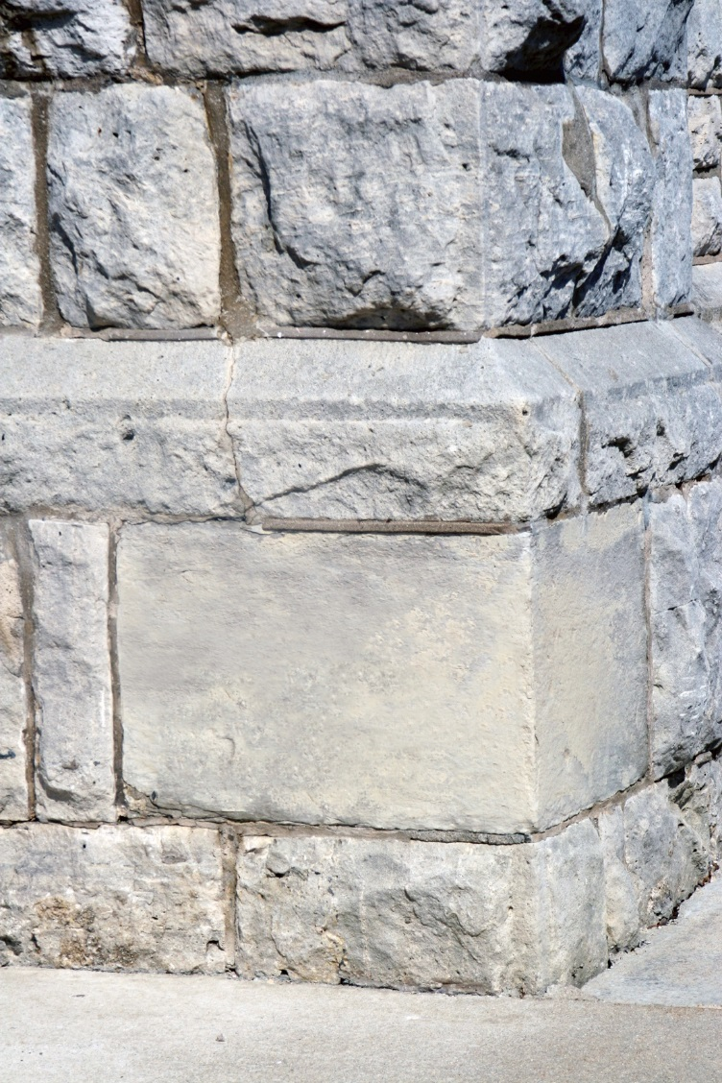
Temple of the Holy Spirit
God’s People are a building “not made with hands” (2 Corinthians 5:1), which God is constructing.
Peter refers to Christians as “living stones.”
The structure of the temple of the Holy Spirit depends on Jesus Christ as the “cornerstone” for its coherence and stability.
© carolo7/iStock.com

Slide 10
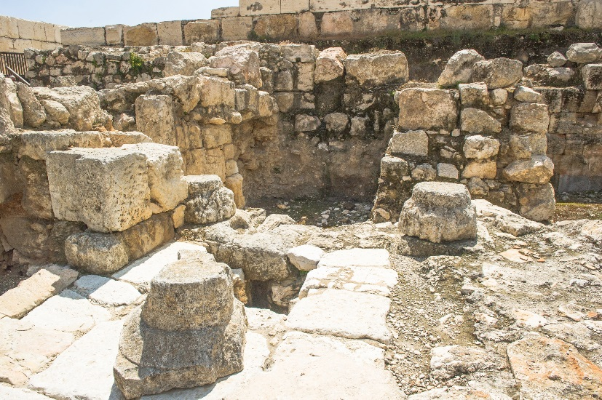
Temple of the Holy Spirit (cont’d.)
Paul gives a severe warning to any who would cause division in the fellowship, as was happening in the Corinthian Church: “If anyone destroys God’s temple, God will destroy that person; for the temple of God, which you are, is holy” (1 Corinthians 3:17).
©Anton_Ivanov / Shutterstock.com
Notes:
Notes: Emphasize that we are to take care of our bodies, gifts given to us by God, to help us to serve him and his Church by all means possible.

Slide 11

Family
This is the most pervasive metaphor for the Church in the New Testament.
We become children of God the Father by having faith in Jesus Christ, the Son, and by receiving the Holy Spirit.
Baptism is the symbol of our adoption into the family of the triune God.
© DNF Style /Shutterstock.com

Slide 12

People of God
This image is rooted in the Old Testament covenants, where God accompanies and loves the Israelites.
The New Covenant, sealed in the Lord’s blood, invites all people everywhere to unite.
God calls the Church into existence, forming a community of faith, hope, and love centered in Christ and empowered by the Holy Spirit.
© Yuri_Arcurs/iStock.com

Slide 13
Common Theme
The common theme of these images of the Church is relationships:
• God’s relationship with his People as Husband, King, Father, Builder
• the People of God’s relationship with God as Bride, Flock, Family, Body
• our relationship with one another as branches of the same vine, sheep in the same flock, children in the same family, members of the same body

Slide 14
Acknowledgment
The Scripture quotations on slides 3, 4, 7, 9, and 10 are from the New American Bible, revised edition © 2010, 1991, 1986, 1970 Confraternity of Christian Doctrine, Inc., Washington, D.C. All Rights Reserved. No part of this work may be reproduced or transmitted in any form or by any means, electronic or mechanical, including photocopying, recording, or by any information storage and retrieval system, without permission in writing from the copyright owners.

