Slide 1
Revelation
Document #: TX004829

Slide 2

How We Come to Know Others:
A Conversation Starter
Call to mind your best friend.
How did you first meet your
best friend?
Were you drawn to your
friend by what others told
you about him or her or
by what you discovered
about him or her as you
got to know that person?
© shutterstock / Dmitriy Shironosov
Notes:
These prompts can be left as rhetorical questions or you can solicit answers from the students. The goal is to get the students to understand that we come to know our friends not just by what others tell us about them, but by what they reveal to us as the relationship grows. This will serve as an analogy of coming to know God.

Slide 3
How We Can Discover God
There are several ways people come to a knowledge of God.
Many of these ways involve a deep, personal experience with God.
A person can come to discover God through prayer, through Scripture, and through various lived experiences in a community of faith.
One can also discover God through the use of the intellect, through daily life and observation of the natural world, and through the faith of others.

Slide 4
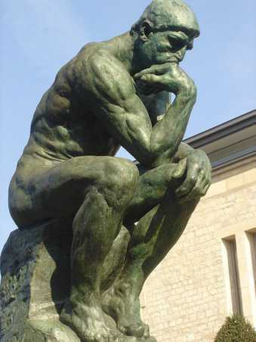
Discovering God Through the Human Intellect
Saint Thomas Aquinas and Saint Anselm gave proofs for the existence of God that appeal to our intellect.
We discover God through our human intellect when our reasoning leads us to acknowledge God as Creator and by having a sense of awe at his work in creation.
The proof of God’s existence through order tells us that the human intellect can lead a person to realize that order in the universe implies a design and that a design implies a designer.
Image in public domain
Notes:
Saint Thomas Aquinas’s proofs of the existence of God were reviewed in the previous course. If time did not allow for the proofs to be reviewed in that course, they can be reviewed at this time. This would also be a good opportunity to review the proofs given by Saint Anselm.

Slide 5
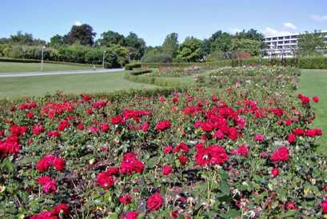
Discovering God in Our Daily Lives or in the Natural World
God can be discovered in the
ordinary events of our daily
lives.
His presence is discernable
in a kind word, a kind action,
or a holy thought or desire.
Many discover God through
his creation, when they see a beautiful sunrise, gaze across the ocean, take a walk along the beach, or observe the beauty of a ladybug perched on a finger.
Saint Francis of Assisi was able to see God’s beauty in all creation.
Public domain
Notes:
An added exercise can be to have an audio recording of the song “Canticle of the Sun,” by Marty Haugen and David Haas (Come and Journey, GIA Publications, 1996), to accompany this slide. The song can be played and the students can be asked how the lyrics voice the concept on this slide.

Slide 6
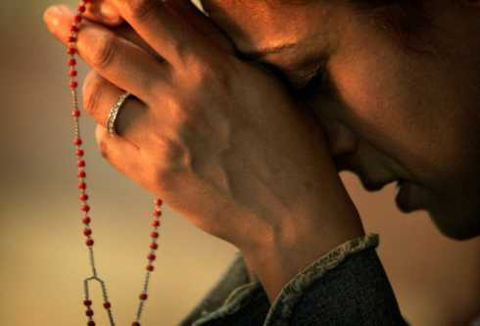
Discovering God Through the Faith of Others
Some people discover God when they see others live out their faith.
A quotation attributed to Saint Francis of Assisi states: “Preach the Gospel at all times. When necessary, use words.”
People have been moved by seeing the devotion and love with which people receive Holy Communion.
People are moved by seeing the social action taken by others who are on fire with faith.
© blogs.reuters.com
Notes:
A reference can be made to the PowerPoint “God’s Existence” (Document: TX001169), when students created a list of the characteristics of a faith-filled person.

Slide 7
Review
In the next couple of slides, I will present scenarios.
Each scenario will end indicating which way the person discovered God—through human intellect, through daily life or the natural world, or through the faith of others.
After the scenario has been read, I will ask you to raise your hands to indicate if you think the given way to discover God is true or false.

Slide 8
I was thinking about God and his creation of the universe the other day, and said, “Wow!” I was discovering God through my human intellect.
True or False?
Notes:
True. I am discovering God through my human intellect and thought processes.

Slide 9
I was gardening the other day and looking at how amazing the smallest flower was. I was encountering God in the faith of others.
True or False?
Notes:
False. I am discovering God through the natural world.

Slide 10
The other day my mom gave me a huge hug when I came home from school after a bad day. I realized that my mom is the best and that I learn about God’s love for me because of her love for me. I was discovering God in my daily life.
True or False?
Notes:
True. I am discovering God in my daily life.

Slide 11
I arrived at Mass early recently and noticed an elderly woman, who had trouble moving, clutching a rosary in her hand while mumbling the prayer. I was impressed by her faith and resolved to at least say a decade of the rosary. I was discovering God through the human intellect.
True or False?
Notes:
False. I am discovering God through the faith of others.

Slide 12
What are examples of ways you have discovered God?
Notes:
Conclude this presentation by inviting students to share examples of how they have discovered God. You may choose to offer the following prompts for the different ways we can discover God:
How have you discovered God using your intellect? What have you learned in your religion classes that has brought you closer to God?
Where in your daily life have you experienced God? Have you ever had an experience seeing God’s creation that helped you to more fully discover God?
Who in your life has helped you discover God through the example of their faith?

