Slide 1
Examining Economic Justice
Catholic Social Teaching
Document #: TX002019
Notes:
[Music: Introduction music such as “Peace Is Flowing like a River”]

Slide 2

The principle of the universal destination of goods holds that the earth’s goods should be distributed fairly among all the people of the earth. God has provided for all people to have their basic needs met if we share the earth’s goods fairly.

Slide 3
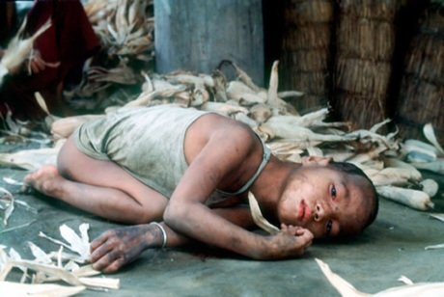
Economic Justice Issues
Poverty
Hunger
Human Work / Labor
Economic Systems

Slide 4
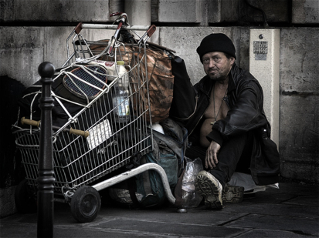
National and World Scope of Hunger and Poverty
WikiMediaCommons
925 million people worldwide suffered from hunger in 2010.
1.4 billion people lived in extreme poverty in 2005.
One in eight U.S. citizens lived below the poverty line in 2009.
More than 1.7 million Los Angeles County residents were at risk of hunger in 2009.

Slide 5
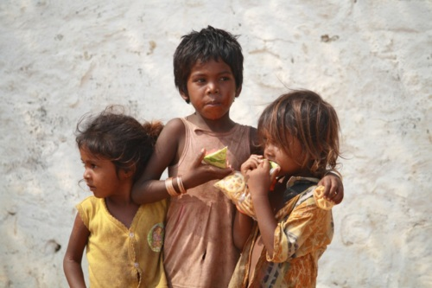
Poverty and Hunger
Are a result of human sin
Are supported by sinful social structures
Are not inevitable, because adequate resources exist and systems can be changed

Slide 6
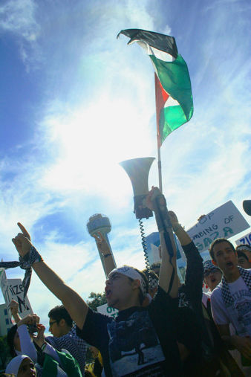
Democracy
Even democracies can have small groups of powerful people.
Catholic social teaching endorses democracy as a solution to poverty and hunger.
Discussion
How is the concept of democracy spreading across the globe?

Slide 7
Causes of Poverty
lack of infrastructure people need
lack of clean water
spread of disease
greed and selfishness
economic injustices by businesses and nations
racism and sexism
What other causes can you name?

Slide 8
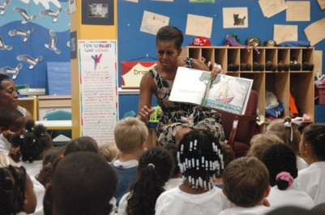
Ways to Address Poverty
building infrastructure for education, fair trade, health care, better transportation, and water systems
calling for a worldwide effort to promote development
paying fair wages and practicing economic justice in business
governments regulating business to ensure just economic practices
changing people’s hearts from selfishness to solidarity
respecting the dignity of each person
What other ways can you name?

Slide 9
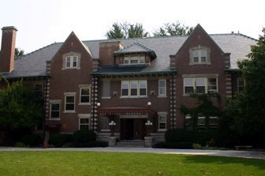
The Gap between Rich and Poor
The richest 1 percent of the world’s adults own 40 percent of the world’s assets.
Greed and the lack of moral social structures prevent unequal distribution of the earth’s goods.
These inequities are detrimental to the development of social solidarity and community.
Discussion
In what ways is a gap between rich and poor evident in your community?

Slide 10
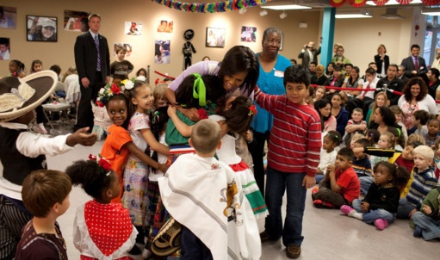
What Justice Requires
Justice requires all members of society to work for economic, political, and social reforms.
Justice requires the reduction of social and economic inequities.
Justice requires the promotion of a healthy economy, just wages, and social solidarity.

Slide 11



What can you do to fight poverty and hunger?
Live a simpler lifestyle
Donate time and money to people in need
Support local economy and workers
Advocate to reduce poverty
What else can you do?

Slide 12
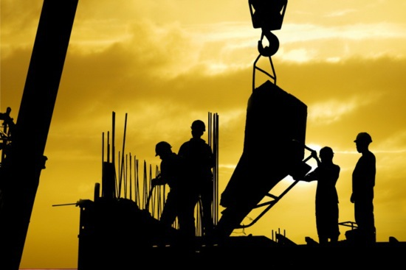
What Is
Human Work?
Human work is labor directly tied to the just distribution of resources.
Human work is part of God’s plan of creation.
Image in shutterstock

Slide 13
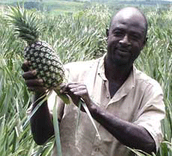
Purpose of Work
To be partners with God in caring for the earth’s resources
To contribute to human dignity and the common good
To model our lives and our work after Jesus

Slide 14
Duty of Work
What do we mean when we say “the duty of work”?
Work is not an option.
Every person who is able to work has a duty to work.
Through work we help to create a just world.
Working for justice changes social structures.

Slide 15

Workers’ Rights
What do we mean when we say “the rights of workers”?
Right to work
Right to participate in ownership, decision making, and profits of business
Right to rest from work
Image in shutterstock
Right to enjoy equal pay and benefits
Right to be paid a just wage
Right to form labor unions and associations, and to strike if necessary

Slide 16
Labor and Capital
In economics, capital is a term used to describe . . .
materials needed to make a product or provide a service
money needed to start a business
human skills and knowledge necessary for business success
Discussion
Why is human capital considered the most important economic capital?

Slide 17

Economic Systems
Capitalism is based on private ownership of goods and the free-market system.
Socialism is based on the creation and distribution of goods by the entire community or by the government. Socialism is condemned by Catholic social teaching.
By Katrina.Tuliao [CC-BY-2.0 (www.creativecommons.org/licenses/by/2.0)], via Wikimedia Commons
A moral economic system ensures the just distribution of the earth’s goods.

Slide 18
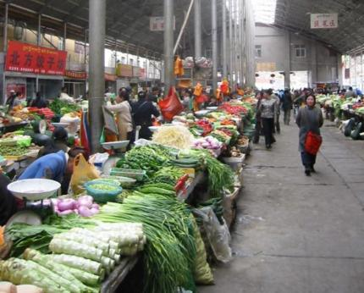
The Free Market
The free market means . . .
effective delivery of goods and services
a market system in which individuals and businesses are free to create and sell goods and services at a price they choose
By Nathan Freitas (http://www.onwardtibet.org/ (site is down)) [CC-BY-SA-2.0 (www.creativecommons.org/licenses/by-sa/2.0)], via Wikimedia Commons

Slide 19
The Free Market (continued)
The free market should . . .
respond to needs for important products and services
help to keep prices low and businesses’ profit goals fair
encourage individuals and businesses to take risks in developing new and better products and services
By Nathan Freitas (http://www.onwardtibet.org/ (site is down)) [CC-BY-SA-2.0 (www.creativecommons.org/licenses/by-sa/2.0)], via Wikimedia Commons
encourage businesses to be efficient and conserve the earth’s resources

Slide 20
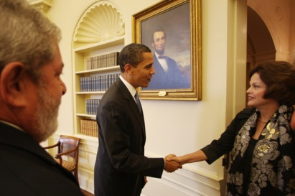
Government and business must work together for . . .
fair distribution of the earth’s goods
protection of consumer and worker rights
protection of the environment
Discussion
Give examples of how government and business can improve working relationships.

Slide 21
True success and happiness include . . .
becoming more like Christ and following
his plan
staying open to God’s love
Discussion
How do you define happiness?
How do you define success?

