Slide 1
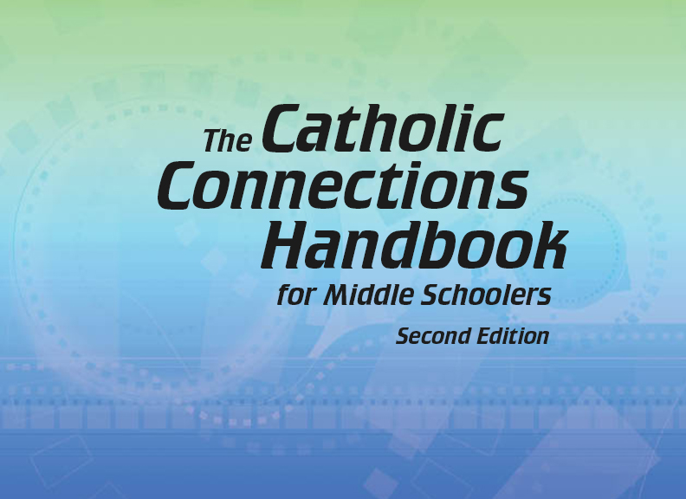

Document #: TX005817

Slide 2
Liturgy
and Sacraments
Chapter 30
The Eucharist: The Liturgy of the Word

Slide 3
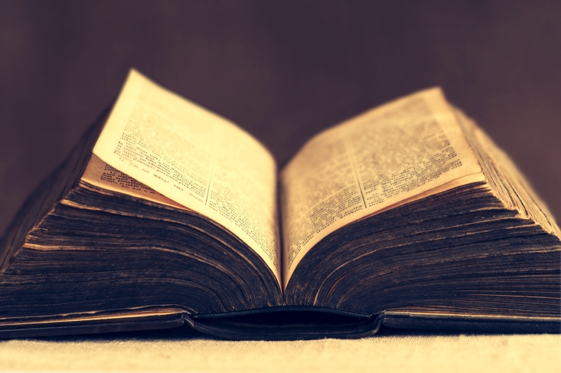
Chapter Summary
In this chapter, we will consider the Liturgy of the Word. In this first part of the Eucharistic celebration, the Word of God
is proclaimed through biblical readings and is related to our lives in the homily.
© I. Grasbergs / Shutterstock.com
The Church responds in creed and prayer.

Slide 4
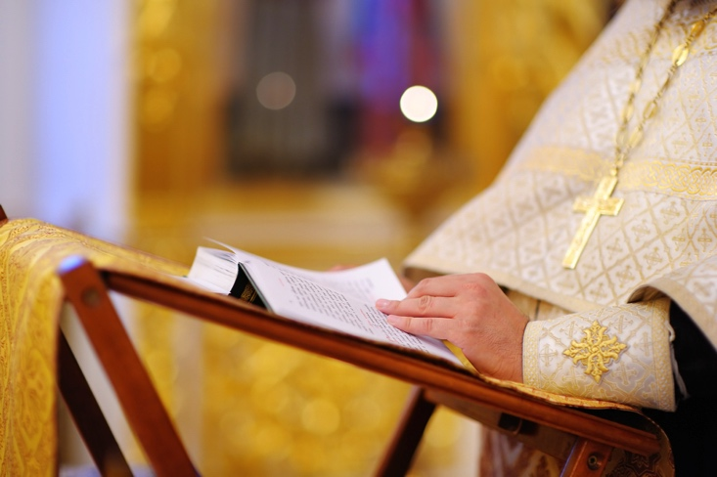
Introduction
(Handbook, pages 318–319)
The Liturgy of the Word proclaims the important events from salvation history and consists of biblical readings, a homily, the Creed and the Prayer of the Faithful.
© MariaSbytova/Shutterstock.com

Slide 5
Post It!
Take a sticky note.
Write one thing that the Scriptures (Liturgy of the Word) reveal to us, when read during the Mass.
Post the sticky note to the board.
© Pockygallery/Shutterstock.com

Slide 6
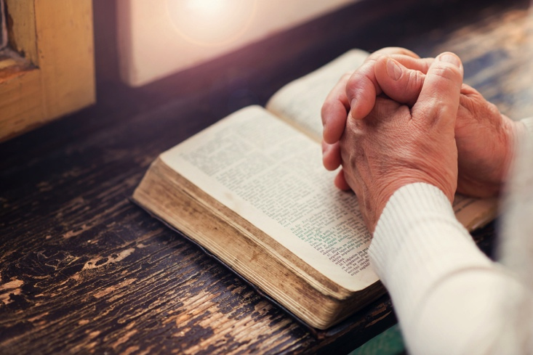
“Jesus, the Word of God”
(Handbook, pages 319–320)
Jesus is the Logos,
God’s Word Made Flesh.
© Halfpoint/Shutterstock.com

Slide 7
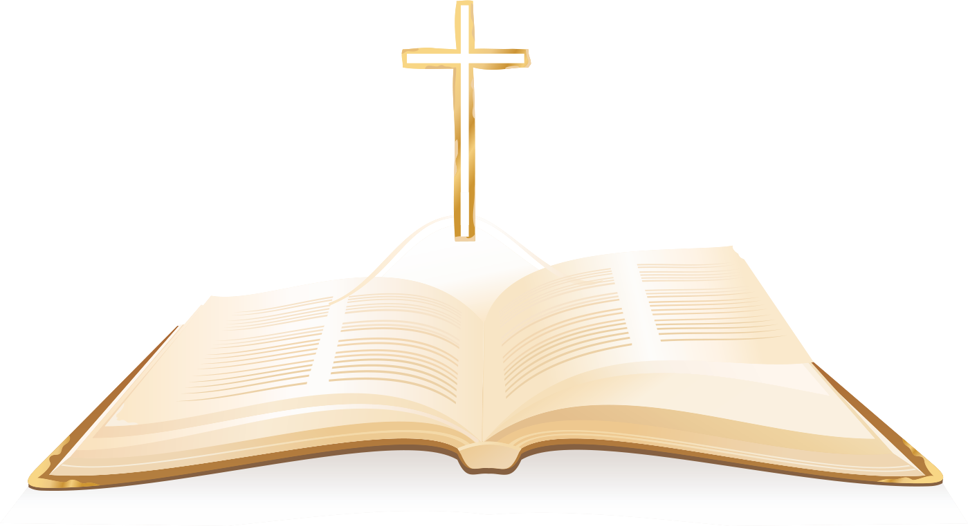
Journal It!
© Olesssia/Shutterstock.com
Write in your journal about how Jesus is the Word Made Flesh.
How is Jesus made real?
Where do you see Jesus revealed in your life?

Slide 8
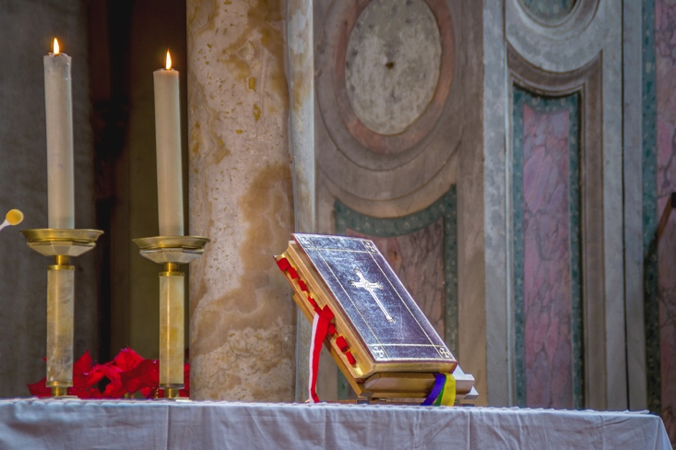
“The Liturgy of the Word”
and “The Gospel Reading”
(Handbook, pages 321–323)
The Liturgy of the Word on Sundays includes readings from the Old Testament, a Psalm, a reading from a New Testament letter, and a reading from the Gospel. The readings are followed by the homily, the Creed, and the Prayer of the Faithful.
© Thoom/Shutterstock.com

Slide 9

Review It!
What does the Liturgy of the Word
for Sunday Mass include?
Put the following components in the order they happen.
What component is missing?
© iQoncept/Shutterstock.com
Old Testament
New Testament
Letter
Psalm
Homily
Gospel
Creed
Notes:
Answers:
Order: Old Testament, Psalm, New Testament Letter, Gospel, Homily, Creed
Missing: Prayer of the Faithful

Slide 10
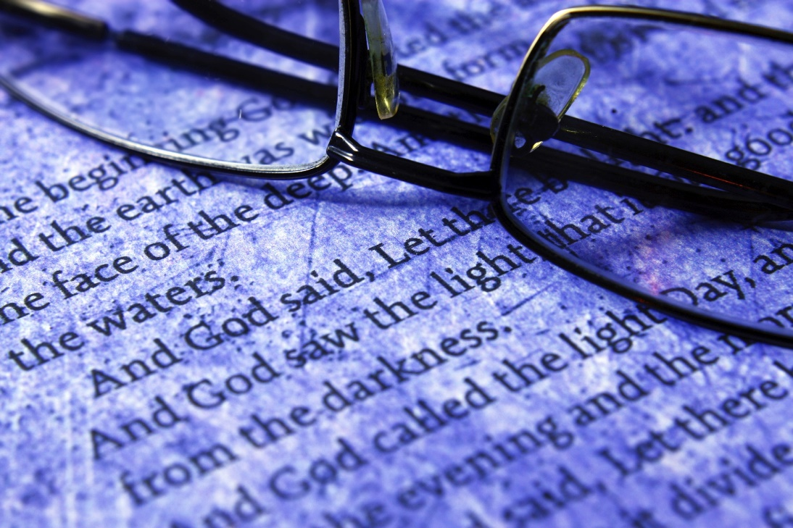
“Feeding on the Word”
(Handbook, pages 323–326)
The Liturgy of the Word is ultimately about hearing the Word of God, applying it to our lives through the homily, and then responding with the Creed and by offering prayers for others.
© alexskopje/iStock.com

Slide 11

Post It!
Take three sticky notes.
Write three common themes we hear during the Liturgy of the Word, one theme on each sticky note.
Post the sticky notes to the board.
© Photoevent/iStock.com

