Slide 1
The Church Is Catholic
The Church
Unit 2, Chapter 6
Document #: TX005556
© 2016 Saint Mary’s Press
Living in Christ Series

Slide 2


The Meaning of the Word Catholic
The third Mark of the Church is that she is Catholic. In one sense of the word (“universal”), it signifies that she is in relationship with every person.
“The Church has it all,” because she has “all” of Christ and all of the means of salvation.
“The Church calls to all,” inviting everyone.
© 2016 Saint Mary’s Press
Living in Christ Series
© RTimages / Shutterstock.com
Notes:
Notes: Direct the students to read the quotation from Saint Cyril of Jerusalem in article 24 of the student book, and to answer the question that concludes that article, “How might you summarize in your own words Saint Cyril’s explanation of the word Catholic?”

Slide 3
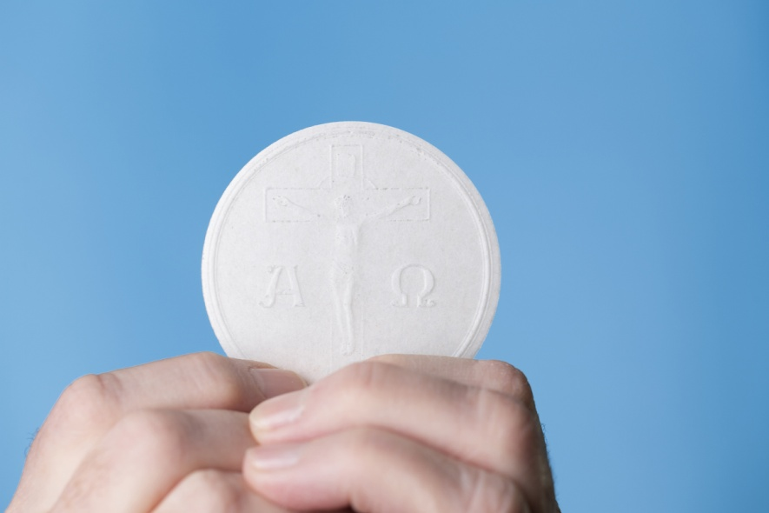
Catholicity: The Fullness of Christ in the Church
Each particular church, in union with Rome, has the full means of salvation within it.
The Church is fully present throughout the world . . .
but she is also fully
present in given
locations, which differ
from one another.
© Hanzi-mor / Shutterstock.com
© 2016 Saint Mary’s Press
Living in Christ Series
Notes:
Notes: Ask the students to close their eyes; tell them to “see” the Church. Ask what they see. Review the definitions of Church from chapter 1, as in article 25 of the student book, relating them to what the students pictured. Explain that the fullness of Christ and the means of salvation exist in each of these three references.

Slide 4
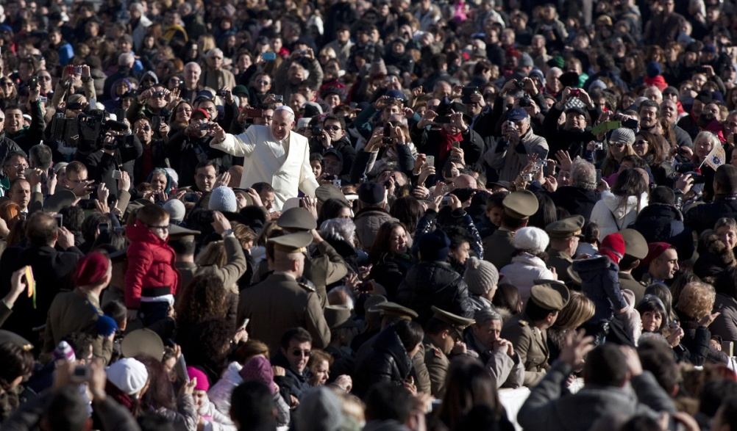
Catholicity and the Roman Catholic Church
Particular churches possess the catholicity of the apostolic faith when they are in communion with the Church of Rome.
They recognize the authority of the Pope, the visible foundation for unity.
© giulio napolitano / Shutterstock.com
© 2016 Saint Mary’s Press
Living in Christ Series
Notes:
Notes: Ask for other examples where a person is a “visible foundation for unity.” Point out that we who recognize the Pope as the leader of the universal Church are united with him, and with all others who recognize his authority.

Slide 5
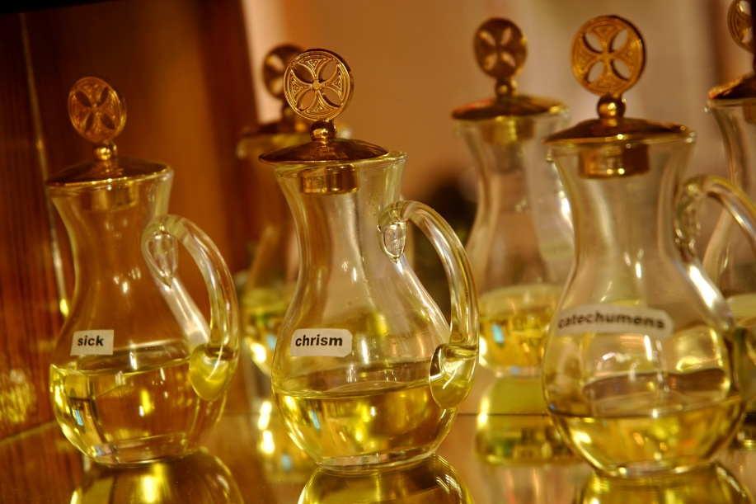
The Fullness of the Sacraments
The Church celebrates all Seven Sacraments that Christ instituted.
They express fullness in the sense that they touch the totality of a person’s life.
© Ezz Mika Elya / Shutterstock.com
© 2016 Saint Mary’s Press
Living in Christ Series
Notes:
Notes: Ask which Sacraments lay the foundation for the Christian life (Baptism, the Eucharist, Confirmation); which continue Christ’s work of healing (Penance and Reconciliation, Anointing of the Sick); and which reflect the Church’s mission to the world (Matrimony, Holy Orders).

Slide 6
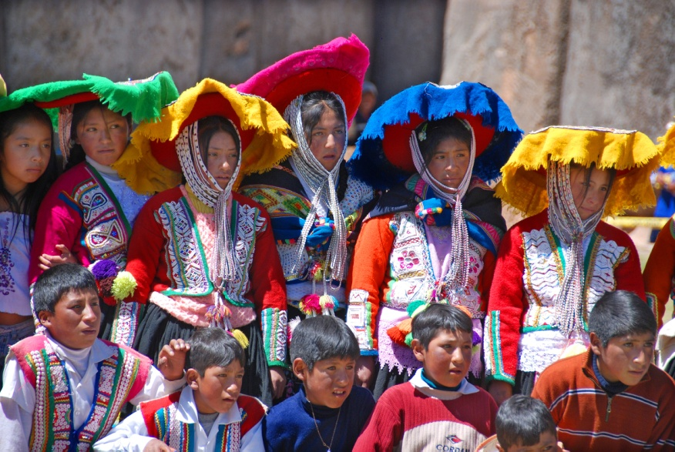
The Church’s Relationship with All People
The Church is open to dialogue with people of non-Christian religions.
Non-Christian religions
seek God, and
goodness and truth
can be found in them.
The Church considers
this goodness and
truth to be a preparation
for the Gospel.
© meunierd / Shutterstock.com
© 2016 Saint Mary’s Press
Living in Christ Series
Notes:
Notes: Point out that the Church has a duty to proclaim the Gospel to all, while still acknowledging and encouraging spiritual and moral truths found in other religions.

Slide 7
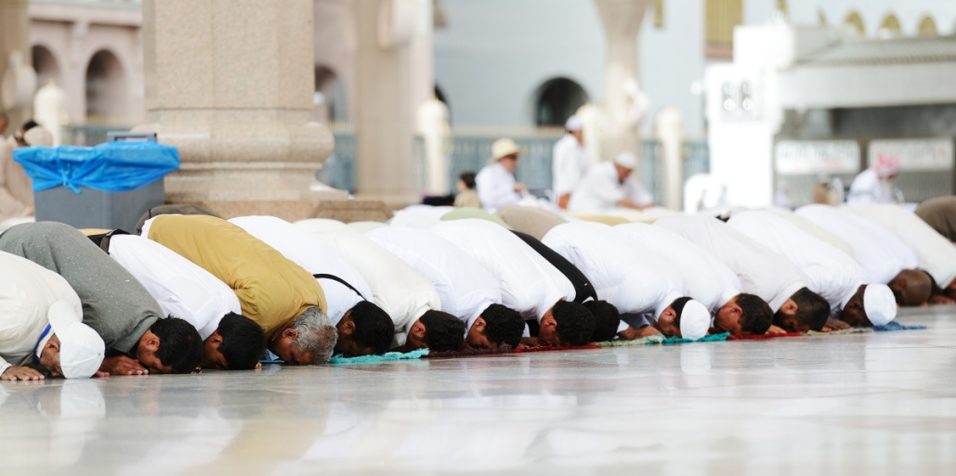
The Church’s Relationship with Jews and Muslims
There are many links between the Church and the Jewish people and religion.
The Jewish people remain dear to God.
God’s plan of salvation also includes Islam.
© 2016 Saint Mary’s Press
Living in Christ Series
© Zurijeta / Shutterstock.com
Notes:
Notes: Ask volunteers to name some things Catholics and Jews have in common, and some things Catholics and Muslims have in common. Explain that the Church teaches that we should not blame Jewish people for the death of Christ, as was done in the past.

Slide 8
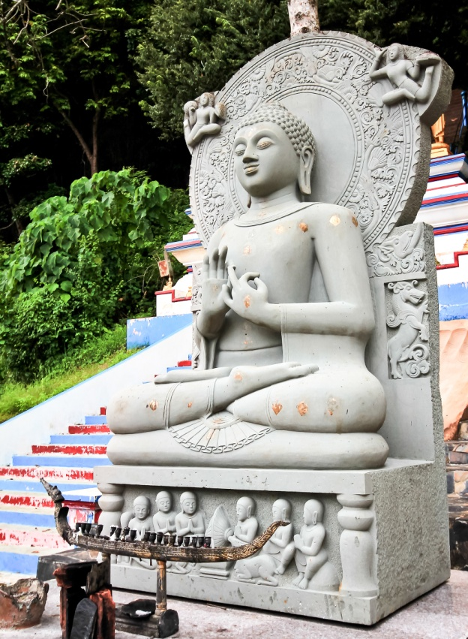
The Church’s Relationship with Other Non-Christian Religions
Hindus and Buddhists search for the one God.
The Church deeply respects people of different religious traditions.
The Church is connected with all people, even those with no religion.
© sayyanj / Shutterstock.com
© 2016 Saint Mary’s Press
Living in Christ Series
Notes:
Notes: Discuss some ways that missionaries and others may proclaim the Gospel in nonverbal ways, through symbols, through art, and by the way they live.

Slide 9
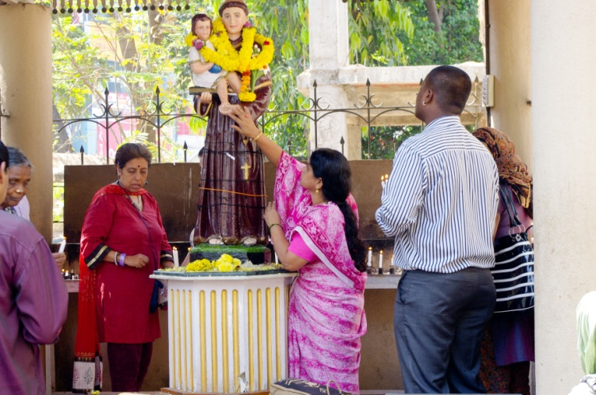
Universality and Diversity
We must embrace, not erase, differences of culture, race, wealth, or social class.
Our saints have come from various walks of life and places in the world.
© 2016 Saint Mary’s Press
Living in Christ Series
© Komar / Shutterstock.com
Notes:
Notes: If your students have researched saints for their Confirmation, ask several volunteers to identify those saints’ nationalities, social classes, and the work they did.

Slide 10
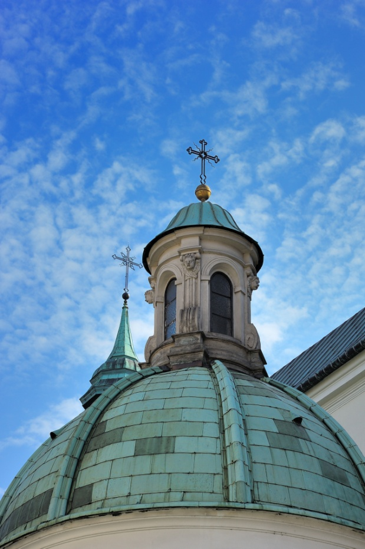
Eastern Catholic Churches
Eastern Churches separated from the Roman Church in the eleventh century.
Twenty-one churches have since returned to full communion with Rome.
Some of their rituals and practices differ from those of the Latin Church.
© gibleho / Shutterstock.com
© 2016 Saint Mary’s Press
Living in Christ Series
Notes:
Notes: Explain that Eastern Catholic Churches are distinct from the Eastern Orthodox Church, which is not in full communion with Rome. Discuss the bulleted examples in article 27 of the student book. If there are Eastern Catholic Churches near where you live, relate their history in the region.

Slide 11
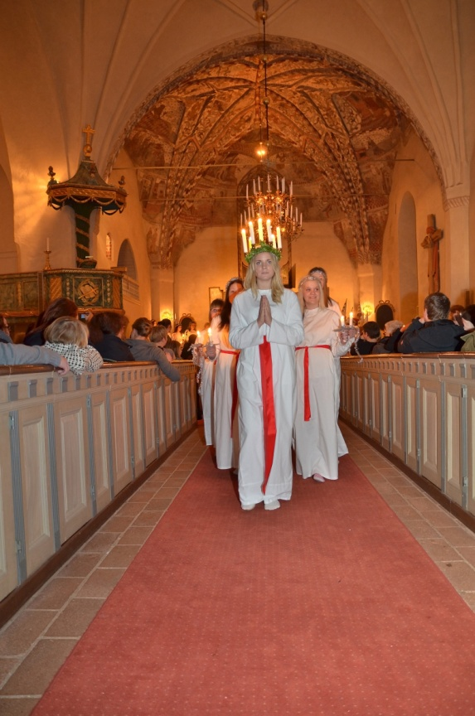
Additional Examples of Catholicity
The Church integrates diverse cultural elements and popular devotions into her unity:
pilgrimages, religious dances, religious processions
devotions to saints and to Mary tied to the culture of particular peoples
© Conny Sjostrom / Shutterstock.com
© 2016 Saint Mary’s Press
Living in Christ Series
Notes:
Notes: Ask the students for examples of religious practices or devotions that relate to their own cultures. (See the section “Additional Examples of Catholicity” in article 27 of the student book for examples.) Consider sharing examples from your culture as well.

