Slide 1
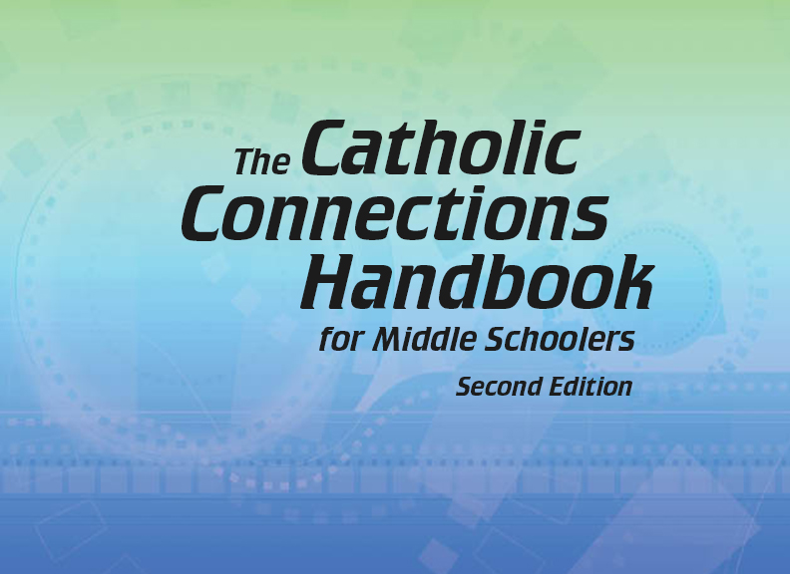


Slide 2

Christian Morality
and Social Justice
Chapter B
Respecting Life

Slide 3
Chapter Summary
Respecting Life
In the second half of chapter 42 in the Handbook, you will consider these topics in light of the Fifth Commandment: euthanasia, suicide, scandal, and war. Life-affirming alternatives exist! We can choose the path of peace, even in the most stressful situations.
© Ussr/www.shutterstock.com

Slide 4

“The Fifth Commandment: Living and Dying with Dignity” (Part 1)
(Handbook, pages 462–463)
The Fifth Commandment forbids us from purposely ending our own life, because doing so takes over a decision only God can make.
© YuryZap/www.shutterstock.com

Slide 5
“The Fifth Commandment: Living and Dying with Dignity” (Part 1)
(Handbook, pages 462–463)
Taking one’s life rejects God’s love, his gift of hope, and his call to respect our lives and the lives of others.
Suicide hurts family and friends as well as the person who chooses it. It deprives the world of that person’s gifts and talents.
Those who are thinking of suicide should confide in a caring adult.

Slide 6
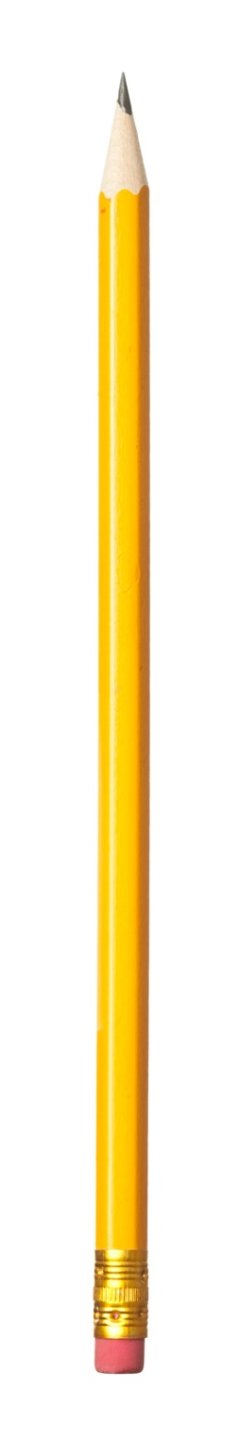
“The Fifth Commandment: Living and Dying with Dignity” (Part 1)
(Handbook, pages 462–463)
Journal It!
© RuslanDashinsky/www.istockphoto.com
Why is life so precious?
What makes it valuable?

Slide 7

“The Fifth Commandment: Living and Dying with Dignity” (Part 2)
(Handbook, pages 463–464)
There are end-of-life options that preserve the dignity of the dying person.
© J.Simunek/www.shutterstock.com

Slide 8
“The Fifth Commandment: Living and Dying with Dignity” (Part 2)
(Handbook, pages 463–464)
Ending someone’s life because he or she is suffering is called euthanasia.
Committing euthanasia to end the suffering of another person denies the dignity of the person and the respect we owe to God.
Hospice programs can help a person die with dignity and as pain-free as possible.
Extraordinary means to keep someone alive (means that might be painful, expensive, burdensome, or of doubtful benefit) need not be used, as long as the intention is not to cause death.

Slide 9
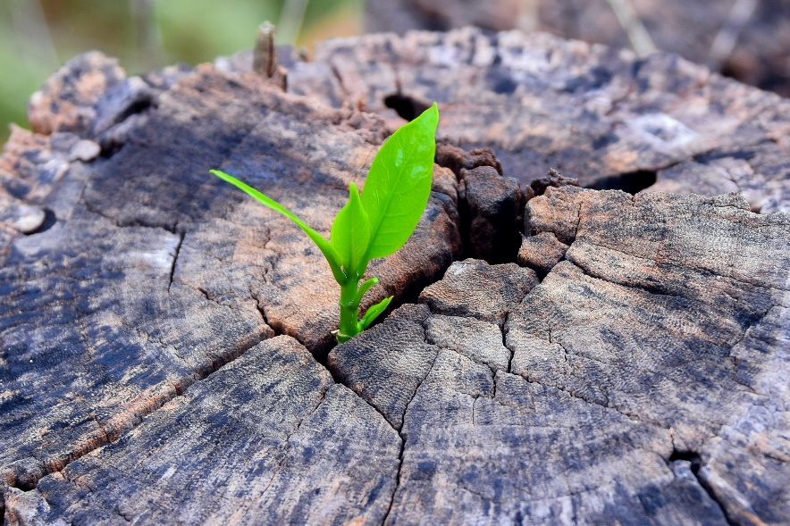
“The Fifth Commandment:
Living and Dying with Dignity” (Part 2)
(Handbook, pages 463–464)
At a funeral Mass, we say the following:
“Life is changed not ended.”
(The Roman Missal, “Preface I for the Dead”)
What do you think this means?
How does this portray the value of human life?
© Jes2u.photo/www.shutterstock.com

Slide 10
“The World We Live In”
(Handbook, pages 464–465)
Scandal leads to sin through action, attitude, or inaction.
© Sarunyu_foto/www.shutterstock.com

Slide 11
“The World We Live In”
(Handbook, pages 464–465)
Scandal can lead us to sin. We should avoid “giving scandal,” or being a bad example, and we should be careful not to follow bad examples set by others.
The first scandal presented to us in the Bible is in the Book of Genesis. As the story tells us, Eve encouraged Adam to join her in disobedience.

Slide 12
“The World We Live In”
(Handbook, pages 464–465)
People who are in positions of influence have a special obligation to avoid giving scandal.
Others influence us. This is a fact of life. We need to follow the good examples provided by others, and not the bad examples. We need to be good examples for the people we influence, and not bad examples.

Slide 13
“The World We Live In”
(Handbook, pages 464–465)
Journal It!
© RuslanDashinsky/www.istockphoto.com
In what ways can you work to avoid scandal in your actions, attitudes, or inaction?
What should you do if you fall into this sin?

Slide 14

“The World We Live In”
(Handbook, pages 464–465)
Because of the many evils and injustices that are part of war, we must avoid war if at all possible.
© Klublu/www.shutterstock.com

Slide 15
“The World We Live In”
(Handbook, pages 464–465)
War harms the human spirit. We should always avoid war, and it should always be a last resort.
When war occurs, the combatants must follow universally accepted principles that arise from natural law and the teachings of the Church.
War is not a game. It is a tragic reality. In war, both sides lose. We should not translate our competitive spirit into war, because so many lives are at stake on both sides.

Slide 16
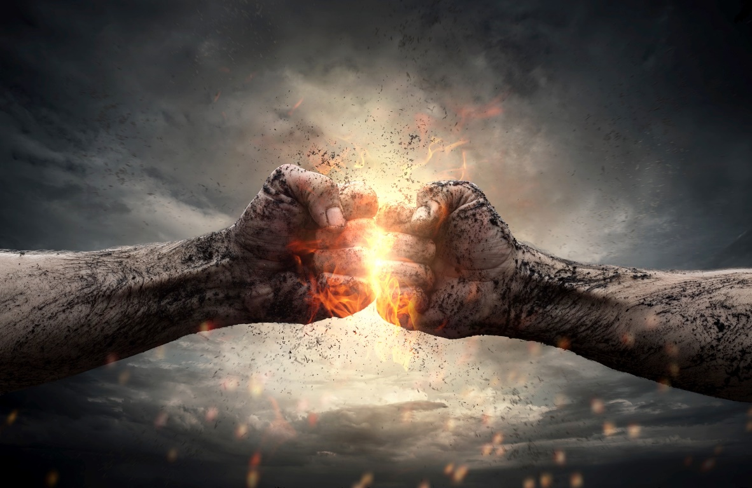
“The World We Live In”
(Handbook, pages 464–465)
Create a flowchart that depicts why war is to be avoided.
© Rangizezz/www.shutterstock.com

Slide 17
Acknowledgments
The excerpt about funeral Mass on slide 9 is from the English translation of The Roman Missal © 2010, International Commission on English in the Liturgy Corporation (ICEL) (Washington, DC: United States Conference of Catholic Bishops, 2011), page 622. Copyright © 2011, USCCB, Washington, DC. All rights reserved. No part of this work may be reproduced or transmitted in any form or by any means, electronic or mechanical, including photocopying, recording, or by any information storage and retrieval system, without permission in writing from the copyright holder. Used by permission of ICEL.
During this presentation’s preparation, all citations, facts, figures, names, addresses, telephone numbers, Internet URLs, and other pieces of information cited within were verified for accuracy. The authors and Saint Mary’s Press staff have made every attempt to reference current and valid sources, but we cannot guarantee the content of any source, and we are not responsible for any changes that may have occurred since our verification. If you find an error in, or have a question or concern about, any of the information or sources listed within, please contact Saint Mary’s Press.

