Slide 1
Jesus Reveals Our Call to Holiness
Jesus Christ: God’s Love Made Visible, Second Edition Unit 4, Chapter 12
Document#: TX004818

Slide 2
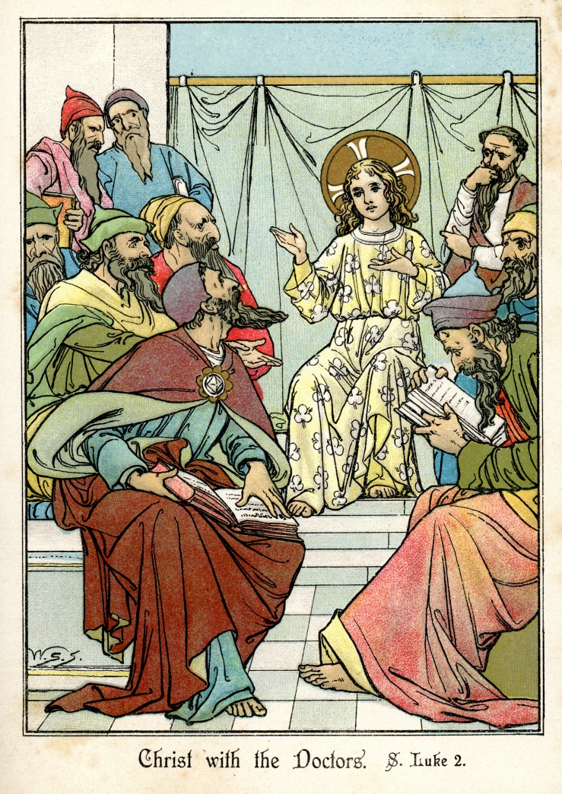
The Sermon on the Mount
The Sermon on the Mount is a collection of Jesus’ teachings on important topics.
The Gospel of Matthew presents these teachings as a speech given by Jesus.
© duncan1890 / iStockphoto.com
Notes:
Explain that in the Sermon on the Mount, we clearly see what Jesus asks of his disciples. If the students have Bibles, direct them to find Matthew 5–7 and to scan the headings. Ask which teachings are familiar.
This slide corresponds to content in article 53, “The Sermon on the Mount,” in the student book.

Slide 3
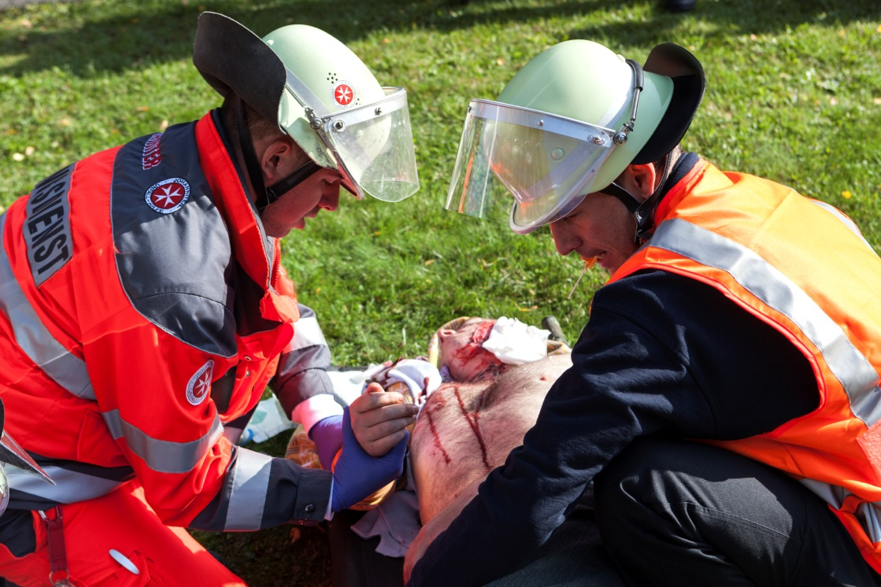
The Beatitudes
Jesus pronounces as blessed certain unlikely groups of people.
The Beatitudes identify actions and attitudes that characterize the Christian life.
Beatitude, the joy of the Lord, is our ultimate vocation as disciples.
© ollo / iStockphoto.com
Notes:
Direct the students to read the last paragraph of the section titled “The Beatitudes: Our Doorway to the Kingdom of Heaven” in article 53 of the student book; it contrasts our desire for riches, fame, power, or prestige with the Beatitude’s mercy, peacemaking, and righteousness. Ask for examples from daily life in which one of these desires conflicts with Jesus’ vision for our life.
This slide corresponds to content in article 53, “The Sermon on the Mount,” in the student book.

Slide 4
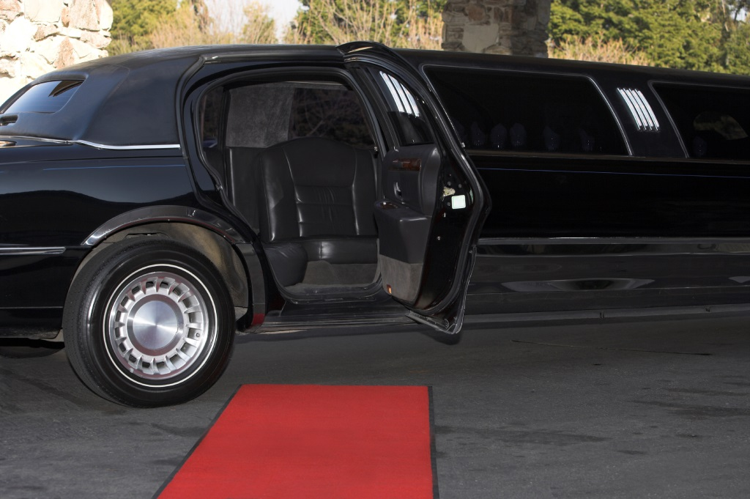
God or Money: You Cannot Serve Both
Jesus stresses the importance of our dependence on God.
God alone knows what we truly need, and God alone will provide for us.
Jesus cautions against placing our trust in money or in material possessions.
© 66North / iStockphoto.com
Notes:
Point out the statement found in the second paragraph of the section “God or Money: You Cannot Serve Both” of the student book: “trusting in material things can distort our perspective regarding what is really important.” Ask for examples of television shows or movies that seem to promote a distorted perspective about what is important.
This slide corresponds to content in article 53, “The Sermon on the Mount,” in the student book.

Slide 5
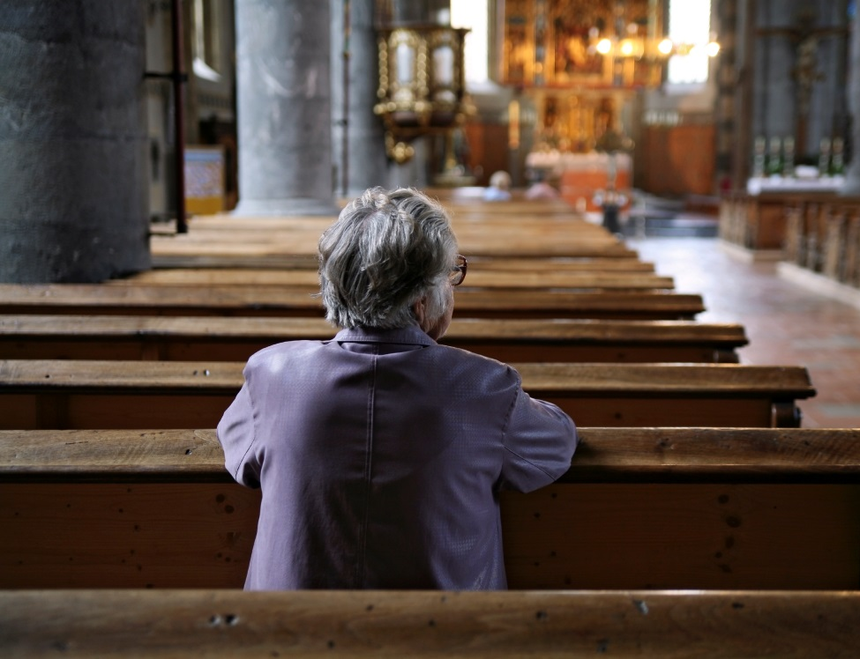
Prayer, Fasting, and Almsgiving
Jesus urges us to pray sincerely, with humility . . .
to fast as an act of genuine repentance . . .
and to share with those in need out of an authentic desire to lessen their suffering.
© Jaap2 / iStockphoto.com
Notes:
Discuss the question that concludes article 53 of the student book, “Why is it important to pray, fast, and give alms without regard for reward or recognition?”
This slide corresponds to content in article 53, “The Sermon on the Mount,” in the student book.

Slide 6
The Parables
Parables are stories that use everyday images to convey religious truths.
We gain self-knowledge by comparing ourselves to something in a parable.
Parables often contain a narrative twist or surprise.
© Chris Schmidt / iStockphoto.com
Notes:
Ask the students for examples of stories that have been effective in teaching them something. Explore why storytelling is a good teaching tool.
This slide corresponds to content in article 54, “The Parables of Jesus,” in the student book.

Slide 7
The Treasure in the Field and the Pearl of Great Price
In both parables, a man sells everything he has to buy only one thing.
Both stories invite us to commit ourselves fully to leading lives of discipleship.
© Johnny Habell / Shutterstock.com
Notes:
Challenge the students to apply the bullet points in the previous slide to these parables (Matthew 13:44–46): an everyday image, a comparison to one’s own life, a surprise.
This slide corresponds to content in article 54, “The Parables of Jesus,” in the student book.

Slide 8
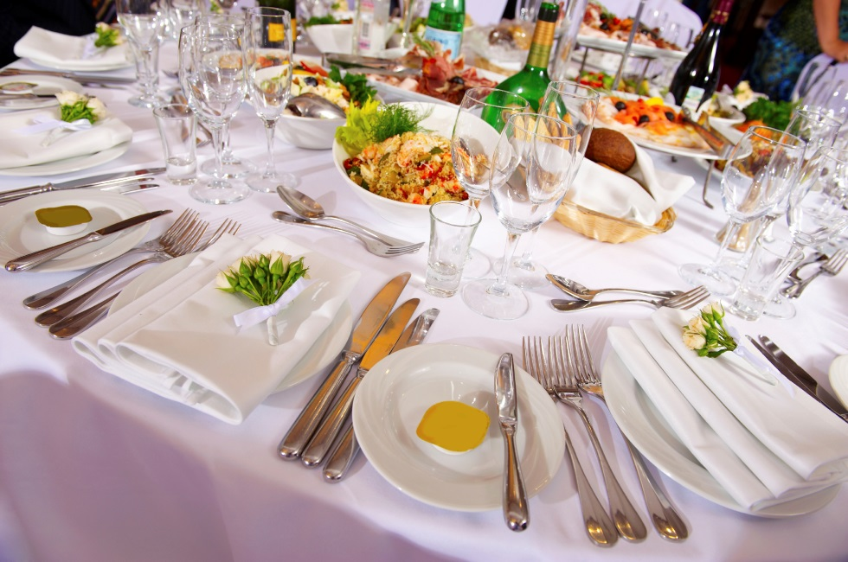
The Great Feast
Jesus offers us a profound and stirring image of the Kingdom of Heaven.
It is like a great feast at which all people are welcome.
Those who may not be welcome anywhere else are welcome at this feast.
© MariyaL / iStockphoto.com
Notes:
Ask a volunteer to read Luke 14:16–24. Brainstorm a list of words that feast or banquet evokes. Ask volunteers to apply words on the list to our life with God in Heaven and how they challenge us to live today (e.g., we will have abundance in Heaven; today, we can ensure that all have enough).
This slide corresponds to content in article 54, “The Parables of Jesus,” in the student book.

Slide 9
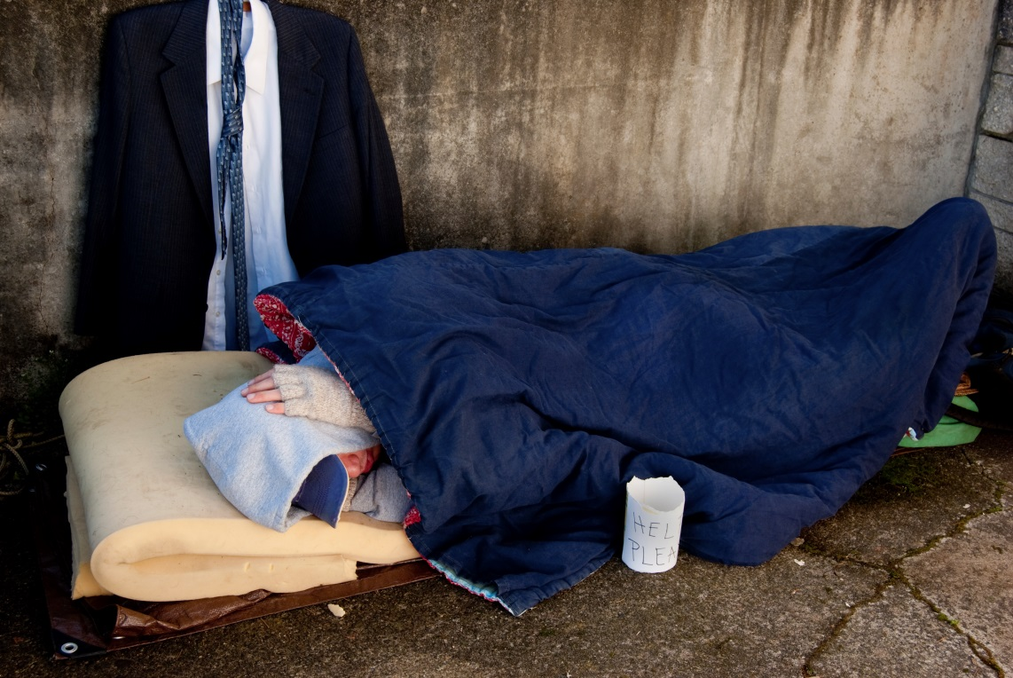
The Lost Sheep, the Lost Coin, and the Lost Son
All three parables express a common theme, that of great loss and joyous return.
God’s love will never fail to find us, welcome us home, and rejoice at our return.
© carolthacker / iStockphoto.com
Notes:
Consider preparing a script version of the Lost Son (Luke 15:11–32) with parts for a narrator, father, and sons. Discuss how the story could be updated for modern times. Ask what we learn from each character.
This slide corresponds to content in article 54, “The Parables of Jesus,” in the student book.

Slide 10
Jesus and the Rich Man
Jesus invites us, by his example, to lead lives committed to the service of others.
We may find that other priorities stand in our way.
Jesus challenges us to radically rethink our priorities and our lives.
© RonOrmanJr / iStockphoto.com
Notes:
Read aloud Mark 10:17–22, pointing out Jesus’ love for the man, and his answer to the man’s question. Explain that we don’t know what happened next, but we can imagine possible endings for the narrative. Ask for volunteers to supply endings and to explain their choices.
This slide corresponds to content in article 55, “Jesus and the Rich Man (Mark 10:17–22),” in the student book.

Slide 11
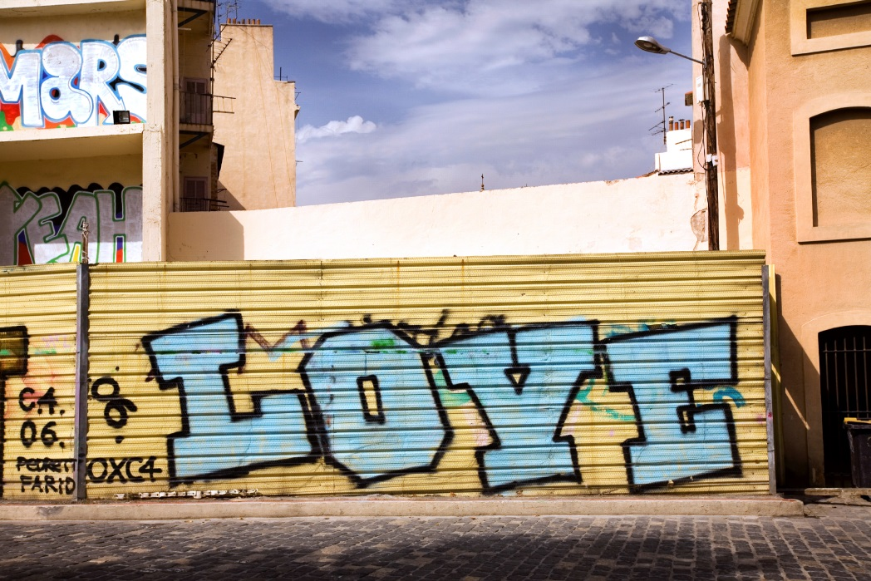
The Greatest Commandment
A Pharisee asks which commandment is the most important.
Jesus invokes passages from the Old Testament.
He summarizes the entirety of the “law and the prophets” (Matthew 22:40) …
and “the essential message of the Gospel—love.”
© Nikada / iStockphoto.com
Notes:
Read Matthew 22:34–40. Explain that Jesus is drawing on Old Testament teachings, not developing something new. Ask for volunteers to summarize what the Ten Commandments teach about loving God and others, as shown in article 56 in the student book.
This slide corresponds to content in article 56, “The Greatest Commandment (Matthew 22:34–40),” in the student book.

Slide 12
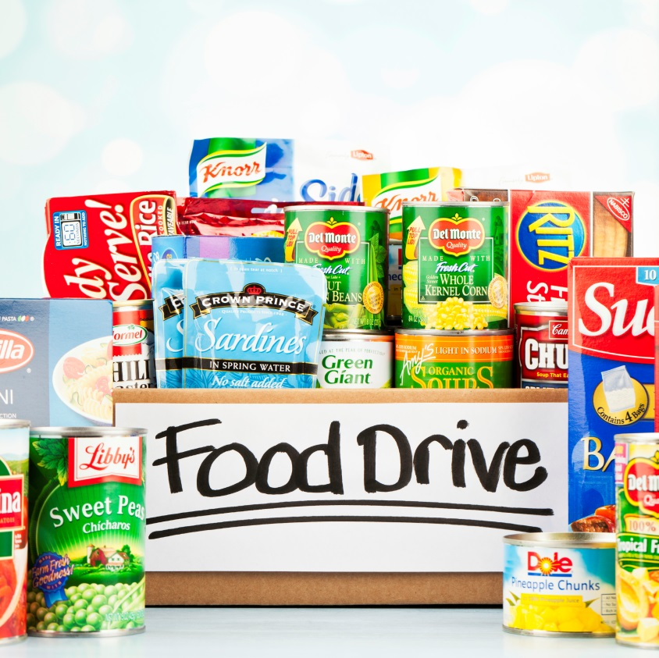
The Judgment of the Nations
Jesus always makes those who are poor a priority.
We must actively love poor people if we hope to enter the Kingdom of Heaven.
© Catherine Lane / iStockphoto.com
Notes:
Read Matthew 25:31–46, or retell the parable in your own words. Ask for examples of ways that your school community responds to Jesus’ expectations for service.
This slide corresponds to content in article 57, “The Judgment of the Nations (Matthew 25:31–46),” in the student book.

Slide 13
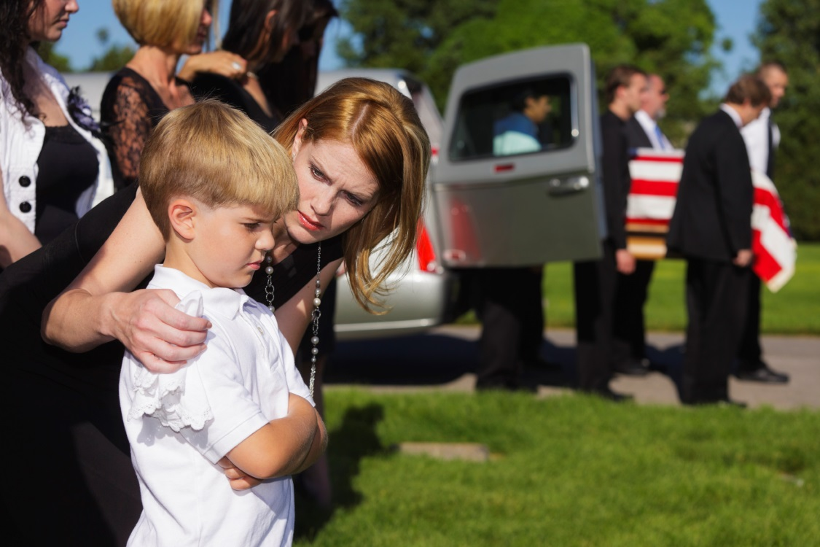
The Sheep and the Goats
Those who have consistently responded to the needs of the suffering are invited into the Kingdom of the Divine Father.
Those who have failed to respond to those who suffer are considered accursed.
© Rich Legg / iStockphoto.com
Notes:
Direct the students to read the Did You Know? sidebar in article 57 of the student book. Discuss what it means to say that when we minister to others, we minister to Christ.
This slide corresponds to content in article 57, “The Judgment of the Nations (Matthew 25:31–46),” in the student book.

Slide 14
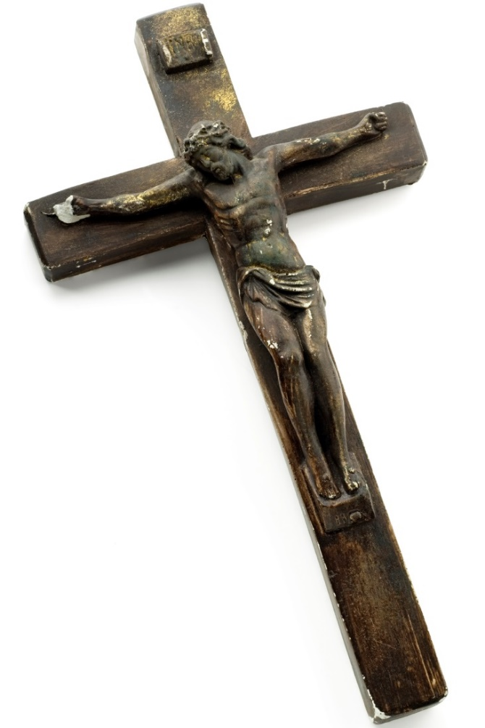
The Challenge of True Discipleship
The standard for genuine discipleship is not what we say but what we do.
Jesus teaches the Parable of the Sheep and the Goats shortly before his Passion.
© milosluz / iStockphoto.com
Notes:
Draw the connection between Jesus’ Passion and Death and the selfless service he expects from us.
This slide corresponds to content in article 57, “The Judgment of the Nations (Matthew 25:31–46),” in the student book.

