Slide 1


Document #: TX005833

Slide 2
Prayer and Church History
Chapter 46
The Bible: Models of Prayer

Slide 3
Chapter Summary
We best learn how to pray by imitating someone who is good at praying.
King David, the Virgin Mary, and Jesus Christ modeled prayer for us.
Praying is a skill like any other skill. It improves with practice.
Prayer is our way of petitioning God, praising God, and being closer to God.

Slide 4
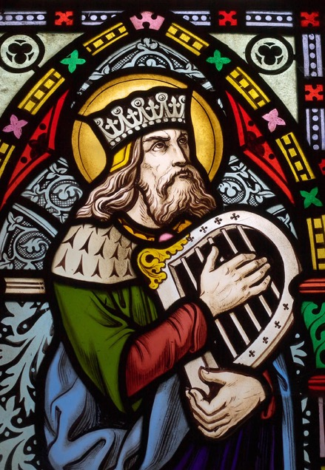
Introduction (Handbook pages 504‒505)
Prayer is a skill we develop with practice and by studying role models like King David, Mary, and Jesus.
© Sybille Yates / Shutterstock.com

Slide 5
Think About It!
Think, Pair, Share
Think
What skills do you already have and use in your life? study skills? sports skills? music skills? people skills, such as being a good listener?
What would happen to your skill if you never used it?
What happens to your skill at praying if you never use it?
Pair up with someone.
Share your answers to the questions with each other.

Slide 6
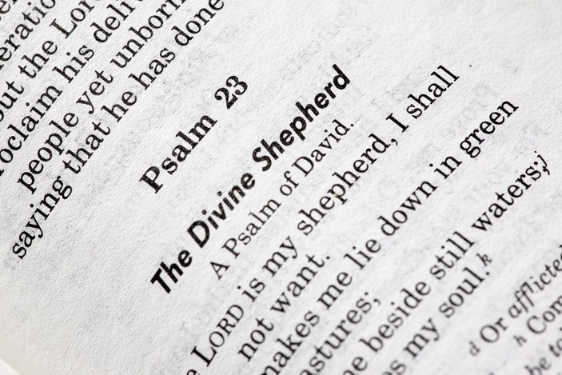
“King David” (Handbook, pages 505‒508)
King David had great faith in, and love for, God.
King David is known for the Book of Psalms, many of which he composed.
© Tyler Olson / Shutterstock.com

Slide 7
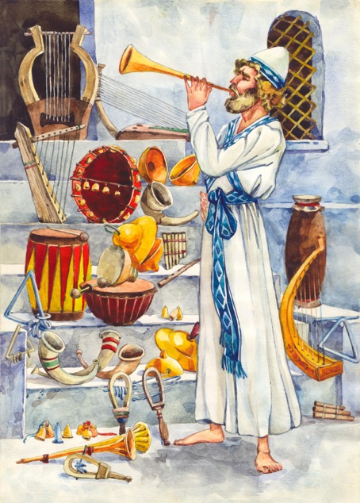
Search It!
Psalm 150 is a song of praise. Find it in your Bible.
Psalm 28 is a song of petition. Find it in your Bible.
© ArtMari/Shutterstock.com

Slide 8
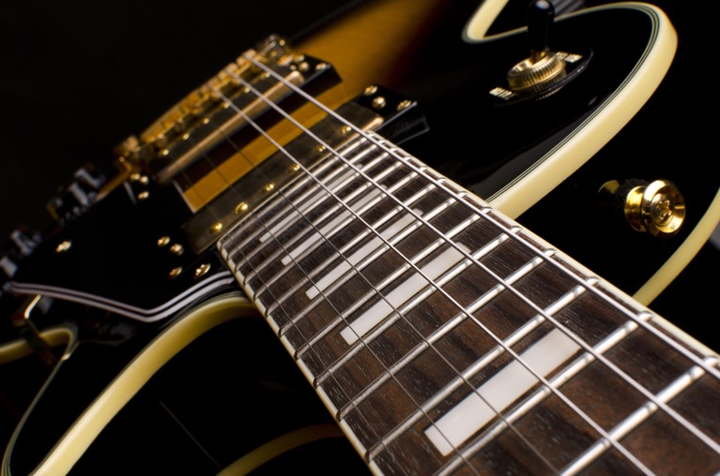
Journal It!
Using Psalm 150 as an example, write your own psalm of praise using musical instruments
you know.
© hakuna_jina/Shutterstock.com

Slide 9
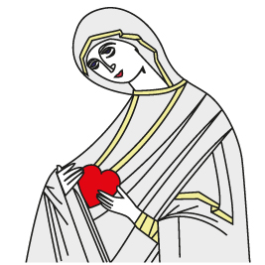
“The Virgin Mary” (Handbook, pages 508‒509)
Mary, the Mother of God, models true devotion and trust in the Lord.
Mary gave her whole heart and soul to God.
© Dimec/Shutterstock.com

Slide 10
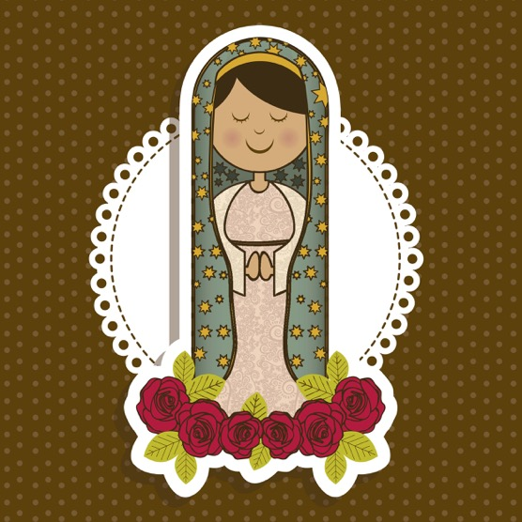
Review It!
In her song, the Magnificat,
Mary recognizes God’s goodness in her life. She prays, “My soul is glad because of God my Savior” (Luke 1:47).
© grmarc/Shutterstock.com
(The scriptural quotation on this slide is from the Good News Translation® [Today’s English Version, Second Edition].Copyright © 1992 by the American Bible Society. All rights reserved. Bible text from the Good News Translation [GNT] is not to be reproduced in copies or otherwise by any means except as permitted in writing by the American Bible Society, 1865 Broadway, New York, NY 10023, americanbible.org.)

Slide 11

Journal It!
How is God good to you?
What are you thankful for?
© PrinceOfLove/Shutterstock.com

Slide 12
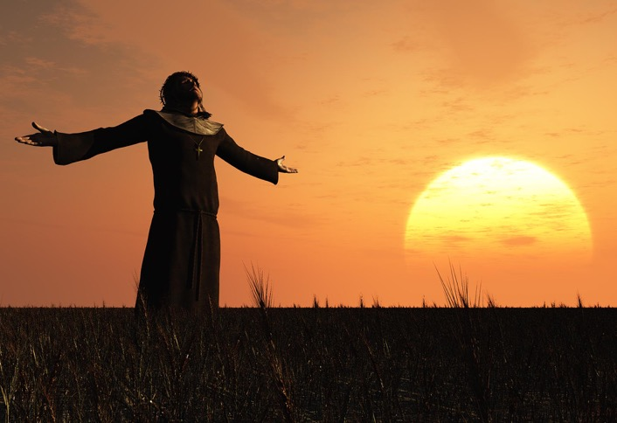
“Jesus Christ” Part 1 (Handbook, pages 509‒510)
Jesus, while fully divine, was also fully human.
Jesus needed to establish a prayerful relationship with God the Father.
© iurii/Shutterstock.com

Slide 13
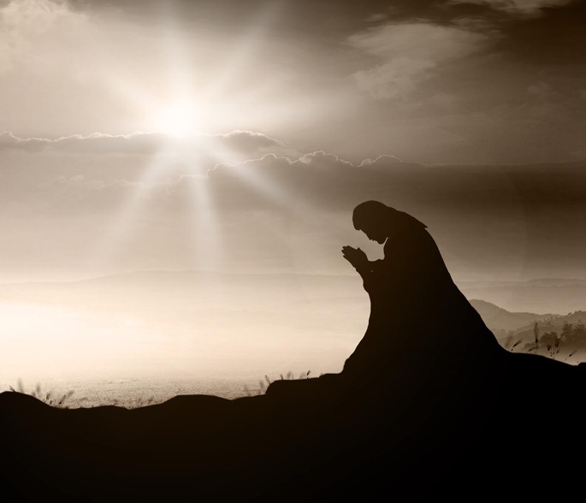
Review It!
Jesus prayed alone, with others, and for others, with both short and long prayers.
© CHOATphotographer/Shutterstock.com

Slide 14

Think About It!
Think about your every- day life. When do you pray? Do you use prayers you know, or do you talk with God spontaneously?
Take a few moments before bedtime to thank God for your day. Ask his help to make tomorrow a good day.
© Samiran Sarkar/ Shutterstock.com

Slide 15
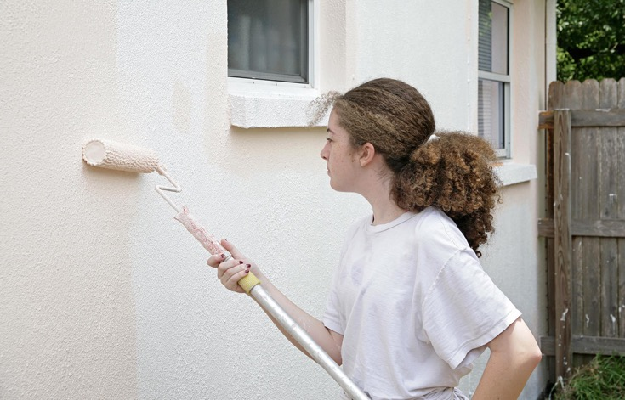
“Jesus Christ” Part 2 (Handbook, pages 511‒512)
Prayer is not just words but is a commitment to ourselves to do God’s will.
© Lisa F. Young / Shutterstock.com

Slide 16
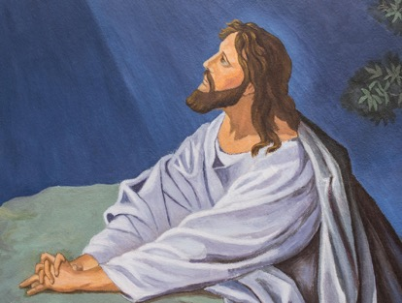
Review It!
Jesus prayed to his Father: “Not what I want, but what you want” (Matthew 26:39).
(The scriptural quotation on this slide is from the Good News Translation® [Today’s English Version, Second Edition].Copyright © 1992 by the American Bible Society. All rights reserved. Bible text from the Good News Translation [GNT] is not to be reproduced in copies or otherwise by any means except as permitted in writing by the American Bible Society, 1865 Broadway, New York, NY 10023, americanbible.org.]
© Freedom Studio / Shutterstock.com

Slide 17

Pray It!
God’s will for you is your happiness—the happiness that comes from a life of love.
Pray this prayer: “O God, I put my life into your hands. Lead me along the way of happiness, love, and peace. Amen.”
© Stasique/Shutterstock.com

