Slide 1


Document #: TX005855

Slide 2
The Prophets,
Jesus Christ, and the Holy Spirit
Chapter 17
The Holy Spirit

Slide 3
Chapter Summary
The Holy Spirit was at work throughout the Old Testament preparing God’s people for the coming of Jesus Christ.
The Holy Spirit’s mission and Jesus’ mission are one and the same: to lead us to salvation.
The mission of Jesus and the Holy Spirit is also the mission of the Church.

Slide 4

Try It!
            Exhale every bit of
            breath in your lungs and then
            try to say the sentence below.
“Without the breath of God,
we can’t say a word!”
© pathdoc/Shutterstock.com

Slide 5

Introduction and “The Breath of God”
(Handbook, Pages 182–184)
The Holy Spirit is the Third
Divine Person of the Trinity
and most often works “behind
the scenes” rather than on
center stage.
Jesus and the Holy Spirit are
inseparable from each other
and from the Father.
The breath of the Holy Spirit gives us God’s life.
Through the Holy Spirit’s presence, we come to know God.
© Matt Antonino / Shutterstock.com

Slide 6

Think About It!
Discussion Questions:
Think of a successful event.
What were all the things that had to happen before the event in order for it to be successful?
Is there something in your own life that would not have been possible without prior events? What things have prepared the way for what you do now?
© Crdjan/Shutterstock.com

Slide 7
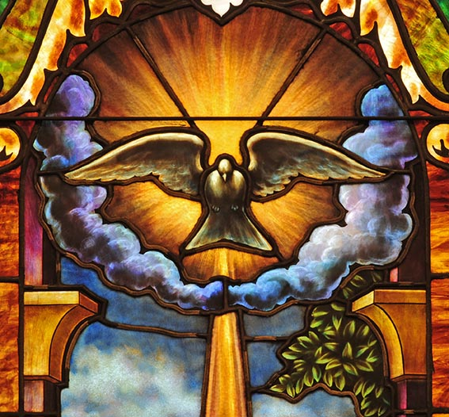
“The Holy Spirit Prepares the Way”
(Handbook, Pages 185–186)
The Holy Spirit was present in
the Book of Genesis as the
wind or breath (ruah) that
moves over the waters to
bring life out of nothingness.
Throughout the Old Testament,
the Holy Spirit works behind the
scenes preparing God’s people
for the coming of the Messiah—
especially through the prophets.
Isaiah announces that the coming Messiah is filled with God’s Spirit and will bring justice.
© Nancy Bauer / Shutterstock.com

Slide 8
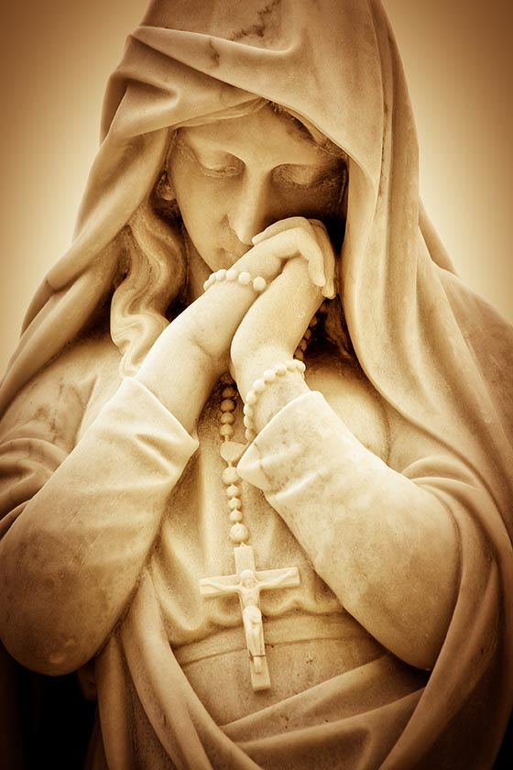
Pray It!
Pray the Hail Mary.
Take each line of the Hail Mary and discuss what it means.
Which lines of the prayer are about her relationship with Jesus? Which lines are about her relationship with us?
© Kamira/Shutterstock.com

Slide 9
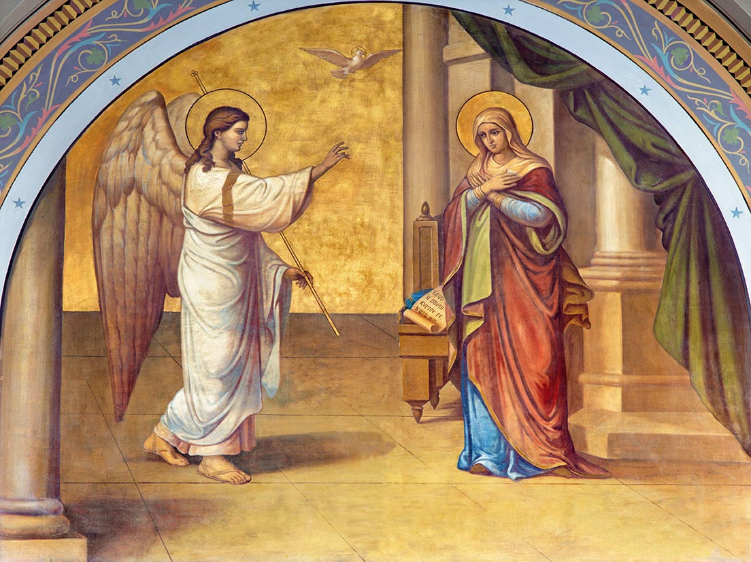
“In the Fullness of Time” and “Jesus and the Holy Spirit”
(Handbook, pp. 186–188)
The Holy Spirit’s work of pre-
paration for Christ’s coming was
completed in Mary, because she
said yes to God’s invitation.
By the power of the Spirit Mary
was “full of grace,” full of God’s
life and love.
The Holy Spirit brought people
together into relationship with Jesus.
Jesus said that his mission and the
Holy Spirit’s mission are the same.
© Renata Sedmakova / Shutterstock.com

Slide 10
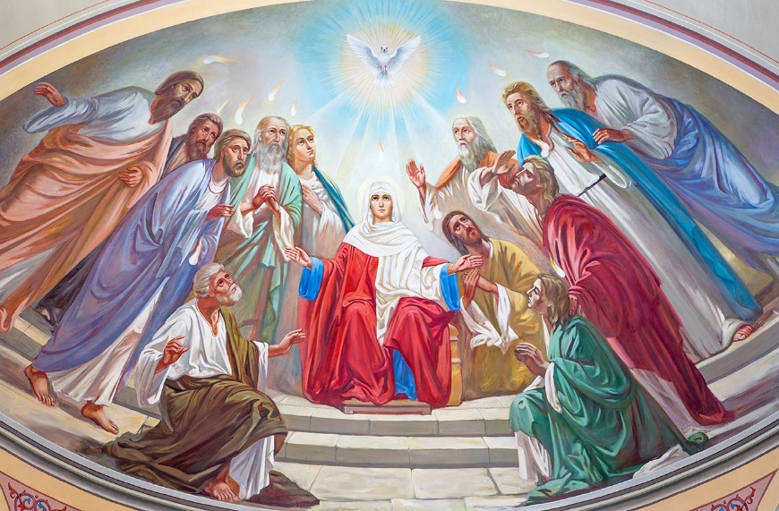
“On a Mission”
(Handbook, Pages 189–190)
On the Feast of Pentecost,
fifty days after Jesus’
Resurrection, the Holy Spirit
descended on the disciples.
The Spirit gave the disciples
courage to go out and preach
the message of Jesus Christ.
The Church shares in the mission
of the Spirit and the Son to go to
the ends of the earth spreading the Good News of salvation.
The Holy Spirit works in the Church to build her up, to bring her new life, and to make her holy.
© Renata Sedmakova / Shutterstock.com

Slide 11

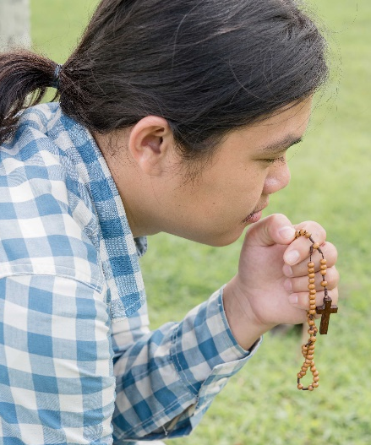

Our Mission
Think-Pair-Share
Think: What do you think it was like for the disciples to have Jesus around all the time? How does the Holy Spirit help you to understand who Jesus is and to live out his mission?
Pair: Find a classmate.
Share: How is the Holy Spirit active in your life? How are you called to live out Jesus’ mission in your home, your school, your community?
© Bernardo Ramonfaur / Shutterstock.com
© PhilipYb Studio / Shutterstock.com
© michaeljung / Shutterstock.com

