Slide 1
The Church in the World
The Church
Unit 4
Document #: TX005573

Slide 2
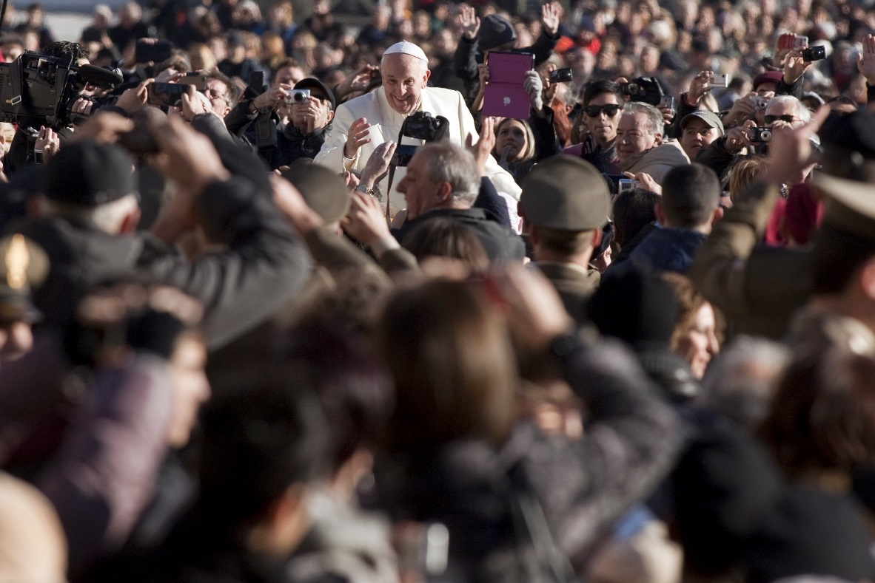
Entrusted with Truth
God has entrusted that truth to the Church.
Thus the Church must proclaim the truth to the world.
© giulio napolitano / Shutterstock.com

Slide 3
Truth Inspires Activity
This obligation inspires and gives life to the Church’s missionary activity.
Notes:
Notes: If you wish to take the time now, you can stop here and discuss the Church’s activities in the world.

Slide 4
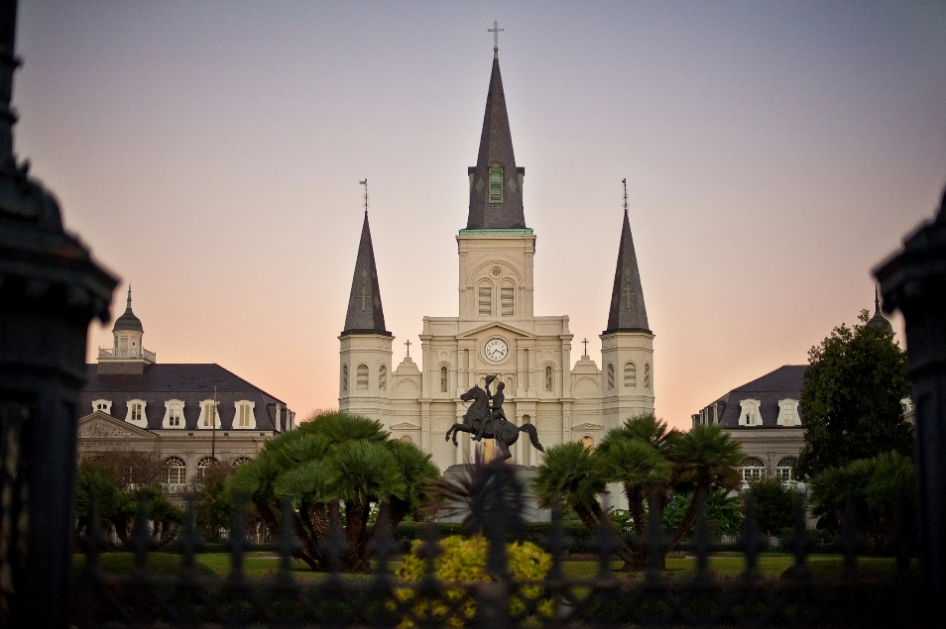
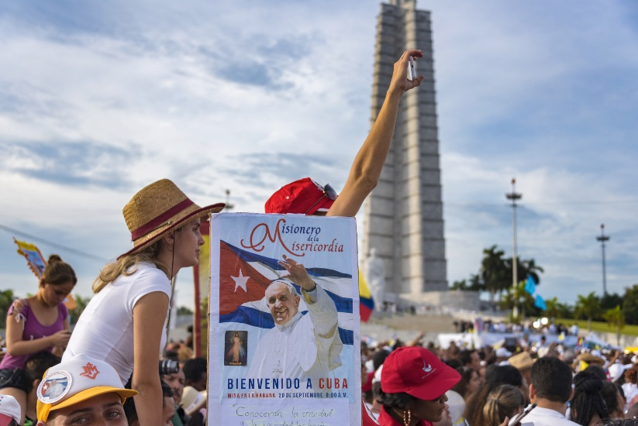
The Church Is Catholic
The Church is:
local
national
global
©Sam Strickler / Shutterstock.com
©rmnoa357 / Shutterstock.com
Notes:
Notes: Top right: The cathedral is the gathering place of the local church. The Cathedral of Saint Louis in New Orleans is the oldest cathedral in North America. It was founded as a Catholic parish in 1720. Bottom left: Pope Francis visited Cuba in September 2015. Emphasize that the Church is found in all countries of the world.

Slide 5
Signs of the Times
The Church is responsible for looking at the particular circumstances of each generation and interpreting them in light of Scripture and Tradition.

Slide 6

Church and the Modern World
Interpreting the signs of the times in light of the Gospels brings the Church into dialogue with different cultures and groups.
But she always remains constant in her universal mission.
©Dawn Hudson / Shutterstock.com
Notes:
Notes: The Vatican II document Pastoral Constitution on the Church in the Modern World (Gaudium et Spes, 1965) proclaims that nothing human is foreign to the Church. Her mission is to bring God to the human person—of all races, cultures, and nations—and the human person to God.

Slide 7

Proclaim and Act
It is not enough for the Church to proclaim the Gospel message.
She must be able to apply that message to the issues facing each generation.
©Monkey Business Images / Shutterstock.com
Notes:
Notes: Ask the students to name some issues that concern them. The growth of science and technology is one issue that could be mentioned.

Slide 8

Ageless Message
The essential Gospel message does not change, but it requires wisdom and discernment to understand how it applies to these and other particular issues.
© Stokkete /Shutterstock.com

Slide 9
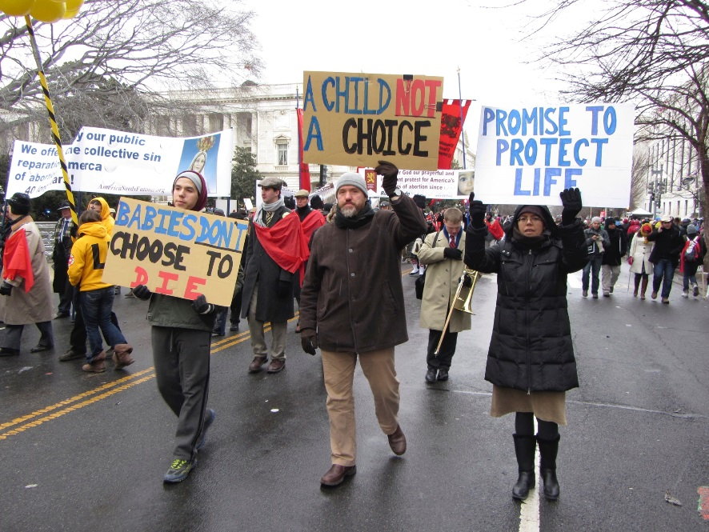
Engaging Modern Culture
The Church has a responsibility to be active in the modern world, promoting and proclaiming the truth that has been entrusted to her—by God.
The Church often finds itself in the position of standing counter to the developments in our modern society.
© Coast-to-Coast/iStock.com

Slide 10
Today’s Issues
What are some of the issues facing Catholics and the Church today?
Notes:
Notes: Here is an opportunity for you to engage the class in discussion. The issues don’t have to be resolved right now, but just bring them to light for later discussion.

Slide 11
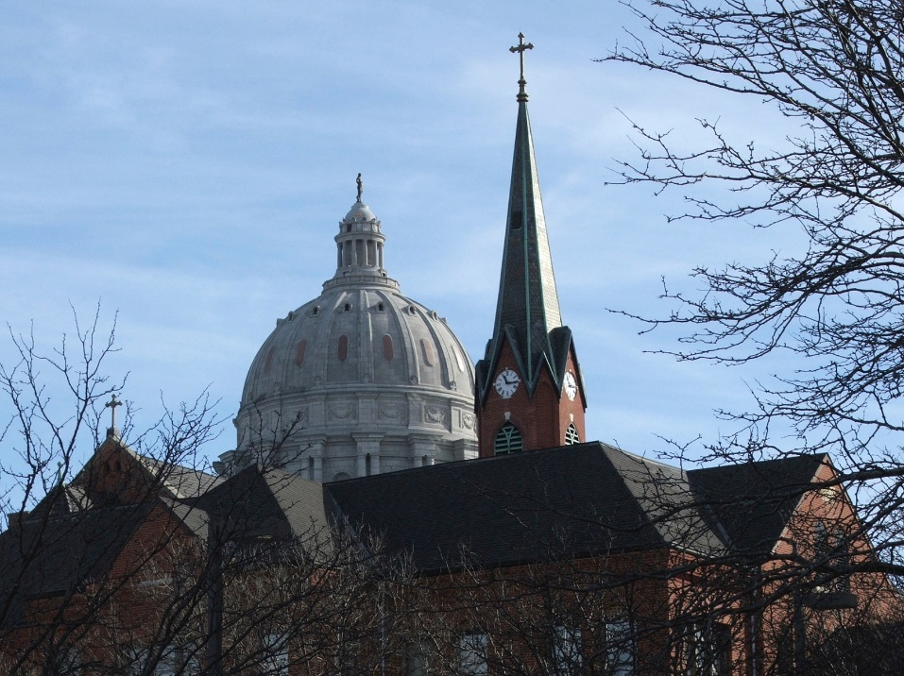
The Church and Politics
What about the concept of separation of Church and state?
This means that the government will not support a particular religion or establish a national religion.
It does not mean that the Church can have no say in the political arena.
© tomorrowspix / iStock.com

Slide 12

Right and Responsibility
The Church has the right and the responsibility to bring Christian values into the public debate.
She addresses specific issues that affirm or stand counter to the Gospel message.
Her input strengthens the public debate.
©Jiri Miklo / Shutterstock.com
Notes:
Notes: Be sure to address the fact that standing counter to society’s pressures is difficult, but that we are guided by the Church to stand for truth, no matter what pressures are put on us to change.

Slide 13

Evangelization
The Church has a missionary mandate to help all people to share in the communion of the Holy Spirit.
Evangelization is the primary way we accomplish that mission.
We must teach the truth to the world.
© Monkey Business Images / Shutterstock.com
Notes:
Notes: Ask the students for ideas of how they might evangelize in their world (home, school, work, play).

Slide 14
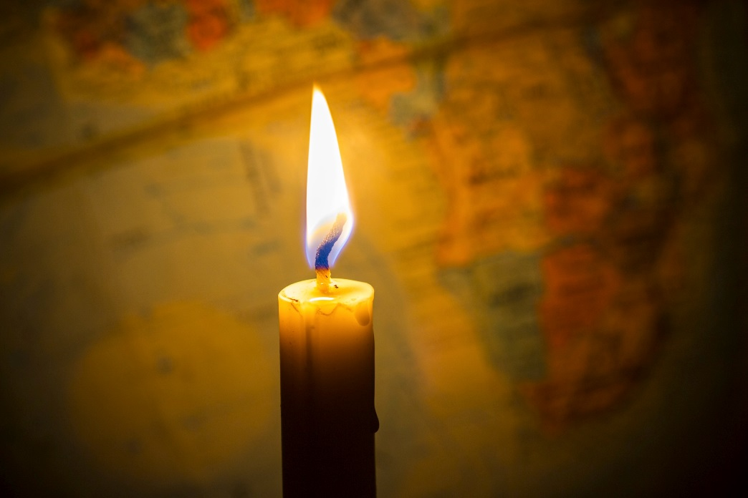
Proclaiming
We are to proclaim Christ both by our words and by the witness of our lives.
©Freedom Studio / Shutterstock.com
Notes:
Notes: The candle with the map of the world behind it reminds us that we are called to bring light to the world. How can we do that in our current situation?

Slide 15
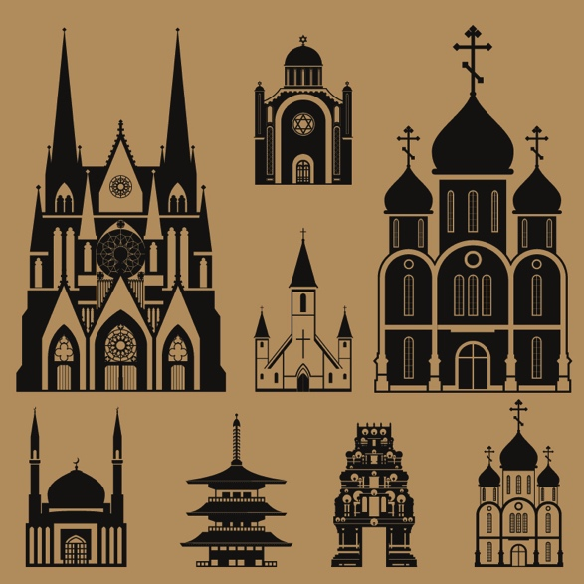
Dialogue
The Church seeks dialogue with people of different religions, witnessing to her own faith while acknowledging and encouraging the spiritual and moral truths found in their religions.
But the Church does not support any religious groups that lead people astray or distort the image of God found in all humans.
©Denis Dubrovin / Shutterstock.com
Notes:
Notes: Emphasize that the Church is the repository of truth as given to us by God and Christ. We must never lose sight of that fact. Other faiths possess truth, but the fullness of truth resides in the Catholic Church. However, the Church recognizes the presence of the Holy Spirit in the truths that we do share with other faiths and religions. See if the students can identify the houses of worship here: At left, large church: Catholic cathedral; at right, large church: Orthodox church or cathedral; top middle: Jewish temple; middle, between large churches: Protestant church; bottom row: mosque, Buddhist temple, Jain temple, Orthodox church.

Slide 16

Diversity
The Church recognizes and embraces diversity.
“So then you are no longer strangers and sojourners, but you are fellow citizens with the holy ones and members of the household of God, . . . with Christ Jesus himself as the capstone” (Ephesians 2:19–20).
© Andresr/Shuttestock.com

Slide 17
Acknowledgment
The Scripture quotation on slide 16 is from the New American Bible, revised edition © 2010, 1991, 1986, 1970 Confraternity of Christian Doctrine, Inc., Washington, D.C. All Rights Reserved. No part of this work may be reproduced or transmitted in any form or by any means, electronic or mechanical, including photocopying, recording, or by any information storage and retrieval system, without permission in writing from the copyright owners.

