Slide 1
Promoting Peace
Catholic Social Justice
Document #: TX002005
Notes:
[Music: Introduction music such as “Peace Is Flowing like a River”]

Slide 2
Genocide
Injustice
War
Prejudice
Murder
Oppression
Torture
Poverty
Discrimination
God calls us to live in peace, respect all creation, and “do to others as you would have them do to you” (Luke 6:31).
For Discussion
How do you carry out God’s call on a daily basis? Give examples.

Slide 3
Genocide
Injustice
War
Prejudice
Murder
Oppression
Torture
Poverty
Discrimination
The Root Cause of Violence
The root cause of violence is the negative effect of Original Sin.
Catholic social teaching defines violence as “any human action that causes harm to the life or dignity of another person.”
Acts of violence can be any psychological, social, spiritual, or physical attack on another person or persons.

Slide 4
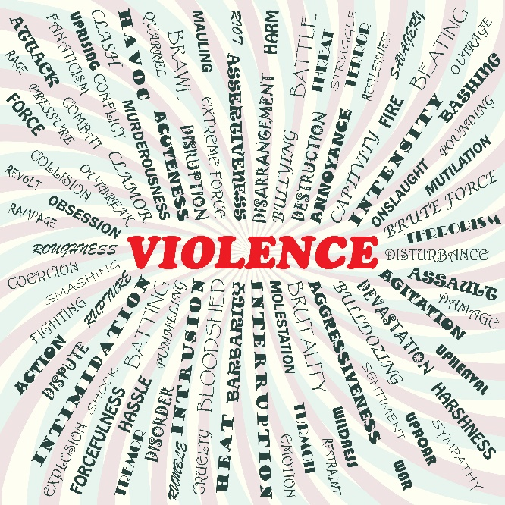
Acts of Violence
calling another person a derogatory name or belittling another’s appearance, beliefs, or background
slandering another person
©Jomar Aplaon / Shutterstock.com
bullying another person
forcing someone into having sex against his or her will
prohibiting someone from practicing his or her faith
causing people to be poor, hungry, or illiterate because of the unjust distribution of the earth’s resources
selling weapons that will be used in immoral armed conflicts
causing people illness or even death by tampering with the earth’s environment

Slide 5
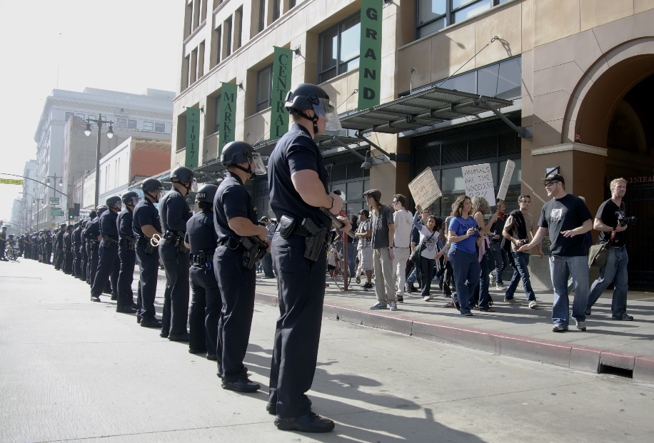
© shalunts / Shutterstock.com
Acts of Violence (continued)
Poverty, oppression, discrimination, and other social sins make individuals and groups more prone to look for violent solutions to the problems that face them.
Partner Share
What conditions in your local community might cause people to resort to violence to solve problems?

Slide 6
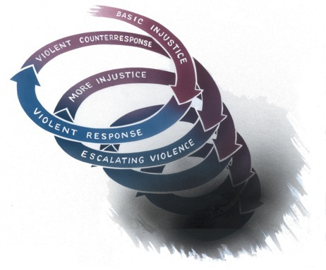
The Spiral of Violence
Brazilian Archbishop Dom Hélder Câmara (1909–1999) first proposed the image of violence as a spiral.
This image portrays how violence and injustice are related and are rooted in the human tendency toward retaliation and revenge.

Slide 7
The Spiral of Violence (continued)
Basic injustice The spiral begins when people resolve a conflict selfishly, by seeking only their own interests at the expense of others.
Violent response If the injustice is severe, it prompts a response from those affected by it.
Violent counter-response Once one side decides to use violence to solve the conflict, the other side might see no other choice but to respond with greater violence.
Escalating violence The level of violence escalates as each side attempts to overcome the other with the use of greater force.
Violence ends temporarily, followed by more injustice When one side finally uses enough force to overwhelm the other side, the conflict may temporarily appear to end.

Slide 8
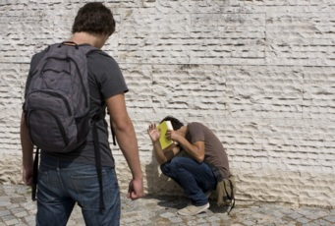
Ways to Confront Violence
Image in shutterstock
There are morally acceptable ways to respond to violent situations:
self-defense from unjust attacker, using minimal violence
nonviolent conflict resolution
nonviolent resistance to evil
Jesus teaches: “Love your enemies.”
Discussion
What are some ways I can demonstrate love of enemies?

Slide 9
The Impact of Violent Media
The bishops have called for the government, the entertainment industry, citizens, and parents to be morally responsible in regulating, creating, and using media with explicit sexual and violent content.
You have a responsibility to feed your mind, heart, and soul with media choices that nourish your respect for human dignity.

Slide 10
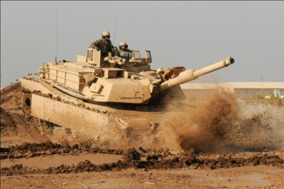
War and Legitimate
Self-Defense
Starting a war is an immoral act and a sin against the Fifth Commandment.
WikiMediaCommons
War and terrorism have been condemned by the Church’s Magisterium throughout all of Catholic social teaching.
War is a threat to the sacredness of life.
The Church tries to prevent war from starting.

Slide 11
Legitimate Self-Defense
When threatened with bodily harm by an unjust aggressor, we have a right to defend ourselves and other innocent people.
Legitimate defense can be not only a right but a duty for one who is responsible for the lives of others.

Slide 12
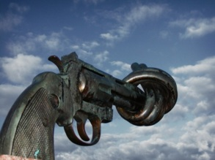
Just War
To help states to determine when war is justified, the Church has developed criteria that must be met for a war to be morally permissible. The conditions for a just war are as follows:
Just cause The state must have a just cause—that is, it must be using war to prevent or correct a grave, public evil.
Comparative justice The good achieved through war must far outweigh the resulting loss of life and disruption to society.
Legitimate authority Only duly constituted public authorities may use deadly force or wage war.
Probability of success War may not be used in a futile cause or in a case where disproportionate measures—for example, using nuclear or biological weapons, resulting in massive loss of life—are required to achieve success.
Proportionality The overall destruction expected from the use of force must be outweighed by the good to be achieved. In particular the loss of civilian lives must be avoided at all costs.
Last resort Force may be used only after all peaceful alternatives have been seriously tried and exhausted.

Slide 13
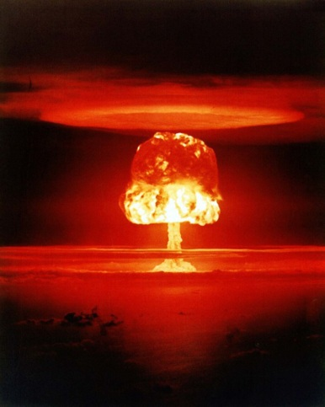
The Arms Race
After World War II, the United States and the Soviet Union (which included Russia and ten other Eastern European countries) each developed stockpiles of nuclear bombs.
A policy developed, known as mutually assured destruction (MAD): If one country launched weapons, the other country would immediately launch its own (rather than risk being destroyed), causing catastrophic death and destruction in both countries.

Slide 14
The Arms Race (continued)
The arms race is a sinful social structure that supports escalating violent conflict between nations.
It has led to the creation of weapons of mass destruction (WMD)—weapons with tremendous destructive potential, capable of killing thousands or millions of people.
Modern weapons include chemical weapons and nuclear weapons.
Use of these weapons always constitutes an unjust war.

Slide 15
The Arms Trade
The arms race is the international sale of weapons for profit, without any concern for the moral issues at stake. It is a race, because as one side in a conflict buys weapons, the other side in the conflict responds by buying more weapons too.
The Church teaches that the arms race is a serious threat to peace.
Catholic social teaching makes clear that nations have a moral responsibility to regulate arms trade, production, stockpiling, sale, and trafficking.

Slide 16
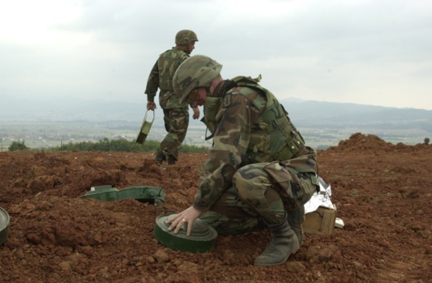
Land Mines
Use of antipersonnel land mines is an example of a grave moral issue connected to modern warfare.
After a war is over, the unexploded land mines are usually not recovered until they are set off by an unsuspecting passerby, such as a farmer or even a child, causing death or the loss of limbs.

Slide 17
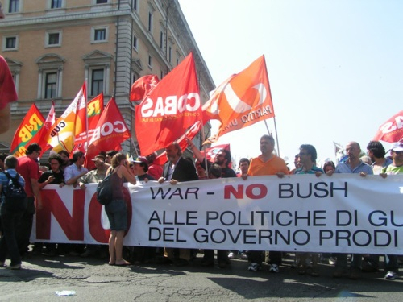
Waging Peace
Creating peaceful societies requires as much work, dedication, and sacrifice as fighting a war.
True peace is the result of working for forgiveness, reconciliation, and justice.
Discussion
What are some ways I can demonstrate love of enemies?

Slide 18
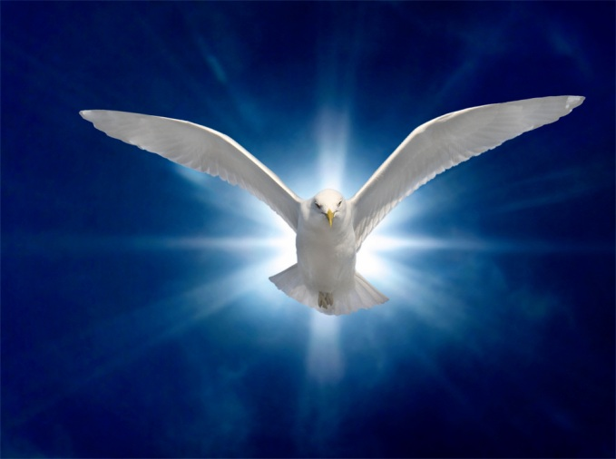
The Church and Racism
The saving work of Jesus Christ ushers in God’s Kingdom of peace.
Peace is a divine gift, a fruit of the Holy Spirit, given to those who place their faith in Jesus Christ.
Peace is more than just the absence of violence.
Image in shutterstock

Slide 19
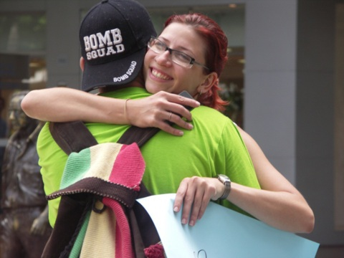
Waging Peace through Love
Work to correct injustice.
Build solidarity.
Promote forgiveness and reconciliation.
Make time for prayer.
WikkiMediaCommons
Discussion
How can I commit myself to a life of love, not hatred or violence?
What steps can I take today?

Slide 20

Commit to Nonviolence
When we love our enemies, we show them love of God.
People who practice nonviolent love of enemies place trust in God. God calls us to be peacemakers.
True peace is achieved through nonviolence, acts of love, and constant prayer.
Image in shutterstock
Notes:
(The scriptural quotation in this presentation is from the New American Bible with Revised New Testament and Revised Psalms. Copyright © 1991, 1986, and 1970 by the Confraternity of Christian Doctrine, Washington, D.C. Used by the permission of the copyright owner. All Rights Reserved. No part of the New American Bible may be reproduced in any form without permission in writing from the copyright owner.)

