Slide 1
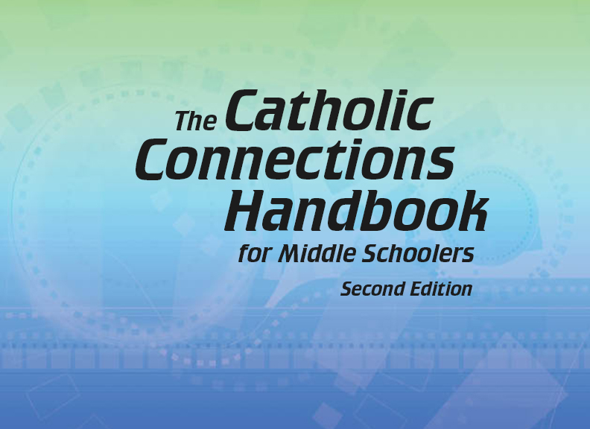

Document #: TX005836

Slide 2
Prayer and Church History
Chapter 49
The Lord’s Prayer: The Perfect Prayer

Slide 3
Chapter Summary
The Lord’s Prayer is “the perfect prayer,” for 10 specific reasons.
Take time to think about ways to pray, ways to address God, and ways to view the relationship between God and yourself.
The Lord’s Prayer can transform us from a “me” mentality to a loving “we” community.

Slide 4
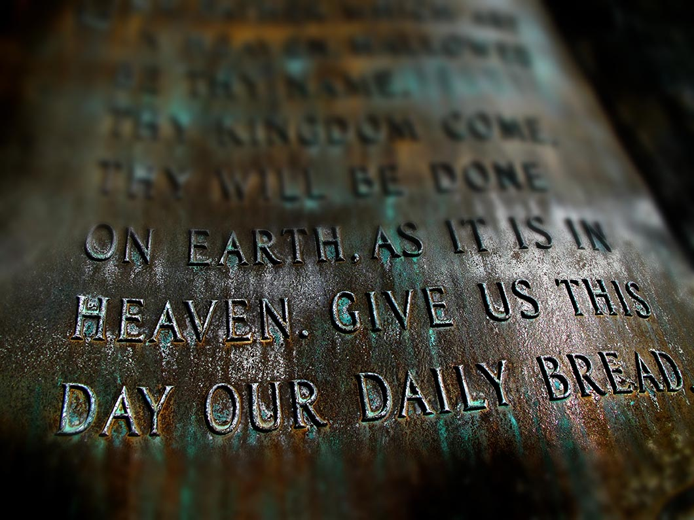
Introduction (Handbook, pages 534–535)
Jesus gave us the perfect prayer, the Lord’s Prayer.
Jesus gave us a prayer that expresses everything we need to live as one of his followers.
© Lane V. Erickson / Shutterstock.com

Slide 5
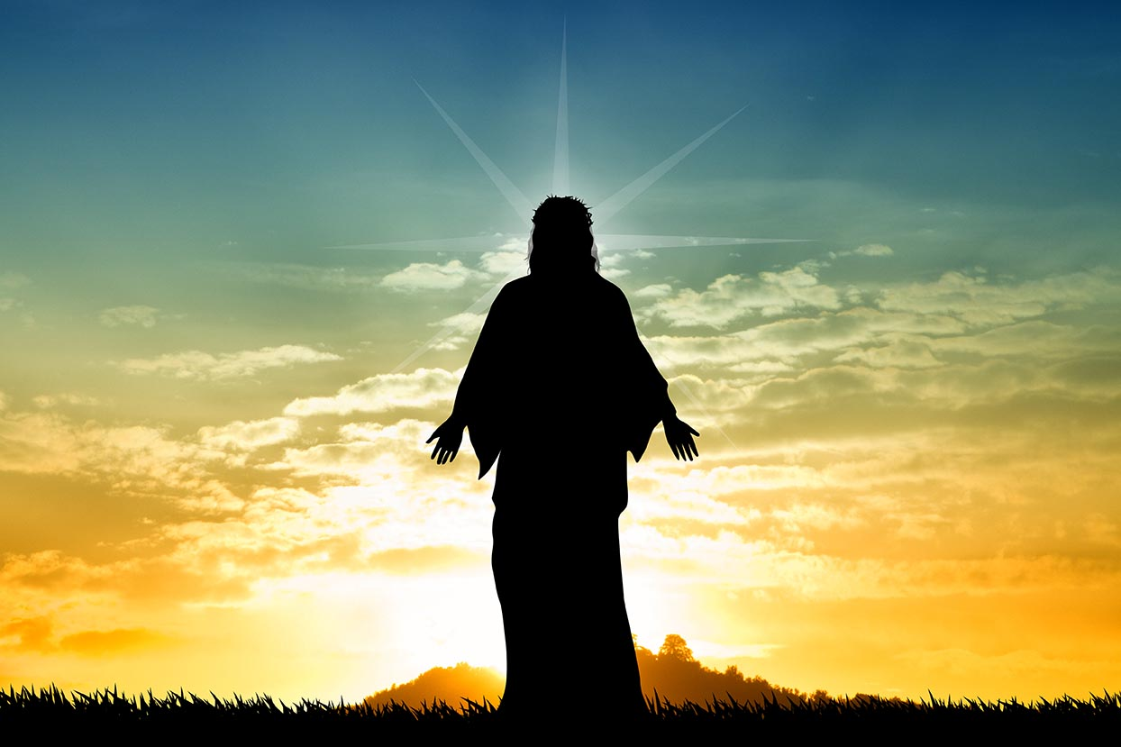
Reasons 1–3 (Handbook, pages 536–537)
Jesus gave us the Lord’s Prayer to teach us how to pray to God.
© Sogno Lucido / Shutterstock.com

Slide 6
Journal It!
Put the first three reasons into your own words by writing down your responses to these questions:
Who gave us the Lord’s Prayer?
What does the Lord’s Prayer teach?
In the Lord’s Prayer, how do we address God?

Slide 7

Reasons 4–6 (Handbook, pages 538–539)
The Lord’s Prayer helps us know who God is and who we are.
© PHOTOCREO Michal Bednarek / Shutterstock.com

Slide 8
Journal It!
Put the next three reasons into your own words by writing down your responses to these questions:
What does the Lord’s Prayer tell us about God?
What does this prayer tell us about ourselves?
What does the Lord’s Prayer help us to do?

Slide 9
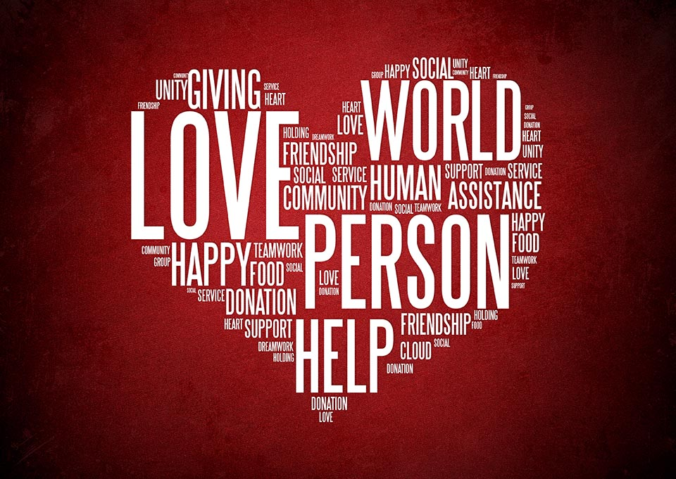
Reasons 7–10 (Handbook, pages 540–542)
The Lord’s Prayer teaches us to be humble, to be a community, and to live the Gospel.
© dizain/Shutterstock.com

Slide 10
Journal It!
Put the last four reasons into your own words by responding to these questions:
As children of God, what should our hearts be like?
What does “our” Father mean?
Why is the Lord’s Prayer the prayer of the Church?
What does the Lord’s Prayer summarize?

Slide 11
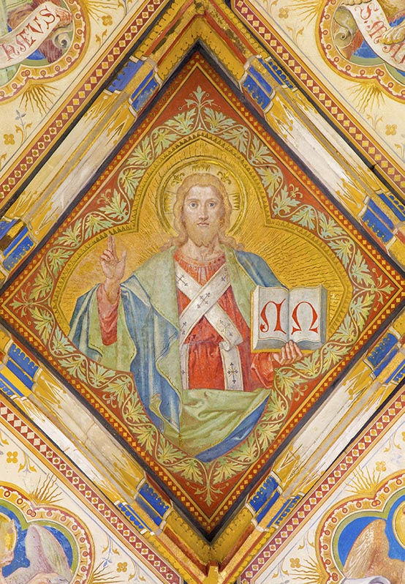
Icon of Christ the Teacher
© sedmak/iStock.com

Slide 12
See Teacher Note, Teacher Guide page 93
The icon of Christ the Teacher shows Christ blessing with one hand and holding the Bible or Book of the Gospels with the other. Sometimes a Scripture verse is written on the book.
In this icon, the letters A and Q, the beginning and ending letters of the Greek alphabet, are written. Jesus is the Alpha and the Omega of our lives—the beginning and the end.

