Slide 1
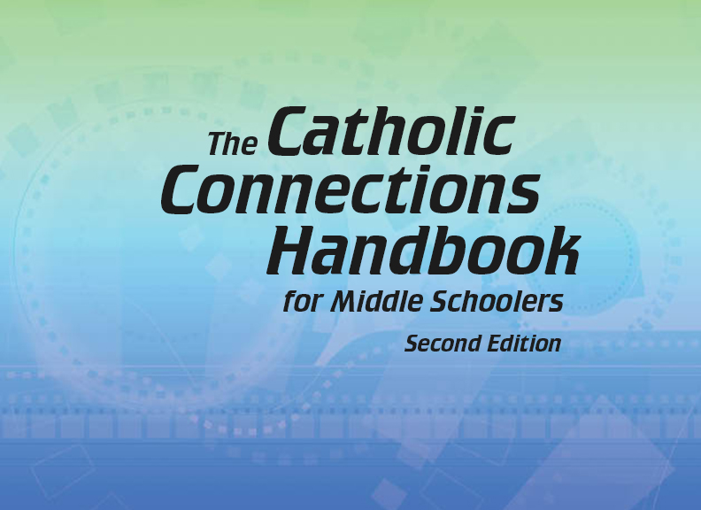

Document #: TX005825

Slide 2
Liturgy
and Sacraments
Chapter G
The Bible: The Book
of Revelation

Slide 3
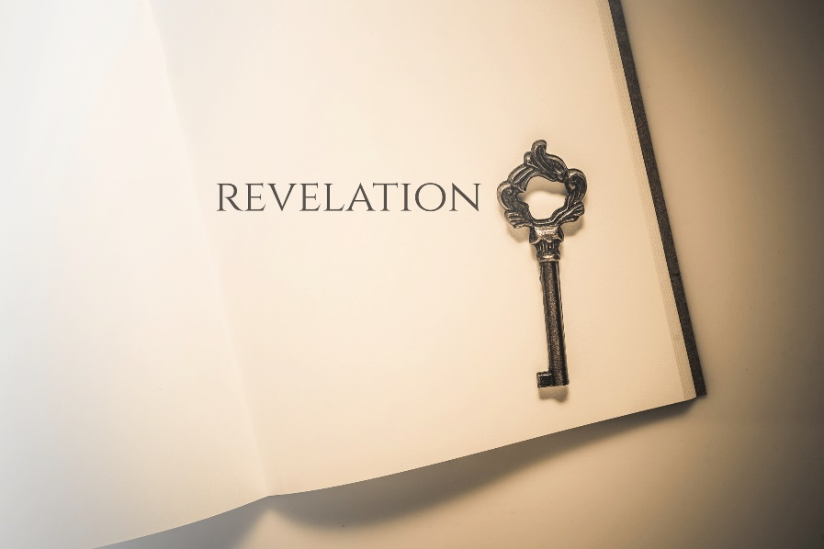
Chapter Summary
In this chapter, we will explore the meaning and message of Revelation, the amazing and often misunderstood final book of the Bible.
© GongTo/Shutterstock.com
We will see the persecution of early the Christians and John’s coded call to hope that God will prevail, connections between lives of faith and Revelation’s vision of worship in heaven, an epic battle between good and evil, and a new city where the faithful will live forever with God.

Slide 4

“Persecution and Symbolism” (Revelation 13:1‒18)
Revelation uses symbols and codes to offer hopeful messages to persecuted people.
© Mclek/Shutterstock.com

Slide 5

Journal It!
Write about a time when you had to speak in “code” to someone.
How did you do this?
What was the main point of your message?
© tovovan/Shutterstock.com

Slide 6
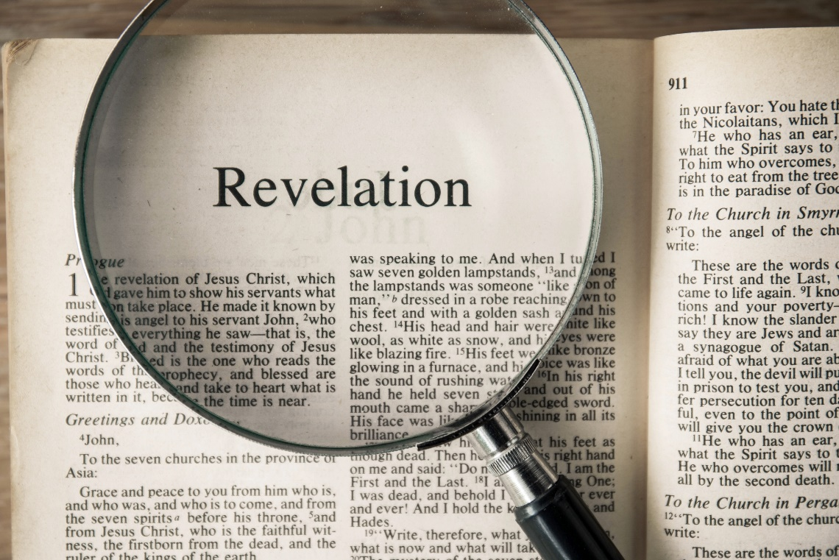
“Worship in Heaven”
(Revelation 4:1‒5:14)
Revelation reveals a vision of heavenly worship that inspires the way we pray today.
© GongTo/Shutterstock.com

Slide 7
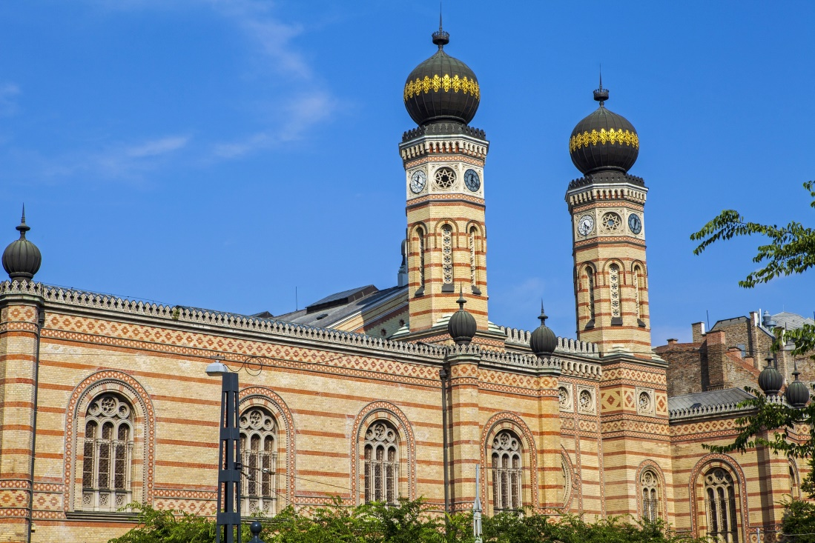
Share It!
Have you ever attended services in a non-Catholic house of worship, such as a synagogue, mosque, or non-Catholic church? How was worship different there?
If you haven’t attended services at one of these places, do some quick research online. Then share with the person next to you!
© Chrisdorney/Shutterstock.com

Slide 8
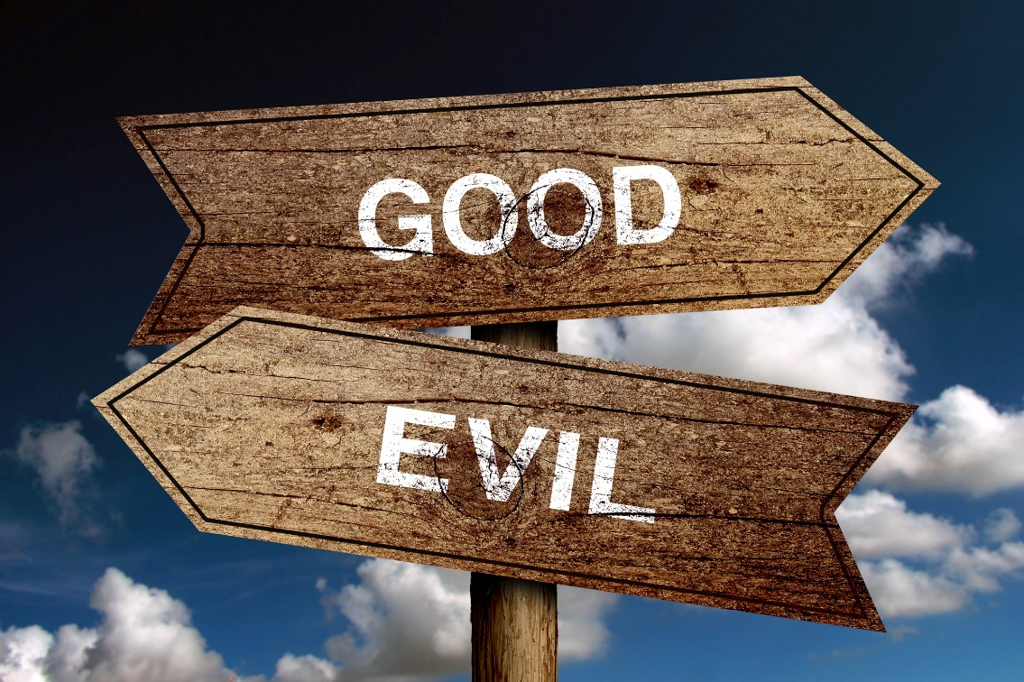
“The Battle of Good and Evil”
(Revelation 12:1‒13:2)
The battle between good and evil involves all of God’s people; in the end, God prevails and saves his faithful people.
© ChristianChan/Shutterstock.com

Slide 9

Post It!
Take a sticky note.
Write one way in which you see the battle between good and evil in the world today.
Post your sticky note to the board.
Then share with a partner. How do you feel about these battles? How do you think they can be overcome?
© MSSA/Shutterstock.com

Slide 10
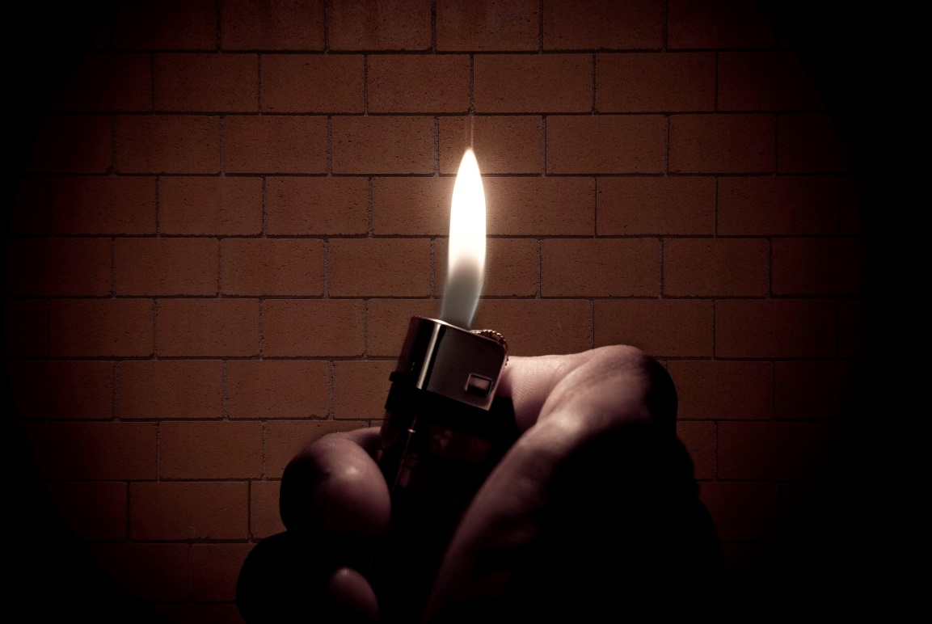
“All Things New”
(Revelation 21:1‒22:5)
Revelation concludes with stories of Christ overcoming evil and promises of eternal joy with God for those who remain faithful.
© jcjgphotography/Shutterstock.com

Slide 11
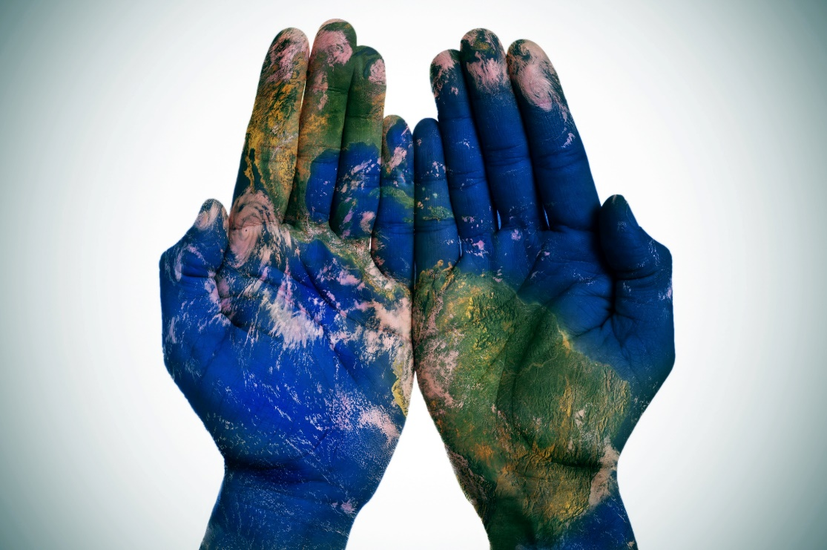
Journal It!
If you could change one thing about the world, what would it be?
Why?
How would you do it?
Whom would you recruit to help you?
© Nito/Shutterstock.com

