Slide 1
The Church and the World
The Church
Unit 4, Chapter 13
Document #: TX005563
© 2016 Saint Mary’s Press
Living in Christ Series

Slide 2

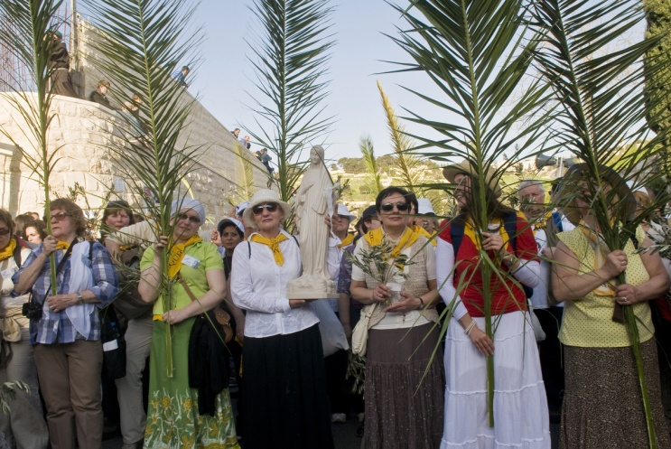
Engaging the World
The Church is entrusted with handing down the truths of the Catholic faith.
Evangelization requires active engagement with modern life and culture.
© 2016 Saint Mary’s Press
Living in Christ Series
© Kobby Dagan / Shutterstock.com
Notes:
Notes: Ask for a definition of evangelization (the proclamation of Christ through both word and deed).

Slide 3
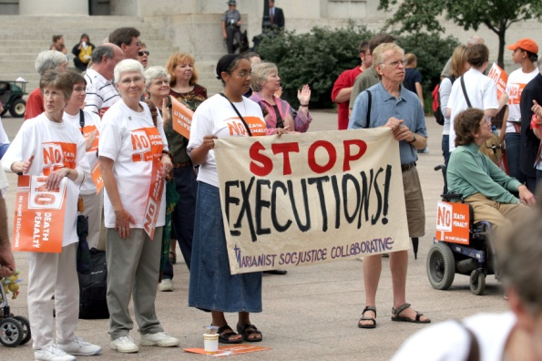
Reading the Signs of the Times
The Church looks at the particular circumstances of each generation.
She interprets them in
the light of Sacred
Scripture and Tradition.
The Church must apply
that message to the
issues each generation
faces.
© Robert J. Daveant / Shutterstock.com
© 2016 Saint Mary’s Press
Living in Christ Series
Notes:
Notes: Read aloud the paragraph that concludes article 53 of the student book, “In our present world . . .” Ask the question following that paragraph: “What is one ‘sign of the times’ today that you think merits the Church’s attention?”

Slide 4

Engaging Modern Culture
The Catholic Church must be active in the modern world, proclaiming the truth.
She must take advantage of the latest technologies and cultural developments.
The Church often stands counter to developments in our modern society.
© Jiri Hera / Shutterstock.com
© 2016 Saint Mary’s Press
Living in Christ Series
Notes:
Notes: With the students, brainstorm some issues illustrating the last point. Include a range of issues, reflecting the Church’s teachings on social justice, the media, family life, and personal morality.

Slide 5

Bringing Christian Values into Politics
The prophetic mission of the Church extends to political issues.
The Church is careful not to advocate for specific political candidates or parties;
instead she addresses specific issues.
© nata / Shutterstock.com
© 2016 Saint Mary’s Press
Living in Christ Series
Notes:
Notes: Explain that the principle of separation of church and state does not require the Church, or other faith communities, to refrain from stating their views about political issues. Discuss the second sidebar in article 54 of the student book, “Faithful Citizenship.”

Slide 6

One Pressing Issue: The Culture of Death
The Church works to address poverty, environmental issues . . .
whatever threatens the dignity of the human person.
The Church stands firm in promoting a culture of life.
© 2016 Saint Mary’s Press
Living in Christ Series
© Strahil Dimitrov / Shutterstock.com
Notes:
Notes: Point out that the Church recognizes that all human life, from the moment of conception to natural death, is sacred and should be treated with dignity. Ask for examples of efforts the students have been involved in to promote a culture of life. Consider sharing your own efforts.

Slide 7

Evangelization
The Church must reach
out to those who do not
know Christ or the
Gospel.
She must serve and
care for vibrant
Christian communities . . .
and re-evangelize the baptized who no longer actively live their faith.
© Vladimir Arndt / Shutterstock.com
© 2016 Saint Mary’s Press
Living in Christ Series
Notes:
Notes: Ask who in the Church has a responsibility to share the Good News of Jesus Christ (everyone). Remind the students of the evangelizing activity of Jesus and his Apostles, and the mission the Risen Lord gave to them.

Slide 8

Examples of Evangelization
The laity evangelize at home and at work, often by the witness of their lives.
Religious orders have played an important role in the evangelical mission of the Church.
Deacons, priests, and
bishops evangelize in
a special way.
© bikeriderlondon / Shutterstock.com
© 2016 Saint Mary’s Press
Living in Christ Series
Notes:
Notes: Ask the students how people they know evangelize by the witness of their lives. Ask how the deacons and priests in their parish evangelize in a special way. (See article 55, the section “Examples of Evangelization,” in the student book.)

Slide 9

Inculturation
Inculturation involves a respectful encounter between the Christian faith and a particular culture.
It integrates particular cultural values into the life of the Church.
It proclaims the Gospel message in different cultural contexts.
© maxstockphoto / Shutterstock.com
© 2016 Saint Mary’s Press
Living in Christ Series
Notes:
Notes: Ask the students to think about their own parish or school: Are there people whose culture is not represented in worship practices? How might the principle of inculturation be applied or extended?

Slide 10

Principles of Evangelization
We respect religious freedom,
yet we proclaim the truth boldly.
We use the latest technologies
to evangelize.
We commit to
personal holiness.
We reach out to
people of all ages.
© Mark Skainy / Shutterstock.com
© 2016 Saint Mary’s Press
Living in Christ Series
Notes:
Notes: Discuss the importance of the third principle. Ask how that point might affect the principle that follows it.

