Slide 1
The Mission of the Catholic Church
The Catholic Faith Handbook for Youth, Third Edition
Chapter 13
Document #: TX003144
Notes:
Use this presentation to introduce or review the material on the Church’s mission and the images of the Church found in chapter 13. You may wish to use slides 5, 6, and 7 as journaling prompts.

Slide 2
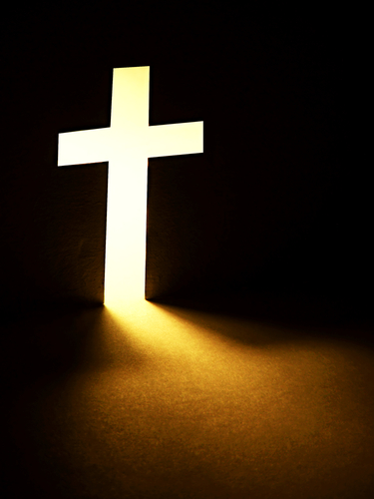
What do you think of when you hear the word church?
Copyright: isak55 / www.shutterstock.com
Notes:
Invite the students to share what comes to mind when they hear the word church.

Slide 3
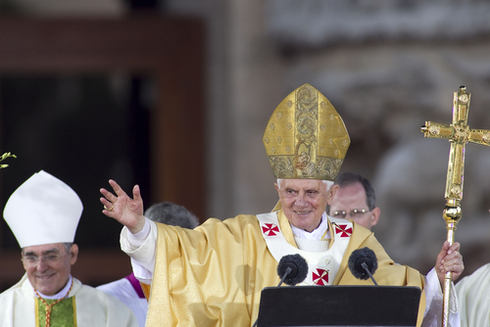
Founded by Christ
Copyright: Maxisport / www.shutterstock.com
Jesus intended for his followers to continue his mission after he was gone.
Jesus trained the Twelve Apostles for leadership, with Peter as their head.
Today’s bishops are the successors to the Apostles, and the Pope is the successor to Saint Peter.
Notes:
Remind the students that the bishops and the Pope are the primary teachers in the Church.

Slide 4
The Mission of the Church
The word church means “convocation.”
Copyright: JHershPhoto / www.shutterstock.com
It is people who have been called together to continue Christ’s mission.
The Church is both the means and the goal of God’s plan.
The Church is at once both visible and spiritual.
Notes:
Ask the students how the Church proclaims the Good News of salvation. (The proclamation of the Gospel at Mass) Encourage the students to think of other ways as well, including through the Sacraments, education, missionary work, moral and political pronouncements, and ministries to those who are marginalized.

Slide 5
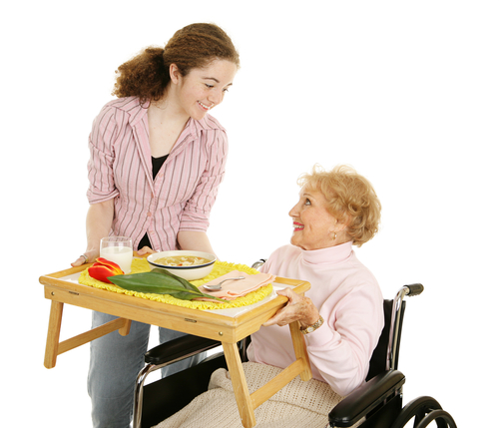
The People of God
“You are a chosen race, a royal priesthood, a holy nation, God’s own people” (1 Peter 2:9).
What does God expect of you as part of the People of God?
Copyright: Lisa F. Young / www.shutterstock.com
Notes:
Invite the students to journal on this question, and on the questions on the next two slides.

Slide 6
The Body of Christ
“Now you are the body of Christ and individually members of it” (1 Corinthians 12:27).
How will you be Christ’s hands, feet, or eyes in the world?
Copyright: Lisa F. Young / www.shutterstock.com
Notes:
Allow a few minutes for the students to journal on this question.

Slide 7
The Temple of the Holy Spirit
“Do you not know that you are God’s temple and that God’s Spirit dwells in you?” (1 Corinthians 3:16).
What gifts does the Holy Spirit nourish in you so you can contribute to Christ’s mission?
Copyright: Helga Esteb / www.shutterstock.com
Notes:
Allow a few minutes for the students to journal on this question.

Slide 8
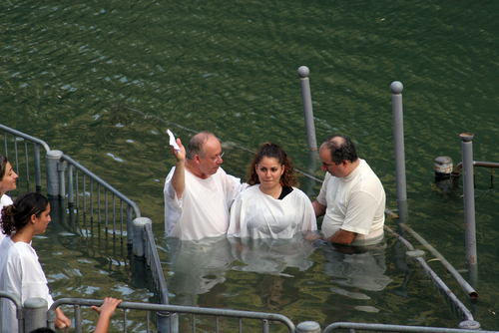
Marks of the Church
One
Holy
Catholic
Apostolic
Copyright: Zvonimir Atletic / www.shutterstock.com
Notes:
If you have not already done so, encourage the students to reflect on their answers to the reflection questions on page 144. You may wish to have them write their answers in a journal, or you might want to encourage a classroom discussion.

Slide 9
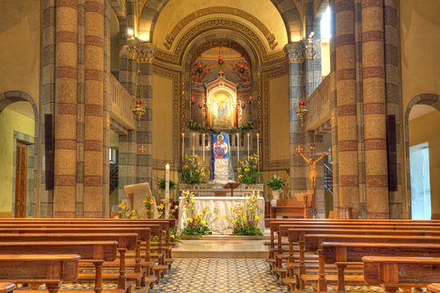
A Community of Faith
Jesus’ disciples worked together to continue his mission.
We need the love and support of other Christians to be true disciples of Jesus Christ.
Copyright: Rostislav Glinsky / www.shutterstock.com
God wants us to take part in proclaiming the Gospel message.
The Church continues to proclaim and make real the Kingdom of God.
The Church strives to be a sign of the Kingdom of God in the world.
Notes:
Call the students’ attention to the statement on page 103 of the student handbook, “The Church can only claim to be made up of sinful but redeemed (saved) people, relying on the power of the Holy Spirit to be a sign of the Reign of God in the world.” Ask the students how they see the Church doing this.

