Slide 1
Chapter 2: Indigenous Religious Traditions
World Religions: A Voyage of Discovery
DOC ID #: TX003939

Slide 2
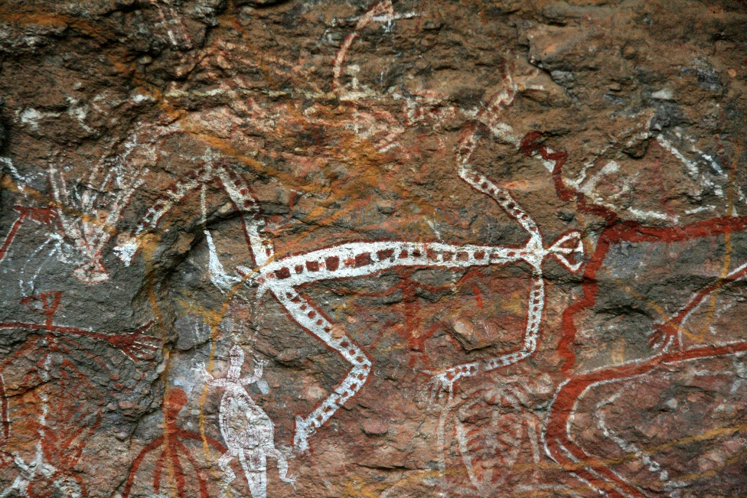
Aboriginal Rock Art
Through the ages, Aboriginal Australians have communicated through art.
Their art includes paintings on leaves and carving in wood or stone.
© Sam DCruz / www.shutterstock.com
Myths about the Dreaming are a major subject of Aboriginal art.
Notes:
Notes: The image shown on this slide is an example of Aboriginal art from Kakadu National Park in Australia’s Northern Territory. Helpful details on rock painting and other cultural aspects are available at the Park’s website: http://www.environment.gov.au/parks/kakadu/culture/index.html.

Slide 3
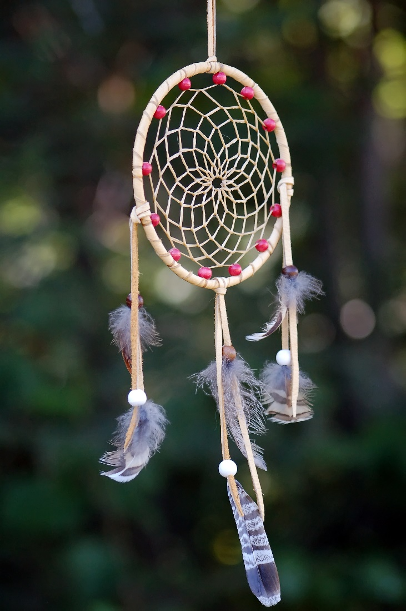
Dreamcatcher and Iktomi
The dreamcatcher has become a very popular Native American object.
A Lakota myth attributes the origin of the dreamcatcher to the spider Iktomi.
The dreamcatcher is symbolic of the web of life.
© nialat / www.shutterstock.com
Notes:
Notes: Originating in the upper Midwest, the dreamcatcher has come to represent a large variety of tribes and cultural traditions. Iktomi is the Lakota “trickster”—a mythic figure that is known to many indigenous peoples in various forms (Coyote being a popular form among some Native American tribes). Iktomi is said once to have provided to an elder vital wisdom on life while spinning its web. At the conclusion of his lesson, he instructed the elder to take the web and use it to help his people realize their dreams and goals; the dreamcatcher is thus symbolic of the web of life. A responsible recounting of this story is available at http://www.statemuseum.arizona.edu/artifact/dreamcatcher.shtml.

Slide 4
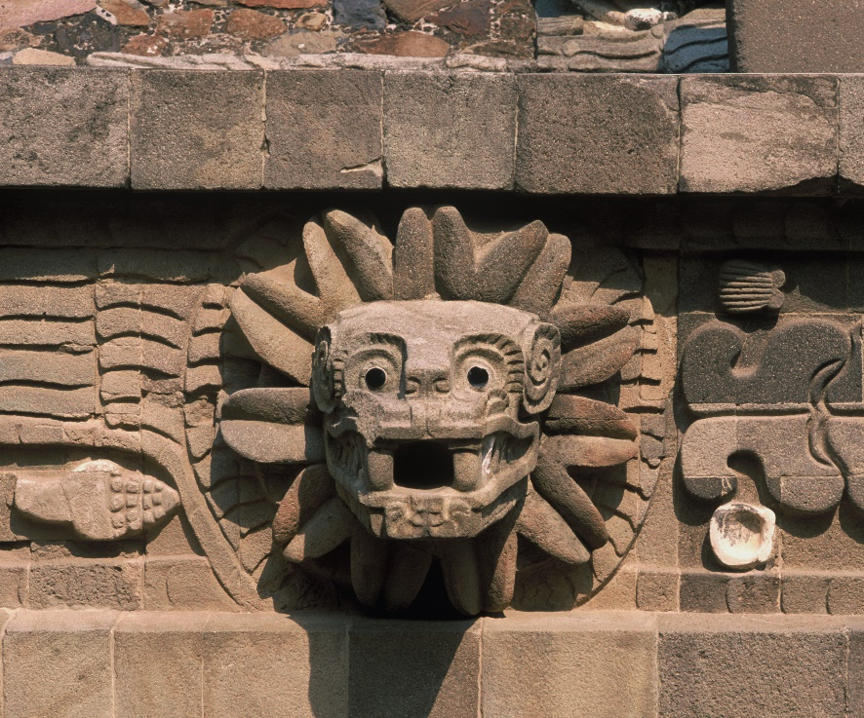
Quetzalcoatl
Quetzalcoatl, the “Feathered Serpent,” was a powerful Aztec god.
Aztec myth tells of Quetzalcoatl’s having created human beings.
Quetzalcoatl is said to have invented the calendar.
© Gordon Galbraith / www.shutterstock.com
Notes:
Notes: Quetzalcoatl was regarded as a powerful god by various Mesoamerican cultures, including the Aztec culture. The myth tells specifically that Quetzalcoatl created the human beings who inhabit our present universe. Along with having created the calendar, Quetzalcoatl is credited with being the patron god of priests, and with other important functions. The slide shows one of many sculptures of Quetzalcoatl adorning the Temple of Quetzalcoatl, Teotihuacan, Mexico. The god was worshipped by three major cultures: Teohuacan (third through eighth centuries), Toltec (ninth through twelfth), and Aztec (fourteenth through sixteenth).

Slide 5
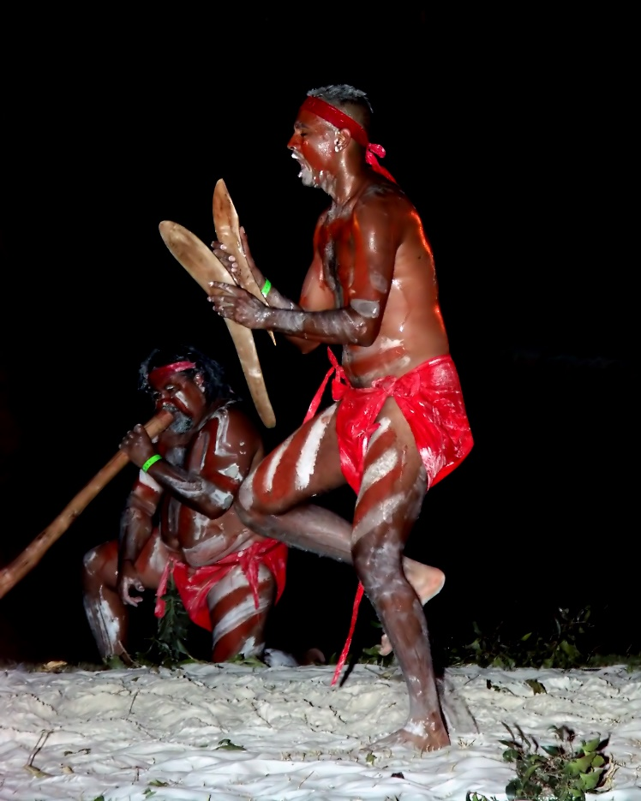
Australian Aboriginal Corroboree Dancers
The corroboree celebrates through song and dance myths of the Dreaming.
The didgeridoo is played in religious ceremonies.
Dancing and music are important elements of religious ritual.
© Jeff Chandler / www.shutterstock.com
Notes:
Notes: The didgeridoo (or didjeridu) was invented by Aborigines at least one thousand years ago. Ranging from 3 to 10 feet in length, the instrument is categorized by musicologists as a brass aerophone (like a trumpet or trombone).

Slide 6
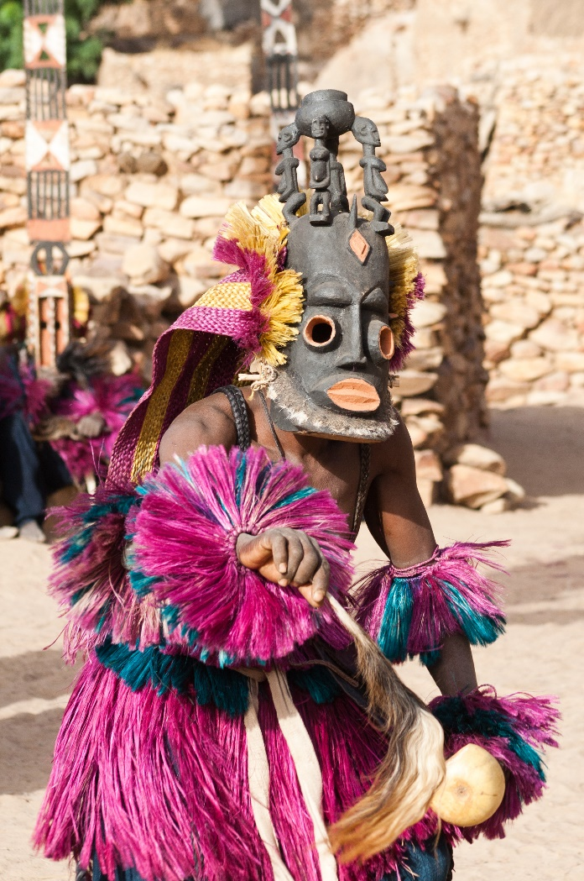
African Religious Dance
Dancing is a common ritual practice in many African indigenous religions.
Men of the Dogon people, who live in Mali, dance while wearing masks.
Other African peoples, including the Yoruba, also wear masks when dancing.
© Michele Alfieri / www.shutterstock.com
Notes:
Notes: The general topic of dance provides an opportunity to explore the vast diversity of African religious cultures. Ritual use of masks is another opportunity.

Slide 7
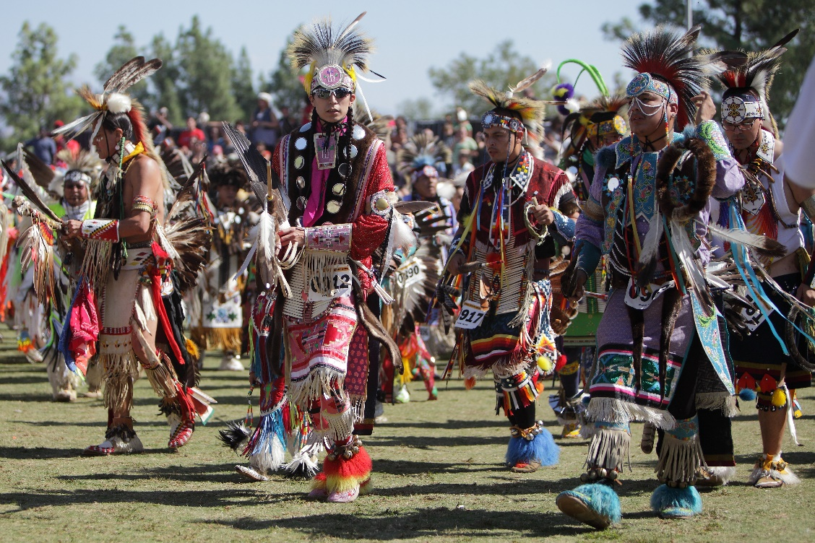
Native American Dancers
Dancing is a common religious practice among Native American peoples.
Some of the most important rituals involve dancing, such as the Sun Dance and the Ghost Dance.
© Digital Media Pro / www.shutterstock.com
Notes:
Notes: The Sun Dance was traditionally performed by most nations of the Northern Plains, and now is performed by nations across North America. The Ghost Dance was developed in the late nineteenth century as a form of resistance against the cultural changes brought about by the influx of European Americans into Native lands. Much good scholarship is available on both the Sun Dance and the Ghost Dance. The University of Nebraska provides succinct online descriptions of both at http://plainshumanities.unl.edu/encyclopedia/doc/egp.rel.046 and http://plainshumanities.unl.edu/encyclopedia/doc/egp.rel.023. For a good book-length study of the Ghost Dance, see especially The Ghost Dance: Ethnohistory and Revitalization, by Alice Beck Kehoe (Austin, TX: Holt Rinehart & Winston, 1989).

Slide 8
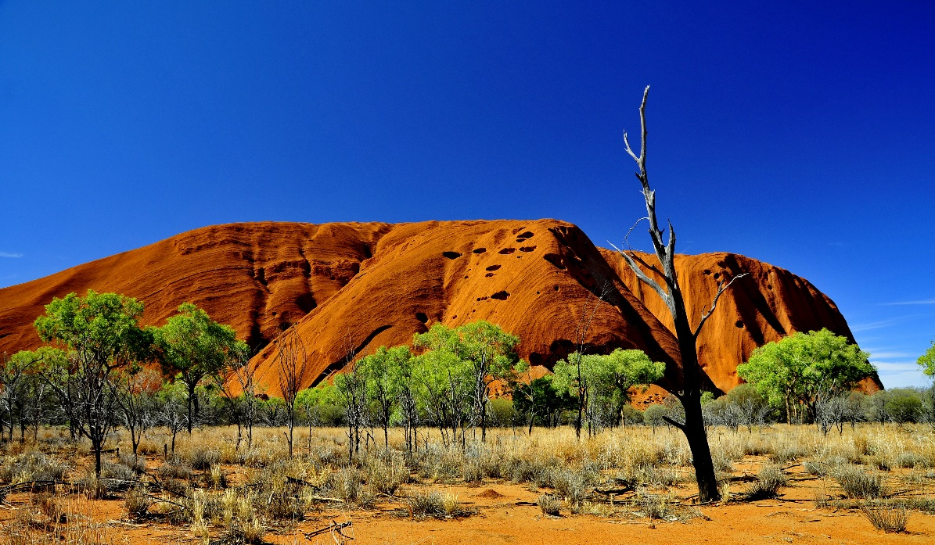
Uluru (Ayers Rock)
Uluru is venerated by the Anangu peoples of central Australia.
It is a prime example of the axis mundi, the “center of the world.”
© Stanislav Fosenbauer / www.shutterstock.com
Axis mundi means “the place of origin and homeland of the people.”
Notes:
Notes: For thousands of years, Uluru has been venerated by the Anangu peoples. The website of Uluru-Kata Tjuta National Park provides helpful information on “the oldest living culture on earth”: http://www.environment.gov.au/parks/uluru/.
Further examples of the axis mundi could be cited. The concept is developed and explored by Mircea Eliade; see especially the first chapter of The Sacred and the Profane (San Diego: Harcourt Brace Jovanovich, 1987).

Slide 9
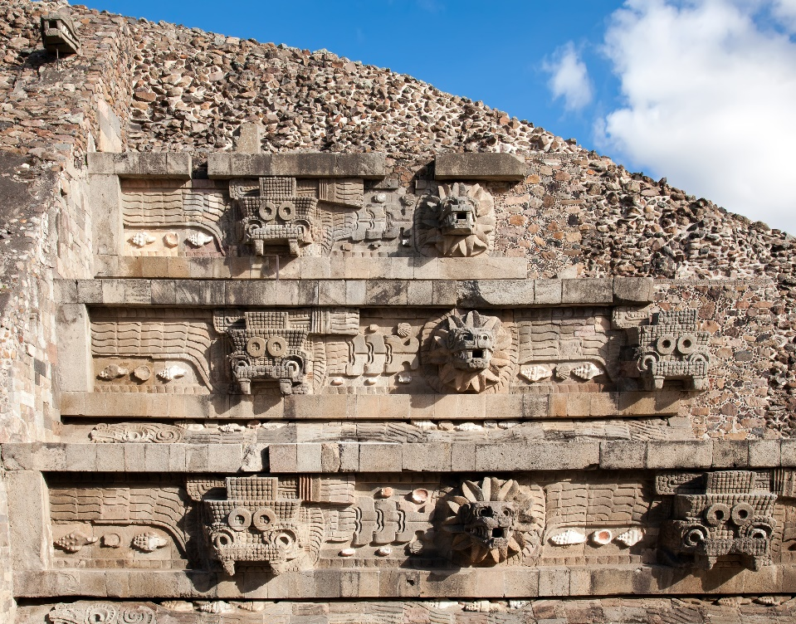
Feathered Serpent Pyramid
This is another example of the axis mundi.
Teotihuacan culture flourished from the third through eighth centuries.
Aztec culture knew the Feathered Serpent as Quetzalcoatl.
© Vladimir Korostyshevskiy / www.shutterstock.com
Notes:
Notes: (The Aztec Quetzalcoatl is featured on slide 4.) A detailed academic website devoted to the Feathered Serpent Pyramid, Teotihuacan, Mexico, is available at http://archaeology.asu.edu/teo/fsp/index.htm.

Slide 10
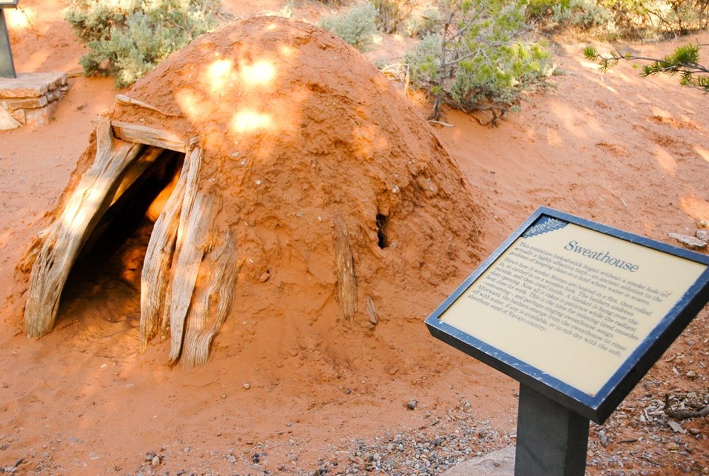
Sweat Lodge
The sweat lodge is utilized by Native American peoples throughout North America.
It is used for ritual purification and cleansing of the body.
© Jeffrey M. Frank / www.shutterstock.com
It is used with other rituals, such as the Sun Dance.
Notes:
Notes: Ritual purification and cleansing are induced by pouring water over heated stones. Sometimes the sweat lodge is understood to have symbolic significance, functioning as a microcosm representative of the universe. As such it resembles the tepee, the typical domestic structure of the Northern Plains.

Slide 11
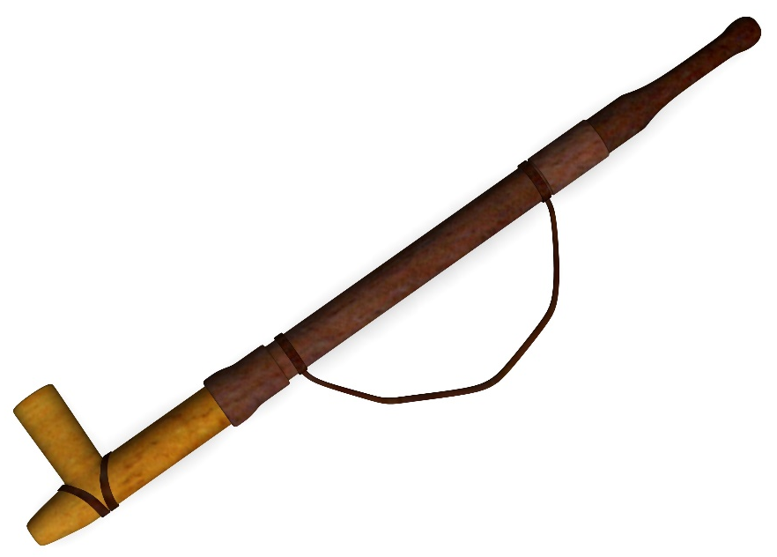
Native American Pipe (Calumet)
The calumet is used by many nations.
It is smoked during religious ceremonies, such as the Sun Dance.
The Northern Plains peoples made calumets of pipestone, a fine-grained reddish rock.
© 3drenderings / www.shutterstock.com
Notes:
Notes: Pipestone is found in only a few quarries, located in Minnesota, Wisconsin, and Ontario. Pipestone is known technically as catlinite, a metamorphosed mudstone. Pipestone National Monument, in Minnesota, established in 1937, provides an informative website: http://www.nps.gov/pipe/index.htm.

