Slide 1
Mary, Our Mother
The Paschal Mystery
Unit 2, Chapter 4
Document #: TX005794
Notes:
Notes: This presentation provides the information on Mary from chapter 4 of the student book, as well as additional background, in easy-to-review format. It can be a chance for the students to volunteer what they know about Mary, as well as to share their reactions to her story. You can also take this opportunity to describe and encourage devotion to our Blessed Mother.

Slide 2
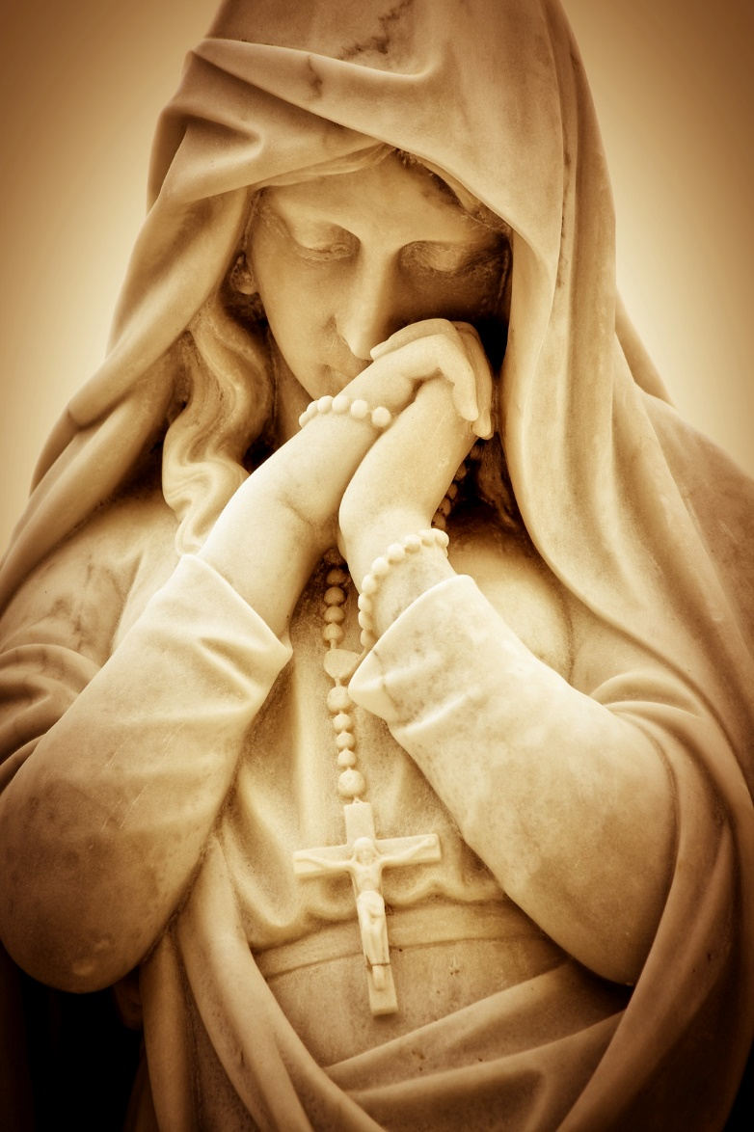
Mary, Our Mother
Think about when you first heard about Mary.
What were you told?
How has your understanding of Mary grown?
© Kamira / Shutterstock.com

Slide 3
What Do We Know about Mary?
Her parents were Saints Anne and Joachim.
She lived in Nazareth in Galilee.
She was the cousin of Elizabeth, the mother of John the Baptist.
She was betrothed (engaged) to Joseph when the angel Gabriel came to her: “Hail, favored one! The Lord is with you.” (Luke 1:28)
The angel announced that she was to be the mother of Jesus, the Mother of God.

Slide 4
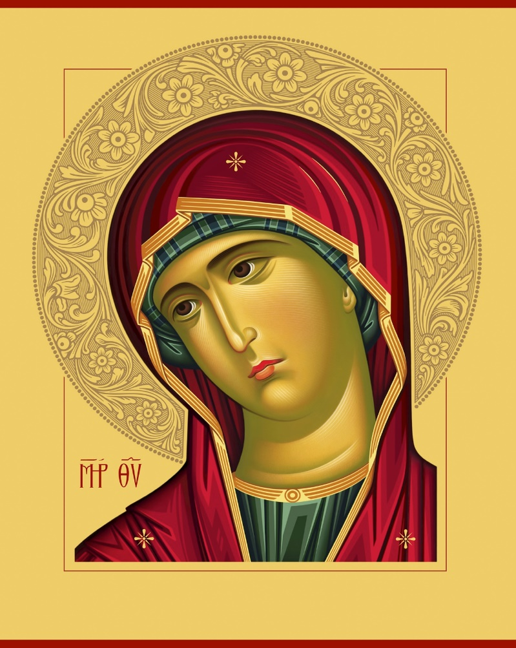
What Do We Know about Mary? (cont’d.)
Mary had a deep faith and trust in God.
She was young and unmarried.
She became pregnant by the Holy Spirit.
© yantarj / Shutterstock.com

Slide 5
Mary Became Pregnant by the Holy Spirit
Take a few moments to reflect on how difficult this must have been for Mary.
How would she tell Joseph?
How would he respond?
What would the neighbors say?
Remember, this was a culture that stoned unmarried pregnant women.
Mary’s “yes” would mean that she would be in danger and so would the baby she would carry: Jesus.

Slide 6
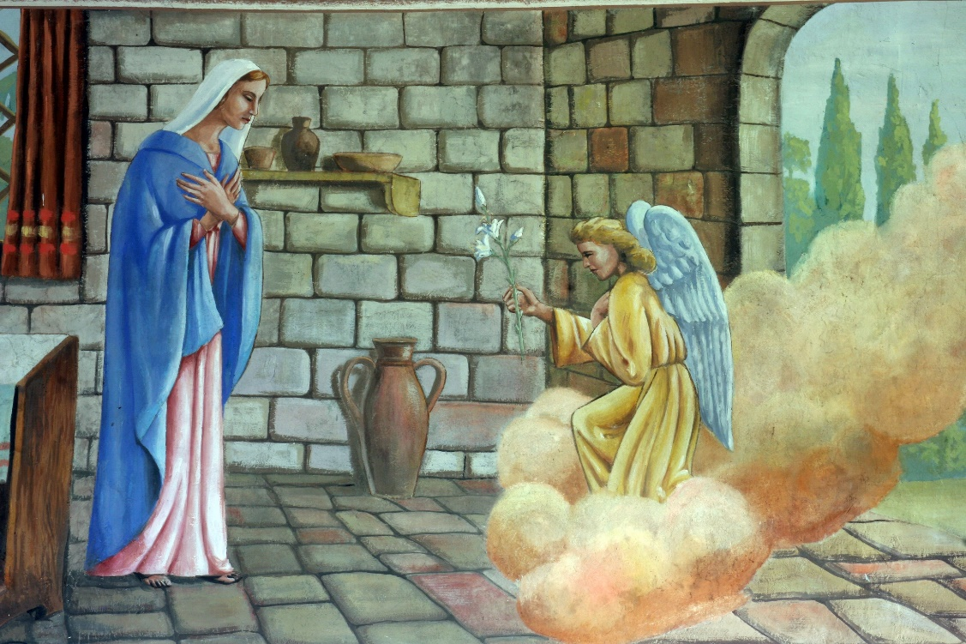
Mary Said Yes
“Behold, I am the handmaid of the Lord. May it be done to me according to your word.” (Luke 1:38)
We celebrate Mary’s yes on the Solemnity of the Annunciation, March 25.
© Zvonimir Atletic / Shutterstock.com

Slide 7
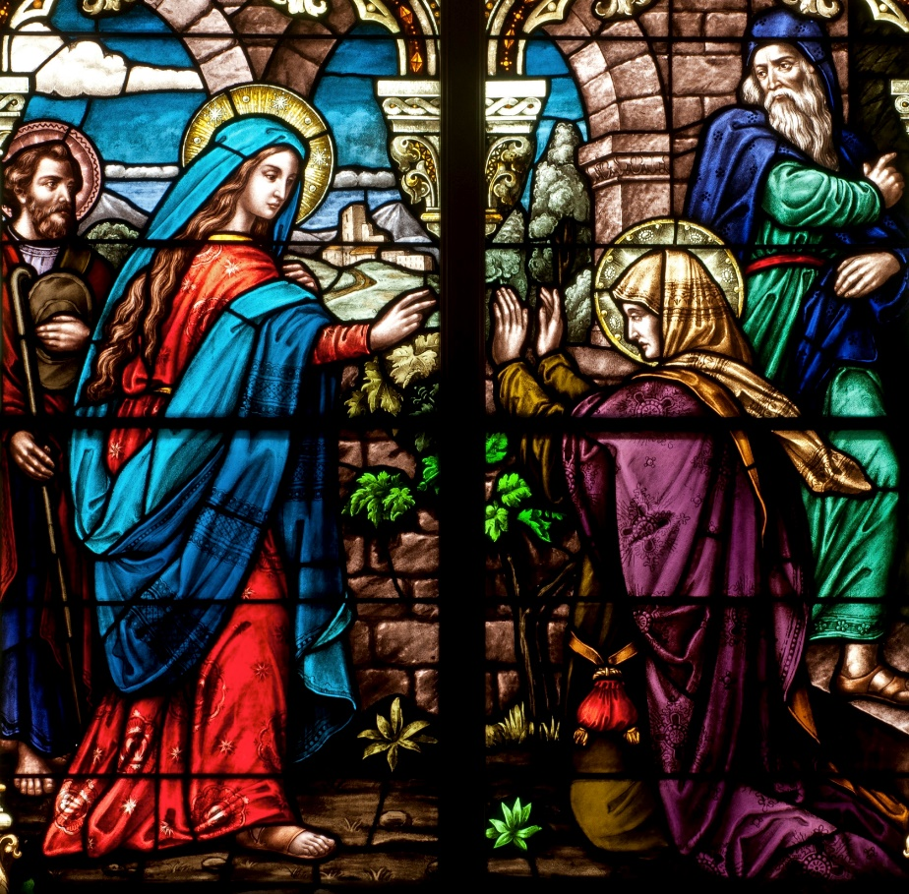
The Visitation
Mary learned that her cousin Elizabeth was also pregnant, and Mary went to visit her.
Elizabeth recognized Mary as a mother, the mother of her Lord.
© Nancy Bauer / Shutterstock.com

Slide 8
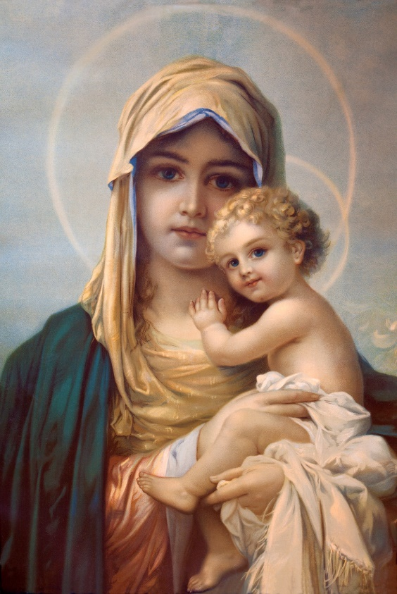
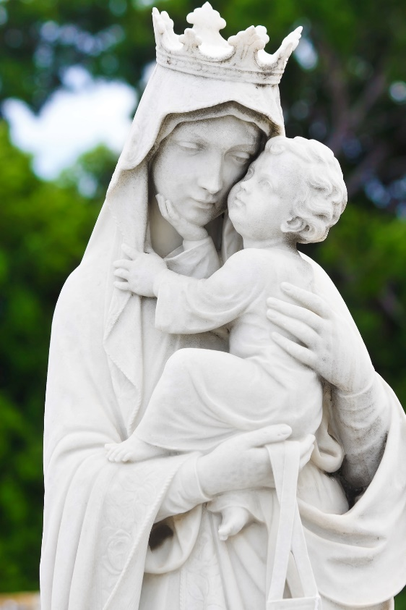
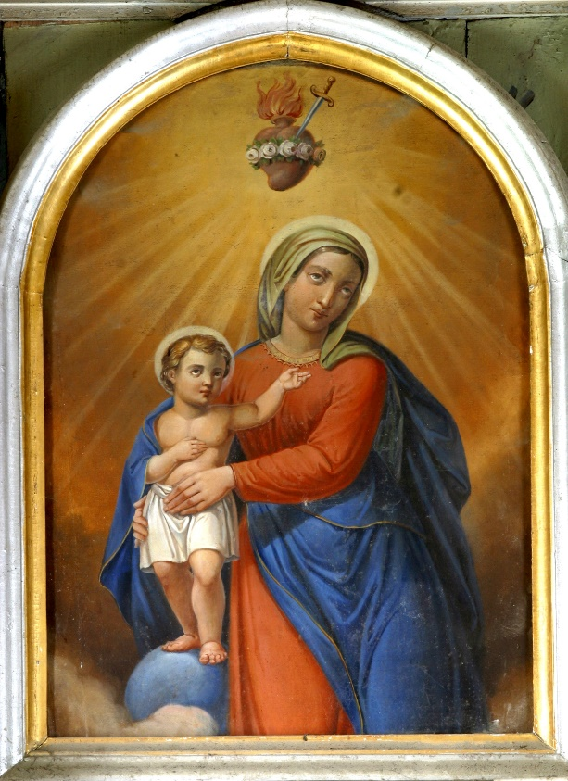
Mary, Mother of Jesus
© Renata Sedmakova / Shutterstock.com
© Kamira / Shutterstock.com
© Zvonimir Atletic / Shutterstock.com

Slide 9
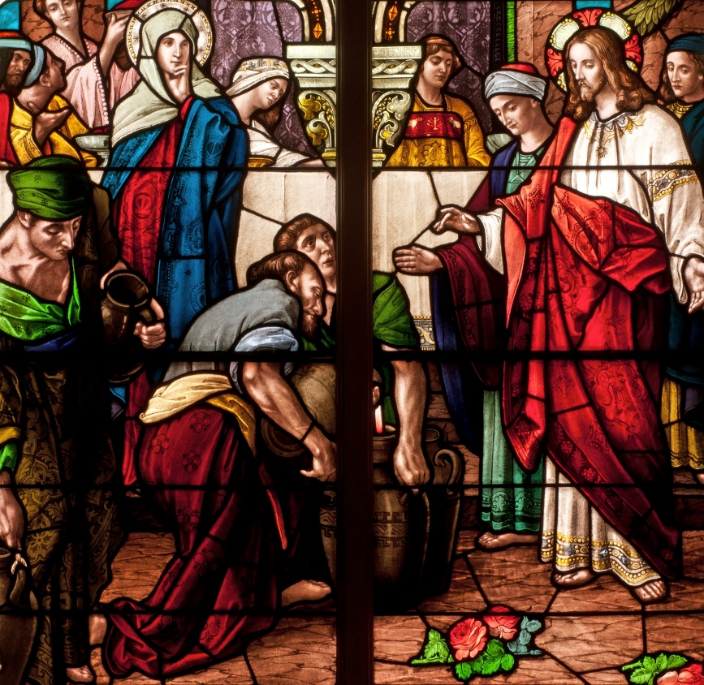
The Wedding Feast at Cana
Mary was a mother who knew her son.
She was concerned for others.
Mary saw that the couple had run out of wine at the wedding feast in Cana. She asked her son to do something.
It was his first public miracle.
He responded when she asked him to help them.
© Nancy Bauer / Shutterstock.com

Slide 10
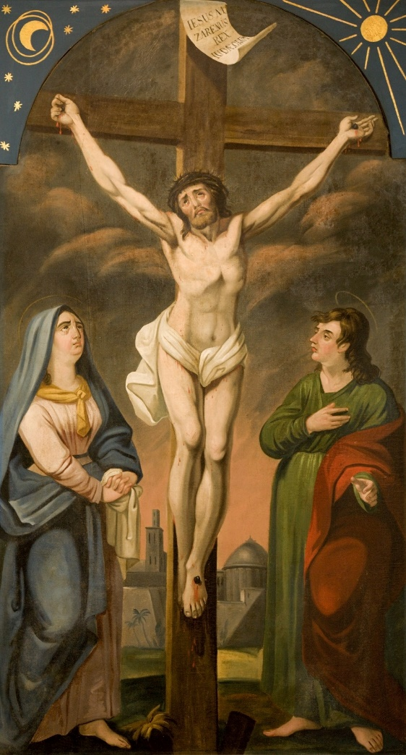
Mary at the Foot of the Cross
“Then he said to the disciple, ‘Behold, your mother.’” (John 19:27)
© Renata Sedmakova / Shutterstock.com
Image in public domain

Slide 11
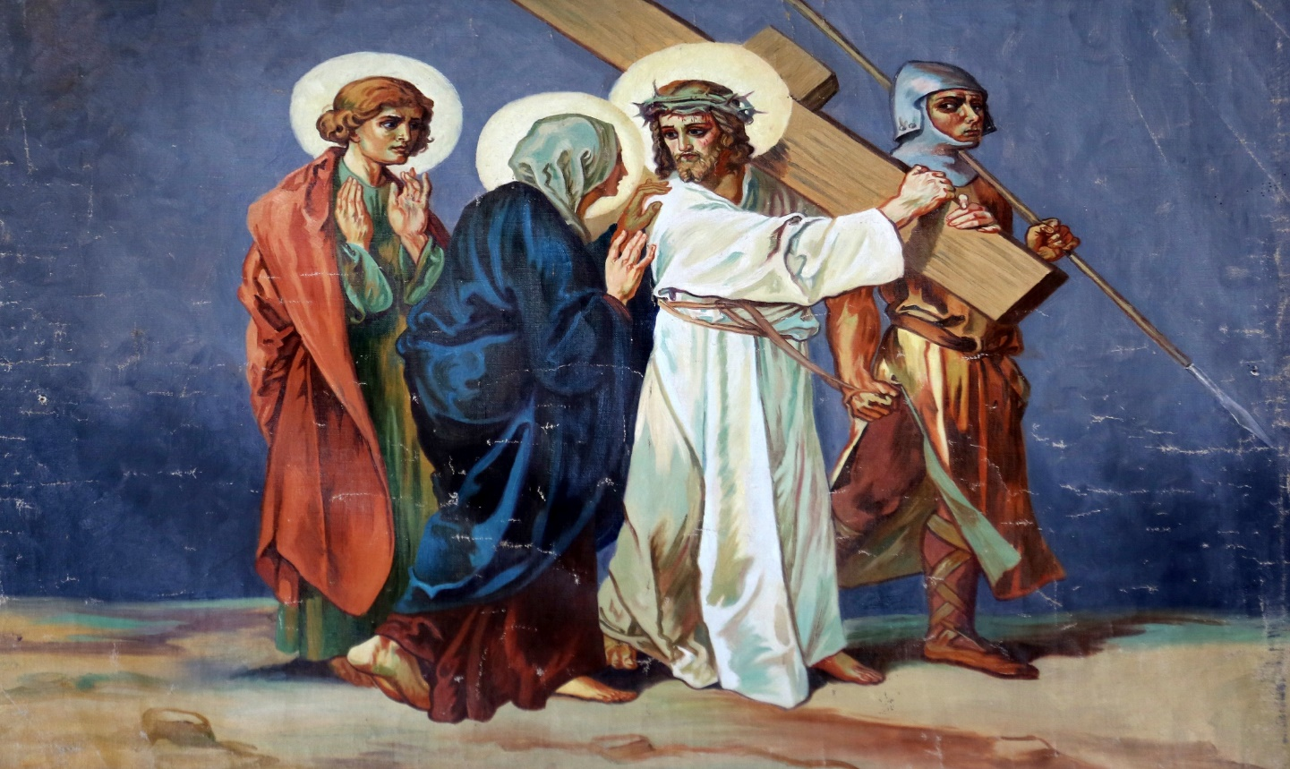
The Fourth Station of the Cross
Jesus meets his mother.
© Zvonimir Atletic / Shutterstock.com

Slide 12
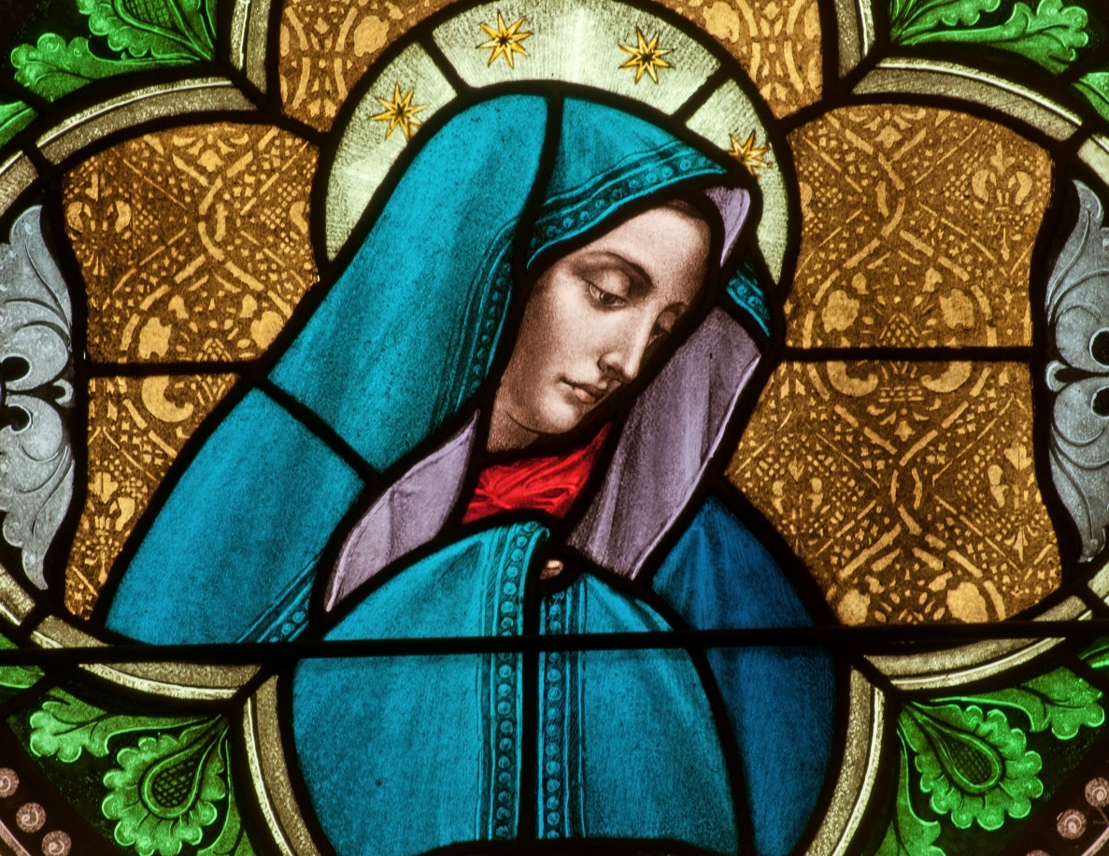
Mary, Our Mother
“Why should we not all together look to her as our common Mother who prays for the unity of God’s family and who ‘precedes’ us all at the head of the long line of witnesses of faith in the one Lord?” (Pope Saint John Paul II, Redemptoris Mater, 30)
© Nancy Bauer / Shutterstock.com

Slide 13
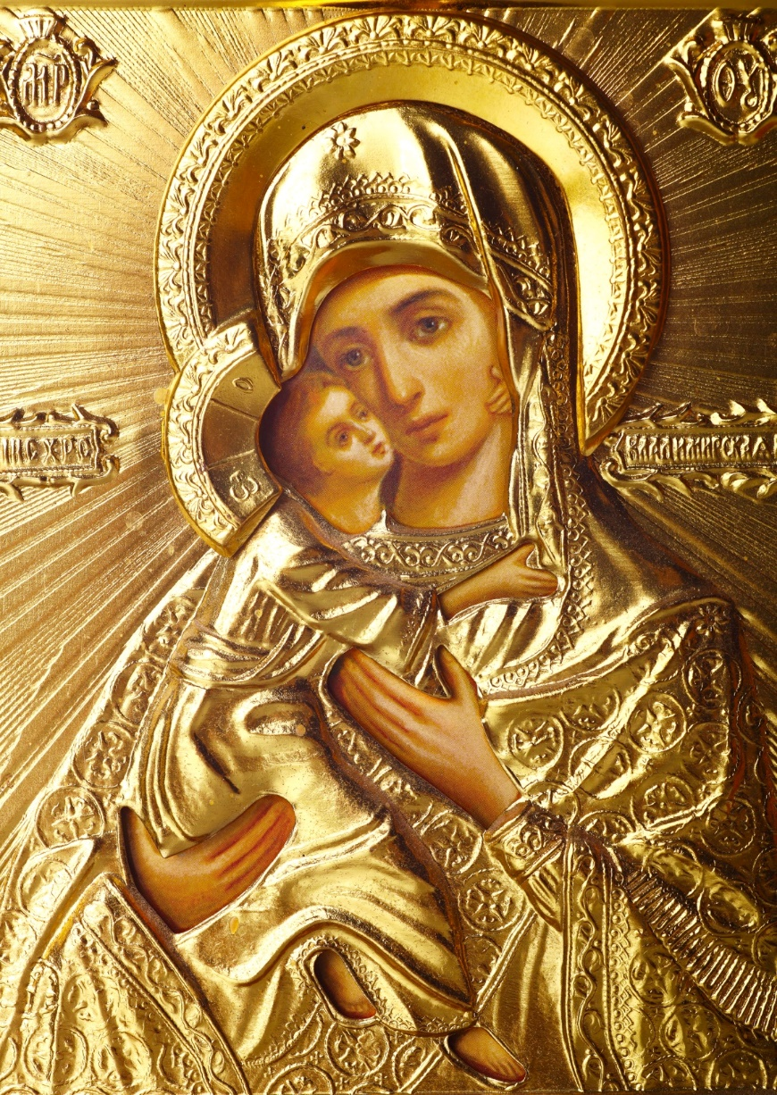
Mary, Our Mother
© Dmitrijs Mihejevs / Shutterstock.com

