Slide 1
Key Concepts of Church
The Church
Unit 1
Document #: TX005567

Slide 2
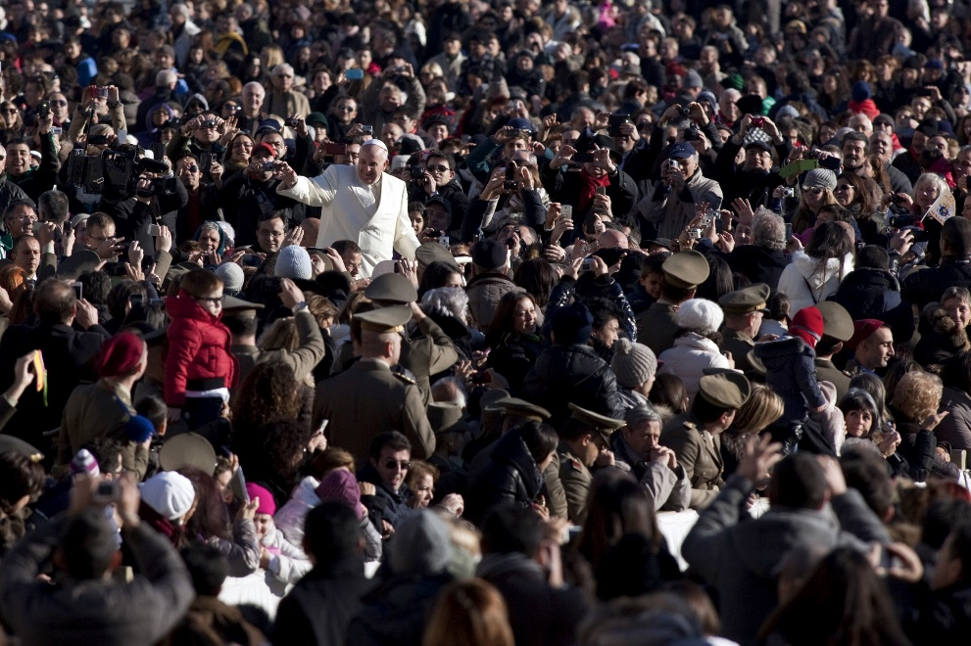
Meanings of Church
The word Church has three meanings in Christian usage:
the entire community of God’s People around the world
the local community, which is a diocese or archdiocese
the community assembled for liturgy, especially for the Mass
©giulio napolitano / Shutterstock.com
Notes:
Notes: You can ask the students what the three meanings are before you click to reveal the bulleted items. Be aware, however, that they will want to answer in terms of a building. Emphasize that Church with a capital C refers to the faith community, not to the building.

Slide 3
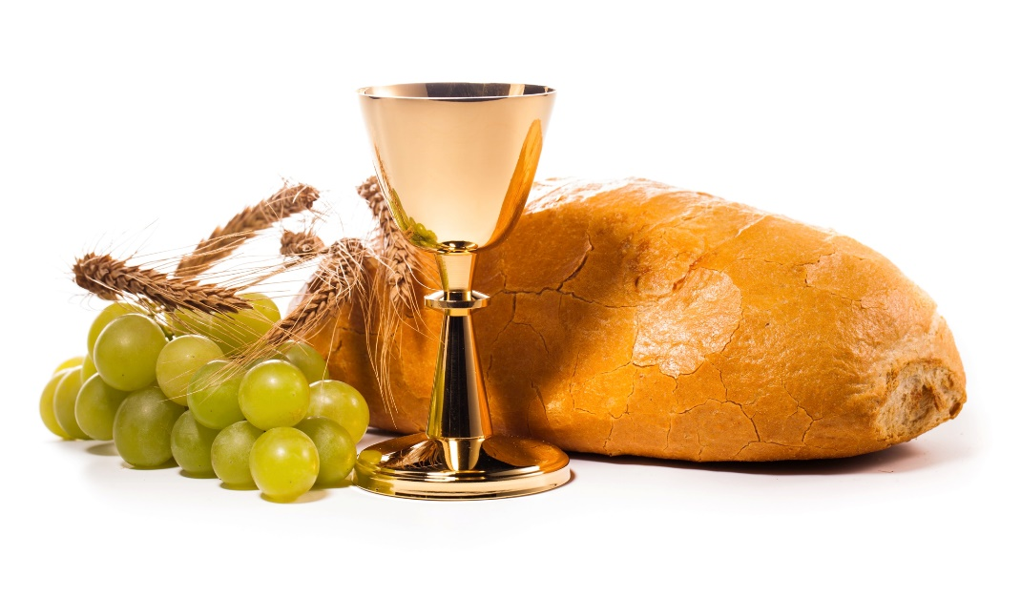
All Three Are Church
It is impossible to separate these three meanings from one another.
The Church is all the people whom God gathers in the world, but she exists concretely in local communities and is made real in the assembly that gathers for liturgy, especially to celebrate the Eucharist.
©Mariusz Szczygiel / Shutterstock.com

Slide 4
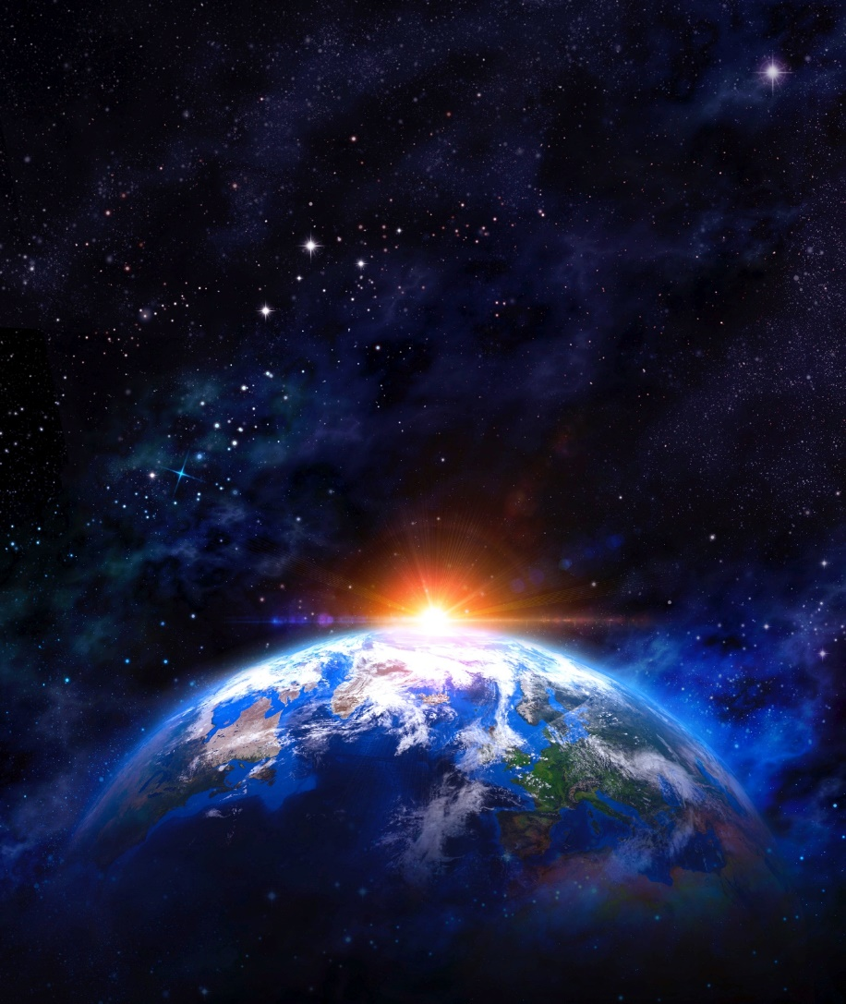
Church as Mystery
“The Church is in history, but at the same time she transcends it. It is only ‘with the eyes of faith’¹ that one can see her in her visible reality and at the same time in her spiritual reality as bearer of divine life.” (Catechism of the Catholic Church [CCC], 770)
© titoOnz / iStock.com
Notes:
1. Roman Catechism I, 10, 20.

Slide 5
Mystical Union
Saint Paul calls the nuptial union of Christ and his Bride, the Church, “a great mystery.”
Because she is united to Christ as her Bridegroom, the Church becomes, in her turn, a mystery.
Holiness is measured according to the “great mystery” in which the Bride responds to the gift of the Bridegroom.
©Kichigin / Shutterstock.com
Notes:
Notes: This is a difficult concept for most students—the idea that the Church is Christ’s Bride. Explain that the image illustrates Christ’s love for the Church, for the People of God who make up this Church, and for Christ’s never-ending care for the Church and his people. As a man loves his wife, so Christ loves his Church.

Slide 6
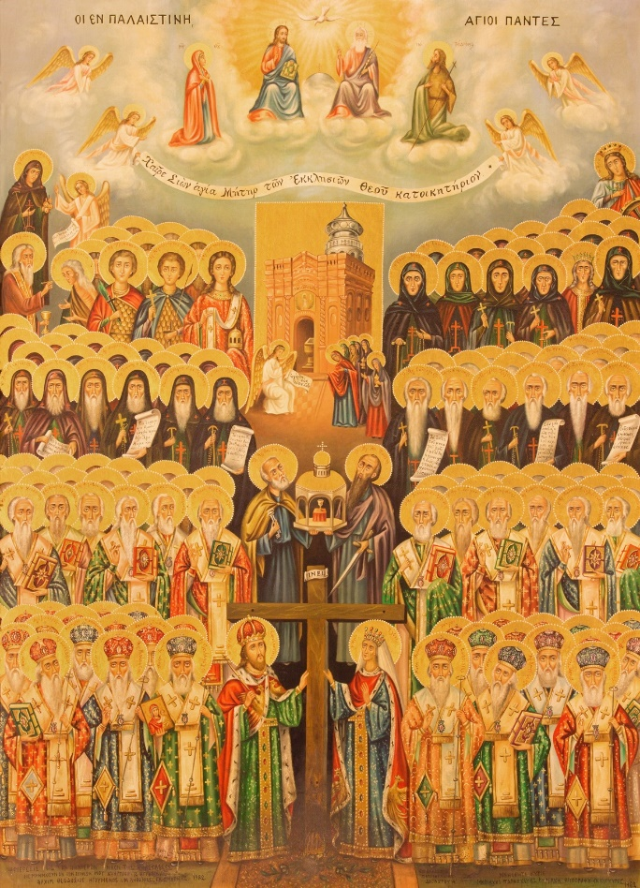
Planned from the Beginning
God the Father planned the Church from the beginning.
Calling together human beings is central to the Father’s plan of salvation, as he wishes to gather us as his own people in order to save us.
Through salvation, we will dwell with him in Heaven.
©Renata Sedmakova / Shutterstock.com
Notes:
Notes: Emphasize that the Trinity—God, Christ, and the Holy Spirit—existed from the beginning of time. Together they planned and created the earth and all upon it. Knowing all things, they knew from the beginning that they would need the Church as the gate to Heaven.

Slide 7
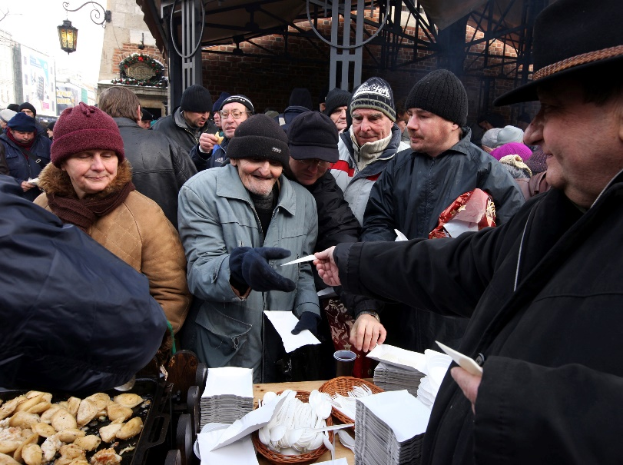
Founded by Christ
The Church is not ours, but the Lord’s, founded by Christ when he proclaimed and ushered in the Kingdom of God.
The Church of the Lord is a place of the presence of the mystery of God and the Lord resurrected in the world.
©praszkiewicz / Shutterstock.com

Slide 8
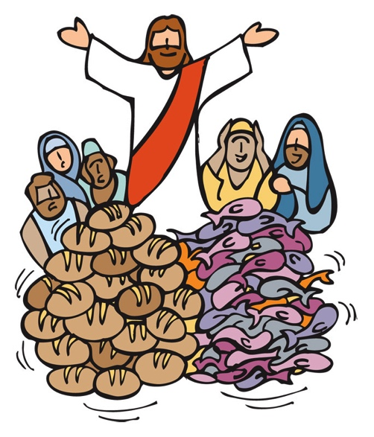
Kingdom of God Is at Hand
“This is the time of fulfillment. The kingdom of God is at hand” (Mark 1:15).
With these words, Christ inaugurated the Church on earth.
©jcpgraphic / Shutterstock.com

Slide 9
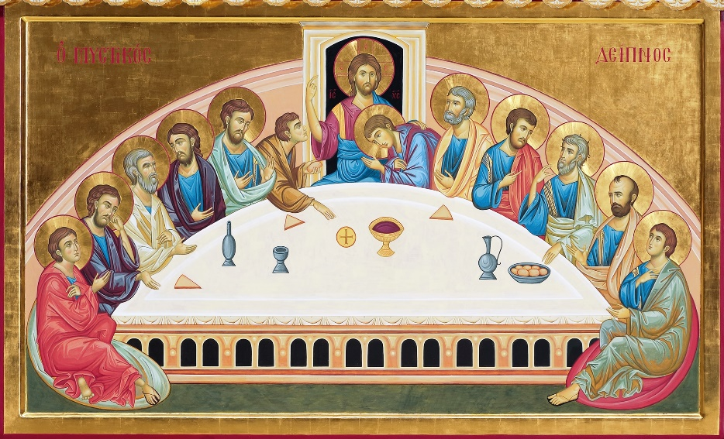
Christ’s Body
Christ’s light shines on the Church’s countenance.
Jesus established the Church primarily by the saving gift of himself.
This gift, which was fulfilled on the cross, was anticipated when Jesus instituted the Eucharist: “This is my body. . . .”
©Paolo Gaetano / iStock.com
Notes:
Notes: Emphasize to the students that Christ’s words are not to be taken merely as symbol, but as reality: “This is my body. . . . This is my blood” (Matthew 26:26–28.

Slide 10
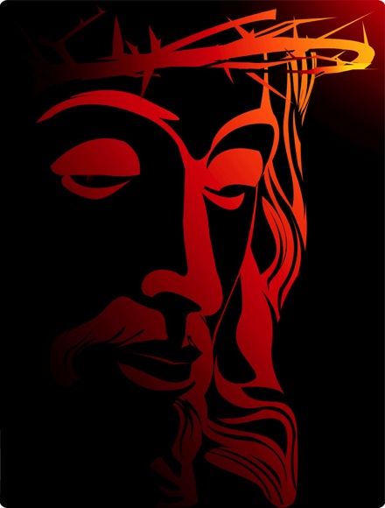
Made Holy
Christ gave his life, dying on the cross, to make his Church holy, sanctified by his blood.
©Creative Illus / Shutterstock.com

Slide 11
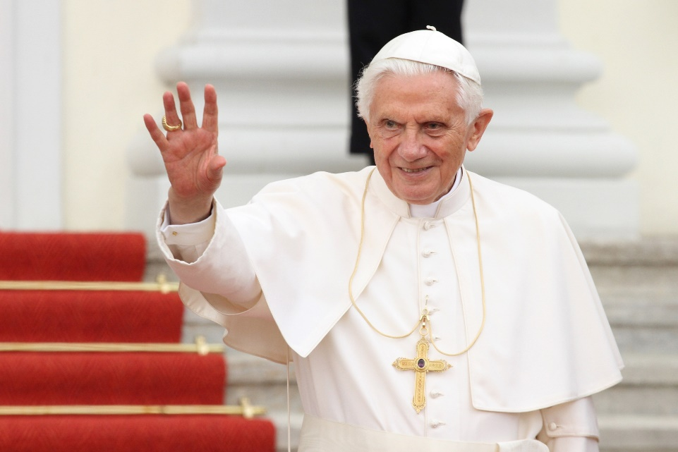
Mystery of Divine Origin
Cardinal Joseph Ratzinger (now Pope Emeritus Benedict XVI) emphasized the mystery of the Church: “The Church is not just a human institution; because of its divine origin, it is, above all, a ‘mystery.’”
© vipflash / Shutterstock.com

Slide 12
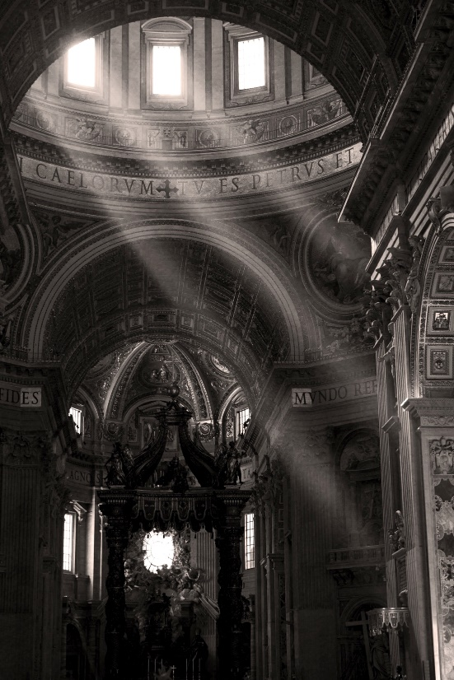
Church as Human and Divine
The Church is both visible
and invisible (spiritual),
a hierarchical society
and the Mystical Body of Christ.
She is one, yet formed of two
components, human and divine.
That is her mystery,
which only faith can accept.
©Alessandro Colle / Shutterstock.com
Notes:
Notes: See CCC, 771

Slide 13
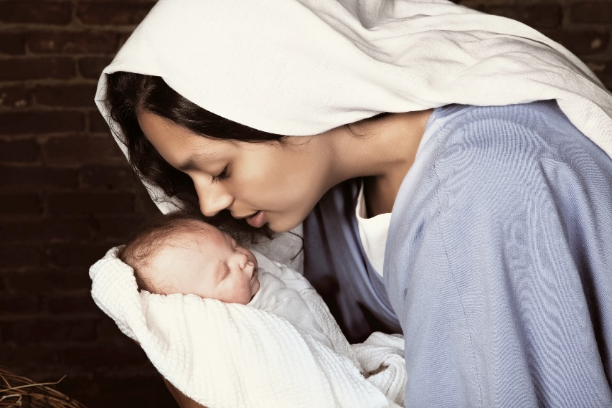
Both Human and Divine
At the time appointed by God, Jesus Christ, the Eternal Word of the Father, became man and lived among us on earth.
He took on a human nature without losing his divine nature.
The mystery of the union of the human and divine natures in one Divine Person is echoed in the nature of the Church.
©Anneka / Shutterstock.com

Slide 14
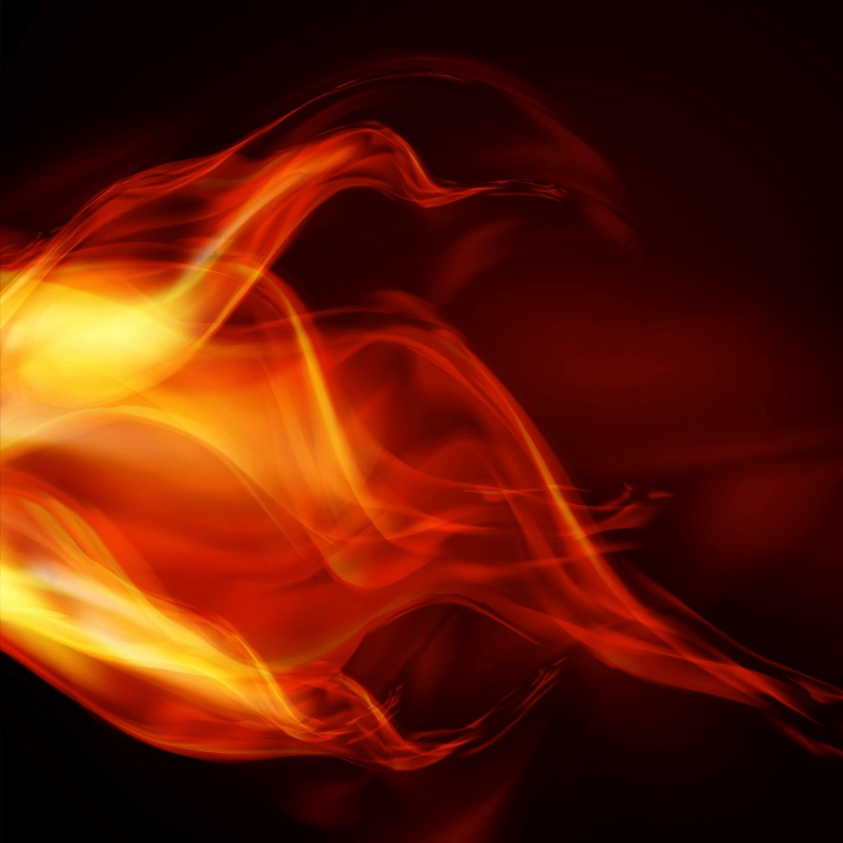
Holy Spirit Animates
The Holy Spirit animates or gives life to the Church.
Prior to his Ascension, Jesus told his disciples, “You will receive power when the holy Spirit comes upon you” (Acts of the Apostles 1:8).
©majcot / Shutterstock.com

Slide 15
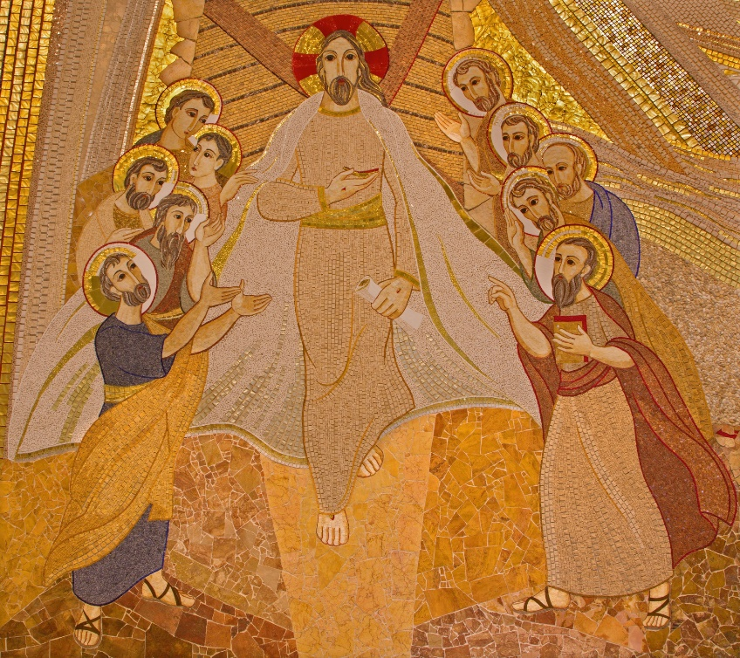
Mission of the Church
The mission of the Apostles in the early Church began with their time with Jesus.
Jesus proclaimed the Good News and healed people and sent the Apostles out to do the same.
© Renata Sedmakova / Shutterstock.com
Notes:
Notes: This would be a good time to have a brief, pointed discussion about exactly what the Good News is.

Slide 16
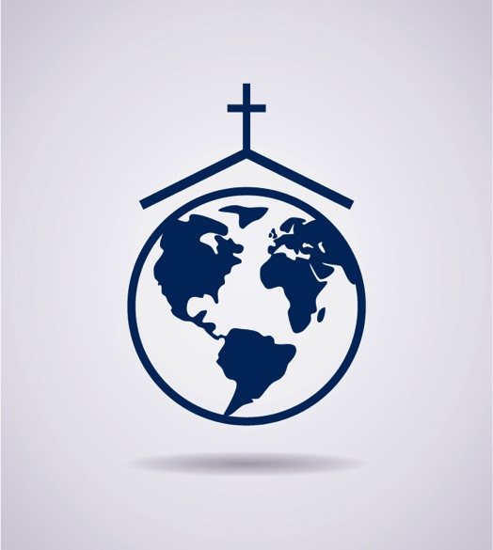
A Global Church
Today the Good News is preached in almost every nation on earth.
The Apostles are no longer with us, but through our Baptism, we have each been entrusted with the same mission: to spread the Good News of salvation through Jesus Christ.
© freesoulproduction / Shutterstock.com

Slide 17
Acknowledgments
The quotation on slide 4 is from the Catechism of the Catholic Church for use in the United States of America, second edition, number 770. Copyright © 1994 by the United States Catholic Conference, Inc.—Libreria Editrice Vaticana. English translation of the Catechism of the Catholic Church: Modifications from the Editio Typica copyright © 1997 by the United States Catholic Conference, Inc.—Libreria Editrice Vaticana.
The Scripture quotations on slides 8 and 14 are from the New American Bible, revised edition © 2010, 1991, 1986, 1970 Confraternity of Christian Doctrine, Inc., Washington, D.C. All Rights Reserved. No part of this work may be reproduced or transmitted in any form or by any means, electronic or mechanical, including photocopying, recording, or by any information storage and retrieval system, without permission in writing from the copyright owners.
The quotation on slide 11 by Pope Emeritus Benedict XVI is from an article in the Zenit Daily Dispatch, Vatican City, July 26, 1999, at www.ewtn.com/library/Theology/ZMYSTERY.HTM.

