Slide 1
What Is Faith?
Document # TX004834

Slide 2
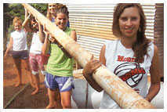
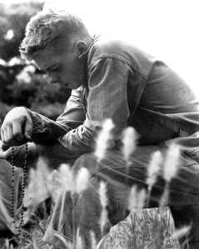
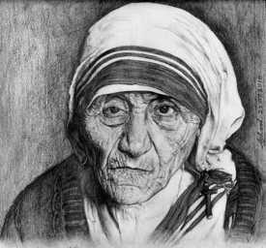
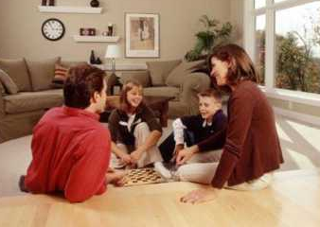
Describe how these images represent faith.
© camptocampus.com
Public domain
Public domain
© wowlao.blogspot
Notes:
While showing these images, lead a class discussion on the different ways people express faith.

Slide 3
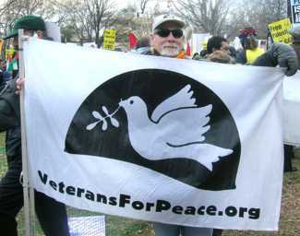
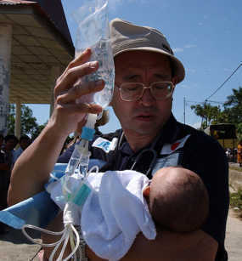
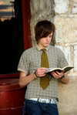
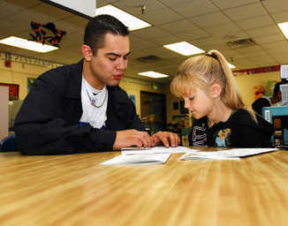
Describe how these images represent faith.
Public domain
Public domain
© revelation320.typepad
Public domain
Notes:
While showing these images, lead a discussion on the different ways people express faith.

Slide 4
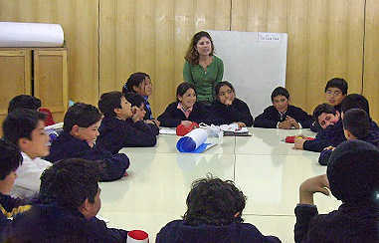
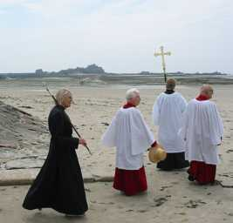
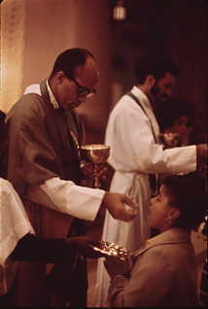
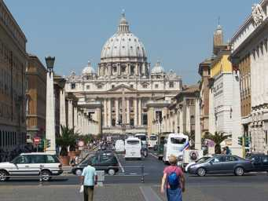
Describe how these images represent faith.
Public domain
Public domain
Public domain
Public domain
Notes:
While showing these images, lead a discussion on the different ways people express faith.

Slide 5
What Are the Connections?
Faith
Religion
Belief

Slide 6
Religion
Comes from the Latin religio, meaning “respect for the sacred” or “reverence for the gods.”
Refers to the set of practices and beliefs followed by those who believe in and worship God.

Slide 7
Belief
Comes from German, meaning what is “dear” or “esteemed.”
Refers to a mental act or state of mind placing trust or confidence in a person or doctrine.

Slide 8
Faith | Religion | Belief
Latin fides, meaning “trust” or “belief” | Latin religio, meaning “respect for the sacred” or “reverence for the gods” | Germanic origin, meaning what is “dear” or “esteemed”
A specific act or human response to Revelation An internal surrender of our whole self to God (recall the Greatest Commandment) God-given theological virtue or habit of belief | Set of practices and beliefs followed by those who believe in and worship God | A mental act or state of mind placing trust or confidence in a person or doctrine

Slide 9
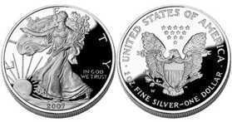
Faith and Religion
Two sides of the same coin
Cannot have one without the other
Faith without religion = fades away
Religious practices without faith = “going through the motions”
Faith requires willingness.
Mary said, “Behold, I am the handmaid of the Lord.
May it be done to me according to your word.”
(Luke 1:38)
© boostsilver.com
Notes:
Allow time for the last two points to sink in. Consider asking for examples of people who represent these last two points and the consequences of each type of faith.

Slide 10
Faith requires willingness but
it does not have to be perfect.
Notes:
Remind the students that in faith we accept God’s Revelation. We express that faith in our religious beliefs and practices.

Slide 11
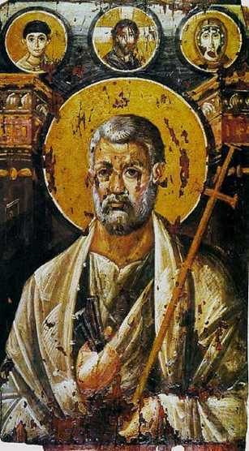
The Scriptures and Faith
“Simon Peter said in reply, ‘You are the Messiah, the Son of the living God’” (Matthew 16:16).
“[Peter] said to him, ‘Lord, I am prepared to go to prison and to die with you.’ But he replied, ‘I tell you, Peter, before the cock crows this day, you will deny three times that you know me.’” (Luke 22:33–34)
“And so I say to you, you are Peter, and upon this rock I will build my church … ” (Matthew 16:18).
Public domain
Notes:
Emphasize that Jesus chose Peter because of his strong willingness yet imperfect faith. Help the students to understand that our faith does not need to be perfect—what is most important is that we try.

Slide 12
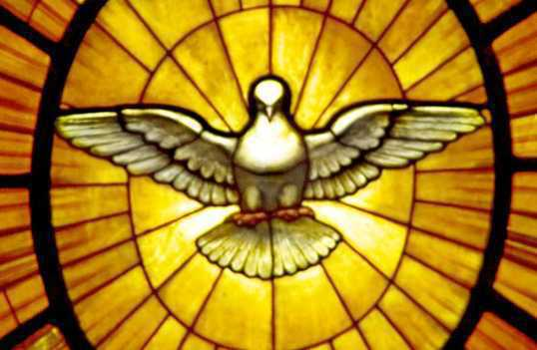
The Catechism and Faith
The Catechism of the Catholic Church says, “Faith is a supernatural gift from God. In order to believe, man needs the interior helps of the Holy Spirit.” (179)
Public domain

Slide 13
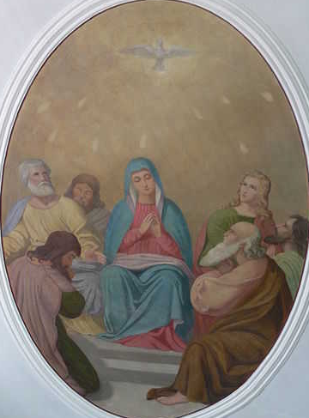
The Holy Spirit
Peter, Mary, and all the faithful allow God’s Holy Spirit to work in their lives:
“When the time for Pentecost was fulfilled, they were all in one place together. And suddenly there came from the sky a noise like a strong driving wind, and it filled the entire house in which they were. Then there appeared to them tongues as of fire, which parted and came to rest on each one of them. And they were all filled with the holy Spirit and began to speak in different tongues, as the Spirit enabled them to proclaim.” (Acts of the Apostles 2:1–4)
Public domain
Notes:
Encourage the students to share examples of other people’s faith-filled responses to the Holy Spirit. These can be examples from Scripture, the saints, or people they know.

Slide 14
Continuous Cycle
Faith is a continuous cycle. The more you practice your faith, the stronger it will grow. The firm foundation of faith will sustain you even in difficult times.
Practice faith
Increase faith
Practice faith in new and different ways
Increase faith
“Everyone who listens to these words of mine and acts on them will be like a wise man who built his house on rock. The rain fell, the floods came, and the winds blew and buffeted the house. But it did not collapse; it had been set solidly on rock.”
(Matthew 7:24–25)

Slide 15
How will you build your foundation
?

Slide 16
Acknowledgment
The Scripture quotations in this presentation are from the New American Bible with Revised New Testament and Revised Psalms. Copyright © 1991, 1986, and 1970 by the Confraternity of Christian Doctrine, Washington, D.C. Used by the permission of the copyright owner. All Rights Reserved. No part of the New American Bible may be reproduced in any form without permission in writing from the copyright owner.
The quotation from the Catechism of the Catholic Church in this presentation is from the English translation of the Catechism of the Catholic Church for use in the United States of America, second edition, number 179. Copyright © 1994 by the United States Catholic Conference, Inc.—Libreria Editrice Vaticana. English translation of the Catechism of the Catholic Church: Modifications from the Editio Typica © 1997, by the United States Catholic Conference, Inc.—Libreria Editrice Vaticana.)

