Slide 1
The Two Natures of Jesus: Human and Divine
Jesus Christ: God’s Love Made Visible, Second Edition Unit 3, Chapter 7
Document#: TX004812

Slide 2
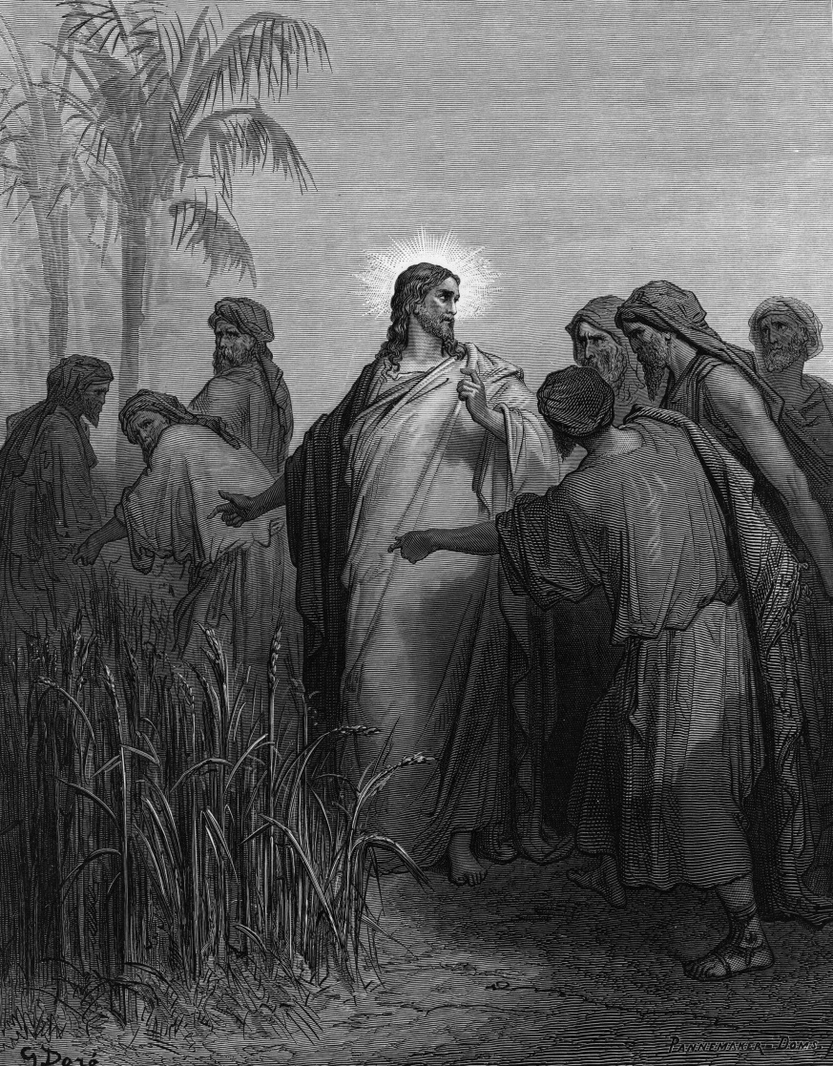
A Human Mind, a Human Heart
Scripture and Tradition teach that Jesus Christ is true God and true man.
Learning about Jesus’ earthly life enriches our appreciation of the Incarnation.
© HultonArchive / iStockphoto.com
Notes:
Ask the question in article 29 in the student book, “Why do you think it is important to remember that Jesus was a man, and not just God?”
This slide corresponds to content in article 29, “Jesus: A Human Mind, a Human Heart,” in the student book.

Slide 3
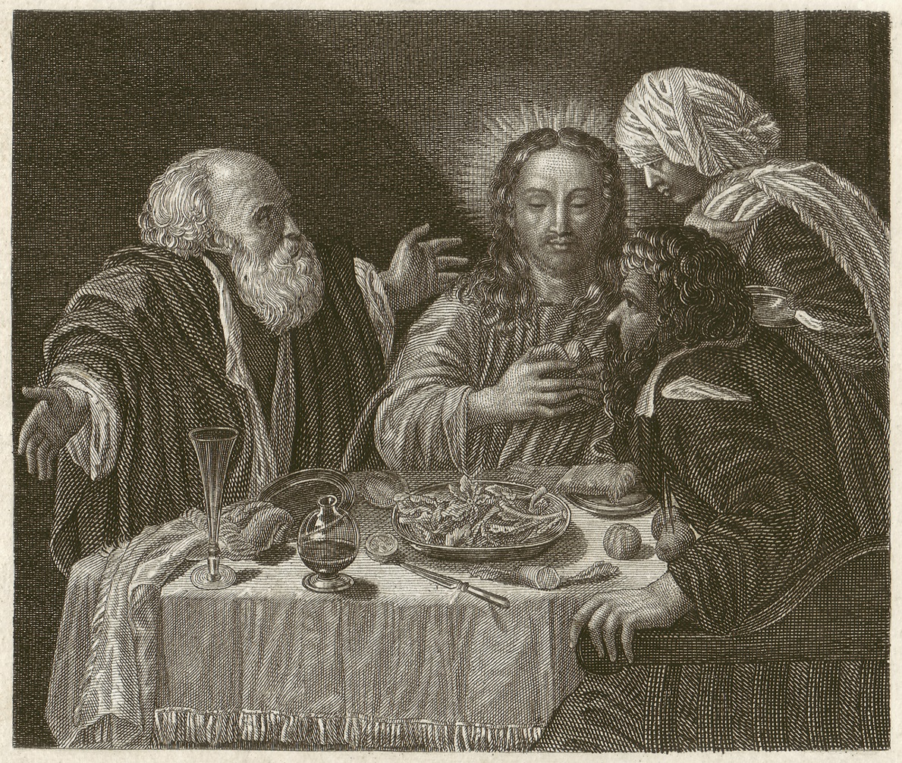
Joys and Trials
Jesus experienced both the blessings and the difficulties of normal life, just as we do.
Jesus’ fully human life sanctifies every part of our lives.
Every good day and every bad day offer opportunities to grow in holiness.
© ZU_09 / iStockphoto.com
Notes:
Ask the students to name some of the blessings and difficulties in Jesus’ life that they have also experienced, as shown in article 29 in the student book.
This slide corresponds to content in article 29, “Jesus: A Human Mind, a Human Heart,” in the student book.

Slide 4
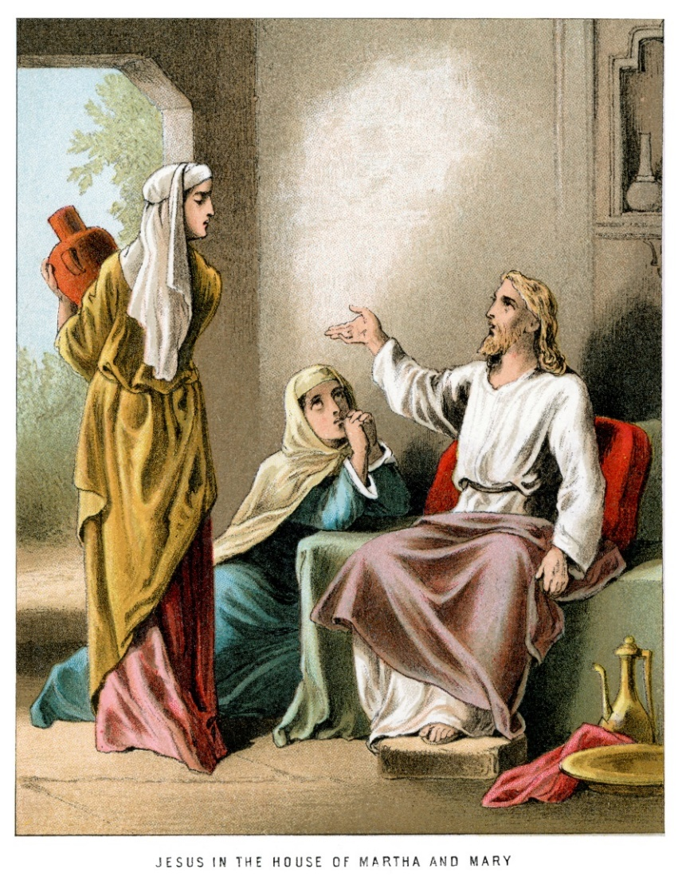
Faithful Friendship
Jesus often visited Martha, Mary, and Lazarus in Bethany.
Martha showed Jesus hospitality.
Mary listened to him teach and anointed him before death.
Jesus wept when Lazarus died, and he raised him to life.
© duncan1890 / iStockphoto.com
Notes:
Recount these events or ask volunteers to do so (Luke 10:38–42; John 11:1–44 and John 12:9–10; John 12:1–8). Ask the students to identify situations, actions, or emotions in each event that they, too, have experienced.
This slide corresponds to content in article 29, “Jesus: A Human Mind, a Human Heart,” in the student book.

Slide 5
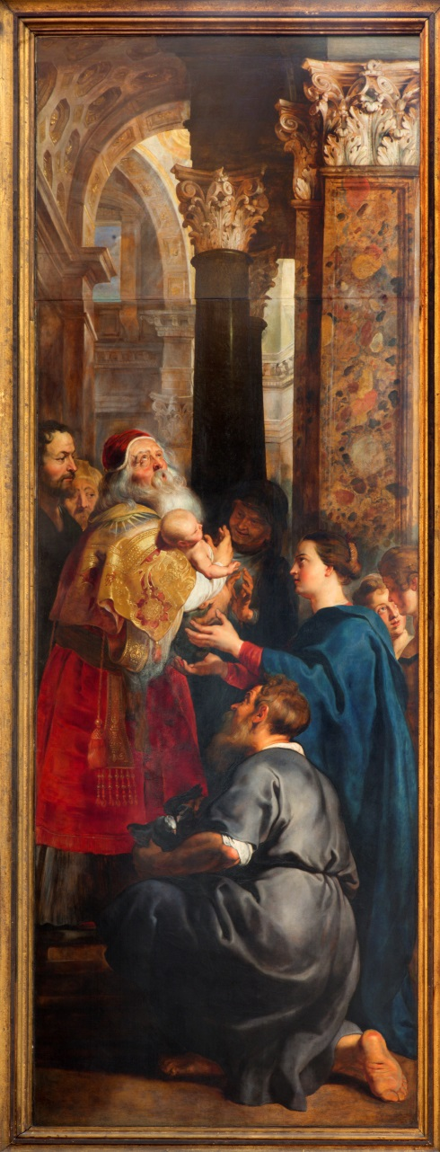
A Faithful Jew
Jesus lived the life of a Jew obedient to the Law of God.
He was raised in a Jewish home.
He was circumcised and presented at the Temple.
© sedmak / iStockphoto.com
Notes:
Remind students of the meaning of circumcision in Judaism, as shown in article 30 in the student book, and explain the requirement for presentation of a firstborn son.
This slide corresponds to content in article 30, “Jesus: A Faithful Jew,” in the student book.

Slide 6
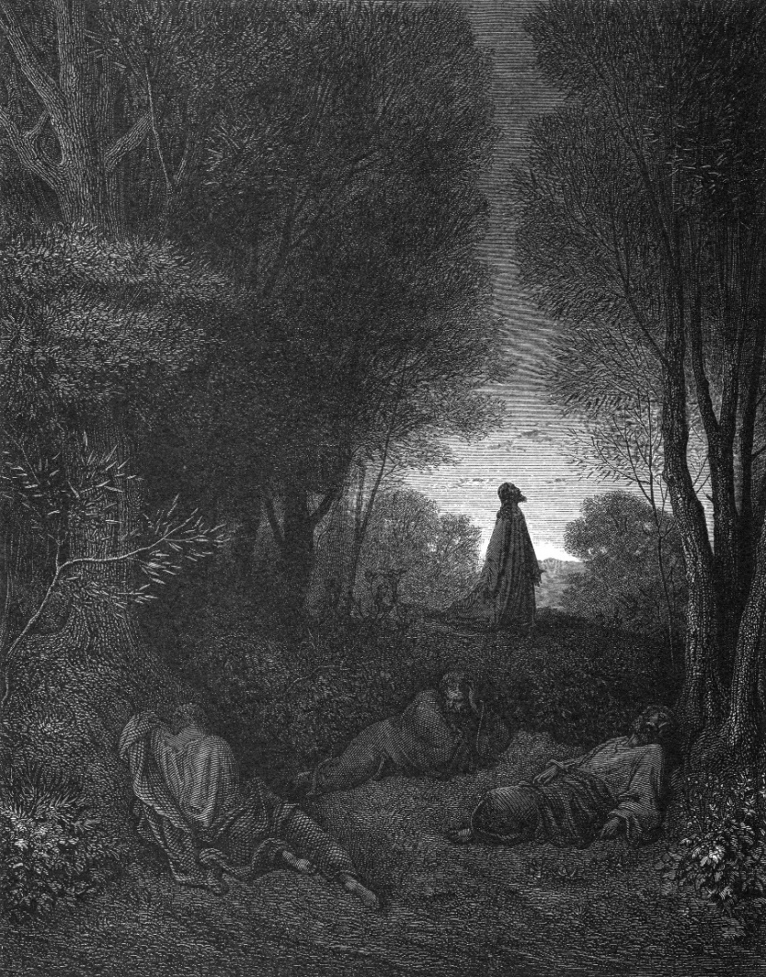
Jesus’ Religious Practice
Jesus celebrated Jewish holidays.
He often demonstrated his knowledge of the Hebrew Scriptures.
He went to the synagogue on the Sabbath.
© ivan-96 / iStockphoto.com
Notes:
Explain that Jesus would most likely have observed the Jewish practice of praying three times a day. The Gospels relate that Jesus often went off by himself to pray, usually in the early morning or at night.
This slide corresponds to content in article 30, “Jesus: A Faithful Jew,” in the student book.

Slide 7
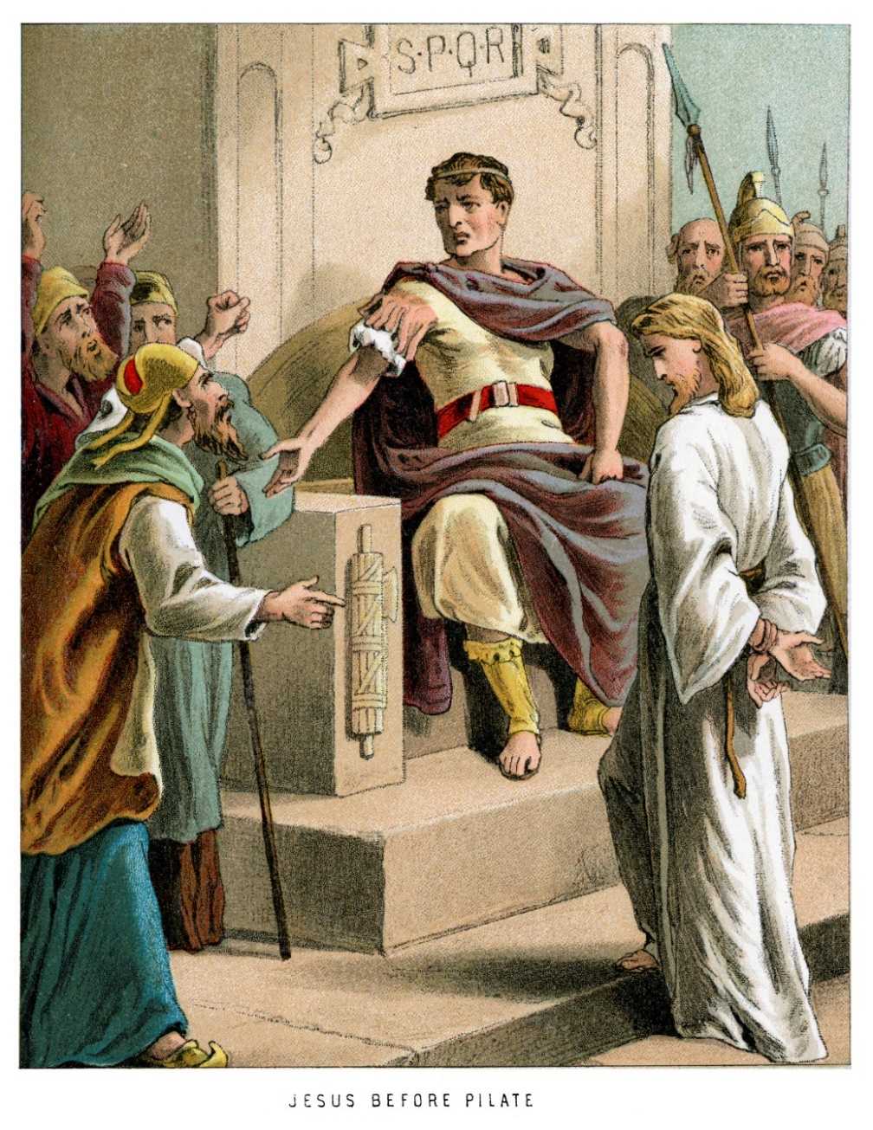
Jesus’ Life
Jesus lived in Palestine, the land of Israel.
Greek influence was still felt during the first century.
Romans ruled Palestine but allowed local kings to rule the land.
© duncan1890 / iStockphoto.com
Notes:
Review the information in article 31 in the student book about the rulers of Palestine during Jesus’ lifetime.
This slide corresponds to content in article 31, “Jesus’ Life in First-Century Palestine,” in the student book.

Slide 8
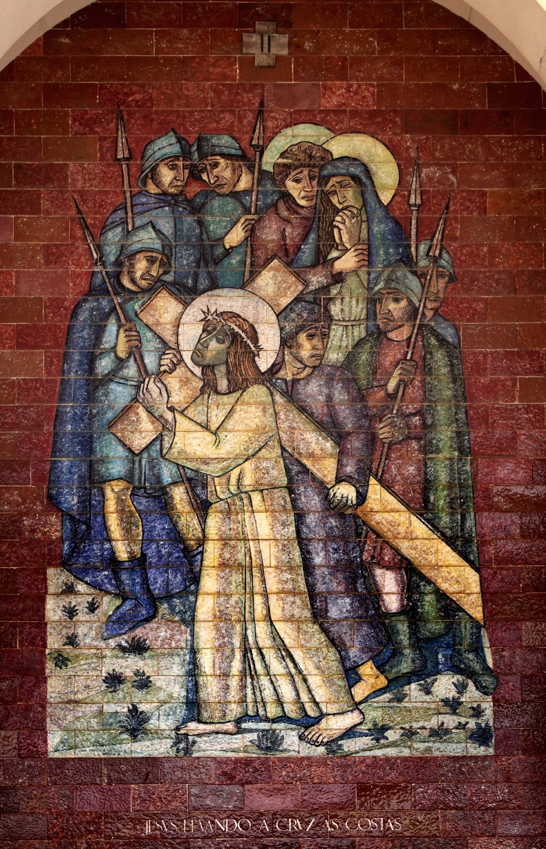
The Roman Occupation
Jesus and his companions lived under the rule of a foreign power.
The Romans practiced tolerance, but did not hesitate to put down rebellions.
They used crucifixion as a deterrent to political opposition.
© Zacarias Pereira da Mata / Shutterstock.com
Notes:
Explain the religious plurality of Palestine, as described in article 31 in the student book.
This slide corresponds to content in article 31, “Jesus’ Life in First-Century Palestine,” in the student book.

Slide 9
Understanding Social Context
Theologians study the historical, cultural, and political background of Jesus’ time.
This knowledge can help us to grasp key aspects of his life and teachings.
© MonroeGivens / iStockphoto.com
Notes:
Provide one or two examples from the Gospels that illustrate the importance of the social context in which Jesus lived, such as the saying about carrying a soldier’s pack (Matthew 5:41), the roles of Pilate and Herod in Jesus’ trial (Luke 23), or the account of the woman with the hemorrhage (Mark 5:25–34).
This slide corresponds to content in article 31, “Jesus’ Life in First-Century Palestine,” in the student book.

Slide 10
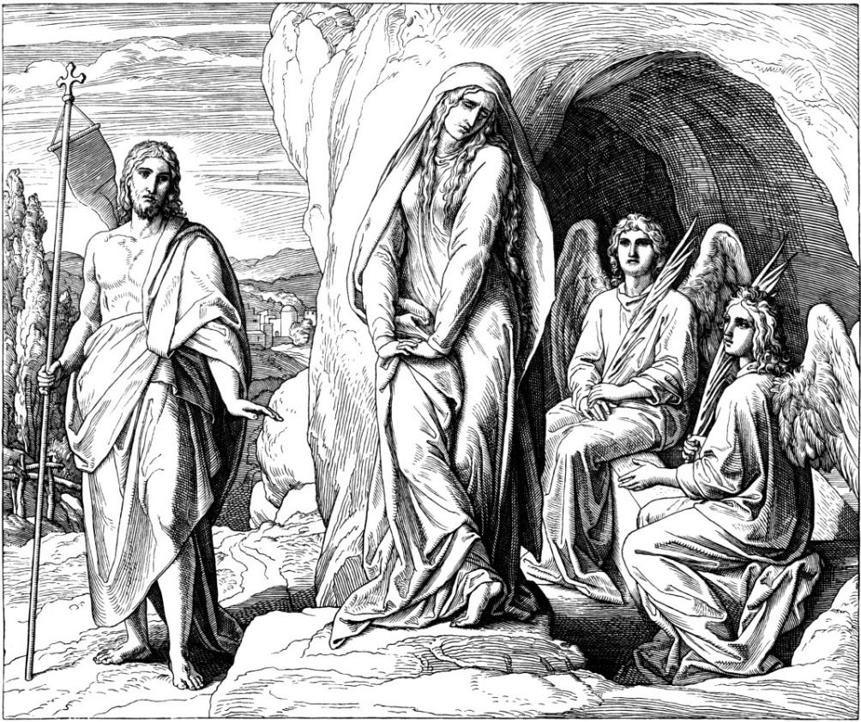
Union of Human and Divine
Without losing his divine nature, the Son of God assumed a human nature.
Christ was at all times one Divine Person with two natures.
Christians call this the hypostatic union.
© ivan-96 / iStockphoto.com
Notes:
Explain that the “one Divine Person” is the Second Person of the Trinity; the “two natures” are the human and divine natures. This doctrine means that everything Jesus did was also done by God, including suffering and dying for our salvation.
This slide corresponds to content in article 32, “Jesus: Union of the Human and the Divine,” in the student book.

Slide 11
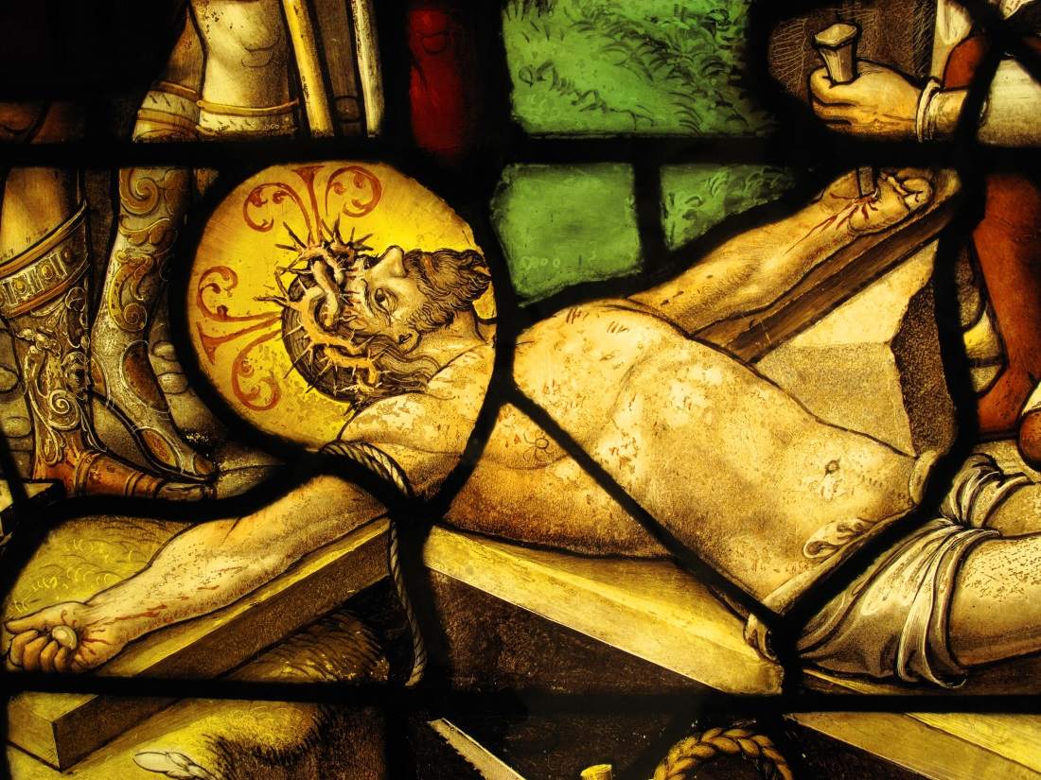
Jesus: Lord and Redeemer
In the New Testament, giving Jesus the title Kyrios, or “Lord,” indicates his divinity.
In the Roman world, a redeemer could pay a ransom to free a slave.
Jesus’ Death redeemed us from sin and from death.
© TonyBaggett / iStockphoto.com
Notes:
Explain why Jesus’ ability to ransom us from sin depends on the hypostatic union, as shown in article 33 in the student book.
This slide corresponds to content in article 33, “Jesus: Lord and Redeemer,” in the student book.

Slide 12
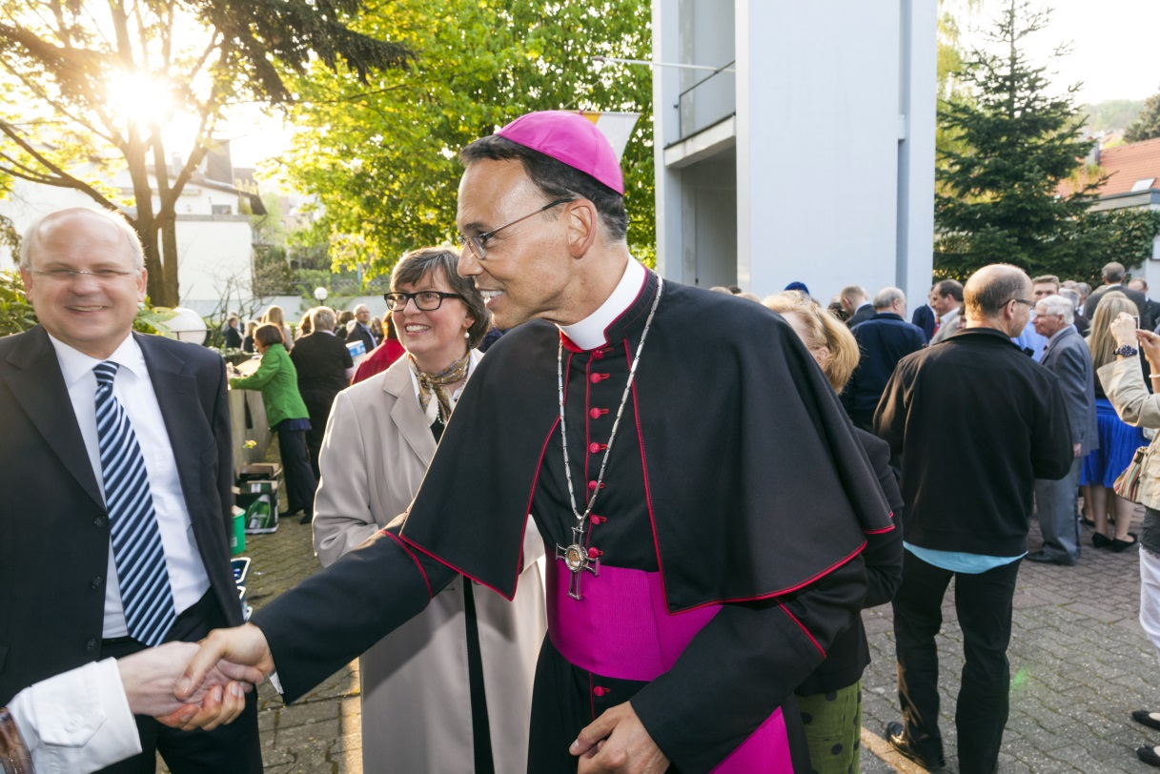
Jesus as Suffering Servant
The prophet Isaiah wrote four servant songs.
They praise the virtues of a person who serves God faithfully.
Early Christians detected clear parallels between Jesus and the servant.
© Nancy Bauer / Shutterstock.com
Notes:
Select some passages from the servant songs to read aloud (Isaiah chapters 42, 49, 50, and 53). Help the students identify parallels with Jesus’ life.
This slide corresponds to content in article 33, “Jesus: Lord and Redeemer,” in the student book.

