Slide 1
Redeemed by Christ: Our Eternal Destiny
The Paschal Mystery
Unit 3, Chapter 8
Document #: TX005439

Slide 2
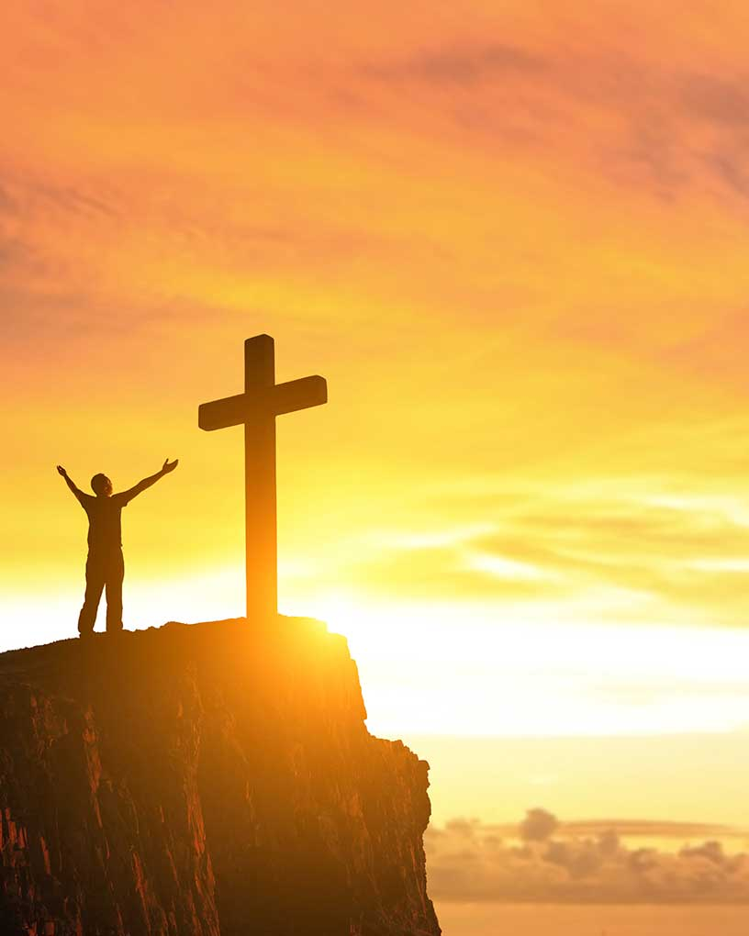
The Paschal Mystery Saves Us
We need to be saved from the things that fill our lives with empty promises.
The Paschal Mystery saves us from both Original Sin and personal sin.
It also saves us from the consequences of sin.
© PonyWang / istock
Notes:
Notes: Remind the students of the distinction between Original Sin and personal sin.
This slide corresponds to student text content in article 29.

Slide 3
Saved from the Consequences of Sin
Sin causes us to feel guilt and shame.
Shame can result in loneliness, despair, and the feeling of being unloved.
To ease these feelings, we may develop addictions or attachments to things.
© Antonio Guiliem / Shutterstock
Notes:
Notes: Ask for examples from movies that illustrate the consequences of sin.
This slide corresponds to student book content in article 29.

Slide 4
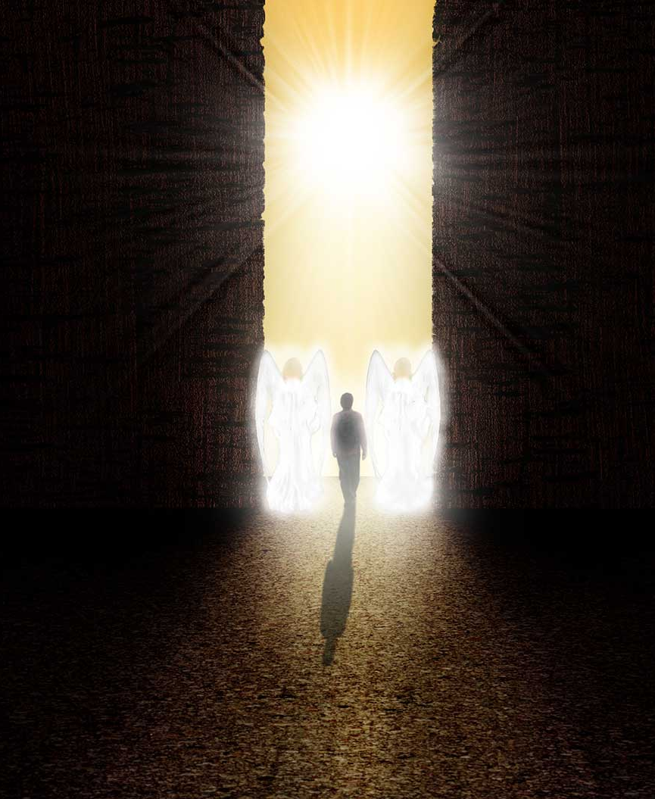
Saved from Death
Death entered the world as a result of Original Sin.
In the Paschal Mystery, Christ conquered death.
Death can now be a passage to new and eternal life.
© alexvav / Shutterstock
Notes:
Notes: Review the definitions of venial and mortal sin that conclude article 29 of the student text. Point out the consequences of mortal sin.
This slide corresponds to student text content in article 29.

Slide 5
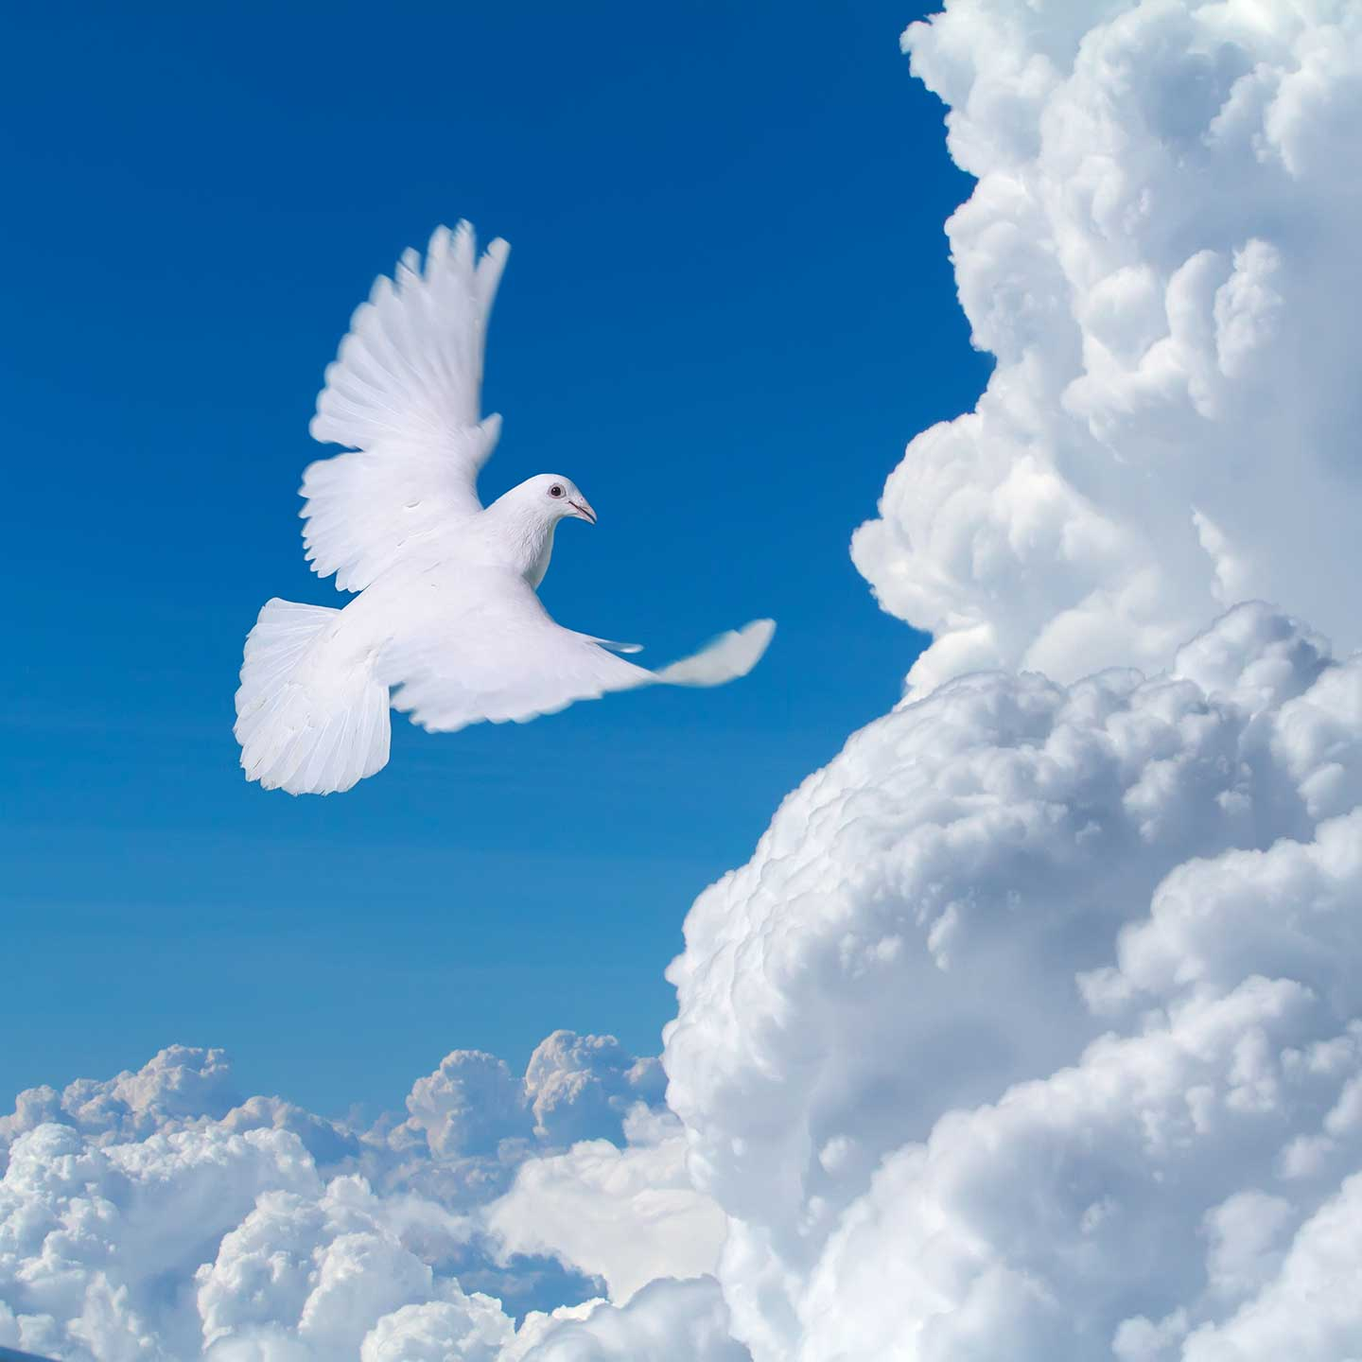
Saved for Eternal Life
Christ offers the forgiveness of sins.
We can be free from fear and the consequences of sin.
We can experience all the joy and love God wants us to have.
© Willyam Bradberry / Shutterstock
Notes:
Notes: Explain how we find forgiveness for sins in the Sacraments of the Church, as discussed in article 30 of the student text. Discuss how freedom flows from that forgiveness, also explained in article 30.
This slide corresponds to student text content in article 30.

Slide 6
Saved for the Beatific Vision
Christ restores our ability to experience the full measure of God’s love.
Jesus saves us for eternal life in Heaven, where we will enjoy the Beatific Vision.
© caracterdesign / istock
Notes:
Notes: Ask for a definition of the Beatific Vision. Discuss what Scripture tells us about eternal life, as discussed in article 30 of the student text. Ask for other images and descriptions of life in Heaven that the students find helpful.
This slide corresponds to student text content in article 30.

Slide 7
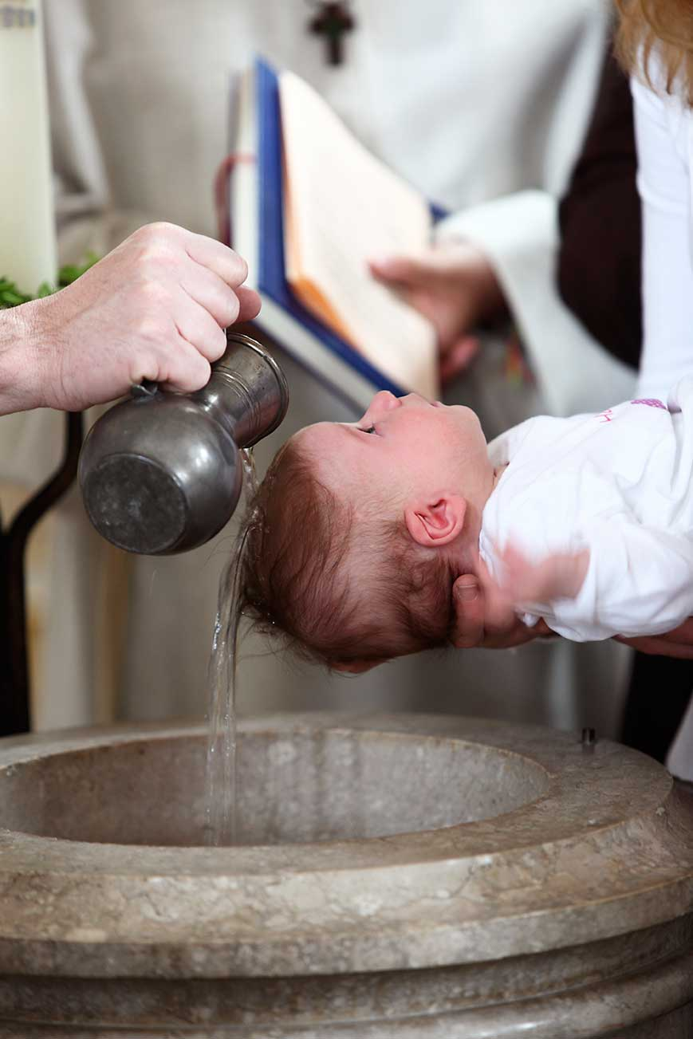
We Share in Christ’s Death and Resurrection
In Baptism we die to sin and are raised to new life in Christ.
The mark of Original Sin has been removed from our soul, but we still struggle.
At Baptism, we receive sanctifying grace to assist us.
© BirgitKorber / istock
Notes:
Notes: Discuss the role of sanctifying grace on our journey to perfection. Point out that we are not expected to achieve perfection on our own, but that we do need to cooperate with the grace God gives us through the Sacraments.
This slide corresponds to student text content in article 30.

Slide 8
Our Judgment by God
God does not want us to fear his judgment, but he does call us to prepare for it.
Each of us will face two times of Judgment:
. . . our Particular Judgment and the Final Judgment.
© spxChrome / istock
Notes:
Notes: The two types of judgment are explained in the next slides. Read the words of Saint John of the Cross in the first paragraph of article 31 of the student text: “At the evening of life, you shall be examined in love.” Ask for examples from the students’ lives where someone in a position to judge them did so with love.
This slide corresponds to student text content in article 31.

Slide 9
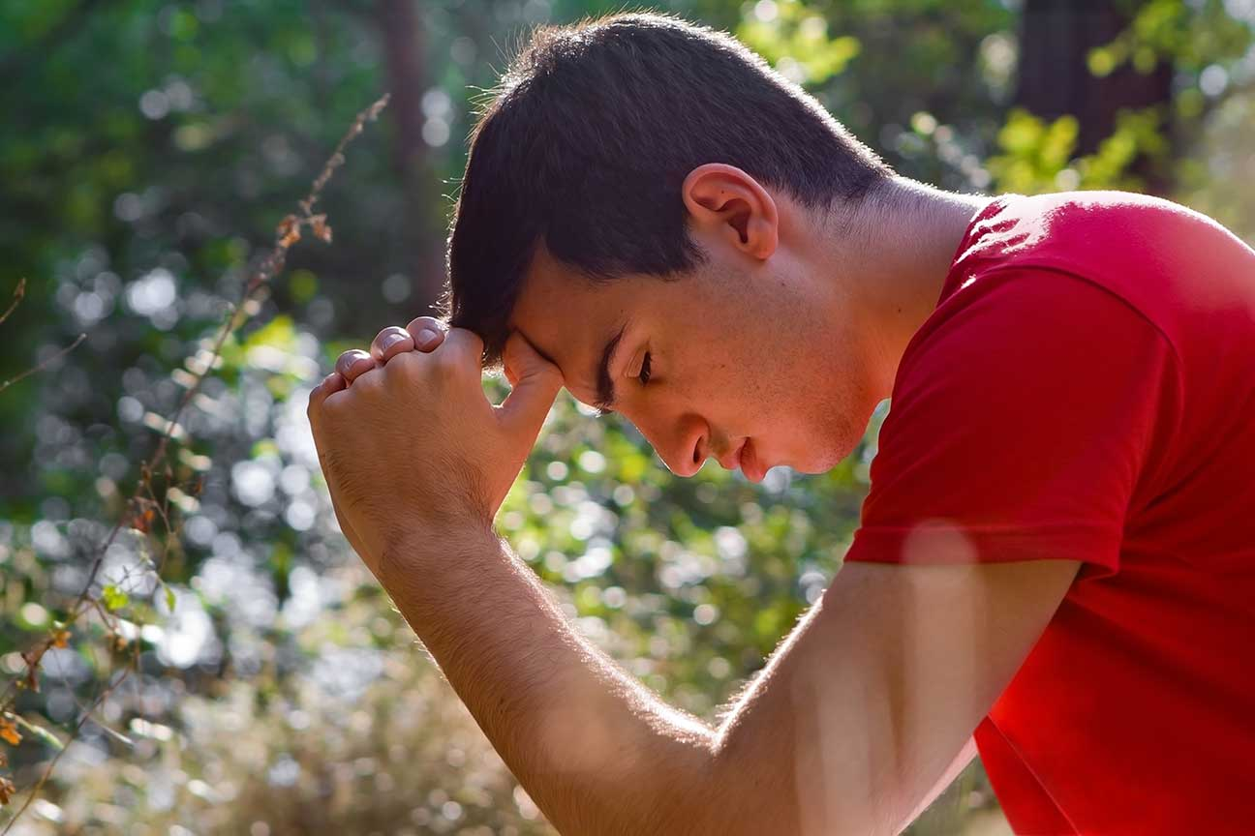
Our Particular Judgment
Immediately after death each person undergoes personal judgment by Christ.
Our soul will be rewarded according to our faith and works.
© Dream Perfection / Shutterstock
Notes:
Notes: Direct the students to read the requirements for inheriting eternal life in the bullet points in the section “Our Particular Judgment.” Ask how God’s grace enables us to achieve eternal life.
This slide corresponds to student text content in article 31.

Slide 10
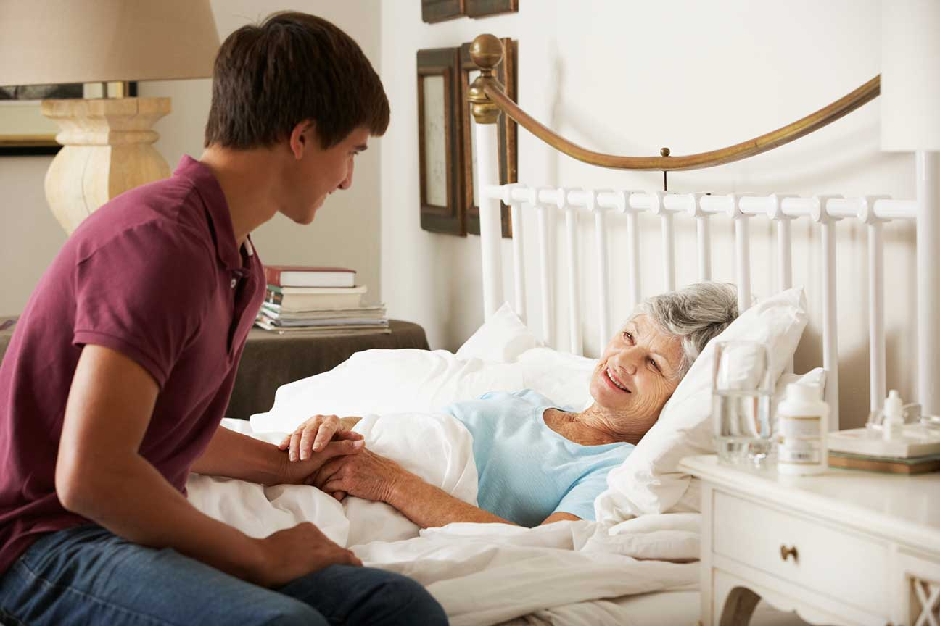
The Final Judgment
The Second Coming, or the Parousia, will signal a final judgment of humanity.
Christ will separate humanity into two groups:
◦ those who have followed his will by caring for others
◦ and those who have lived only for themselves
© Mark Bowden / istock
Notes:
Notes: Read Matthew 25:31–46, “The Judgment of the Nations.” Discuss the ways that the Church serves Christ in the needy; ask the students how they have done so.
This slide corresponds to student text content in article 31.

Slide 11
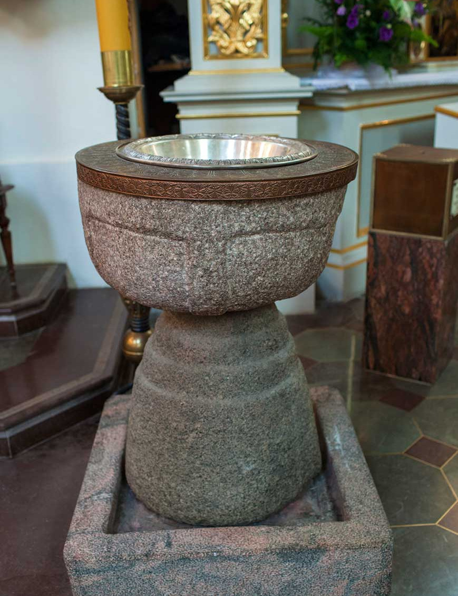
Who Can Be Saved?
The Church has always taught that the Sacrament of Baptism is necessary for our salvation.
The Church also teaches that salvation is possible for those who are ignorant of the Gospel.
© MagMos / istock
Notes:
Notes: Explain that those who have not heard the Gospel can find salvation if they do the will of God according to their understanding of it.
This slide corresponds to student text content in article 31.

Slide 12
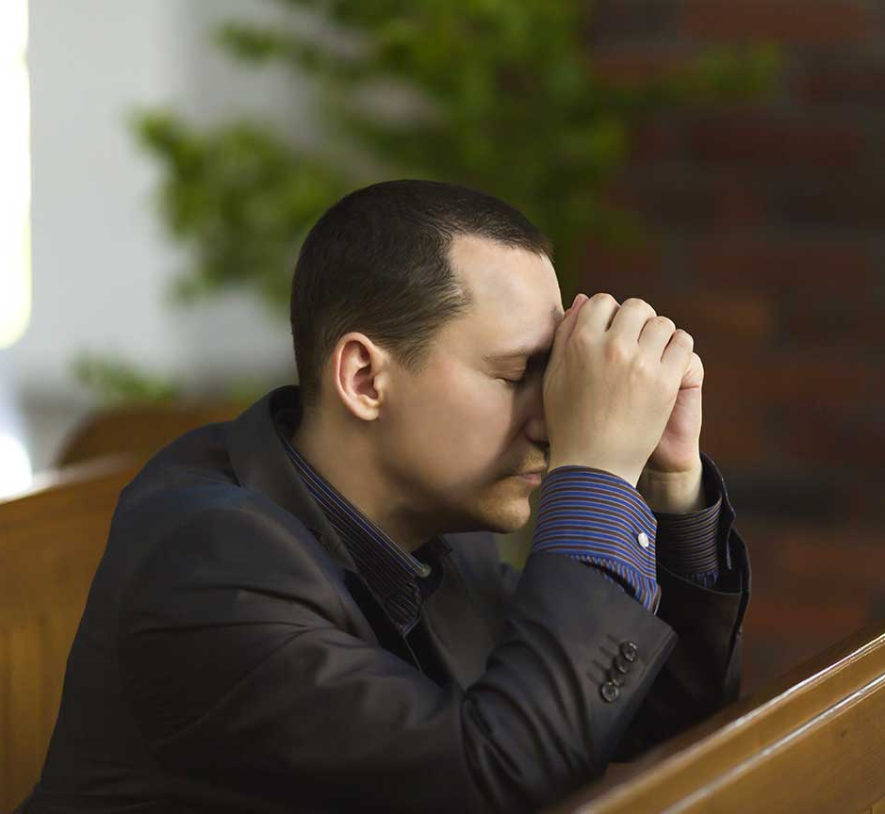
When Will Christ Return?
Only God knows the time.
We should be prepared, following God’s will every day, yet also remembering that . . .
. . . it is only through the power of the Holy Trinity that we are brought into eternal life.
© Dzmitry Malyeuski / Shutterstock
Notes:
Notes: Direct the students to read the Live It! sidebar, “Our Weakness Is Our Strength,” on page 147 of the student text. Discuss how our own efforts and God’s grace work together to prepare us for Christ’s coming.
This slide corresponds to student text content in articles 30 and 31.

Slide 13
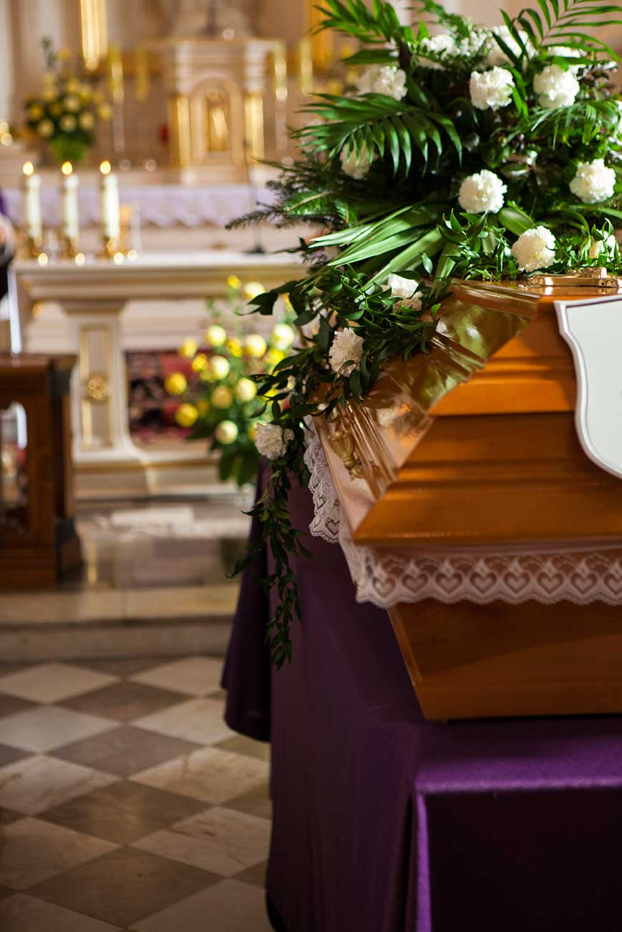
Where Do We Go after Death?
Those who remained faithful to God will be in perfect union with him in Heaven.
Those who separated themselves from God in this life will be separated from him for all eternity in Hell.
© MagMos / istock
Notes:
Notes: Remind the students of Saint Augustine’s ideas about the human longing for God. Explain that Hell is a separation from the thing we most long for. Point out that our separation from God is a result of our choices, and it begins while we are still alive.
This slide corresponds to student text content in article 32.

Slide 14
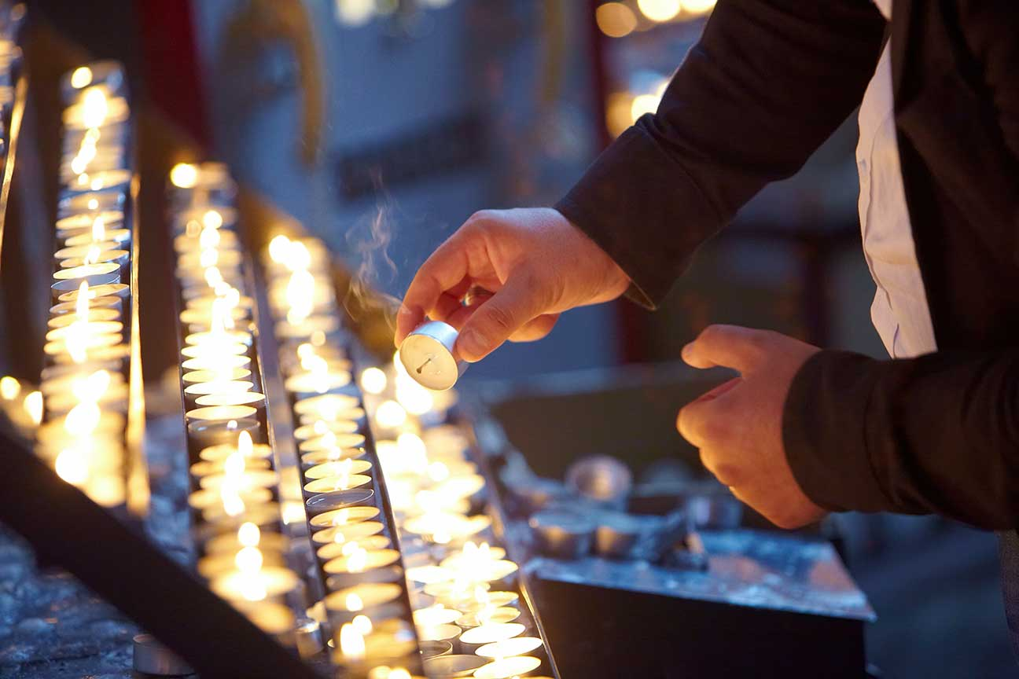
Purgatory
All who die in God’s friendship, but who are not perfect saints, undergo a purification.
They will achieve the holiness necessary to enter into the glory of God in Heaven.
This state of final purification is called purgatory.
© Yauhen Buzuk / Shutterstock
Notes:
Notes: Explain that our prayers, and even our own good works, can help the souls of those in Purgatory. (See the Pray It! sidebar, “Praying for the Dead”, on page 157 of the student text.)
This slide corresponds to student book content in article 32. This slide corresponds to student text content in article 32.

