Slide 1
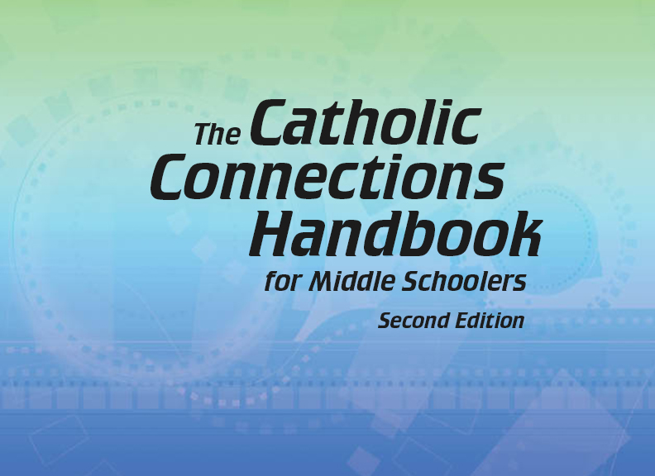

Document #: TX005856

Slide 2
The Prophets, Jesus Christ, and the Holy Spirit
Chapter 18
Grace and the Gifts of the Holy Spirit

Slide 3
Chapter Summary
Through grace God extends his friendship and love to each of us unconditionally.
When we accept God’s gift of friendship and the gifts of the Holy Spirit, we allow God’s grace to transform us and enable us to live holy lives in loving service to God and neighbor.

Slide 4

Think About It!
Discussion Questions
Do you know anyone named Grace?
What is grace?
Why do you think people would want their child to have that name? What do you think that name might mean?
© enterlinedesign/Shutterstock.com

Slide 5

Introduction and “God Takes the First Step” (Handbook, Pages 192–194)
Grace is the gift of God’s loving presence in our lives.
The human heart longs for God, and only God can satisfy that longing.
We are made to be with God, and God offers love and friendship to every person. But God does not force his gift of love on us. We must choose to accept it.
© art_of_sun / Shutterstock.com

Slide 6

“Let God’s Grace In” and “Give Love Away” (Handbook, Pages 194–196)
Think-Pair-Share
Think: Write down your thoughts about love. What does it mean? How is it shared with family? with friends? with strangers? Can you run out of love—why or why not?
Pair: Partner with a classmate.
Share: Discuss your answers to the questions. What can you learn from each other’s answers?
© olakumalo/Shutterstock.com

Slide 7

Grace Leads to Real Change
When we allow God’s grace into our lives, it is able to bring about real change in us.
When we say “yes” to God’s invitation to participate in his life, we act in a way that reflects Jesus’ teachings and example.
When we participate in God’s life, in whose image we have been made, we give love away —like God.
© Creativa Images / Shutterstock.com

Slide 8

Share It!
Discussion Question
How many of you are familiar with the 10,000 hour rule?
What is a gift from God that you are practicing using?
What gifts have you already gotten better at using?
© Romolo Tavani / Shutterstock.com

Slide 9

“Everything Is Possible with God’s Grace” (Handbook, Pages 197–198)
Grace has an eternal effect on our relationship with God.
We must open the gift of God’s grace in our life.
Grace allows us to fulfill our job descriptions as Catholics to love God and our neighbor.
© Rido/Shutterstock.com

Slide 10

Think About It!
Identify one thing you do well that comes naturally to you, and condense it down to one word (math, football, art, science, patience, etc.) and share it with the class.
© dotshock/Shutterstock.com

Slide 11

“The Gifts of the Holy Spirit” (Handbook, Pages 198–201)
God gives us the Gifts of the Holy Spirit to help us love him and live good and holy lives.
The Seven Gifts of the Holy Spirit are special graces that help us respond to God’s call to live holy lives.
The Gifts of the Holy Spirit are Wisdom, Understanding, Counsel (Right Judgment), Fortitude (Courage), Knowledge, Piety (Reverence), and Fear of the Lord (Wonder and Awe).
© Thoom/Shutterstock.com

