Slide 1
Natural Revelation
The Living Word: The Revelation of God’s Love, Second Edition
Unit 1, Chapter 2
Document#: TX004680

Slide 2


Natural Revelation
Through creation and reason, we come to know God.
God shaped all living things as a sign of his desire to be known.
God also provided
Divine Revelation
for us, by sending
his own Son, Jesus.
© photo.ua / Shutterstock.com
Notes:
Notes: Explain to the students that our ability to fully know the truth about God through natural revelation has been hindered, due in part to the consequences of Original Sin. Natural revelation is the subject of this chapter.
This slide corresponds to content in the chapter 2 introduction in the student book.

Slide 3
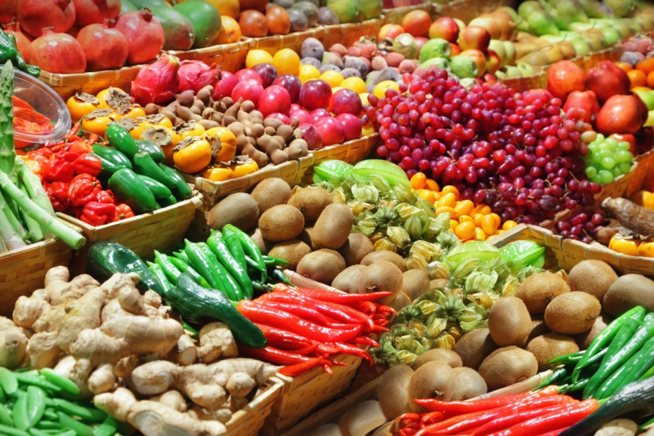
Sacred Scripture and Natural Revelation
In the Old Testament, the goodness of every created thing points to the Supreme Good: God.
Many New Testament writings point to our capacity to know God through the natural order.
© Adisa / Shutterstock.com
Notes:
Notes: Point out to the students that both the Old Testament and the New Testament call attention to God’s glory in the universe he created. Encourage the students to suggest some reasons why people may not recognize that all created things point to the Creator.
This slide corresponds to content in article 5, “Sacred Scripture and Natural Revelation,” in the student book.

Slide 4

Natural Revelation and the Church Fathers
Saint Augustine: Open the book of creation and discover the presence of God.
Saint Irenaeus: “Man fully alive is the glory of God.”
God’s glory is seen
in the smallest to
the largest of his
creations.
© bikeriderlondon / Shutterstock.com
Notes:
Notes: Explain to the students that these early Church teachers believed that the beauty of nature can lead us to a deeper knowledge of God. Invite the students to share an experience when they felt awed by God’s presence in nature.
This slide corresponds to content in article 6, “Natural Revelation and the Wisdom of the Church Fathers,” in the student book.

Slide 5
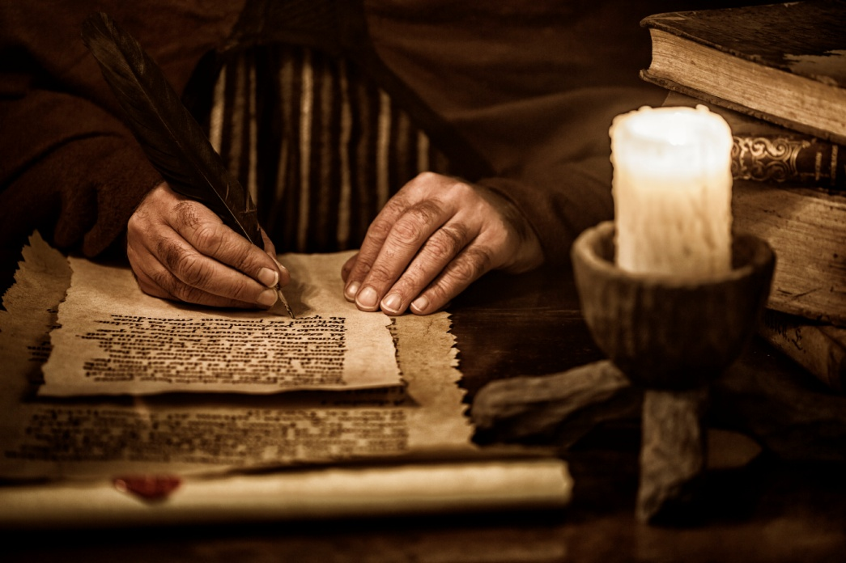
Natural Revelation and Scholastic Theology
Scholastic theology arose in the twelfth through fourteenth centuries.
It is the use of philosophical methods to better understand revealed truth.
© aluxum /iStockphoto.com
Notes:
Notes: Ask the students to recall examples of someone giving a logical reason to believe that God exists.
This slide corresponds to content in article 7, “Natural Revelation and Scholastic Theology,” in the student book.

Slide 6
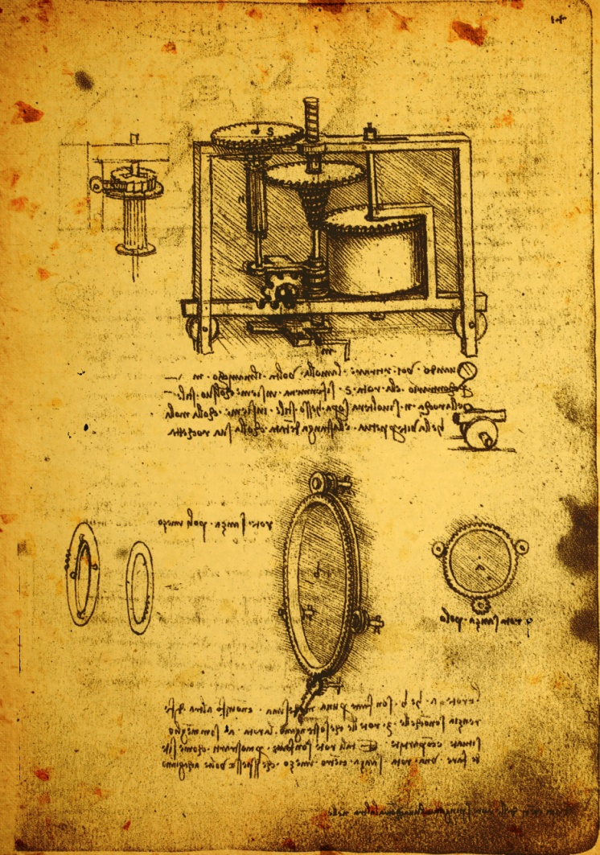
Saint Anselm: One Proof of God’s Existence
God is “that than which nothing greater can be thought.”
It is greater to exist in reality than to exist merely in the mind.
Following from this, God must exist in reality, not only in the mind.
© Janka Dharmasena /iStockphoto.com
Notes:
Notes: Call on students to explain each logical step of Saint Anselm’s proof in their own words.
This slide corresponds to content in article 7, “Natural Revelation and Scholastic Theology,” in the student book.

Slide 7
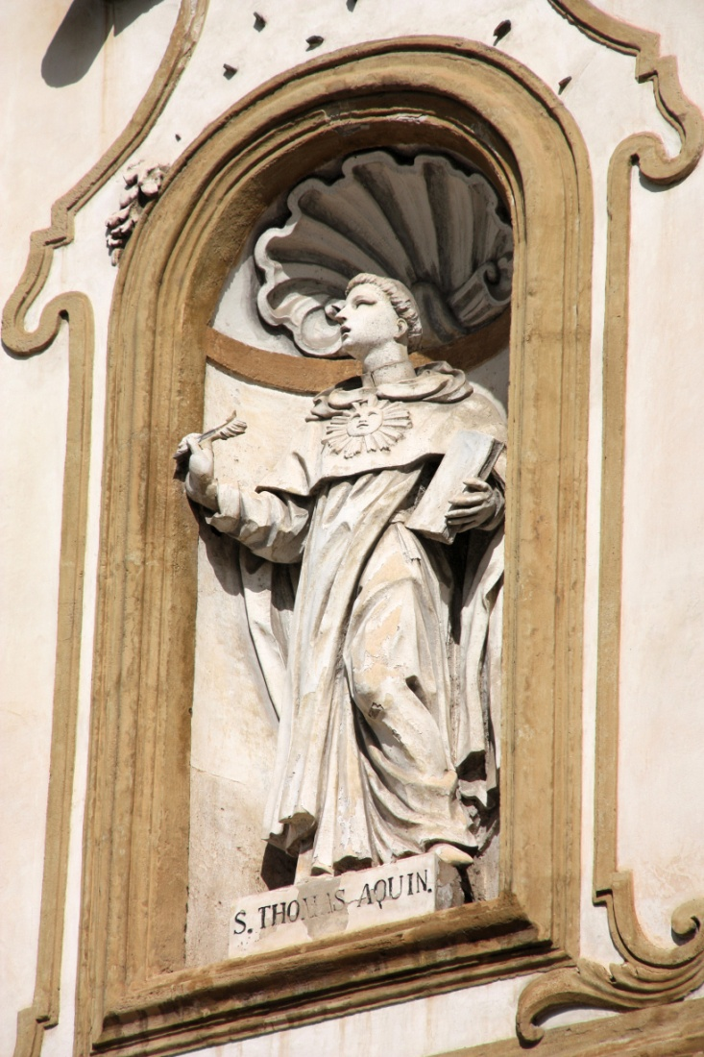
Saint Thomas Aquinas
Aquinas is arguably the most influential scholastic theologian.
He is best known for his twenty-one volume work, Summa Theologiae.
Aquinas taught that the reality of God can be logically demonstrated in five ways.
© Tupungato / Shutterstock.com
Notes:
Notes: Point out to the students that the writings of Aquinas still provide the basis for much of Catholic theology, more than seven hundred years after his death.
This slide corresponds to content in article 7, “Natural Revelation and Scholastic Theology,” in the student book.

Slide 8
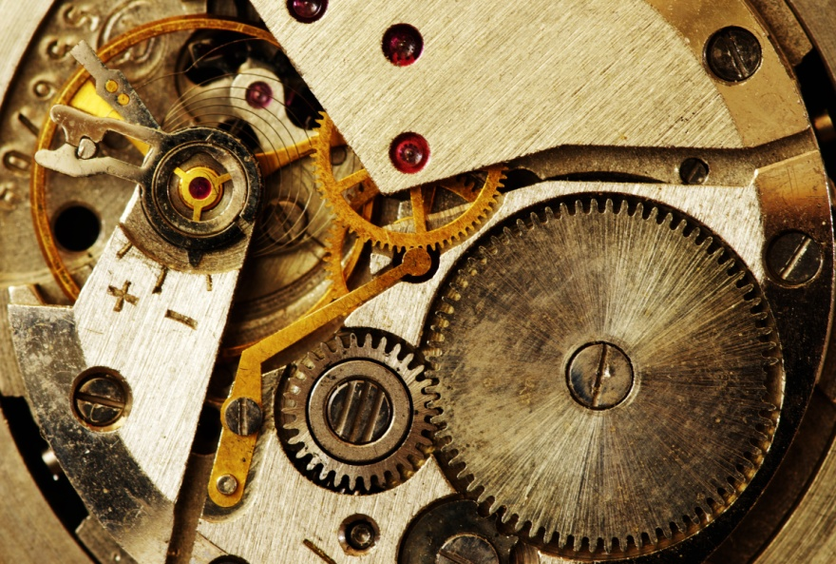
First and Second Proofs
Everything is always moving and changing.
God is the First Mover who set everything in motion and still guides our actions.
Similarly, God is the First Efficient Cause, the uncaused cause of all that exists.
© Pakhnyushcha / Shutterstock.com
Notes:
Notes: Ask the students to explain these two proofs in their own words, noting the similarity between them: when we trace events backwards, we must find a first mover or first cause.
This slide corresponds to content in article 7, “Natural Revelation and Scholastic Theology,” in the student book.

Slide 9
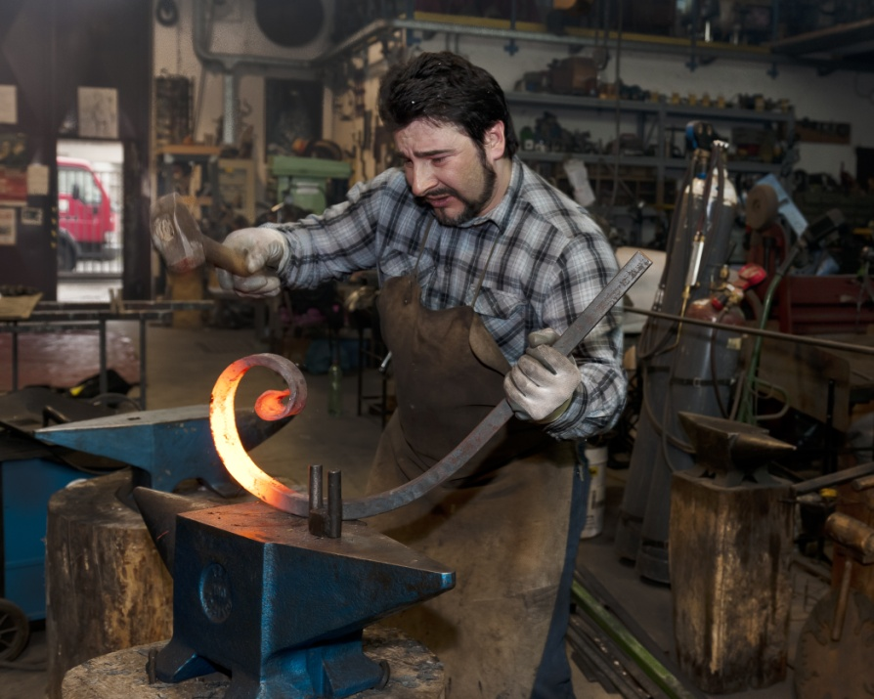
The Third Proof: Contingency
Things came into existence because of something else.
Things cannot exist
without a Necessary
Being, who creates
but is not created.
That Necessary Being
is God.
© operafotografca / Shutterstock.com
Notes:
Notes: Point out to the students that this proof is related to the first two proofs: all are related to cause and effect. Note that Aquinas wanted to show that the human mind can use reason to logically prove the existence of God.
This slide corresponds to content in article 7, “Natural Revelation and Scholastic Theology,” in the student book.

Slide 10
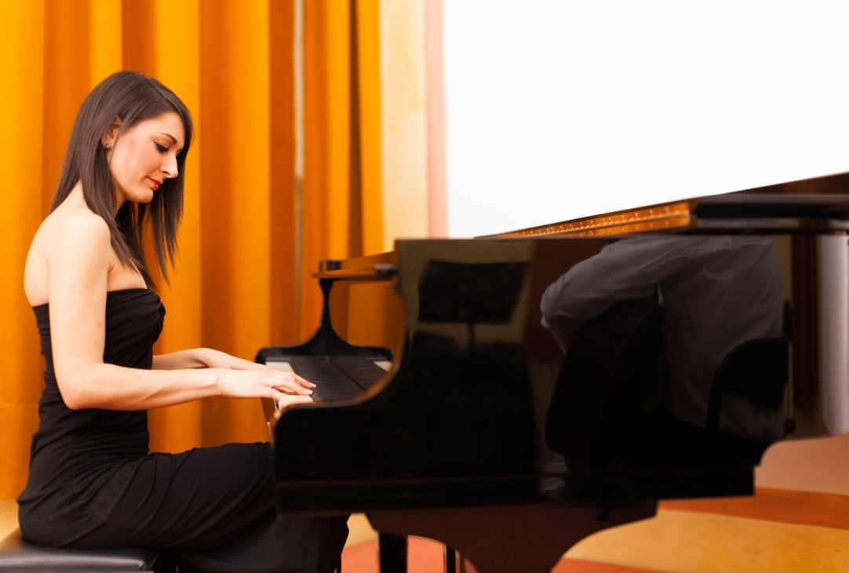
The Fourth Proof: Perfection
How do we recognize perfect beauty, goodness, and knowledge?
We know perfection because there is one All-Perfect Being, God.
© Minerva Studio / Shutterstock.com
Notes:
Notes: Point out to the students that this argument moves forward, rather than backward. We think about something, then we imagine it being more perfect, and then we imagine something that is even more perfect. Eventually we arrive at the All-Perfect Being, God.
This slide corresponds to content in article 7, “Natural Revelation and Scholastic Theology,” in the student book.

Slide 11
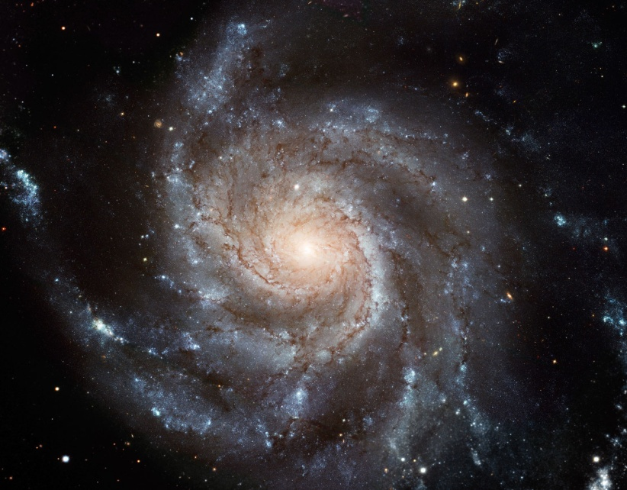
The Fifth Proof: Intelligent Being
Many things in the universe have no intelligence of their own.
They still act toward
and achieve their end.
There must be
something intelligent
that directs all things.
NASA, ESA, K. Kuntz (JHU), F. Bresolin (University of Hawaii), J. Trauger (Jet Propulsion Lab), J. Mould (NOAO), Y.-H. Chu (University of Illinois, Urbana), and STScI
Notes:
Notes: Ask the students which title for God they would use to argue in favor of his existence: First Mover, First Cause, Necessary Being, Model of Perfection or Intelligent Being.
This slide corresponds to content in article 7, “Natural Revelation and Scholastic Theology,” in the student book.

Slide 12
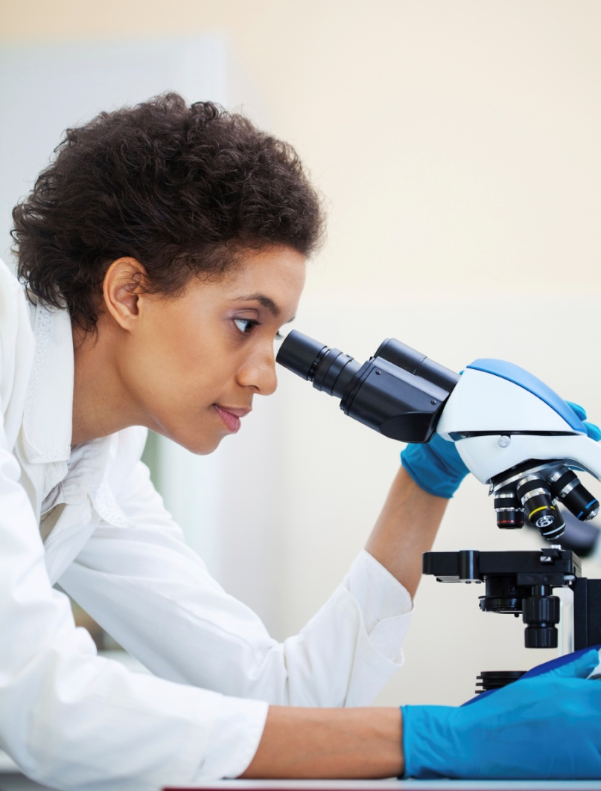
Vatican Council I to the Present
Vatican Council I: “God can be known with certainty from the created world.”
Catholic theologians continue to teach that natural revelation, paired with human reason, helps us to become aware of God.
© fotostorm /iStockphoto.com
Notes:
Notes: Explain to the students Cardinal Newman’s theory that a number of probable hints point to the existence of God; taken together, they produce a powerful argument. Ask the students to brainstorm a list of such hints.
This slide corresponds to content in article 8, “Natural Revelation: Vatican Council I to the Present,” in the student book.

